Slide 1


Introduction to bioeconomy: different bioeconomy levels and their interconnection and assessment
PhD Lauma Žihare, RTU Latvia
Prof. Francesco Romagnoli, RTU, Latvia
Notes:
Welcome to today lecture. I am Prof. Francesco Romagnoli from the Institute of Energy Systems and Environment at the Riga Technical University. Together with support of Dr. Luama Zihare I am happy to share with you the contents of the lecture about “Introduction to bioeconomy: different bioeconomy levels and their interconnection and assessment.”

Slide 2
Aim/objectives
In this unit learners will be aware of the basic principles and concepts of bioeconomy and acquire a transdisciplinary understanding of bioeconomy such as different bioeconomy levels and their interconnection and assessment.
Key examples of bioeconomy application in the agro-farming sector will be presented in this unit (e.g. biorefinery concept and its analysis).

Slide 3
Learning outcomes
LOut1. Describe and name the bioeconomy principles with an emphasis on the agro-farming sector
LOut7. Associate the basic principles of value-added use of bio-resources in the agro-farming sector
LOut10. Examine and interpret bioeconomy principles with an emphasis in the agro-farming sector
LOut23. Evaluate options for the management of bioeconomy solutions for the agro-farming sector
Notes:
Presentation about the basic principles and concepts of bioeconomy;
Transdisciplinary understanding of bioeconomy and its levels of interaction;
bioeconomic links and benchmarks
Knowledge domain
Bio- and circular-economy, sustainability assessment of the agro-farming sector, sustainable bioresource and biomass use, environmental well-being.

Slide 4
Keywords
Bioeconomy;
transdisciplinary;
interlinkages;
bioeconomy levels;
bioeconomy solutions;
added value products;
sustainable bioresource and biomass use.
Notes:
1-2 slides
Look up in document

Slide 5
Introduction
In this lecture you will be introduced to theory that will help you understand two questions:
«Why bioeconomy?» and
«How to implement bioeconomy principles?»
  Added value of bioresources
  Examples of industrial symbiosis
  Sustainable bioeconomy development at a national, regional, and local level
  Underused bioresources and innovations
Notes:
The course module enables students to understand how to implement bio-economy principles to mitigate climate change, sustainably use of bioresources and create innovation by producing products with high added value within the agro-farming sector and in connection to rural development. The course will be covering the following key aspects.
Introducing approaches, technologies, and examples of the use of local bioresources within the agro-farming sector and the production of high value-added products.
Topicality of bioeconomy in the context of sustainable development at a national, regional, and local level, under this light, the study course provides information about the concept of bio-economy and its influencing factors (environmental, climate, economic, socioeconomic, technological) and tools (political, economic, etc.).
Learning outcomes:
To understand the overall sustainable aspects of bio-economy;
To acquire basic knowledge on the potential definition of strategic sustainable development of the agro-farming sector;
Being able to find sustainable, innovative and economically sound, environmentally well-being and climate-friendly solutions for the use of bio-resources in the agro-farming sector;
To acquire basic knowledge on the major concepts in agrobiodiversity and explain the role of preserving ecosystem services and environmental well-being;

Slide 6
Table of contents
Bioeconomy principles and concepts
  Bioeconomy definition
  Bioresources and high added value
  Biotechnologies
  Industrial symbiosis
  Cascading
Transdisciplinary understanding of bioeconomy
Interconnection and assessment
  Nexus approach
Bioeconomy levels
  Micro level
  Meso level
  Macro level
Notes:
Four main parts will be dedicated to this section:
Bioeconomy principles and concepts
Transdisciplinary understanding of bioeconomy
Interconnection and assessment
Bioeconomy levels

Slide 7
Basic principles and concepts of bioeconomy
Notes:
Let’s start now to talk about the Basic principles and concepts of bioeconomy

Slide 8
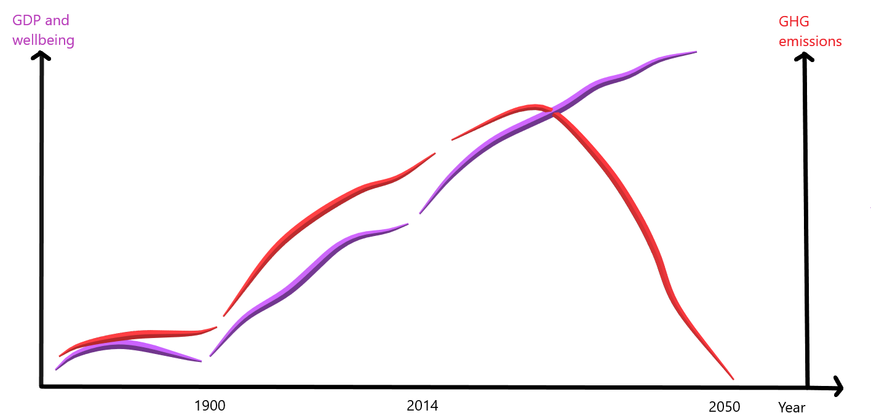
Next wave of economy
Bio economy
wave
Decoupling emissions from economy growth
Fossil economy
wave
Natural economy
wave
Source (modified): The Finish Bioeconomy strategy, 2014 [1]
(author: L.Zihare, 2020)
Notes:
After rapid fossil economic development, an estimation of resource insufficiency is evident. It has become a push towards bioeconomy and necessity for research and infrastructure for alternative energy and sustainable agriculture. However, bioeconomy cannot substitute fossil resources with bioresources to the same extent to ensure the consumption of existing demand.
The transition from a fossil economy to a bioeconomy is perceived as the new wave of economic development has a positive effect on the emissions from economic growth, which goes parallel with the growth of nationl GDP.
The strategic goals of the Bioeconomy Strategy are:
1. A competitive operating environment for the bioeconomy,
2. New business from the bioeconomy,
3. A strong bioeconomy competence base,
4. Accessibility and sustainability of biomasses.
The goal is to create new economic growth and jobs through growth in business, and high value-added products and services, while securing the viability of natural ecosystems. It is expected to be the next economic wave, after the fossil economy. The bioeconomy combines many sectors of primary production, refining and end product markets

Slide 9
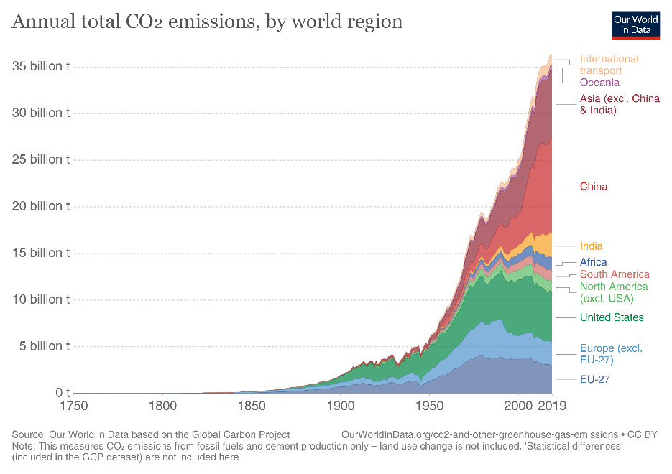
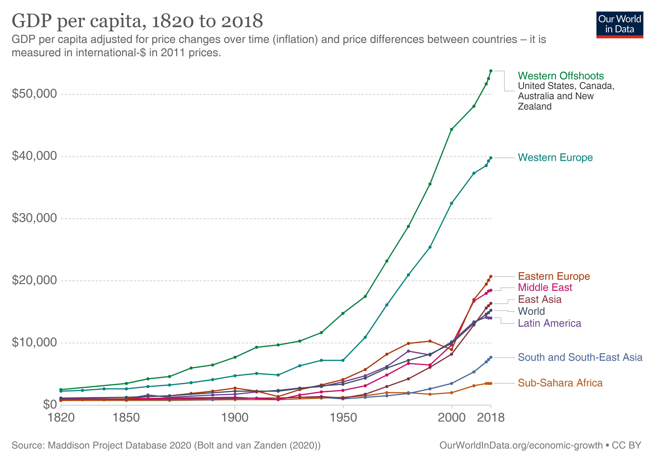
Natural economy and fossil economy
Fossil economy
Fossil economy
Natural economy
Natural economy
Source: [2], [3]
https://www.ipcc.ch/site/assets/uploads/2018/12/UNEP-1.pdf
Notes:
Previously, we saw the tendencies of three waves: natural, fossil and bioeconomy. In this slide, you can see the same tendencies based on real data for economic growth and CO2 emissions globally. Both graphs show exponential growth resulting from fossil economy boost.

Slide 10
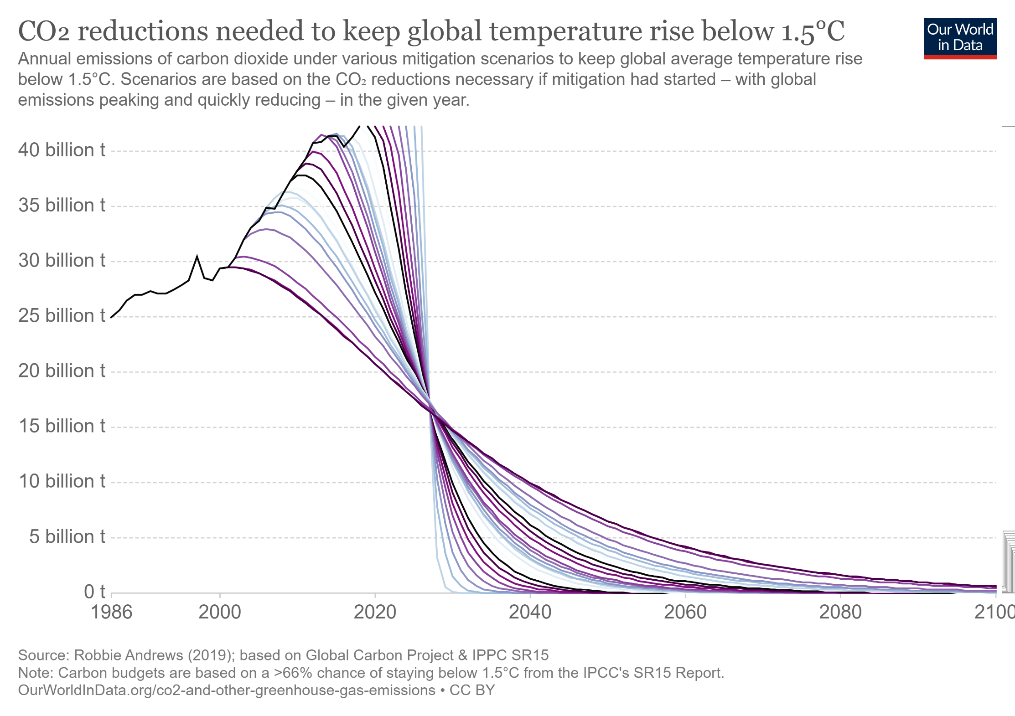
Bio economy, green economy, sustainability
Bio economy
Fossil economy
Notes:
Projections show also different scenarios for CO2 mitigation fir the forthcoming decades, which of the scenario will actually fulfil is depending on each country strategy, international collaboration success, each enterprise, consumer behaviour, initiatives towards climate neutrality, energy sector and also sustainable agrofarming, that is responsible for food security.

Slide 11
Bioeconomy growth scientific perspective
1.Environmental science field
(author: L.Zihare, 2020 [4])
2. Green sustainable science technology
2. Social sciences
5. Economics, Econometrics and Finance
3. Environmental studies and energy fuels
3. Energy
4. Energy fuels
6. Biotechnology applied microbiology
4. Agricultural and biological sciences
6. Business, management and Accounting
5. Economics
Notes:
Sustainability has become a global trend that is theoretically sought by all sectors and countries. Another widespread tendency in recent years is the shift towards the use of knowledge-based bio-resources within the economy for the production of higher value-added products, and the subsequent development of the bioeconomy towards sustainability objectives. Bioeconomy development comes from large base of scientific research, therefore a literature analysis of scientific publications related to bioeconomy has been assessed. Boolean string of "bioeconomy" or "biobased economy" or "bio-economy" or "bio economy" were performed in timeframe from 1992 -2020. The results show that Bioeconomy has been developed exponentially after number of articles published in Scopus and Web of science databases. The amount of records based on research fields differs between Scopus and Web of science data, although highest importance of this area takes environmental science fields, in Web of science next leader fields is green sustainable science technology, environmental studies and energy fuels, as for Scopus it is social sciences, energy, agricultural and biological sciences and economics. These data however can differ if more specified keywords are added, or timeframe is changed.

Slide 12
Bioeconomy historical development main pathway
Bioeconomy historical development main pathway (author representation based on national documents)
(author: L.Zihare, 2020 [4])
Notes:
In 1993 the European Commission published the White Paper on Growth, Competitiveness and Employment that similarly to bioeconomy nowadays, is the observation of knowledge-based investments and biotechnology necessity. Next fallowed global conference hosted by European Commission “New perspectives on the knowledge based bio economy” that brought together 400 stakeholders from different countries and commenced bioeconomy as global phenomenon. Cologne paper in 2007 promoting bioeconomy concept and two dimensions of bioeconomy: biotechnology innovations and use of biomass for product production, acknowledging the importance of governmental support. Already the biorefinery concept was raised. Overall 49 countries developed bioeconomy strategies on national and regional level till 2018, majority in Europe, but also USA, South Africa and Thailand. Latest bioeconomy strategies Finland, France, Italy, Latvia, Norway, Spain and UK raised a new approach combining bioeconomy and circular economy emphasizing circular bioeconomy concept towards sustainable development

Slide 13
Bioeconomy definition
It encompasses the production of renewable biological resources and their conversion into food, feed, bio-based products and bioenergy
It includes agriculture, forestry, fisheries, food, and pulp and paper production, as well as parts of the chemical, biotechnological and energy industries
Strong innovation potential because of their use of a wide range of sciences
Enabling industrial technologiesand knowledge. (European Comission, 2012)
“The bioeconomy covers all sectors and systems that rely on biological resources (animals, plants, micro-organisms and derived biomass, including organic waste), their functions and principles. (European Comission, 2018)
Bioeconomy
Bioresources
High added value products
Bio-technologies
Notes:
There are many bioeconomy definitions, some are covering more important aspects regarding specific country bioeconomy strategy, OECD definition is with emphasis on biotechnology etc. One of the most inclusive definitions is defined by European Commission starting with European bioeconomy strategy definition in 2012. And fallowing with updated version in 2018.
The bioeconomy encompasses the production of renewable biological resources and their conversion into food, feed, bio-based products and bioenergy. It includes agriculture, forestry, fisheries, food, and pulp and paper production, as well as parts of the chemical, biotechnological and energy industries. Its sectors have a strong innovation potential because of their use of a wide range of sciences (life sciences, agronomy, ecology, food science and social sciences), enabling industrial technologies (biotechnology, nanotechnology, information and communication technologies (ICT), and engineering), and knowledge.
“The bioeconomy covers all sectors and systems that rely on biological resources (animals, plants, micro-organisms and derived biomass, including organic waste), their functions and principles. It includes and interlinks: land and marine ecosystems and the services they provide; all primary production sectors that use and produce biological resources (agriculture, forestry, fisheries and aquaculture); and all economic and industrial sectors that use biological resources and processes to produce food, feed, bio-based products, energy and services" (European Comission, 2018)

Slide 14
Understanding of bioeconomy
Bioeconomy schematic representation
(author representation based on different bioeconomy definitions)
(author: L.Zihare, 2020)
Notes:
From the definition of bioeconomy and the analysis of different understandings, bioeconomy concept is summarized and graphically illustrated in this figure. Bioeconomy is stated as knowledge and technology driven (Golembiewski et al. 2015) and biotechnology is set as first priority. Bioeconomy covers different science fields, including life sciences, agronomy, ecology, engineering, and management sciences (Golembiewski et al. 2015). According to OECD (OECD 2009), bioeconomy is an innovative approach to transforming knowledge into a new sustainable and eco-efficient product that is also competitive. Bioeconomy knowledge drivers are not only science, but also innovative companies with large knowledge of bioproducts and services (Woźniak & Twardowski 2018).
Bioeconomy interconnects with different topics such as primary resources – forestry, agriculture, fisheries and aquaculture, and industrial sectors, such as food, chemical, energy, and ecosystem services of nature like recreation and well-being (VTT, 2018).. The main outputs from bioeconomy are defined in terms of: sustainable bioproducts, economic growth, energy supply, employment, services (Woźniak & Twardowski 2018), such as health services and ecosystem services Bioeconomy also implies the sustainable exploitation of biological resources to produce new bio-based products (Lainez et al. 2018), providing conditions for increased standard of living (Aguilar et al. 2013).
The main bioeconomy system is driven by three main flows – bioeconomy drivers, inputs and outputs, which all are interconnected. It means that changes in one part of the system would have an impact not only on each other, but also directly on the development of the bioeconomy. This demonstrates the crucial role of bioeconomy extensive coverage, which has long exceeded the level of one industry or country. Therefore, it is essential to understand how transdisciplinarity of the bioeconomy is manifested.

Slide 15
Transition Through Transdisciplinary Approach
Planetary boundaries
Bioeconomy main pillars - resource scarcity, climate change and food security
Disciplinarities
Systemic approach (Nexus thinking)
Notes:
To understand the meaning of bioeconomy on a global scale, not only in terms of international but also of ecosystems, it is necessary to identify the bioeconomy area. According to the literature, there are nine planetary boundaries closely related to three bioeconomy main pillars – resource scarcity, climate change, and food security. Planetary boundaries are not a system that could show the development of society, but it can clearly show the boundaries of safe development area and risk zone. In 2013 - 2015 there were addressed a pathway for need to look on bioeconomy from interdisciplinary point of view, mostly because of novel technologies and need to use side streams, therefore engineering, environmental and socioeconomic challenges affect products and processes. Also integration of knowledge from different disciplines is necessary. In 2018 the vision of bioeconomy pathway is determined more complex and one–dimensional approaches are not suited, therefore more holistic and systemic perspectives and solutions are needed. According to categories that has been researched in bioeconomy are: biotechnology & applied microbiology, energy & fuels, environmental science, chemistry, multidisciplinary, environmental engineering, food science & technology, chemical engineering, forestry, applied chemistry, agronomy, agricultural engineering, plant sciences, social sciences, biomedical, multidisciplinary sciences. Three bioeconomy visions are set– biotechnology vision (research, application and commercialisation), bio-resource vision (RD&D, biological materials in agriculture, marine, forestry and bioenergy) and bio-ecology vision (potential for regionally circular and integrated processes and systems). In 2009 OECD (Organisation for Economic Co-operation and Development) has created an analysis of future developments of bioeconomy on three sectors – agriculture, health and industry. It has been stated as interdisciplinary research. Implementation pathways determined technology –based approach and socio-ecological approach, where the second includes inter- and transdisciplinary approach in research. In other article multi-, inter- and transdisciplinary environment is stated as “social process of knowledge production”. Systemic approach can be achieved by nexus thinking and the concept of transdiciplinary approach in bioeconomy. Nexus thinking is based on factor and their interrelationships analysis and will be explained

Slide 16
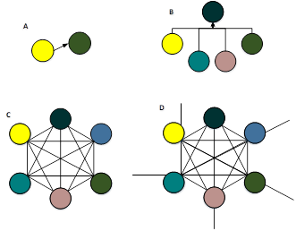
Transdisciplinary understanding of bioeconomy
A) Cross disciplinary concept is viewing one discipline from the perspective of another, cross disciplinary involves associative relations between different methods that are primarily comparative
B) Multidisciplinary is where people from different disciplines working together, each use their disciplinary knowledge
C) Interdisciplinary integrates knowledge and methods from different disciplines, using real-world approach of synthesis.
D) Transdisciplinary creates the integrity of intellectual systems beyond a disciplinary perspective.
Notes:
Crossdisciplinary (Fig. A) concept is viewing one discipline from the perspective of another, crossdisciplinary involves associative relations between different methods that are primarily comparative. Here one discipline, for example agriculture farming interacts with other discipline, for example agriculture economics, to find solution on one issue. Results are solution – oriented. Multidisciplinary (Fig. B) is where people from different disciplines working together, each use their disciplinary knowledge. In multidisciplinary, relationship is usually centralised and hierarchical – it uses the power to define ‘discipline’ in research, in the language of this word. Thus, a particular discipline (in the academic terms, along with related methods) investigation is a privileged development of other methods of ordering and the final results of the general interpretation. As for bioeconomy point of view, would be different discipline experts, that are working on the same bioeconomy issue, for example, on issue of using agriculture waste, microbiologist can give his knowledge and expertise on how to add value to agriculture waste, engineer can find solutions for most effective equipment on various solutions and economist can give his expertise on solutions that he believes is the most cost effective. In this stage, they do not interact with each other. Or interaction is stated as weak link. Results is more subjective. Interdisciplinary (Fig. C) integrates knowledge and methods from different disciplines, using real-world approach of synthesis. In contrast, interdisciplinary has more symmetrical relationship between disciplines, and different methods can be used to address the contrasting aspects of the existing problem. However, even if participatory practice is used in subsequent parts of the process, non-academic interests are often excluded in the most important research, development and interpretation processes [47]. Here the disciplines that interacts are from different basis, they interaction are solution- oriented and with strong links, for example, issue on how to add value on agriculture waste, is a policy question, will it give social benefits and improve national economic situation and on what scale, microbiologist, that can help to find solution, that would give highest added value, economics, that help to find the most cost effective solution and computer science, that can perform modelling on different solution scenarios and their impact to various economic, socioeconomic, health and environmental processes. Transdisciplinary (Fig. D) creates the integrity of intellectual systems beyond a disciplinary perspective. Only in the field of transdisciplinarity, research or evaluation engages in broad, deep and equal ways with different interests, which are usually left outside the formal processes of policy research. Transdisciplinary engagement not only takes place in disciplines, nor is it the case that certain methods are implemented in a way that is subject to wider involvement. According to J.A. Bergendahl et al. nexus projects are going to be more successful if transdisciplinary approach is applied. If previous disciplines focused only on academic disciplines, this approach interacts with non-academic disciplines (society) as equals, broadening the view of issue and solution. If we look at previous mentioned example, in this case it would be supplemented with non-academic disciplines – different non-governmental organizations, local communities, local people, industries and also government agencies, etc. It means, we take into account opinions not only on previous mentioned disciplines on agricultural waste management with high added value, but also e.g. farmer’s opinion, local communities’ opinion, municipalities opinion and industries opinion on different solutions and possibilities to create a new path for bioeconomy development, in this case adding value to agriculture waste by new product production, that is feasible not only in theoretical level, but also realistic on implementation stage, economic and environmental aspect and with market potential.

Slide 17
Definition of transdisciplinary
“…Transdisciplinary deals with problem fields in such a way that it can: (a) grasp the complexity of problems, (b) take into account the diversity of life-world and scientific perceptions of problems, (c) link abstract and case-specific knowledge, and (d) develop knowledge and practices that promote what is perceived to be the common good […] We define TR by these four requirements for knowledge production.’ [54]
“ …Transdisciplinary studies incorporate interdisciplinary integration and add additional research dimensions by (a) addressing problems that are user inspired and context driven, (b) embracing complexity; and (c) acknowledging and incorporating multi-stakeholder perspectives and values…’
“… Trans disciplinarity represents a move from science on/about society towards science for/with society.”
Notes:
In order to research, demonstrate and define transdisciplinary approach of the bioeconomy, it is necessary to understand not only the bioeconomy on a largest scale, but also understand what is transdisciplinary nature. Therefore, a broad analysis of the scientific literature was carried out and various opinions on transdisciplinary definition were compiled. Three of definitions are showed, where main emphasis is captured. Transdisciplinarity represents a move from science on/about society towards science for/with society.

Slide 18
Transdisciplinary approach dimensions
1. Knowledge links from different disciplines (sciences)
2. Subdivisions into sub-systems
3. Integrating different qualities (Intuition and analytic)
4. Knowledge integration, different interests of stakeholders
Transdisciplinary processes
Complimentary approach
Comprehensive, holistic approach
Interdisciplinary approach
Transdisciplinarity processes is way from unsustainable management moving towards sustainable management, covering four dimensions with the aim to connect science (disciplinarities) with practice (stakeholders)
Notes:
Talking about the transdisciplinary approach dimensions we can identify 4 dimension:
1st dimension – helix approach - this dimension brings together different fields from natural – life sciences (biology, medicine, chemistry), economics, applied sciences. It should ensure interdisciplinarity. Different types of helix approach could be implemented: triple helix (basic model), quadruple helix (context of society for Triple helix) or quintuple Helix (context of environments of society).
2nd dimension – Systems: dividing in subsystems, for example in environmental study can separate regions water, air, soil systems and their interlinkages. For stakeholders it is management, financial and equipment as individual systems or complex systems. Needs to be integrated and related to the soft factors – gives circumstances.
3rd dimension Interests: Interests of research or practical perspective. For example, different interests of farmers, residents, policy, different interests of stakeholders. Methods are socially integrating and mediating. 4th dimension Modes of though; cognitive or epistemological perspective analysis or understanding. Methods that integrate different cognitive representations, for example experience of a farmer and the expertise of a scientist.

Slide 19
Transdisciplinary process towards sustainable bioeconomy
Source: L. Zihare, 2020 [4]
Notes:
Transdisciplinarity processes is way from unsustainable management moving towards sustainable management, covering four dimensions with the aim to connect science and practice (disciplinarities) with society (stakeholders) to adapt this processes for sustainable bioeconomy, that not only replace fossil resources with biobased resources, but strengthens different disciplines, taken into account interlinkages, knowledge, and stakeholders and limitations set by planetary boundaries, different dimensions should be included in transition towards sustainable bioeconomy. Syntheses is application of methods of knowledge integration.

Slide 20
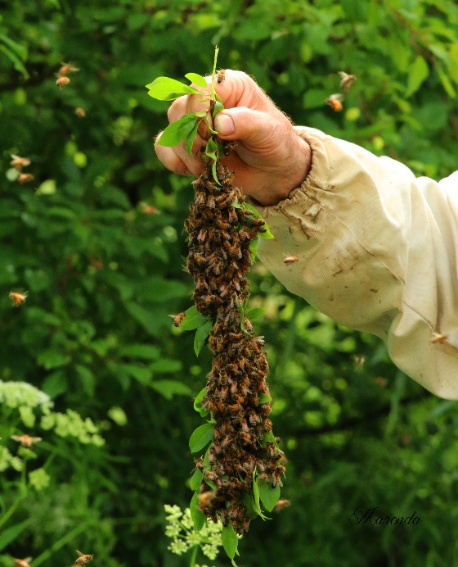
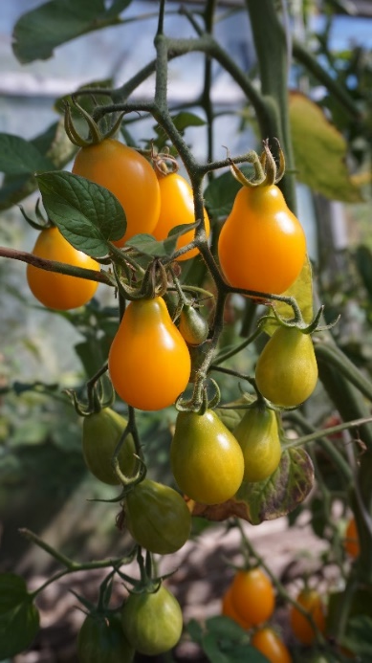
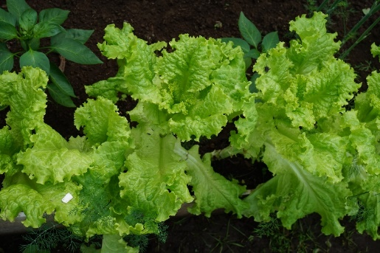
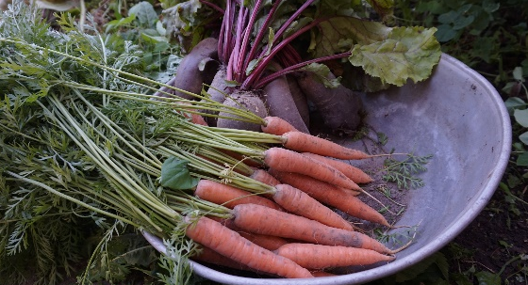
Bioresources
Bioresources are non-fossil biogenic resources which can be used by humans for multiple purposes to produce food, substantial products, and/or energy carriers.
Bioresources is building foundation of bioeconomy, bioeconomy basic purpose is to use bioresources to their fullest extent, to not only decrease the use of fossil resources, but also to gain innovative approach-based methods how to increase bioresource value.
Bioresources
High added value products
Bio-technologies
Sources: [5], [6], [7]
Notes:
Bioresources is building foundation of bioeconomy, bioeconomy basic purpose is to use bioresources to their fullest extent, to not only decrease the use of fossil resources, but also to gain innovative approach based methods hot to increase bioresource value. Bioresources are non-fossil biogenic resources that humans can use for multiple purposes to produce food, substantial products, and/or energy carriers. Bioresources stands for one of the element in bioeconomy triple helix model. Because the bioeconomy makes direct use of natural resources—especially soil, land, water and nutrients—and therefore depends on their availability, it is at the focus of the sustainability debate. Only a bioeconomy that makes responsible use of natural resources, including their efficient use, conservation, restoration and recycling, can contribute to the transformation to a more sustainable economy. For this process, the bioeconomy will have to drive innovations further towards sustainable agricultural intensification. This is defined as “producing more output from the same area of land while reducing the negative environmental impacts and at the same time increasing contributions to natural capital and the flow of environmental services”.

Slide 21
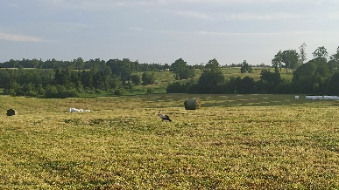
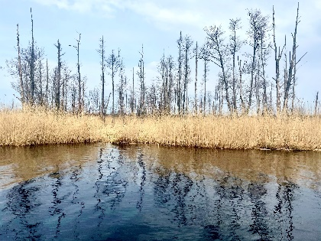
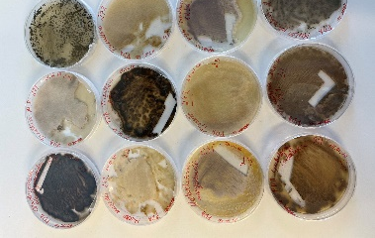
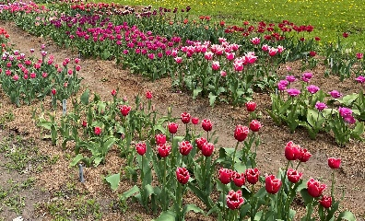
General overview of bioresource use
Conditioning and conversion
Production and marketing
Agriculture
Food
Soil
Biotechnology
Forestry
Feed
Fisheries
Chemistry
Water
Fibre
Aquaculture
Process engineering
Fuel
Microbial production
Culture media
Biorefinery
Fun
Waste management
Sources: [4]
Notes:
The production of biomass can be performed in various forms (soil – from agriculture and forestry, water – fisheries and aquaculture, culture media – microbial production and waste management) that can be conversed using different procedures- biotechnologies, chemistry, process engineering or biorefinery resulting in production and marketing of food, feed, fibre, fuel and “fun”- last one representing such products as flowers.

Slide 22
High added value products
Bioresources
High added value products
Bio-technologies
(author: L.Zihare, 2020 [4])
Notes:
The scond element of bioeconomy is triple helix model is high-added value products. The bio-based economy’s value pyramid indicates that biomass value is determined by its application. In a proper functioning market, the value and price of biomass will be reflected by its application value. The value is low because we do not exploit the structures of the biomass - only the energy content. The added value is the highest at the top of the pyramid and the lowest at the bottom. The volume of biomass needed for the applications is the lowest at the top and the highest at the bottom of the pyramid. Therefore, it is important that, if biomass can be used for these high-value applications, it should not directly go to the lower applications. For example, it is better to first use (parts of) biomass for biochemical plastics and burn them for energy recovery at the end of the material lifecycle. For example, Agro-industrial residues mostly are untreated and underutilized and without appropriate disposal can cause environmental pollution and negative impact on human and animal health. These wastes can be used for bioenergy production, however they contain various potentially valuable compounds like proteins, sugars and minerals. Agricultural industries produce huge amount of residues every year. According to high nutrition value, these residues can be used as raw materials for other product formation and development. There are many reports about liquid and gaseous biofuel acquisition from agro-industrial waste, however there is a potential to derive valuable compounds (e.g. chemicals).

Slide 23
Biotechnologies (biotech)
The single definition is: The application of science and technology to living organisms, as well as parts, products and models thereof, to alter living or non-living materials for the production of knowledge, goods and services. (OECD 2013)*
*The choice of the international patent classification (IPC) subclasses used for this sector is based on this OECD definition.
Bioresources
High added value products
Bio-technologies
Medicine
Bioinformatics,
nanotechnology
Arid and desert
Industrial
Water
Ethics, philosophy and law
Bioinformatics,
nanotechnology
Agriculture
Bioterrorism and biowarfare
Environmental
Sources: [8], [9], [10], [11]
Notes:
The Third element of bioeconomy triple helix model is biotechnologies. By collecting a list of biotechnology definitions OECD has made one single statistical biotechnology definition: “The application of science and technology to living organisms, as well as parts, products and models thereof, to alter living or non-living materials for the production of knowledge, goods and services.” Biotechnologies are classified into 10 groups(colors): Bioinformatics (also called "gold biotechnology") is an interdisciplinary field that addresses biological problems using computational techniques, and makes the rapid organization as well as analysis of biological data possible. The field may also be referred to as computational biology, and can be defined as, "conceptualizing biology in terms of molecules and then applying informatics techniques to understand and organize the information associated with these molecules, on a large scale." Bioinformatics plays a key role in various areas, such as functional genomics, structural genomics, and proteomics, and forms a key component in the biotechnology and pharmaceutical sector. Blue biotechnology is based on the exploitation of sea resources to create products and industrial applications. This branch of biotechnology is the most used for the industries of refining and combustion principally on the production of bio-oils with photosynthetic micro-algae. Green biotechnology is biotechnology applied to agricultural processes. An example would be the selection and domestication of plants via micropropagation. Another example is the designing of transgenic plants to grow under specific environments in the presence (or absence) of chemicals. One hope is that green biotechnology might produce more environmentally friendly solutions than traditional industrial agriculture. An example of this is the engineering of a plant to express a pesticide, thereby ending the need of external application of pesticides. An example of this would be Bt corn. Whether or not green biotechnology products such as this are ultimately more environmentally friendly is a topic of considerable debate. It is commonly considered as the next phase of green revolution, which can be seen as a platform to eradicate world hunger by using technologies which enable the production of more fertile and resistant, towards biotic and abiotic stress, plants and ensures application of environmentally friendly fertilizers and the use of biopesticides, it is mainly focused on the development of agriculture. On the other hand, some of the uses of green biotechnology involve microorganisms to clean and reduce waste. Red biotechnology is the use of biotechnology in the medical and pharmaceutical industries, and health preservation. This branch involves the production of vaccines and antibiotics, regenerative therapies, creation of artificial organs and new diagnostics of diseases. As well as the development of hormones, stem cells, antibodies, siRNA and diagnostic tests. White biotechnology, also known as industrial biotechnology, is biotechnology applied to industrial processes. An example is the designing of an organism to produce a useful chemical. Another example is the using of enzymes as industrial catalysts to either produce valuable chemicals or destroy hazardous/polluting chemicals. White biotechnology tends to consume less in resources than traditional processes used to produce industrial goods. Industrial Biotechnology provides biochemicals, biofuels and biomaterials. It is established since decades in the production of biochemicals for the pharmaceutical markets, food & feed, fine chemicals, detergents and hygienic products. "Yellow biotechnology" refers to the use of biotechnology in food production (food industry), for example in making wine (winemaking), cheese (cheesemaking), and beer (brewing) by fermentation.^{[24]} It has also been used to refer to biotechnology applied to insects. This includes biotechnology-based approaches for the control of harmful insects, the characterisation and utilisation of active ingredients or genes of insects for research, or application in agriculture and medicine and various other approaches. Gray biotechnology is dedicated to environmental applications, and focused on the maintenance of biodiversity and the remotion of pollutants. Brown biotechnology is related to the management of arid lands and deserts. One application is the creation of enhanced seeds that resist extreme environmental conditions of arid regions, which is related to the innovation, creation of agriculture techniques and management of resources. Violet biotechnology is related to law, ethical and philosophical issues around biotechnology. Dark biotechnology is the color associated with bioterrorism or biological weapons and biowarfare which uses microorganisms, and toxins to cause diseases and death in humans, livestock and crops.

Slide 24
Aspects promoting the development of bioeconomy
Bioresources
High added value products
Bio-technologies
Socioeconomic aspects
Legislative aspects
Financial resources
Economic aspects
Scientific research
Climate aspects
Human resources
Environmental aspects
Awareness and knowledge aspects
Innovations
Technological aspects
E D U C A T I O N
Notes:
All things considered, bioeconomy triple helix model has several important aspects promoting the development of bioeconomy, socioeconomic aspects, financial resources, scientific research, human resources, innovations, legislative aspects, economic aspects, environmental aspects, awareness and knowledge aspects and technological aspects. A more general barrier is the availability of well-educated scientists (biology, chemistry, botany) and engineers (plant- and process engineering). Moving towards competence based learning program, study of innovative teaching and training approaches are needed in order to prepare this new skilled generation of working force in bioeconomy.

Slide 25
Bioeconomy sectors and perspectives
Biotechnology innovation perspective
(second decade of the 21st century)
Biorefineries
Industrial symbiosis
Circular bioeconomy concept
Resource substitution perspective
(first decade of the 21st century)
Notes:
Even though biotechnology innovation was recognized from the very beginning as an opportunity for the bioeconomy, the resource substitution perspective was more prominent in the first decade of the twenty-first century. A rising price of oil increases the comparative advantage of using biomass for energy and material use. This line of reasoning promoted the resource substitution perspective of the bioeconomy. Major driving force was Expectation that prices will continue to increase. In second decade of 21st century Biotechnology innovation perspective was introduced. Major driving forces was Paris climate agreement and Advances in the biological sciences. This perspective covers 7 manufacturing sectors and the production of biomass and sectors that already uses manufacturing from biomass, like food, leather, wood and paper products, increasing the efficiency of existing technologies and creating new advanced biotechnologies. Latest perspective creates combined perception on circular bioeconomy concept, biorefineries and cascading approach and industrial symbiosis. Nomenclature of Economic Activities (NACE) codes are presented for different economic activities in the European Community and are subject to legislation at the European Union, which imposes the classification uniformly within all the member states..

Slide 26
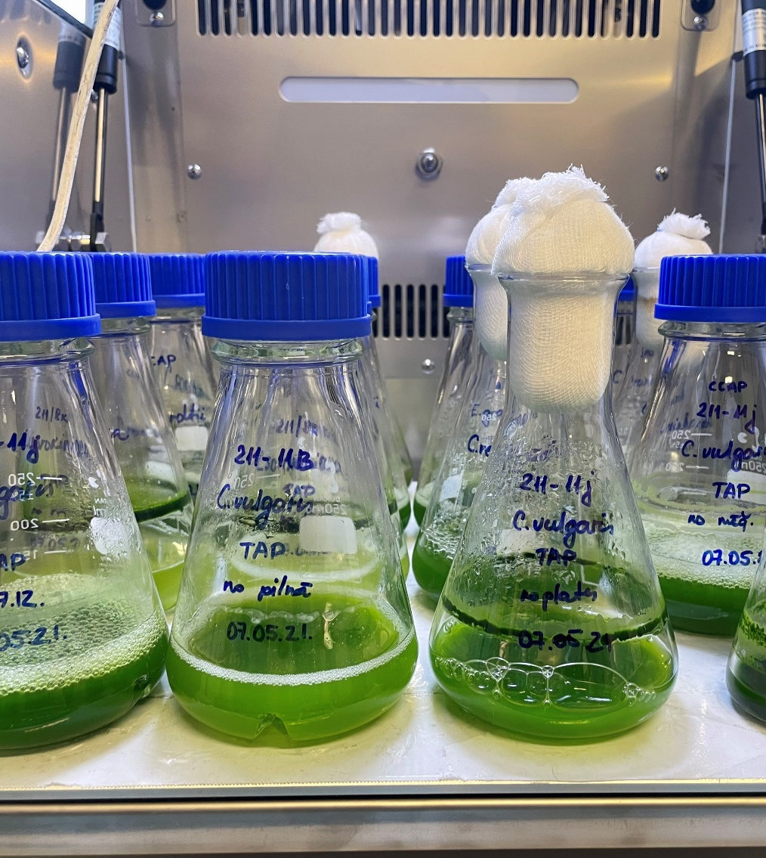
Innovations
Innovations in biotechnology faces three challenges:
a complex knowledge base
converging technologies
issues concerning commercialization and market diffusion.
Holistic innovation approach includes co-creation, innovation systems and open innovation.
Transition to bioeconomy has two innovation stages:
• Incremental, gradual innovations
• Diverse, radically new and disruptive innovations
Author: RTU, IESE
Notes:
Innovations in biotechnology faces three challenges: 1) a complex knowledge base, 2) converging technologies, and 3) issues concerning commercialization and market diffusion. Holistic innovation approach includes co-creation, innovation systems and open innovation. Transition to bioeconomy innovation stages: 1) Incremental, gradual innovations (product and processes) 2)Diverse, radically new and disruptive innovations: redesigned business models, reconfigured supply chains, setup of new value chains – development of new sustainable products and technologies needs knowledge and skills outside their fields of expertise. Universities and research institutions will be cornerstone to accomplish radical innovations.

Slide 27
Circular economy, green and bioeconomy interlinkages
Green economy - enhancing the functionality and resilience of socio-ecological systems by cherishing natural capital; Complementing technical with nature-based solutions
Circular economy - Closing the currently linear economy in a loop by maximising material/energy efﬁciency and recycle through technological development and industrial symbiosis
Bioeconomy - Substituting or complementing industrial inputs with renewable biological resources
Source: D. D'Amato et al. 2018 [12]
Notes:
If we talk about bioresources – the focus comes from bioeconomy and circular economy, but we also should take into account territorial resilience in terms of all ecological system functioning. Therefore Green economy is important step, to build a complete concept. Green economy acts as an «umbrella» concept, including elements from Circular economy (eco-efficiency, renewable energy sources), and nature-based solutions. (nature conservation, resilience). The principle of the green economy is important in all ecological processes. Circular economy and Bioeconomy is resource-focused, whereas principle of Green Economy role is in all ecological processes. Circular economy- Closing the currently linear economy in a loop by maximising material/energy efﬁciency and recycle through technological development and industrial symbiosis. Green economy - Enhancing the functionality and resilience of socio-ecological systems by cherishing natural capital; Complementing technical fix with nature-based solutions. Bioeconomy - Substituting or complementing industrial inputs with renewable biological resources; Fostering

Slide 28
Industrial symbiosis
Industrial symbiosis is the process by which wastes, or by‐products of
an industry or industrial process become the raw materials for another.
Application of this concept allows materials to be used in a more
sustainable way and contributes to the creation of a circular economy.
Notes:
Industrial symbiosis creates an interconnected network that strives to mimic ecological systems' functioning, within which energy and materials cycle continually with no waste products produced. This process serves to reduce the environmental footprint of the industries involved. As a result, Virgin raw materials are required to a lesser degree, and the need for landfill waste disposal is reduced. It also adds the value from materials that otherwise would be discarded, therefore materials remain economically valuable for longer than in traditional industrial systems. Examples of industrial symbiosis are wide range, including the use of waste heat from manufacturers to other industries or municipalities or sludge from fish farms as agricultural fertiliser.

Slide 29

Case study: industrial symbiosis
CO₂
Energy costs
The National Industrial Symbiosis Programme (NISP)
A nitrogen producer
Terra Nitrogen Ltd.
Tomato Greenhouse
John Baarda Ltd.
CO₂
Energy costs
Jobs
Heat
CO₂
Productivity
Source: [13]
Notes:
As one of the good practice examples is The National Industrial Symbiosis Programme (NISP) in the UK that acted for several years as a facilitator to create several symbiotic exchanges across the whole country. Initially funded by UK government. In this specific case, it helped the implementation of a profitable symbiotic exchange between a nitrogen producer Terra Nitrogen capturing steam and Carbon Dioxide and a neighbouring small-scale vegetable grower, which uses the steam to heat up the greenhouses and the Carbon Dioxide to support tomatoes’ growth. Terra Nitrogen generates more than 12,500 tonnes of carbon dioxide every year as a result of its ammonia manufacturing process.
Thee challenge that led to the creation of the symbiotic exchange was the need of the tomato grower to produce tomatoes all year round, independently from weather conditions, expanding its production capacity without considerably increasing costs. NISP practitioners spotted a synergy with local farming business John Baarda, which wanted to experiment with growing tomatoes during the winter. The NISP solution involves the redeployment of waste streams from Terra Nitrogen as power sources for John Baarda’s greenhouse complex, where 300,000 tomato plants are cultivated for Sainsbury’s. The carbon dioxide, a useful ingredient for plant growth, is pumped in and boosts tomato production by up to 50%, while other waste is converted to hot water and used to heat the 38-acre complex. Not only does this mean the reuse of two waste streams, which would otherwise be discharged as emissions, but the scheme has also created 80 jobs. Terra also supplies electricity to the greenhouses, ensuring that Baarda can produce tomatoes throughout the winter, which boosts Britain’s agricultural production.
NISP has put thousands of waste synergies into action between its 15,000 member businesses, resulting in the reuse of over 38 million tonnes of materials previously thought of as waste.

Slide 30
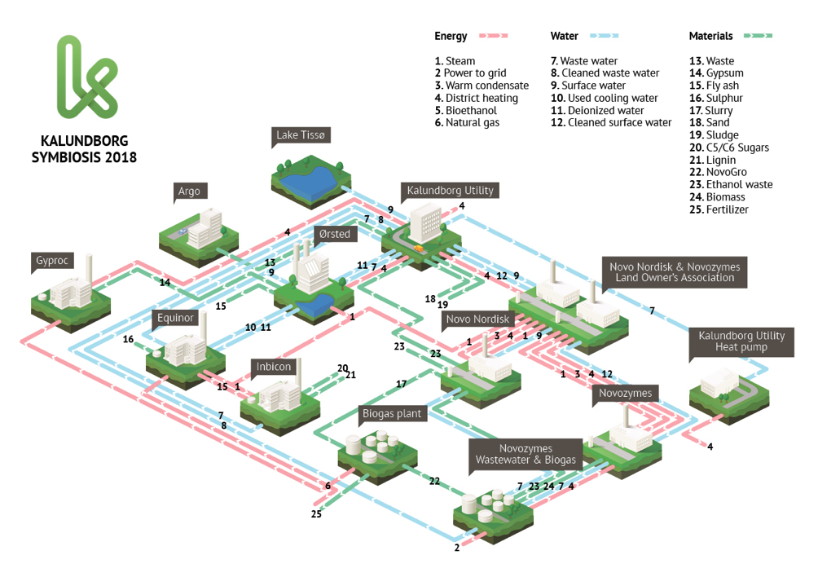
Kalundborg area into an industrial symbiosis
More than 50 years of development
Source: [14]
Notes:
The Kalundborg Symbiosis is a partnership between twelve public and private companies in Kalundborg. The main principle is, that a residue from one company becomes a resource at another, benefiting both the environment and the economy. Having a local partnership means that we can share and reuse resources, and that way we save money as well as minimize waste. The symbiosis creates local growth and supports the green transition.
The development of this industrial symbiosis (IS) started in 1961, with the creation of a pipeline transporting surface water from Lake Tissø to the refinery, thereby reducing the use of groundwater in the refinery. Next the exchange of high temperature steam from the combined heat and power plant, to many of the other partners in the symbiosis. Over 50 years of development of symbiosis includes coal company giving ash to cement industry, pharmaceutical company returning yeast mass from insulin production given as co-feed for local pig farms. Power plant provides heat to the municipality and fish farms, steam oil refinery and enzyme plant. The waste recycling company collects waste from all companies involved in IS and produces landfill gas and from it – electricity. Kalundborg IS includes other streams, such as condensate, sludge, process water streams.

Slide 31
Cascading approach
Cascading in time
Resource quality, value
Cascading in value
Cascading in function
Biomass conversion
Product 1
Product 1’
Product 2
Product 2
Product 2’
Product n
Product 3
Product 3’
Product x
Bioenergy production
Landfill
Defining cascading through time, value and function
Source: Odegard et al. (2012) [15]
Time
Notes:
Figure represents defining cascading through time, value and function. The first approach, cascading in time, is conceptualized as a sequential use of biomass (Fig. 1). This implies reusing or recycling a bio-based product, with energy production at the end of the life cycle; paper recycling and particleboards are conventional examples, but more innovative solutions including bioplastics are also possible. Cascading in function (co-production) optimizes co-production. Cascading in value (loss optimized pathways) cascading in value, the time steps of the cascade can be optimized by prioritizing the highest possible value over the whole life cycle. In these two cases, more efficient biomass use is intended by a successive processing of the total biomass into different products for varying areas of use. This understanding is primarily applied in the context of biorefineries, which involve both conventional waste-to-energy strategies and new pathways for energy use out of waste wood, such as chemicals or bioplastics.

Slide 32
Bioeconomy levels
Notes:
Let’s see more about the effects on implementing bioeconomy principles at different levels

Slide 33
Bioeconomy levels
Resource level
Product level
Company/industry level
Region level
Global level
National level
Macro-regional level
Micro- level
Meso- level
Macro- level
Notes:
Like the concept of sustainability, a sustainable bioeconomy must be assessed at several levels: resources, products, companies, industries, national and global.

Slide 34
Micro, meso and macro level
Micro- level
(Niches,
individuals)
New innovative value chains
New innovative or underused bioresources
Researchers
Entrepreneurs
Meso- level
(regimes,
institutions)
Market analysis
Innovation transfer
Decision making
Innovation transfer
Municipalities
Macro- level
(landscape,
trends)
Policies (global, macro-regional)
Strategies (National, macro-regional,
Regional)
Factor analysis
Policy makers
Notes:
Macro-level (used top-down approach) is focused on bioeconomy development assessment based on factor analysis, case of European Union triple factor nexus through indicator approach is applied as case study to determine benchmark. A composite indicator for bioeconomy effectiveness for international comparison is created.
Meso-level focuses on transition phase through innovation transfer framework, market and economic analysis, and transdisciplinary approach, taking into account different stakeholder requirements and opinion.
Micro-level (used bottom-up approach) focuses on estimating the potential value of different underused bioresources and management systems. This part applies decision analysis and experimental analysis.
Multi-level approach can provide a significant contribution a) for several bioeconomy stakeholders at national, sectoral, and international level; b) for policy makers in more effective bioeconomy development path determination; c) at a regional level for municipalities with management plan and bioresource value notion; d) for entrepreneurs and different stakeholders; e) for society in effective use of resources and consumer behaviour; f) for scientific and research community in the agricultural and forestry fields who carry out research on related topics.

Slide 35
Macro level
Notes:
Let’s now have a look about macro level

Slide 36
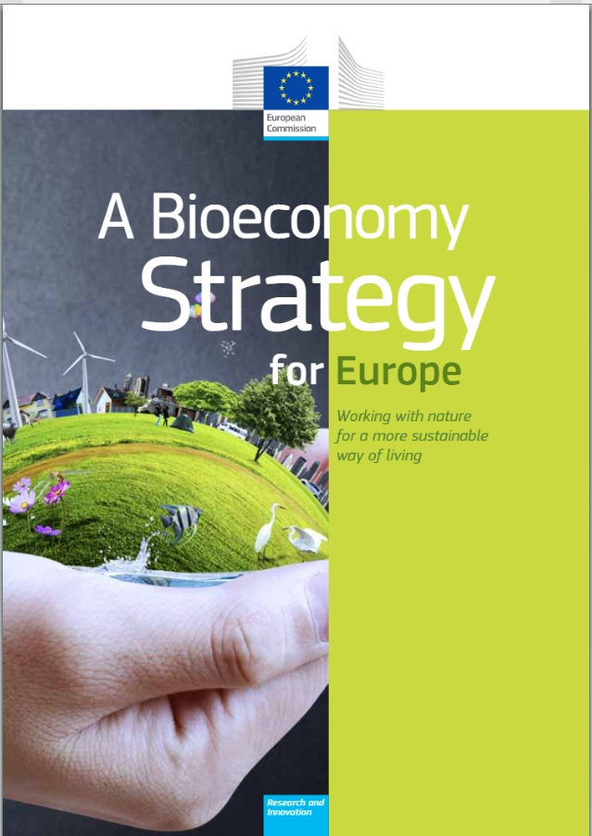
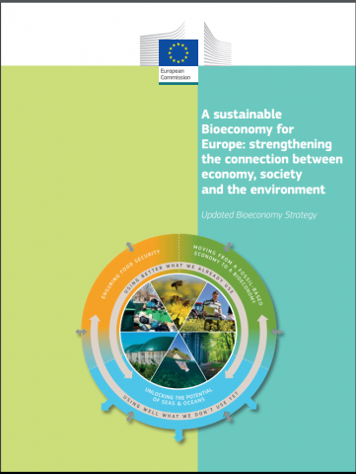
Bioeconomy strategy (European Union)
1. Strengthening and scaling-up the bio-based sectors, unlocking investments and markets;
2. Deploying local bioeconomies rapidly across Europe;
3. Understanding the ecological boundaries of the bioeconomy
Source: [16]
Notes:
The 2012 European Bioeconomy Strategy paved the way for a more innovative, resource-efficient and competitive society that reconciles food security with the sustainable use of renewable resources for industrial purposes, while ensuring environmental protection. A comprehensive review concluded that it has been a success, notably at mobilising research and innovation, boosting private investments, developing new value chains, promoting the uptake of national bioeconomy strategies and involving stakeholders. However, it also found that while the initial five objectives of the Strategy remain valid, their scope needs to be adapted and related actions refocussed in order to use the potential of the bioeconomy better to meet current and future EU priorities. This updated Bioeconomy Strategy proposes actions to scale-up and deploy locally the bioeconomy, capitalising on and going beyond the previous successful Research and Innovation investments, in order to create growth and job opportunities at local level, to reinforce the bio-based sector and contribute to the modernisation of EU industry, to protect the environment and enhance ecosystems’ functions and biodiversity. The strategy contributes to the European Green Deal and industrial, circular economy and clean energy innovation strategies. They all highlight the importance of a sustainable, circular bioeconomy to achieve their objectives.

Slide 37
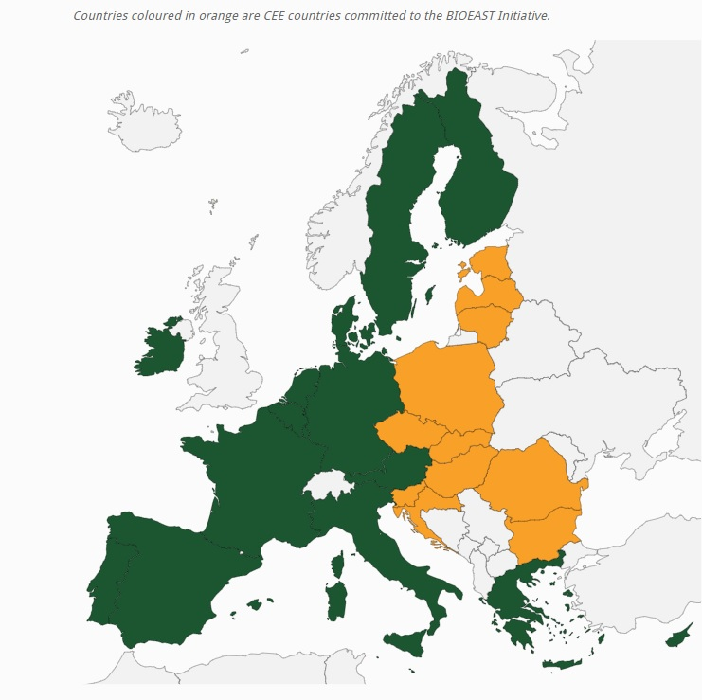
Macro- regional level
Good example is Bioeasts initiative
The Central-Eastern European Initiative for Knowledge-based Agriculture, Aquaculture and Forestry in the Bioeconomy – BIOEAST –offer a shared strategic research and innovation framework for working towards the development of a sustainable bioeconomy in the Central and Eastern European (CEE) countries.
Collaboration between countries
Support creation for bioeconomy strategy development
Source: [17]
Notes:
Good example of macro-regional level is Bioeasts Initiative. The Central-Eastern European Initiative for Knowledge-based Agriculture, Aquaculture and Forestry in the Bioeconomy – BIOEAST –offers a shared strategic research and innovation framework for developing a sustainable bioeconomy in the Central and Eastern European (CEE) countries. Collaboration between countries and Support creation for bioeconomy strategy development

Slide 38
Factor analysis: Nexus approach
(author: L.Zihare, 2020 [4])
Notes:
Bioeconomy in macro level can also be looked as form of factor analysis, in order to determine which factors are the most impacting the bioeconomy development, factor selection is the first step. After factors are identified, the impact and link description between those factors should be acknowledged“. The Nexus Approach to environmental resources management examines the interrelatedness and interdependencies of environmental resources and their transitions and fluxes across spatial scales and between compartments. Instead of just looking at individual components, the functioning, productivity, and management of a complex system are taken into consideration.” The Nexus approach allows the analysis of interlinkages between sectors to reap positive synergies and effectively manage compromises.

Slide 39
Bioeconomy factor interconnection
Direct and indirect interlinkages between seven bioeconomy factors
(author: L.Zihare, 2020 [4])
Notes:
Altogether, 24 bioeconomy affecting factors had been obtained, after expert evaluations and application of Delphi method, seven primary bioeconomy affecting factors and their linkages were identified. Linkages were also based on scientific literature and discussed between experts. Linkages are described as direct or indirect based on how they are affecting factors. Modern technologies have impact on environment; energy efficiency has one of the more noticeable effects. The industry has come a long way from burning coal with efficiency as low as 0.5% to around 90% efficiency in the last decades. In addition, technologies play an immense role in industry by allowing to produce bioproducts from raw materials, thus creating strong link between bioresources, technologies and bioproducts. Preference for specific technology is impacted by production volume and raw materials used and regional legislation.
Main nexus identified from graphical representation linkages are:
production–waste–climate change;
production–waste–bioresources;
policy‒production–bioresources;
technology–production–climate change;
climate change–policy–production;
policy‒technology‒production–bioresources;
climate change–bioresources–production;
policy–research and innovations–technology – let’s look at this last one in more detailed analysis

Slide 40
Bioeconomy factors according to links
(author: L.Zihare, 2020 [4])
Notes:
In the connections, there are more indirect linkages than there is direct linkages between factors, for example, research and innovation factor share is the largest share of indirect linkages between factors (as seen in figure), therefore this factor has the highest share of linkages altogether. So it can be understood as this factor is more of an instrument (driver) for bioeconomy development and works in close connection with other factors. The highest share of direct links, is for bioresources, which is a factor that bioeconomy is based on.

Slide 41
Quadruple factor nexus: policy, research and innovation, technology and bioresources
(author: L.Zihare, 2020 [4])
Policy, research and innovation, technology and bioresources nexus
Notes:
A case study has been performed for European Union countries to better understand the proposed methodology. Quadruple factor nexus: policy, research and innovation, technology and bioresources. Each factor has been described through indicator analysis. Main overlapping factor indicators were used to characterize linkage. Based on statistical data and correlation analysis, benchmark was determined. In order to build quadruple nexus evaluation, each factor is first analysed through indicator analysis.

Slide 42
Bioresources indicators
(author: L.Zihare, 2020 [4])
Indicators that characterize bioresources factor in bioeconomy context
Notes:
Bioresource availability is one of the cornerstones of forest biomass and technology based bioeconomy. The bioeconomy development-related increase in biomass demand can lead to biomass availability constraints that in turn manifest as a feedback loop where biomass scarcity hinders bioeconomy implementation. One source of bioresource characterizing indicators can be the national material flow accounts, where indicators as biomass domestic extraction amounts, imports, exports, as well as domestic material consumption (DMC) and direct material input (DMI) indicators are available. DMC describes “the total amount of materials directly used by an economy”. Other indicators have been proposed in literature, however, for now, these are more applicable at company or sector level, not country level.

Slide 43
Research and innovation factor characteristics
(author: L.Zihare, 2020 [4])
Indicators that characterize research & innovation factor in bioeconomy context
Notes:
Innovations can be described by type of innovation, stage of innovation development, technological readiness level (TRL) of innovation, extent to which innovations are disruptive or radically new, level of complexity in the knowledge base for the innovation development, degree of cooperation between different actors in innovation development, level of complexity in the policy framework (European Commission Bioeconomy strategy 2012) and level of nonlinearity in the innovation development. Figure shows main indicators of research and innovation factor, where two of the indicators have been explained in more detailed by sub-indicators: Patents in resource efficiency technologies and Eco-innovation index (EII). The number of patents is the best quantitative indicator that characterizes Research and Innovation factor, especially, patents for biotechnologies and patents of resource efficiency technologies. Patent data are available and easily collected for analysis, however patent data do not capture all innovations. Patent applications are the main research and innovation output that can determine efficiency of Innovations. The EU 28 average is taken as benchmark and countries over the benchmark are selected as top countries for Research and Innovation factor benchmarking. Top countries are Germany (explicitly higher), France, Italy, United Kingdom, Netherlands and Spain.

Slide 44
Policy factor characteristics
(author: L.Zihare, 2020 [4])
Indicators that characterize policy factor in bioeconomy context
Notes:
Policy is one of the strongest and most significant factors that influences the implementation of sustainable bioeconomy. Bioeconomy development in a country depends on its political system and preferred policy instruments. The EU Bioeconomy strategy (2012) and its updated version (2018) both emphasize the significance of policy for the development of bioeconomy. A combination of various policy instruments is required to ensure the development of bioeconomy. The policy instruments that are intended to promote the development of bioeconomy can generally be classified into four groups:
legal, i.e. necessary changes in regulations and/or quality standards to allow and advance the sale of bioproducts;
support for voluntary initiatives and requirements for public sector regarding implementation of biological waste collection;
providing financial incentives for private investments in biorefineries (e.g. green certificates or feed-inn tariffs);
public financial support for research and development.
By providing performance measurement, reporting and communicating to stakeholders, policy indicators help ensuring consistent and transparent consideration of sustainability within public policy. Indicators that can be used for assessment of bioeconomy policy are those that characterize bioeconomy development.
Regarding policy instrument assessment, another aspect to consider is that various countries may have preference to different policy measures. Nevertheless, policy effectiveness should be assessed in respect to the chosen indicator, not based on what type of instruments are used also longevity of certain policies, for instance, change of a left-wing government to a right-wing one might affect the policies.

Slide 45
Technology factor characteristics
Indicators that characterize technology factor in bioeconomy context
(author: L.Zihare, 2020 [4])
Notes:
One of the greatest emphasis of the technology factor in the context of bioeconomy is for biotechnologies. Technologies bridge the gap from innovations to production and from unused or underused biomass to bioresources. Technologies include environment-related technologies, that allow to mitigate climate-change, biotechnologies and existing technology improvements that either solve the possibility to use biomass that otherwise could not be collected, or help advancing the efficiency of existing resource use. Biotechnology cannot be advanced without knowledge, therefore there is strong link to education and research institutions. As the main result from the development of technologies is patent applications, there should be a correlation between promotion of patent production at a local level and at the international level to succeed in technology commercialization. Technology indicators showed in figure are derived from OECD statistics as key indicators for technology (biotechnology). According to the data available in the OECD database, the number of active biotechnology firms in Latvia (including medical biotechnology, environmental biotechnology, industrial biotechnology, and agricultural biotechnology).

Slide 46
Triple factor nexus
Triple factor nexus: policy, research and innovation and technology
(author: L.Zihare, IESE, 2020 [4])
Notes:
The creation of benchmark for Triple Factor Nexus: Policy, Research and Innovations and Technology. As previously discussed nexus approach, interlinkages and factor characterisation, triple helix of factors, that shows more interlinkages are directed for further benchmark analysis. Effective policy framework is imperative in order to ensure innovation and the development of new technologies and production methods.
It is stated that R&D investments are crucial for the development of innovative technologies. In [120] it is also stated that technology and machinery knowledge and organisation of biomass logistics are required for the development of bio-based solutions.
One indicator that is clearly overlapping between policy and research and innovation factors is investments in research and development. Countries are committed to significantly increase public and private R&D expenditures and number of researchers by 2030 as the part of Sustainable Development Goals.
The output indicators for R&D results are patents. Patent data are more commonly used as output indicator and key measure of innovations. Policy framework should search for optimal solution on innovation rate and direction. Market-based instruments may affect technological trajectory of the economy.
Assessing the nexus in-depth, there are more additional factors, that ensure the existence of these linkages as presented previously. The indicator of this link coincides with Sustainable Development Goal 9 (SDG9) [153], therefore is considered as a strong link towards bioeconomy sustainable development.
For an indepth explanation of this pgrapf you can have a look on the PhD thesis of Dr. Lauma Zihare suggested as Furter reading

Slide 47
Benchmark
P = 122.13c – 92.97, where
P – patent indicator: applications to the European Patent Office per million inhabitants;
c – gross domestic expenditure on R&D by sector
Benchmark for Policy, Research & Innovation and Technology link (author analysis) (Data: Eurostat)
(author: L.Zihare, IESE, 2020)
Notes:
: Benchmark analysis is one of the effective analysis methods for description of bioeconomy performance at a country level. In this case, the existing performance in each European Union country is analysed and compared with the practice in leading EU countries to adapt or improve the existing policy, moving towards sustainable bioeconomy development. In triple factor nexus, two indicators that have been selected for the assessment of one of the possible link benchmarks are R&D expenditures (that characterize the link between policy and R&D) and the number of patent applications (that characterize the link between R&D and Technology). Top countries over the benchmark (which is set as European Union 28 country average) in Patent applications to the European Patent Office (SDG_9_40;Eurostat) attributed to the Gross domestic expenditure on R&D by sector (SDG_09_10; Eurostat) are selected for link indicator benchmark analysis. For these top countries (Germany, France, Italy, the Netherlands and Spain) data correlation is good at intra country level, as well as at inter country level providing European Union with the best practice benchmark, with strong correlation (R=0.8). The empirical model presents the mathematical description of policy, research & innovation and technology link benchmark.
P = 122.13c – 92.97, where P – patent indicator: applications to the European Patent Office per million inhabitants;
c – gross domestic expenditure on R&D by sector. With the use of this empirical model, each country can calculate their situation, based on the benchmark. Some countries that are not in the top list, prove that there is an imbalance between these two indicative parameters, at intra country level. Therefore, more detailed assessment at a country level is needed to address appropriate policy measures or strategy that could accelerate patent applications as a result of expenditure for Research & Development. Policies in different countries may affect these trends, for instance, different, country specific incentives for researchers in academic institutions to apply for patents.
United Kingdom is excluded from analysis due to Brexit and to provide reliable future benchmark.

Slide 48
Meso level
Notes:
Let’s now have a look about bioeconomy meso level

Slide 49
Innovation transfer
Triple helix of knowledge drivers in bioeconomy through technology transfer
General meso-level algorithm
(author: L.Zihare, IESE, 2020)
Notes:
Meso level focuses on bridging the gap between academics and industry. Major commercialization gap is the knowledge gap between academics and industry and the challenge is to link the market needs to new research and to industries. Energy consumption and impact on environment can be decreased by implementing bio-based products with new technological solutions. The main issue for new bioproducts and technologies entering the market is inefficient commercialization strategy and high product costs that cannot compete with fossil-based products. Eco-innovations get more attention in the latest years [156], but entering a market with a new eco-product is not enough to have a sustainable production process, biomaterial use, and ecological and environmental concerns taken into account. If the product is not proven economically viable, it is challenging to enter the market. Therefore, a feasibility study should be done in early development stages. In order to understand the innovation commercialization in meso level analysis is important to provide a market and economic analysis framework to determine if the new bio-based product will have the potential of entering market successfully and to show the shortcomings on product that should be focused on from market point of view.

Slide 50
Factors influencing the innovation commercialization process
(author: L.Zihare, IESE, 2020)
Society and economy (Socioeconomic trends, marketing information, globalisation)
Political instruments (Directives, national regulations, standarts)
Demand pull instruments
(Eco-labels, Economic instruments)
Basic innovation search
Development and validation of technology
Demonstration of technology
Commercialization
Industrial scale-up
Market demand and consumption promotion factors
R&D institutions
Universities
Consumers
Process of innovation
Market supply push factors
Company
(supply chain, green policies)
Product/market conceptualization (Environmental properties – energy use, material use, emiccions, functional properties)
Technology push instruments (Reasearch funds, R&D programmes)
Notes:
Process of innovation (middle line in the figure) goes from research and development industries and/or Universities through technological development stages – basic innovation search, development and validation of technology (laboratory testing), demonstration of technology (prototype, integrated or semi-integrated systems). Industrial scale-up (pilot plant creation), commercialization that leads product to targeted market and actual production where products can reach the consumer needs. All this process of innovation is affected by market supply push factors and market demand and consumption promotion factors.
Industrial R&D priorities are i) the technology push concerning feedstocks and biocatalysts, ii) improvement of economics of established processes, iii) industry’s need of feedstock flexibility, iv) industry’s need of a continuous product pipeline and v) the consumer’s demand for products based on biorenewable feedstocks.
To reach economic viability industrial biotechnology will need reduced investment and operational cost. Therefore, reducing the number of process steps – e.g. by integrating down-streaming and purification in continuous processes - is a crucial question which should be prioritized in R&D. Continuous processes will increase the production capacity significantly, resp. reduce investment and running cost.
Governments should encourage and promote industrial biotechnology by supporting i) cooperation of academia and industry, ii) graduate students exchange

Slide 51
Micro level
Notes:
Let’s now have a look about bioeconomy meso level

Slide 52
Solidago Canadensis possible uses
> New innovative value chains >New innovative or underused bioresources
(author: L.Zihare, IESE, 2020)
Notes:
Invasive alien species (IAS) are defined as species whose introduction and spread outside their natural ecological range posed real threat to biodiversity, economy and human health. There are over 12 000 alien species present in Europe, of which about 15% are invasive. IAS are one of the most important drivers of biodiversity loss and there is mounting evidence that this decline in biodiversity affects the performance of ecosystems.
For the transition from fossil- based economy to bio-based economy to use underused bioresources such as Invasive alien species could be a benefit for innovative novel value chains. In this way we can talk about micro level of bioeconomy.
Micro level includes resource and product level. In this case we will talk about of new high added value bio products that can be obtained from local natural resources that have not been used or are used with low added value.
An example is provide by the Solidago Canadensis possible use within a cascade approach.
Within this perspective Solidago canadensis can be used for obtaining several subproduct. Significant research is done in field for extracts and essential oil, which can be obtained using leaves, shoots, roots or whole plant for essential oil and seeds, buds, inflorescence, stem, roots or whole plant for extracts.
.

Slide 53
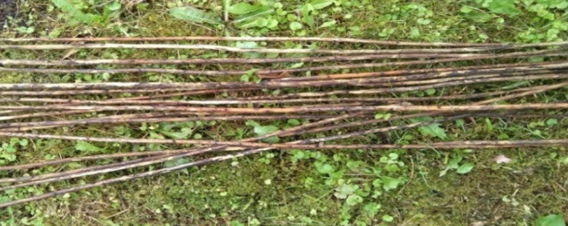
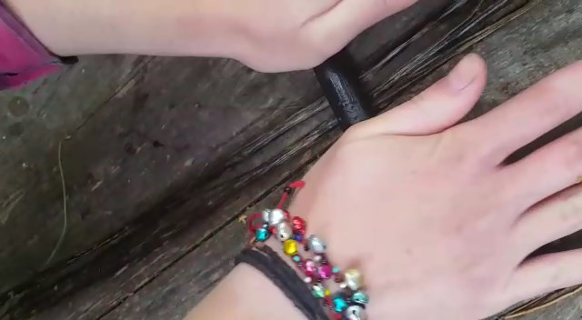
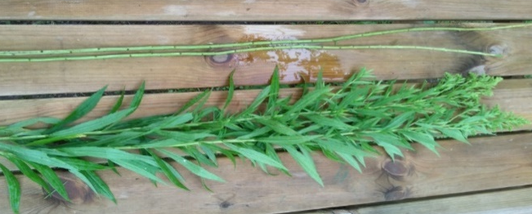
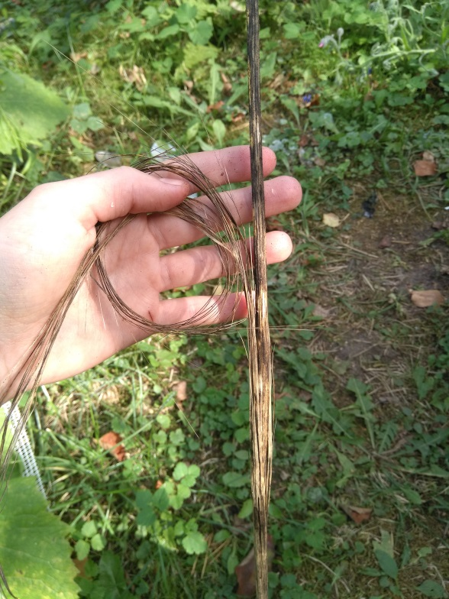
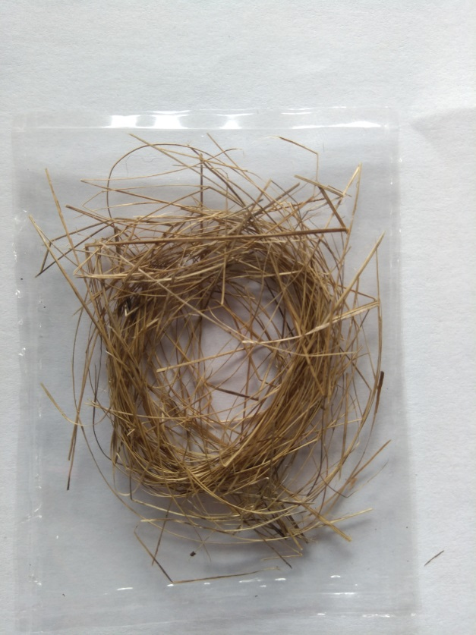
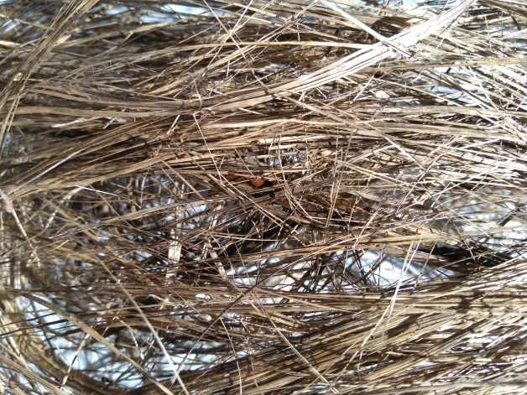
S. Canadensis as fibre source (biological)
Biological method
Decortication
(crushing rollers)
Retting
(Dew retting)
Collection of biomass
Mechanical extraction (carding)
Clean bast fibre
(author: K.Volkova, IESE, 2020)
Notes:
In the picture we can see the Solidago canadensis extraction for fibres with a biological pathway.
The main stages of such extraction processes have been a focus of experiments at the RTU Institute of Energy systems and environment.
Such processes for fibres extraction include the: collection of biomass, removing leaves, retting- there are different retting methods, water retting (requires intense treatment on wastewater), enzymatic retting, that results in low fibre strength, mechanical extraction, also low quality and high cost.

Slide 54
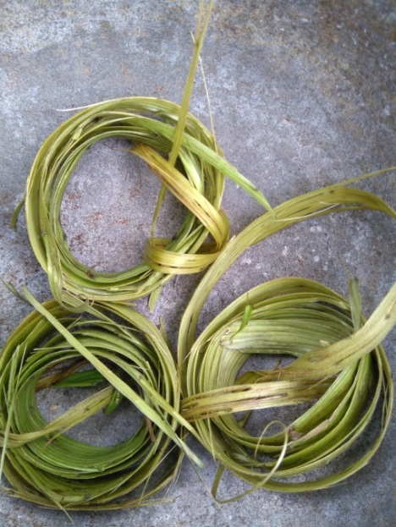
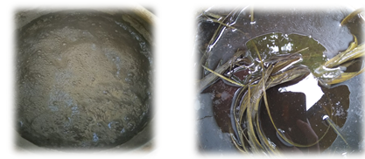
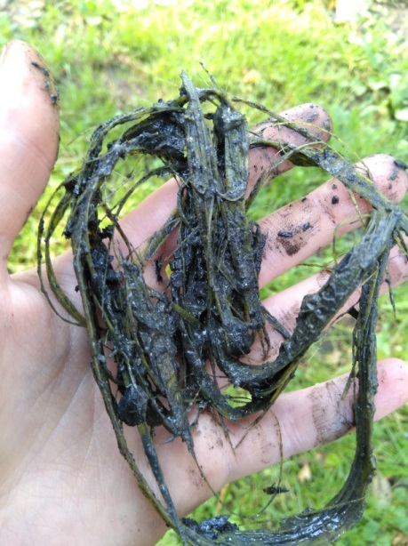
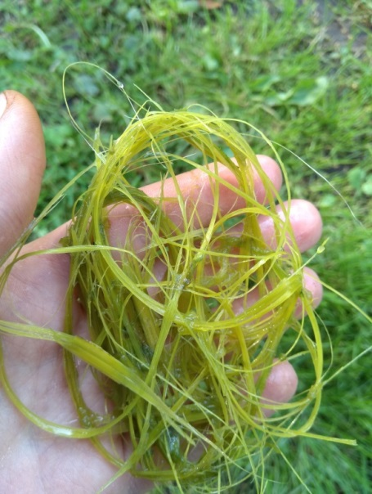
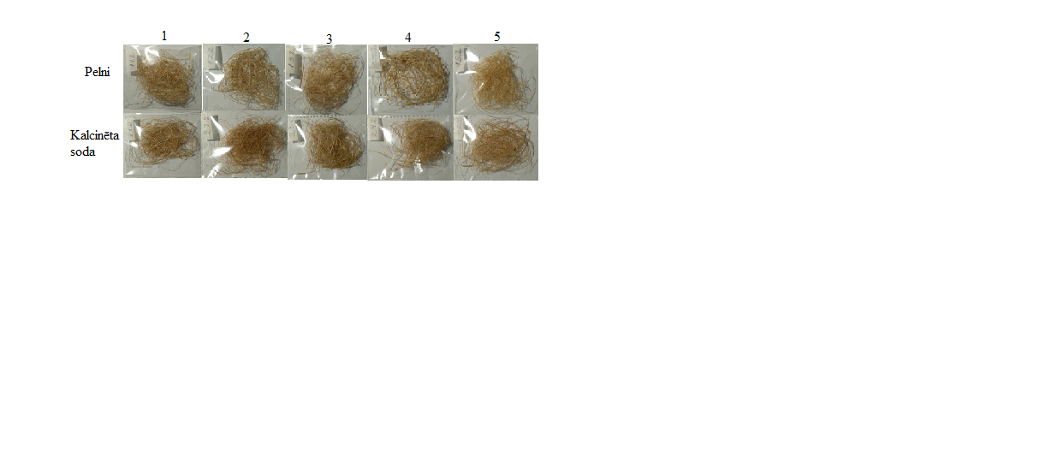
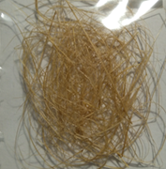
S. Canadensis as fibre source (chemical)
Chemical method
Retting
(chemical retting)
Washing
Collection of biomass
Mechanical processing (peeling)
Mechanical extraction
(carding)
Clean bast fibre
(author: K.Volkova, IESE, 2020)
Notes:
In the picture we can see the Solidago canadensis extraction for fibres with a chemical pathway.
As well in this case the experiments we performed at the RTU Institute of Energy systems and environments.
The first steps are the same as for biological method – collection of biomass, separating leaves from stems, then before retting mechanical peeling is done in order to separate the stem from its peel (bark).

Slide 55
Heracleum Sosnowskyi possible uses:
Product classification according to the parts of the resource to be used
(author: L.Zihare, IESE, 2020)
Notes:
In Latvia most aggressive invasive alien species is hogweed (Heracleum sosnowskyi Manden) which was introduced from the Caucasus region as a potential fodder plant. Many people refuse to cultivate the plant, but due to its rich sowing, hogweed has been uncontrolledly spread to a large part of Latvia's territory and has been included in the black list of invasive plants. Hogweed is an invasive plant in Latvia and several European countries, USA, Russia, and others. At the time hogweed occupies abandoned agricultural land, it results in large amount of waste when eliminated. In order to recover the invaded land for rational use, 3-5 years of regular treatment is necessary.
The research on hogweed in Latvia is mostly concentrated on elimination methods, but according to scientific research, all parts of the Heracleum sosnowskyi plant can be used to produce products. As shown in Figure, it is possible to obtain honey from the flowers, essential oils, furanocoumarin, pectin frand a variety of extracts.
Silage may be prepared for fodder from the green mass, or be grazed fresh for cattle or sheep.

Slide 56
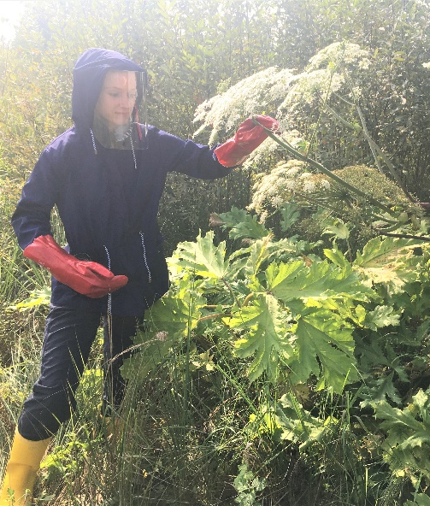
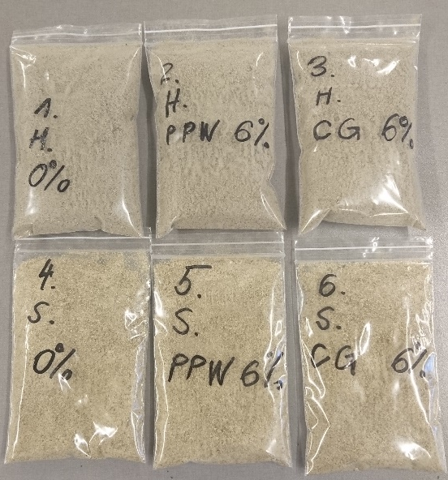
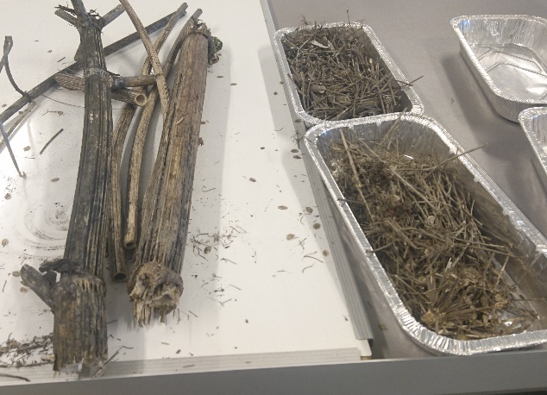
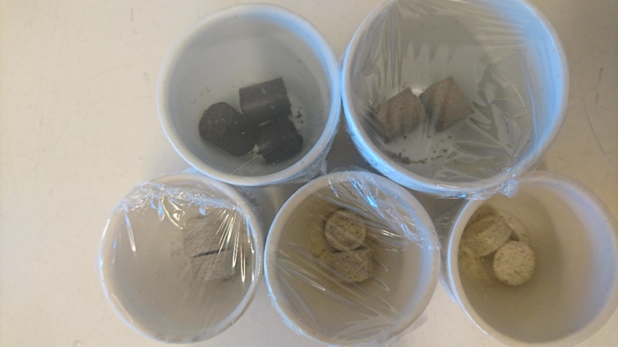
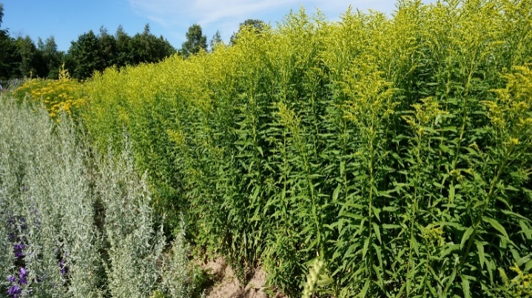
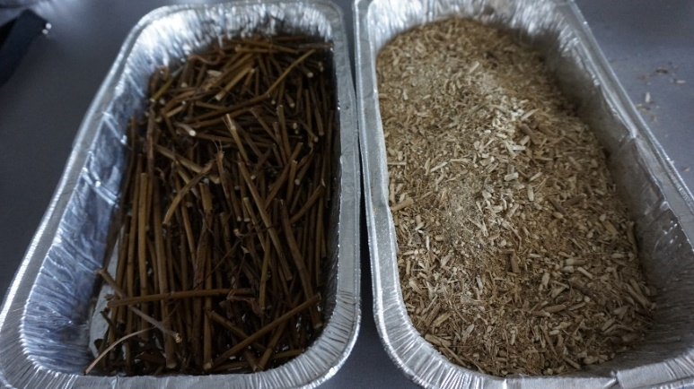
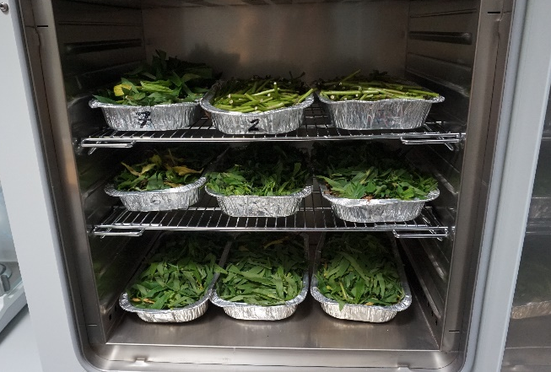
Invasive plant species applications
Pressing
H.Sosnowskyi
Collection of material
Grinding
Pellets
Drying
S.Canadensis
(author: L.Zihare, IESE, 2020)
Notes:
Evaluation has been done by experimentally determining biofuel parameters of two invasive plant species. In comparison to finding a new application, their use as a solid biofuel pellets would not require additional investments for the construction of new production plant. Currently one of the main challenges of pellet industry is limitation of raw materials. In the energy sector, one of the fastest growing markets is pellet production and consumption. Pellets mostly are prepared from wood as raw material, but to satisfy growing demand new materials has to be integrated into production. Existing researches offers non-woody materials such as herbaceous biomass, fruit biomass and aquatic biomass. In comparison with wood biomass, non-wood materials have higher compound variation which creates great challenge to the pellet production industry. Therefore, quality of the raw material is important. Plant materials were initially pre-dried in the laboratory at ambient conditions and afterwards dried completely. Afterwards samples were grinded in a mill into particles smaller than 1 mm in diameter. Two binders were added – coffee grounds and potato peel waste. The binders were air dried for a week. The size of spent coffee grounds was already < 1 mm. However, potato peel waste was ground in the mill. The first eight samples were prepared as following: pure S.canadensis (Sc), pure H.sosnowskyi (Hs), pure coffee grounds (CG), pure potato peel waste (PPW) and Sc with 6wt% CG, Sc with 6wt% PPW, Hs with 6wt% CG and Hs with 6wt% PPW. The biofuel sample was pressed in a pellet press to produce compact and dense test piece. The main biofuel characteristics were tested according to ISO standards on biofuel testing: ash content, moisture content and calorific value.

Slide 57
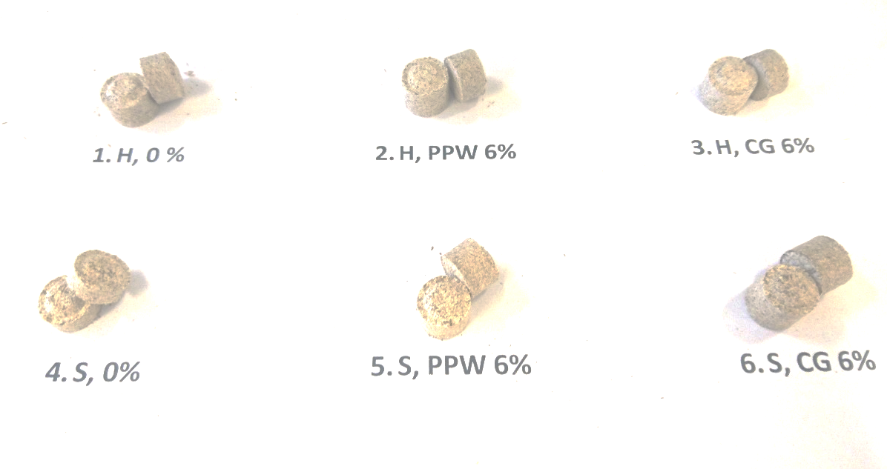
Result of Experimental Analysis: Potential of Solid Biofuel for underused bioresources
(author: L.Zihare, IESE, 2020)
Notes:
H.sosnowskyi and PPW (H, PPW 6 wt%) sample show increase in moisture content, small decrease in ash content and calorific values. S.canadensis with both binders (PPW and CG) show decrease in all parameters. Only H.sosnowskyi with CG binder show increase in calorific value and no important changes in moisture and ash content.
Therefore, H.sosnowskyi and CG were selected for further testing using different proportions of binder. For the final results from all samples show that the highest calorific value is for pure coffee ground sample, whilst the lowest is for potato peel waste. Potato peel waste has the highest moisture content. From these results potato peel waste is proven not to be very suitable binder. Solidago canadensis has a high moisture and ash content and although the calorific value is good for non-woody material, the Heracleum showed better results in all the parameters and therefore were selected for further experiments. In order to determine the quality of the tested sample, a comparison with other existing solid biomass fuels were carried out. Typical values have been taken from ISO 17225-1:2014 standard. The results of all Solidago samples, see Fig.3.44., corresponds to reed and grass calorific values with and without binders, however Heracleum is competitive with broad-leaf logging residues. Moreover, mixed samples are even comparable with coniferous logging residues, broad-leaf wood and coniferous wood. Best results are for Heracleum sample with 50 wt% coffee grounds. To determine the optimal proportion, ash content should be taken into account.

Slide 58
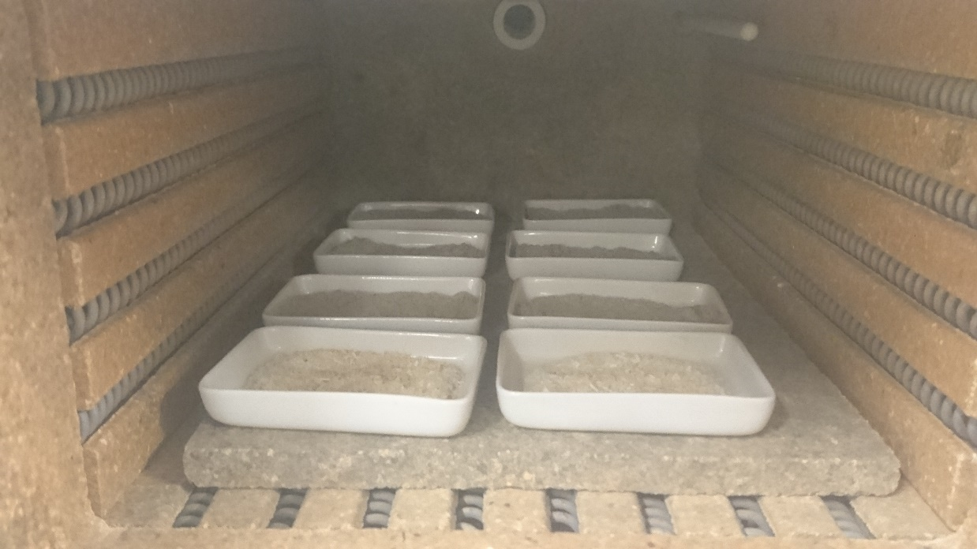
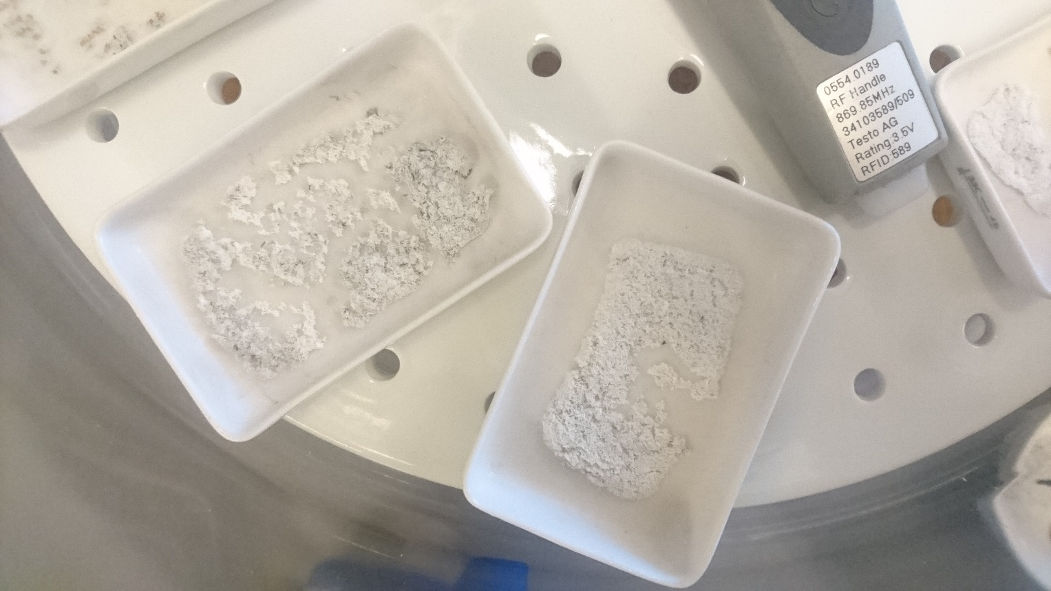
Ash content comparison
(author: L.Zihare, IESE, 2020)
A comparison of ash content between existing solid biomass fuels and tested samples
Notes:
This figure shows ash content values of existing solid biomass fuels and tested samples. Typical values of existing solid biomass fuels are taken from ISO 17225-1:2014 standard. Lowest ash content is for virgin wood material (broad-leaf and coniferous). Non-woody materials cannot compete with virgin wood materials. However, average ash content of logging residues is 3 wt% - 5 wt%, which is similar to ash content of Heracleum. Ash content of Solidago mixed samples are similar to virgin reed canary grass, but results of pure Solidago is similar to grass (in general). Analysing all parameters the optimal moisture content, ash content and calorific value is for H.sosnowskyi with 30 wt% CG binder. Overall, the experimental analysis turned out better for H sosnowskyi pellets with a coffee ground binder. The calorific value and ash content can be competitive against wood. Therefore, it is possible to use this bioresource as an effective energy source. From those conclusions it can be seen that the use of H.sosnowskyi with a coffee ground binder has been fully validated, and it is advisable to use this in industrial pellet production plants. However, from the energy balance and economics point of view, it is preferable to conduct further analysis. Further investigation for durability and bulk density for industrial pellets is the next step.

Slide 59
Synopsis
This lecture gives an insight into bioeconomy concept, definitions
Disciplinarities are explained with emphasis onm transdisciplanary approach towards sustainable bioeconomy
Several examples given for industrial symbiosis
Examples offered in final section in this lecture for different levels of bioeconomy and especially micro level with cases from IESE laboratory.
Notes:
Summary of contents and learners achievments

Slide 60
References
The Finish Bioeconomy strategy, 2014
https://ourworldindata.org/economic-growth Tikai co2 emisijas
https://www.ipcc.ch/site/assets/uploads/2018/12/UNEP-1.pdf
Zihare L., PhD thesis, 2020
https://books.google.lv/books?id=dxKdBAAAQBAJ&pg=PA302&lpg=PA302&dq=Bioresources+are+non-fossil+biogenic+resources+which+can.+be+used+by+humans+for+multiple+purposes+to+produce+food,+substantial+products,+and/or+energy+carriers&source=bl&ots=dZ2sFmIP6d&sig=ACfU3U2vlmTLt2CmFb9NfiS9R1Sik547Dw&hl=en&sa=X&ved=2ahUKEwi4r6OulcLxAhXkAhAIHdTRBJkQ6AF6BAgCEAM#v=onepage&q=Bioresources%20are%20non-fossil%20biogenic%20resources%20which%20can.%20be%20used%20by%20humans%20for%20multiple%20purposes%20to%20produce%20food%2C%20substantial%20products%2C%20and%2For%20energy%20carriers&f=false
Ashok Pandey, Rainer Höfer, Mohammad Taherzadeh, Madhavan Nampoothiri. Elsevier, May 8, 2015 - Science - 730 pages Industrial Biorefineries and White Biotechnology (302.lpp).
Pictures from L. Zihare, RTU
OECD (2013), “Biotechnology”, in OECD Organisation for Economic Co-operation and Development (OECD) Factbook 2013: Economic, Environmental and Social Statistics, OECD Publishing, Paris. DOI: https://doi.org/10.1787/factbook-2013-63-en

Slide 61
References
https://www.oecd-ilibrary.org/docserver/factbook-2013-63-en.pdf?expires=1625151658&id=id&accname=guest&checksum=5727EE0E1272933715F70E8722D3C9F6
https://ec.europa.eu/eurostat/statistics-explained/index.php?title=Glossary:Biotechnology
www.oecd.org/sti/ biotechnology/indicators.
D. D'Amato, J. Korhonen, A. Toppinen, Circular, Green, and Bio Economy: How Do Companies in Land-Use Intensive Sectors Align with Sustainability Concepts?,Ecological Economics,Volume 158,2019,Pages 116-133,ISSN 0921-8009,https://doi.org/10.1016/j.ecolecon.2018.12.026 https://www.sciencedirect.com/science/article/pii/S0921800918306414#f0010
https://www.iema.net/articles/nisp-the-symbiotic-network
http://www.symbiosis.dk/en/
Odegard et al. (2012), https://www.researchgate.net/publication/330791263_Transforming_the_bio-based_sector_towards_a_circular_economy_-_What_can_we_learn_from_wood_cascading/figures?lo=1
https://op.europa.eu/en/publication-detail/-/publication/edace3e3-e189-11e8-b690-01aa75ed71a1/language-en/format-PDF/source-149755478
https://bioeast.eu/cee/

Slide 62
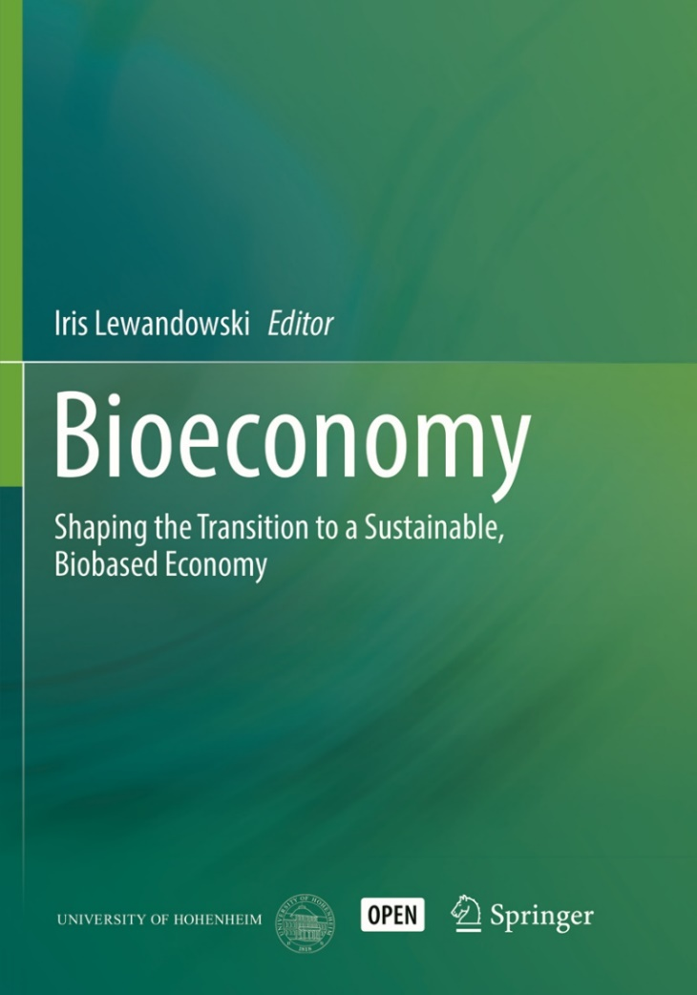
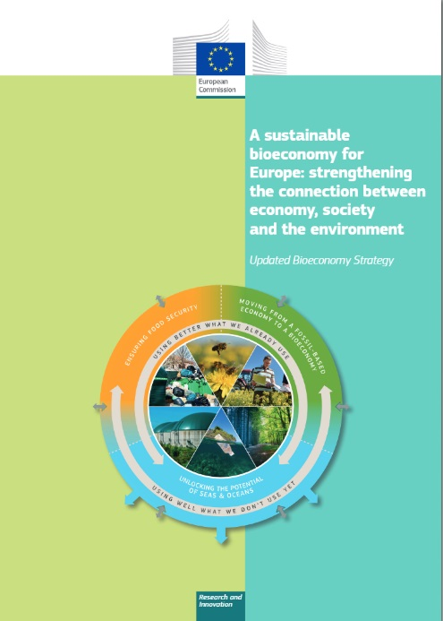
Further readings
«Bioeconomy. Shaping the Transition to a Sustainable, Biobased Economy» Editor: Lewandowski Iris, 2018
Bioeconomy European commision https://ec.europa.eu/info/research-and-innovation/research-area/environment/bioeconomy_en
Bioeconomy strategy and action plan (EU) https://ec.europa.eu/info/research-and-innovation/research-area/environment/bioeconomy/bioeconomy-strategy_en

Slide 63
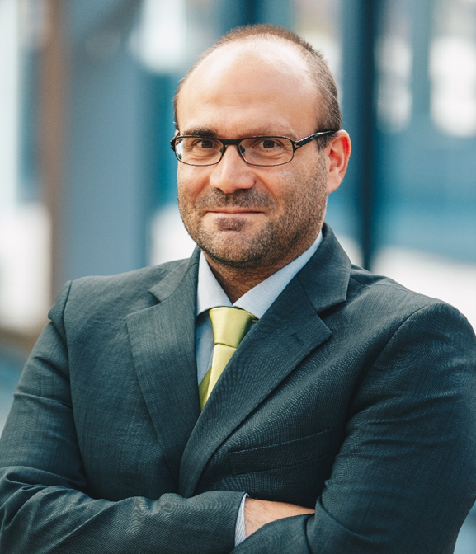
Short-bio
Dr. sc. ing., Francesco Romagnoli, Professor
Scopus Author ID: 36998780600
ORCiD: 0000-0003-1814-7310
H-index = 14
Professor at RTU IESE with a specialization in Eco-design and Life Cycle Assessment
Main research areas: LCA and System Dynamics modelling within techno-feasibility and sustainability evaluations, evaluation of Bio- and circular-economy solutions, overall Life Cycle Sustainability Assessment including environmental LCA (E-LCA), Life Cycle Costs (LCC) and Social LCA (S-LCA), urban system’s resilience evaluation, biogas from seaweeds and microalgae
Leading of the University courses of: LCA and Eocodesign, Risk and Reslience, Applied Geophysics methods.
Head of the Biosystem Laboratory at RTU Institute of Energy Systems and Environment

Slide 64
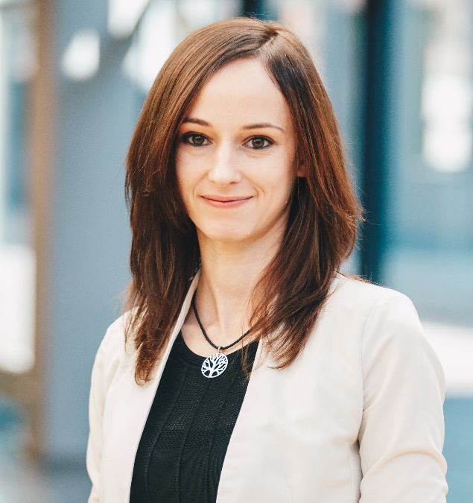
Short-bio
PhD Lauma Žihare, Doctor of Engineering in Environmental science, she is senior researcher and docent in Riga Technical university, Institute of Energy systems and Environment and holds rights of an expert of the Latvian Council of science Field: Environmental engineering.
  Scopus Author ID: 57194540407
  ORCID: https://orcid.org/0000-0002-4687-9175
Lauma Žihare is author of more than 21 scientific articles that are indexed in Scopus, Web of Science.
Co-author of three collective scientific monographs 1) “Sustainable Energy Sources”, also as Editor Lauma Zihare, RTU Press, 2018 2) “Development of Energy Planning in the Local Municipalities of Latvia” also as Scientific editor: Lauma Žihare. Riga: RTU Press, 2020 3) “Bioresources for sustainable development. Introduction to biodiplomacy” (In Latvian, Riga 2021)
Lecturer in study courses: Production of Biobased Resources, Basics of ecological research, Basic of System Simulation, Biotechnologies, Environmental Engineering, Fundamentals of environmental scientific research, Demand Side Management (lead), Biotechonomy.

Slide 65
Thank you
Contact information: lauma.zihare@rtu.lv

Slide 66
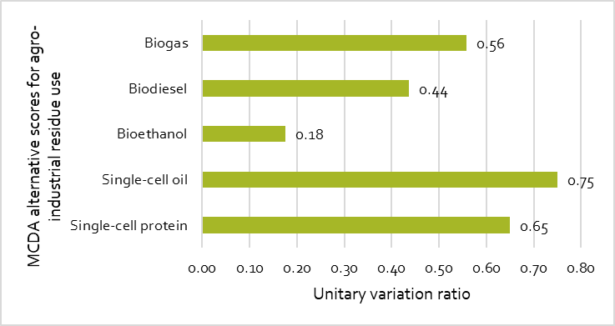
Agro-industrial biomass value
Micro - level
Results of Multi criteria analysis of agro-industrial residue use potential
Agro-industrial residues existing and alternative flow used in analysis
Sensitivity analysis for production readiness level
Notes:
Unit 2 distribution and selection of bioresources

Slide 67
«Market attractiveness – competitive advantages» matrix, or the GE-McKinsey Matrix
Products that fall above the diagonal line are high performers with commercialization potential;
A product in the first quadrant is worth investing in with no further calculation or assessment (leader). Second quadrant have potential for growth. Fourth quadrants represent weak markets; it is not advisable to invest in those products. Fifth quadrant products should be discarded.
“Market attractiveness – competitive advantages” matrix, or the GE-McKinsey Matrix
Notes:
(Bioeconomy evaluation method unit 3)
Resource availability is the first step to promote bioeconomy resource should be local and not dependent on import.
Technology should be available on commercial scale even if it is innovative technology, if innovative technology is not yet in commercial stage it goes back to Research and Development (R&D) stage. GE-McKinsey matrix, that has been used for market assessments.
Products that fall above the diagonal line are high performers with commercialization potential; these are the products that a company needs to focus on. A product in the first quadrant is worth investing in with no further calculation or assessment and may be marked as a product leader.
Products in the second quadrant have potential for growth, and may be advisable for the company to invest in if improvements can be found and implemented.
Third quadrants are in possably attractive markets but before proceeding need to be evaluated further to see if there are opportunities for biorefining
Fourth quadrants represent weak markets; it is not advisable to invest in those products.
Fifth quadrant products should be discarded.

Slide 68
Example of GE-McKinsey matrix
Meso- level
Market size
Market growth
Demand cyclicality
Demand seasonality
Price sensitivity
Market profitability
Differentiation of product
Presence of equal competitors
Competitor level of specialization
Investment capacity
Access to raw materials
Results of GE_McKinsey matrix for forest pulpwood potential products
Demand; Market share
Availability of resources
Price and quality
Environmental actions of manufacturing processess
Notes:
(Bioeconomy evaluation method unit 3)

Slide 69
MCDA analysis: factor interlinkages
MCDA analysis results for seven bioeconomy influencing factor importance based on their interlinkages
Notes:
Unit three
Policy has a strong role in technological development as strategic incentives to research and development leads to the improved production efficiency of technologies. Adopting these technologies in new and existing production plants could lead to growing demand for biomass feedstock. Recognizing the crucial role of research and development in innovative technology development, the EU allocates considerable amount of resources to promote research and development of biotechnologies.
Both direct links (direct influencing and direct dependent) are assumed to be twice as important (stronger) than indirect links (indirect influencing and indirect dependent). Therefore, weights are 1/3 (or 0.33) for direct links and 1/6 (or 0.17) for indirect links.
Interval scales for TOPSIS analysis results varies from 0.2 (waste) to 0.77 (bioresources), and AHP analysis results vary from 0.09 (waste) to 0.18 (research and innovation), PROMETHEE varies from -0,33 (waste) to 0,36 (bioresources).
comparison (AHP) it was determined that the highest impact is for research and innovation, bioresources and technology, that can be confirmed by bioeconomy’s definition as knowledge based and bio-based economy [132] and that in 2012, biotechnology was set as priority driver for bioeconomy development [9]. PROMETHEE analysis shows the greatest impact on Bioresources, Policy and Technology. Although according to the TOPSIS analysis, bioresources have the highest score, technology and policy factors are also important. Bioresources play an important role in bioeconomy, as they are based on biomass and its sustainable use. Technology factor has high results in both methods, as it ensures sustainable use of resources, as well as provides a more effective use and development of new technologies and bioproducts.

Slide 70
Market analysis example
Meso- level
Market sector analysis for thermal packaging in Europe (2017 year estimates)
Notes:
( Unit2?market potential assesment)
Most promising market sector in Europe is food, healthcare(medicine) and pharmacy. Pharmacy is promising by its growth rate, while healthcare by its market value, although it could be difficult to enter such a saturated market, only if the fossil packaging is replaced. Food sector is almost in the middle and could be a promising sector to start entering the market, because of the growth rate and market value balance.
Market pull tools work by increasing the demand for products or services with special features to achieve the goal. The demand for environmentally-friendly products is expected, creating a higher overall level of innovation and responding to changes in demand. The eco-innovation process also involves green public procurement, accounting for 16% of EU GDP, thus bringing eco-friendly products to the market if they are economically viable [159].

Slide 71
Bioeconomy efficiency index
Bioeconomy inputs
Bioeconomy resource productivity and availability
Technology
Environmental impacts
Economic value
Bioeconomy efficiency index for EU (2011-2015)
[Data portal of agro-economics Modelling – DataM, OECD, Eurostat]
Notes:
(Unit 3 bioeconomy measures)
Bioeconomy efficiency index represents which of the indicators have higher or lower impact on each country’s overall bioeconomy efficiency evaluation.
For example, for Denmark and Ireland a large share of their evaluation comes from three highest positions – patent share, bioeconomy labour productivity and government investments into R&D in agriculture sector. For Denmark another strong position constitutes environmental technology development. The share of government support for R&D in agriculture sector is the highest only for the top three countries. The highest impact from the indicators bioeconomy labour productivity on the overall score is for Belgium, followed by Ireland and the Netherlands. This might be related to the fact, that each country has selected its specific pathway for bioeconomy development.
The bioeconomy efficiency index allows the decision makers to identify the most influencing indicators for each country to focus on strengthening the countries performance and could help in bioeconomy strategy development.
Data sources were from portal of agro-economics modelling – DataM, OECD and Eurostat.

Slide 72
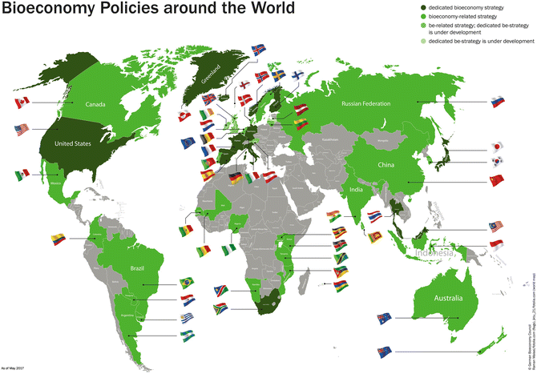
Bioeconomy national policies around the world
Macro- level
Bioeconomy policies and strategies established by 2017 (BÖR 2017)
Notes:
https://link.springer.com/chapter/10.1007/978-3-319-68152-8_3
Many bioeconomy strategies on a regional and national level have been developed, most of them in Europe, but also in the United States, South Africa, or Thailand. Those countries are also willing to intensively promote the development of their bioeconomies politically, using enabling policy means (Dietz et al., 2018). Where a designated bioeconomy strategy is missing, the governments have often addressed the topic in related strategies. One example is The Netherlands, where it is linked to the circular economy strategy (Ministry of Economic Affairs, 2018). (http://biomonitor.eu/wp-content/uploads/2019/10/BioMonitor_Deliverable_1.1_Update_1.pdf)

Slide 73
Meso level methodology
(author: L.Zihare, 2020)
Notes:
Resource availability is the first step to promote bioeconomy resource should be local and not dependent on import.
Technology should be available on commercial scale even if it is innovative technology, if innovative technology is not yet in commercial stage it goes back to Research and Development (R&D) stage. GE-McKinsey matrix, that has been used for market assessments.
Products that fall above the diagonal line are high performers with commercialization potential; these are the products that a company needs to focus on. A product in the first quadrant is worth investing in with no further calculation or assessment and may be marked as a product leader.
Products in the second quadrant have potential for growth, and may be advisable for the company to invest in if improvements can be found and implemented.
Third quadrants are in possably attractive markets but before proceeding need to be evaluated further to see if there are opportunities for biorefining
Fourth quadrants represent weak markets; it is not advisable to invest in those products.
Fifth quadrant products should be discarded.

