Slide 1

Bioeconomy within the agro-farming sector
Module 2.1. Bioeconomy
M.sc. Vivita Priedniece

Slide 2
Aim and objectives
The aim of this lecture is to give an insight into the current state of the agriculture sector in the bioeconomy context
It also offers information on existing and potential agricultural resources that can be used for production of value-added products around the world
Notes:
Not in the video

Slide 3
Learning outcomes
Describe and name the bioeconomy principles with an emphasis on the agro-farming sector
Associate the basic principles of value-added use of bio-resources in the agro-farming sector
Examine and interpret bioeconomy principles with an emphasis in the agro-farming sector
Evaluate options for the management of bioeconomy solutions for the agro-farming sector

Slide 4
Keywords
Agriculture
Waste
Residues
Added-value products
Farming
Bioeconomy
Resources

Slide 5
Table of contents
Agriculture overview
Different types of agriculture
Legislation & statistics – at the EU and global level
Agriculture and environment
Agricultural resources
The use of agricultural resources, including residues
Examples
  Agro-food and bioeconomy policy in the EU
  The European agricultural supply model
  Agricultural biomass value chain
  Bioeconomy strategies in countries from the agricultural viewpoint
  Examples of agricultural resources uses in the context of bioeconomy
Notes:
Video starts

Slide 6
Agriculture and agro-farming sector

Slide 7
Agriculture
Latin ager (field) and colo (cultivation) combined agricultura: agriculture or farming
Historically, systems can be divided according to the involvement of livestock in plant cultivation
Nowadays the term covers a wide range of activities, including cultivation, plant use, domestication of animals, gardening, crop cultivation, livestock rearing
Types of agriculture can be divided according to soil types, cultivation amounts, main crops or animals
Two primary subsectors of agriculture are livestock farming (animal husbandry) and cultivation of plants

Slide 8
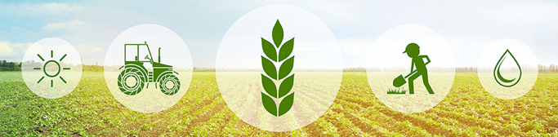
Agro-farming
The advanced form of traditional agriculture
A practice of cultivating plants and livestock
Cultivation of plants is enhanced with the help of livestock and/or advanced machinery to provide a more efficient farming process
Source: from National Material Company, 2021 [1]

Slide 9
An example of different types of agricultural practices
Source: from Geography Revision, 2021 [2]

Slide 10
Shifting cultivation
Characteristic for tropical regions
Includes deforestation
Cleared land is used
  until it becomes barren
  for three to five years
  until it is overtaken by natural fauna and weeds
Barren land is left in a fallow and new land is prepared
This is a type of manual agriculture
The practice of this type of agriculture is decreasing due to sustainable development

Slide 11
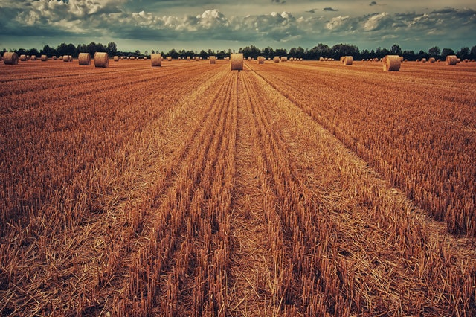
Rudimentary sedentary tillage
The same land is used continuously
Periodically land is left as a fallow
Mainly practiced in tropical regions, crop and rubber plant cultivation
Source: from Ferguson College of Agriculture, 2021 [3]

Slide 12
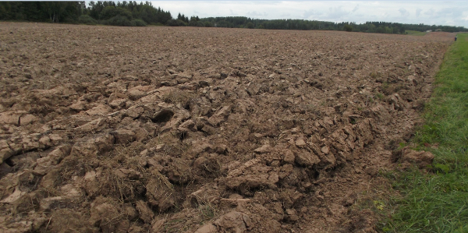
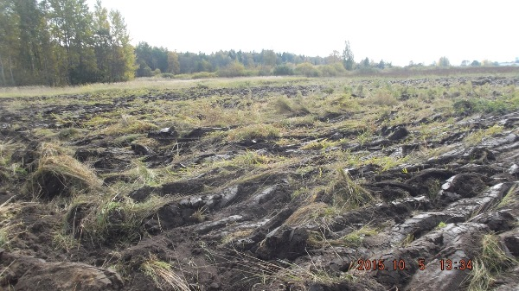
A fallow
Arable land that is not used for cultivation of plants at a specific year, but is treated during the whole or partial vegetation period to prevent growing of weeds, provide accumulation of moisture and nutrients and prepare the land for growing plants
It is sustained for at least 6 months in a row
A grassland, where soil is not mechanically treated during the vegetation period, is not a fallow. The use of herbicides is not a sufficient land treatment activity
Source: from Rural Support Service of Republic of Latvia, 2016 [4]

Slide 13
Nomadic herding
Keeping and rearing of animals in natural pastures
Typical in desert and semi-desert regions
Similar to livestock farming
The main goal is to provide food for family
Nomads together with their herd move to regions with sufficient water and food amount
Animals that are kept in herds are dependent on the region
  sheep, cattle, camels, goats, donkeys, horses

Slide 14
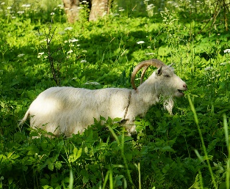
Livestock farming/animal husbandry
Livestock farming in a specific environment
Pastures are made to provide food
Widely used for commercial purposes
Livestock farming at a large scale is practiced in North America, South America and Australia due to low level of precipitation
Livestock farming provides wool, meat and milk
To provide sustainable livestock farming, the use of pastures is reduced and buying of feed increases
Source: from Institute of Energy Systems and Environment, 2020 [5]

Slide 15
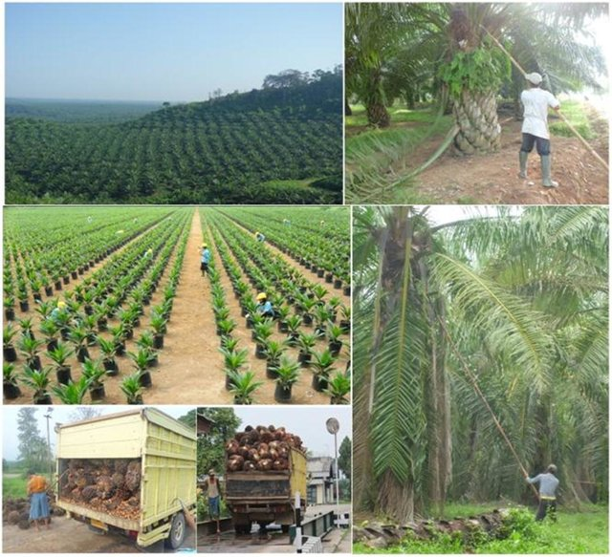
Commercial plantations
Growing of fruits and berries, industrial agriculture or plantations
Takes up large areas
Activity has high commercial value even in small areas
Is mainly practiced in regions with European colonial influence (Africa, Asia, Latin America)
Includes growing of tropical plants:
  teas, rubber trees, coffee beans, coconuts, cocoa, grapes, apples, seasonings, citrus fruits, avocado, mango, palm oil, etc.
Source: from Syuaib M.F., 2016 [6]

Slide 16
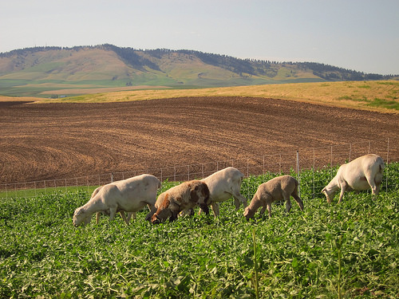
Mixed farming
Growing of crops and livestock farming
Includes continuous growing of crops with changing ripeness periods in the same field
It is beneficial in regions with sufficient precipitation or suitable irrigation systems
Development is tightly connected with market infrastructure
Source: from U.S. Department of agriculture, 2015 [7]

Slide 17
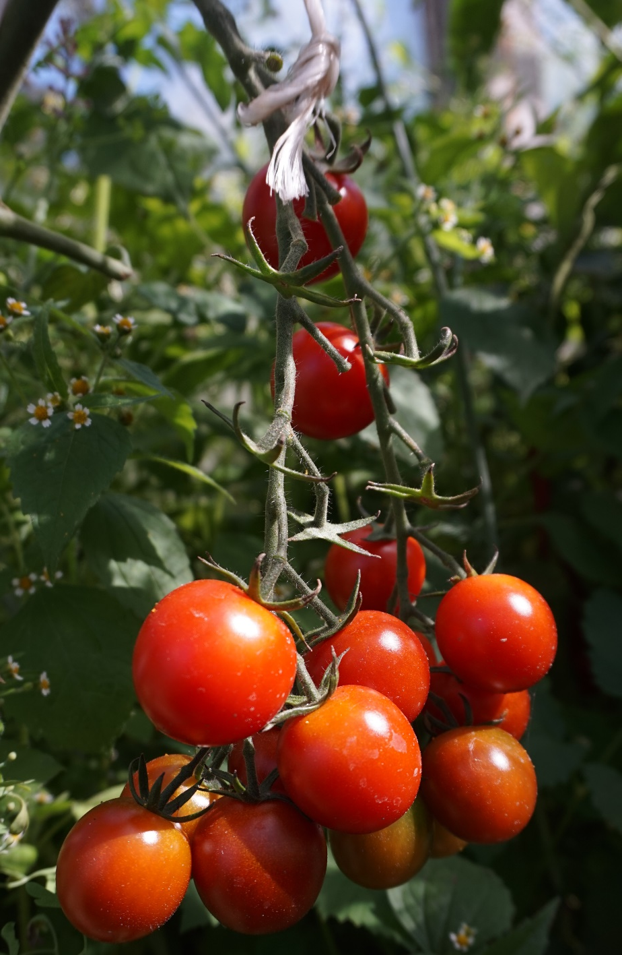
Specialized horticulture
Developed in densely populated urban areas to provide the demand of horticultural resources
Commercial growing of garden plants, fruits and decorative plants
Widely used in northern Hungary, France, regions of Switzerland
Source: from Institute of Energy Systems and Environment, 2020 [5]

Slide 18
Subsistence farming
Subsistence
Intensive subsistence
Cultivation of plants and livestock farming with the aim of providing food for the farmer and his family
The use of simple technologies in small areas
Low productivity and limited improvements
Widely used in Russia, but with a declining trend
In tropical regions - rice growing
Mainly used in Southeast Asia with the help of animals and manual labor
Manure is actively used to improve soil
Other crops, for example, millet and wheat, are grown in limited humidity conditions

Slide 19
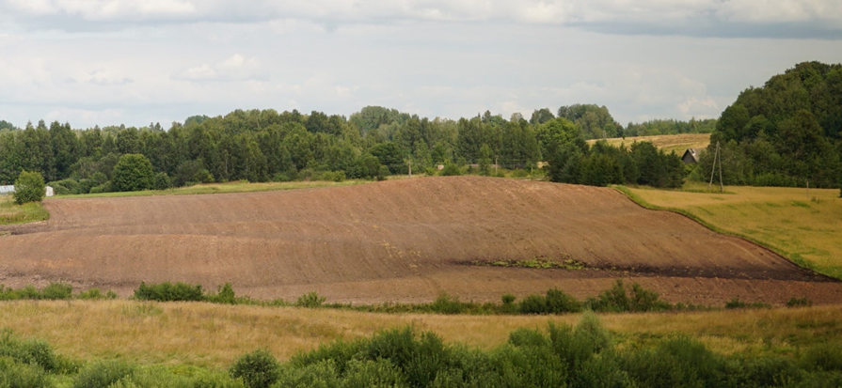
Arable farming
Growing of plants without the inclusion of animals
Practiced in various areas
Mostly grown plants in this type of agriculture are: plantation plants, vegetables, crops, cassava, potatoes, legumes
Source: from Institute of Energy Systems and Environment, 2020 [5]

Slide 20
Agroecology
The use of ecological concepts and principles to optimize interactions between plants, animals, humans and environment while providing a sustainable system
Source: from FAO, 2021 [8]

Slide 21
Circular economy
Circular economy is aimed to maintain components, materials and products at their highest utility in order to eliminate waste from a system
The main stages are: grow – make – use – restore
9% of the world’s economy is circular
Industrial symbiosis supports the development towards circular economy
Use
Reuse/repair/
recycling
Raw materials
Production
Source: from Barros M.V., et.al., 2020 [9]

Slide 22
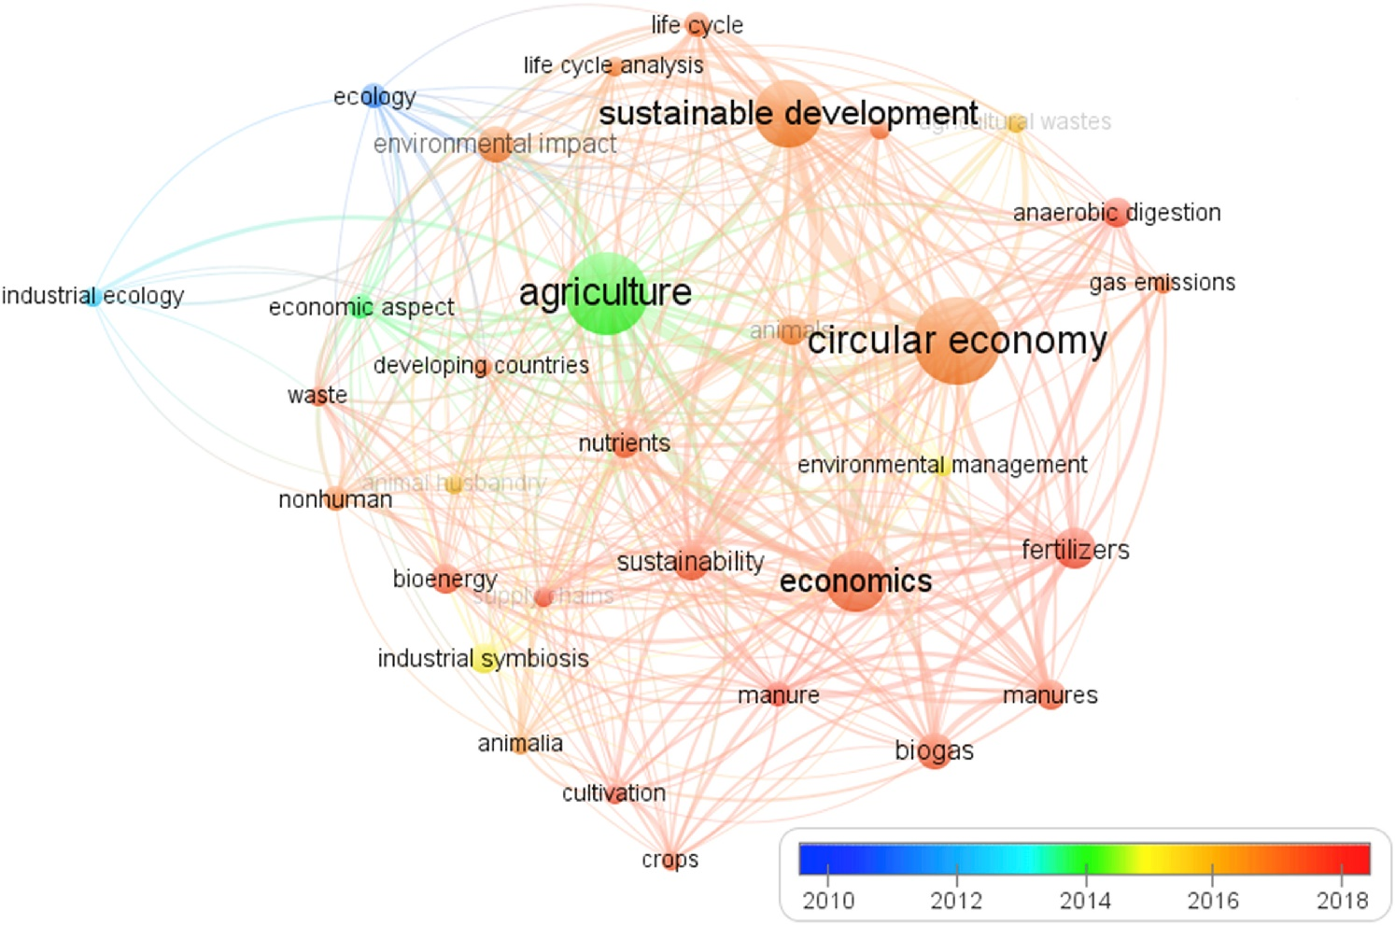
Circular economy in agriculture
The use in agriculture is a highlight in a worldwide context:
  «Shaping the Future of Food» initiatives to develop sustainable, efficient and nutritious food systems
  Shift to circular economy is several areas, such as mushroom production; dairy products; agrifood; the use of fertilizers, biochar, phosphorus efficiency; food waste recovery; bioenergy; animal production, etc.
Source: from Barros M.V., et.al., 2020, [9]

Slide 23
Legislation & statistics
Eurostat, European Commission, FAO

Slide 24
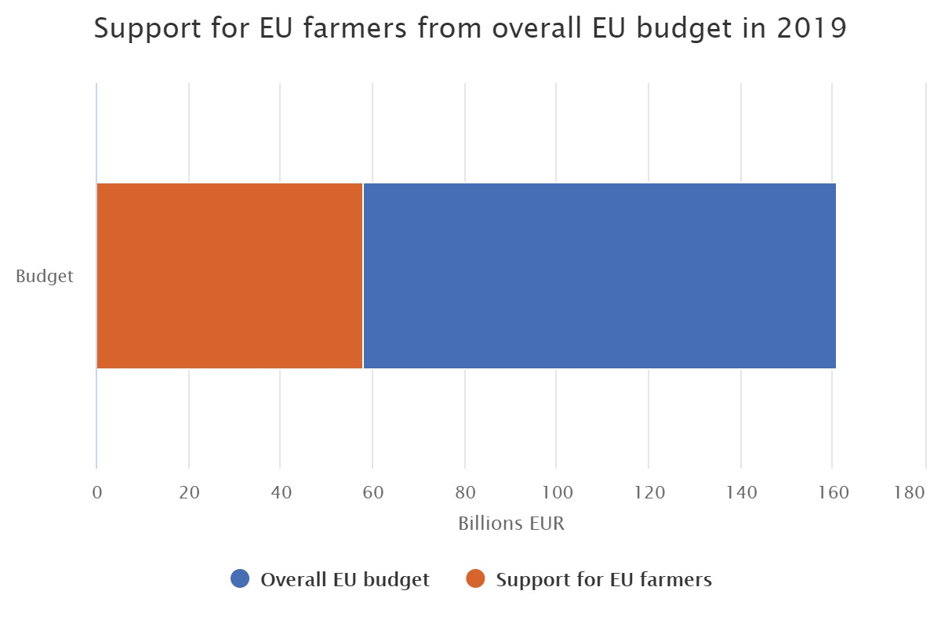
Common agricultural policy (CAP) (I)
Originally launched in 1962
The main goal – development of agriculture
Common agricultural policy is common for all EU member countries, with management and financing in the EU level, from the budget of the EU
  The European agricultural guarantee fund (EAGF)
  The European agricultural fund for rural development (EAFRD)
Source: from European Commission, 2021 [10]

Slide 25
Common agricultural policy (II)
Objectives:
  to ensure fair income for farmers in the EU
  to increase competitiveness
  to counterbalance food chain stages
  to promote limitation of climate change and sustainable management of natural resources
  preservation of rural nature, biodiversity and landscapes of the EU
  to support change of generations
  to protect food and health quality
In Europe, bioeconomy is inter-linked with CAP regarding common goals for food security and rural development
Source: from European Commission, 2021 [10]

Slide 26
European Green Deal
A guide to make the EU economy sustainable
The aim is:
  to promote effective use of resources by the transition to circular economy
  to restore biodiversity and reduce pollution
In the agricultural sector:
  “From Farm to Fork”
  renewed biodiversity strategy
  agriculture of low raw material consumption
  mitigating climate change
  modernization of agriculture
Source: from European Commission, 2021 [11]

Slide 27
From farm to fork (I)
European diets are not in line with national dietary recommendations and an existing food system does not ensure the healthy option as the most accessible one
Movement to provide a sustainable food system
  achieving environmental, health and social benefits with economic gains and more sustainable recovery from crisis
To provide the need to reduce
  dependency on pesticides and antimicrobials, reduce excess fertilization, increase organic farming, improve animal welfare and reverse biodiversity loss
Source: from European Commission, 2020 [12]

Slide 28
From farm to fork (II)
Agriculture accounts for 10.3% of the EU’s GHG emissions (CH₄, N₂O)
Strategy supports the transition to a sustainable food system while improving the incomes of primary producers and reinforcing competitiveness, while offering new opportunities for citizens and food operators alike
A framework for a sustainable food system before the end of 2023
Source: from European Commission, 2020 [12]

Slide 29
Production of main cereals, EU-27
Source: from Eurostat, 2020 [13]

Slide 30
Livestock population, EU-27
Source: from Eurostat, 2020 [14]

Slide 31
OECD and FAO information
Key commodities in 2019:
    cereals ↑
    oilseeds ↓
    sugar ↓
    meat ↓
    dairy ↑
    fish ↓
    biofuels ↑
    cotton ↑
Source: from OECD and FAO, 2020 [15]

Slide 32
Globally
Agriculture is two to four times more effective in raising incomes among the poorest when compared to other sectors
It is also crucial to economic growth:
  in 2018, it accounted for 4 percent of global gross domestic product (GDP)
  in some developing countries, it can account for more than 25% of GDP
However it accounts for
  70% of water use
  a third of food that is lost/wasted
  8.9% of the global population are hungry
Source: from The World Bank, 2020 [16]

Slide 33
Agriculture and environment

Slide 34
Climate impact on agriculture (I)
Agriculture is the main impulse for environmental change, that promotes
  impact created by greenhouse gases
  eutrophication
  water, global phosphorus and nitrogen pollution
  climate change
  air pollution and stratospheric ozone depletion
Agriculture is affected by climate change related disasters in a global scale
Significant agricultural pollution can be observed in areas with large livestock populations and where manure is accumulated

Slide 35
Climate impact on agriculture (II)
Source: from M. J. Adegbeye et al., 2020 [17]

Slide 36
SMART agro-farming practices
Select specific high profitable crops in each group
Manage crops with planning of resources and marketing
Activate crops with care for right quality and price
Reform agricultural cultivation, practices, methods and values
Transform agro-farming culture for wealth creation culture
Source: from Swamy Krishna K. N., 2018 [18]

Slide 37
Agricultural resources
In the context of bioeconomy

Slide 38
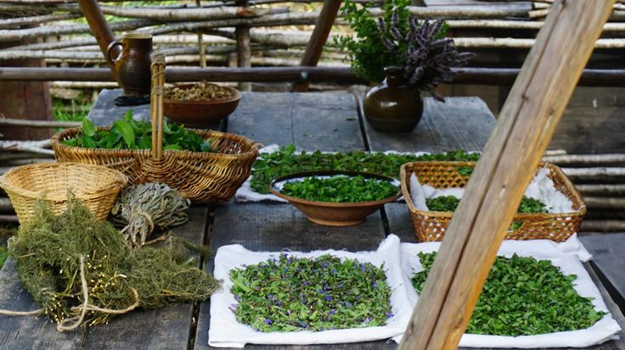
Agricultural resources (bioresources)
Materials of biological origin (plants, animals, microorganisms), that are used to provide human needs (food, products, energy)
They include products, by-products and residues, that are made during extraction, processing or use of a resource
Agricultural resources are:
  crops
  vegetables
  fruits and berries
  crops animal food
  cultivated mushrooms
  livestock (including poultry)
  animal residues
  plant residues
Source: from Institute of Energy Systems and Environment, 2020 [5]

Slide 39
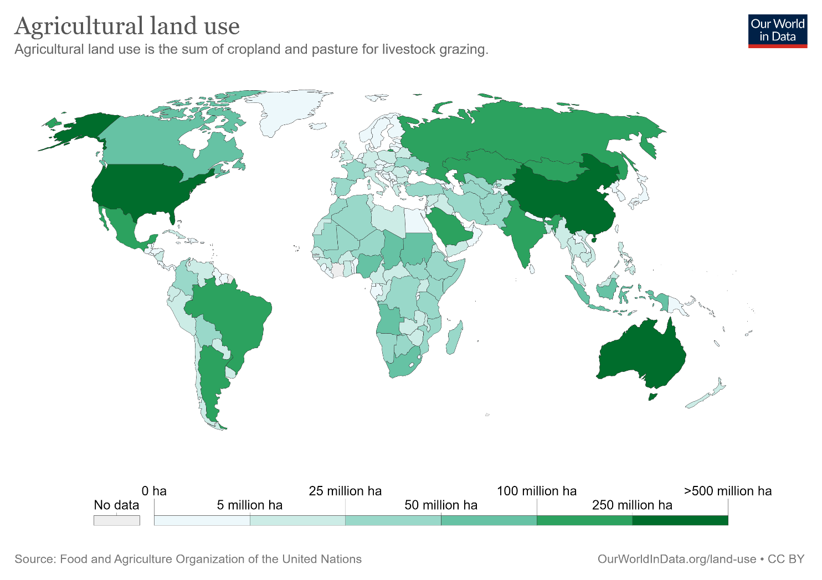
Agricultural land use in the world
Source: from Our World in Data, 2020 [19]

Slide 40
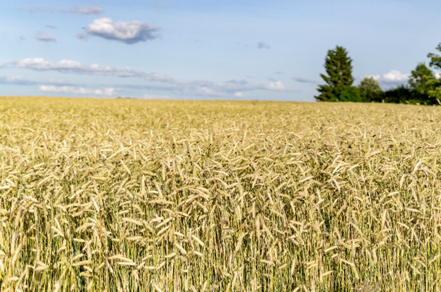
Crops (I)
Plants grown for the manufacturing of food and products
The most commonly grown crops in the world are:
  sugar canes
  corn
  rice, wheat, barley, rye, oats, buckwheat
  root crops (mostly potatoes)
  sorghum
  legumes
  nuts
  oil seed plants - soybeans
Source: from Institute of Energy Systems and Environment, 2020 [5]

Slide 41
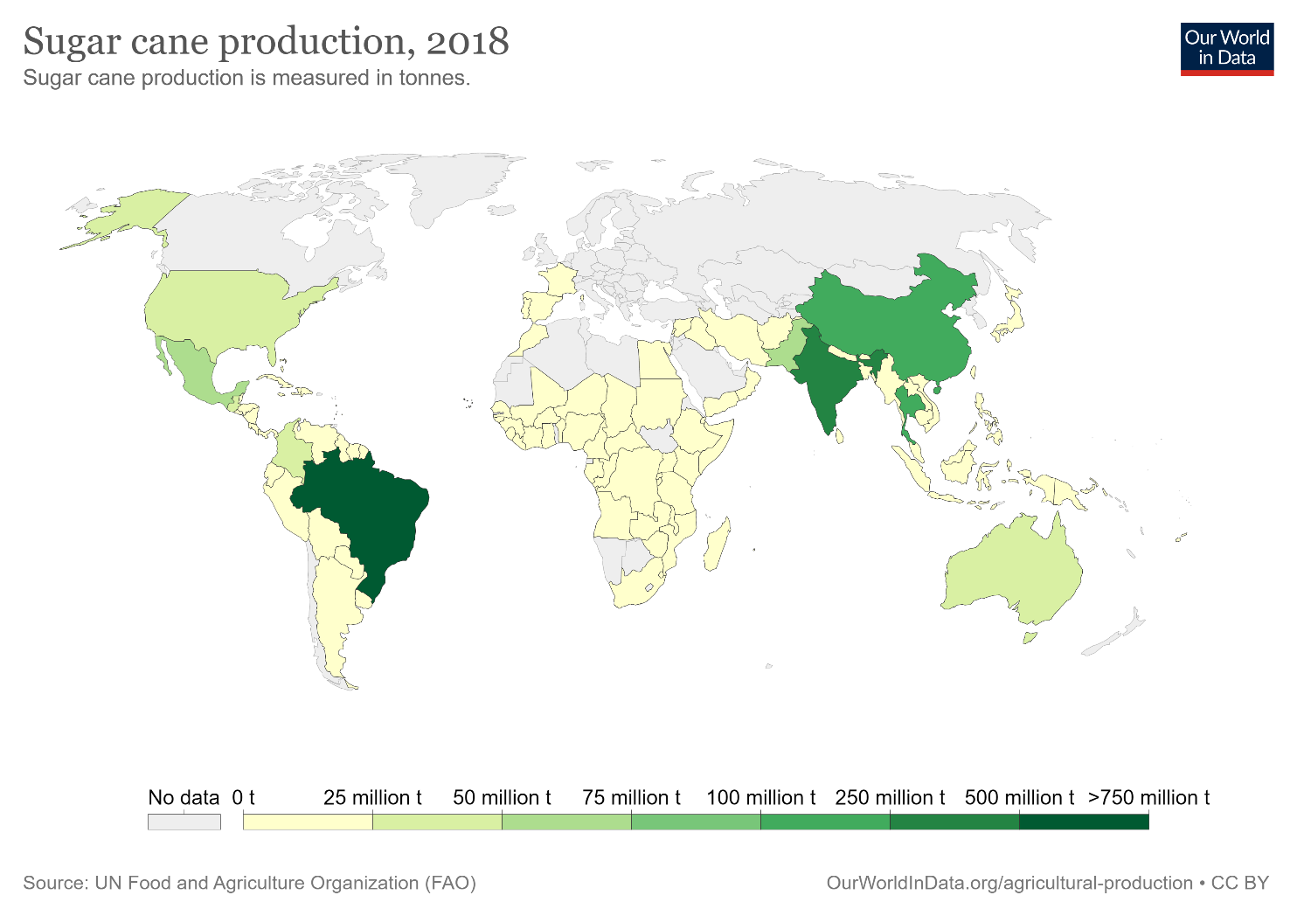
Crops (II)
Source: from Our World in Data, 2020 [19]

Slide 42
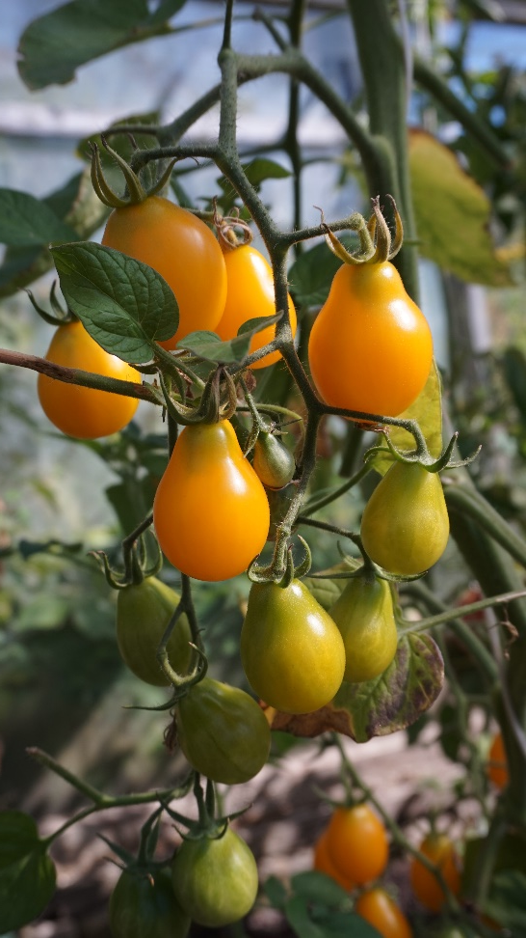
Vegetables
The most commonly grown vegetables in the world are:
  tomatoes
  onions
  cucumbers and gherkins
  cabbages and their types
  eggplants
  carrots and beets
  chili and other peppers
  pumpkins
  salads and chicory
  garlic
Source: from Institute of Energy Systems and Environment, 2020 [5]

Slide 43
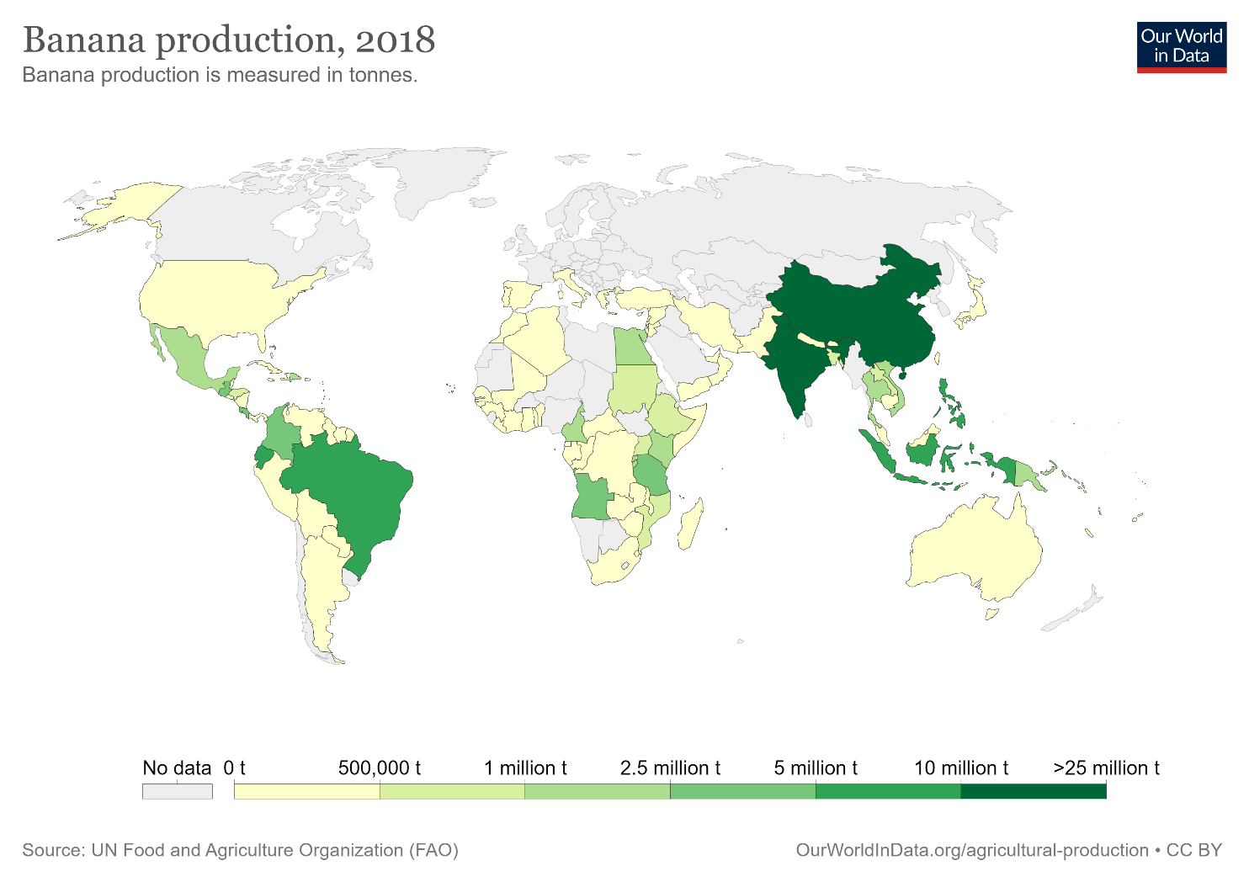
Fruits and berries
The most commonly grown fruits and berries in the world are:
  bananas
  melons
  apples
  grapes
  oranges, tangerines
  mangoes
  pears
  pineapples
  peaches and nectarines
  avocadoes
  blueberries and cranberries
Source: from Our World in Data, 2020 [19]

Slide 44
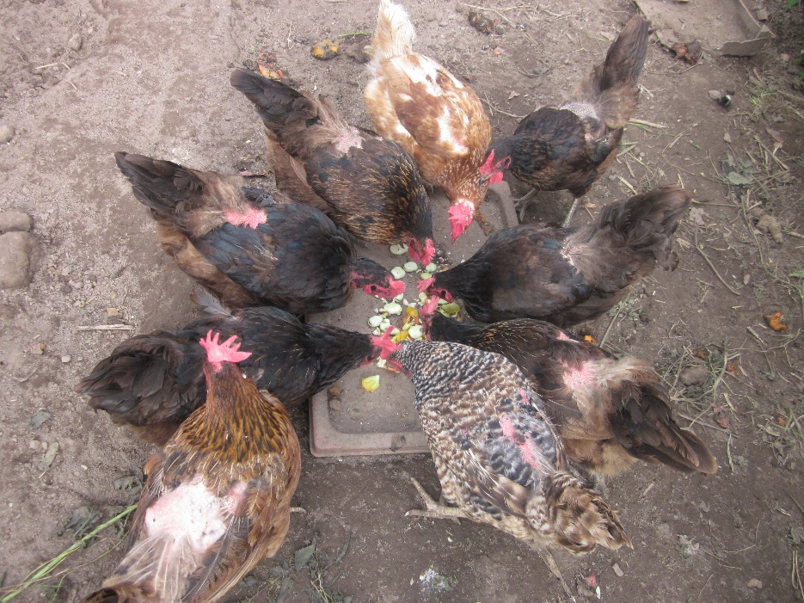
Livestock
Including
  bovine animals
  cows
  pigs
  sheep
  goats
  poultry
  Raw materials for production and consumption of products
Source: from Institute of Energy Systems and Environment, 2020 [5]

Slide 45
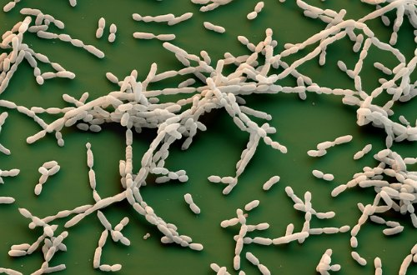
Microorganisms (I)
A potential bioresource in sustainable agriculture and environment preservation
For extraction of biological fertilizer
Fertilizer with microorganisms has characteristics to enhance plant growth, to protect plants from pests and parasites, as well as diseases
Biological herbicides are made using formulations from microorganisms
Source: from Garden Myths, 2015 [20]

Slide 46
Microorganisms (II)
Microorganisms come in a variety of forms and include
  bacteria
  archaea
  most of the protozoa
  as well as algae, fungi and small animals
They can be found in various environments and layers
Microorganisms can also be used to prepare biological pesticides
Source: from Clever composting, 2015 [21]

Slide 47
Agricultural by-products
Grass by-products
  Crop residues that are left on the field after plant extraction from arable land
Wood by-products
  Leftovers from bush, tree, vine and olive maintenance, perennial plants
Potential replacements for petroleum-based materials and chemicals, that will provide sustainable development goals in different sectors
This kind of use of bioresources can cause ecological and ethical problems

Slide 48
The use of agricultural resources
With a focus on residues

Slide 49
The use of agricultural resources
Food production, fuel manufacturing, cosmetics, pharmacy, medicine, industry, energy production
Bioethanol, biofilms production
Manufacturing of ecological materials
Biorefinery
Production of high added value products
Fiber extraction, etc.
Source: from Patsios S., et.al., 2016 [22]

Slide 50
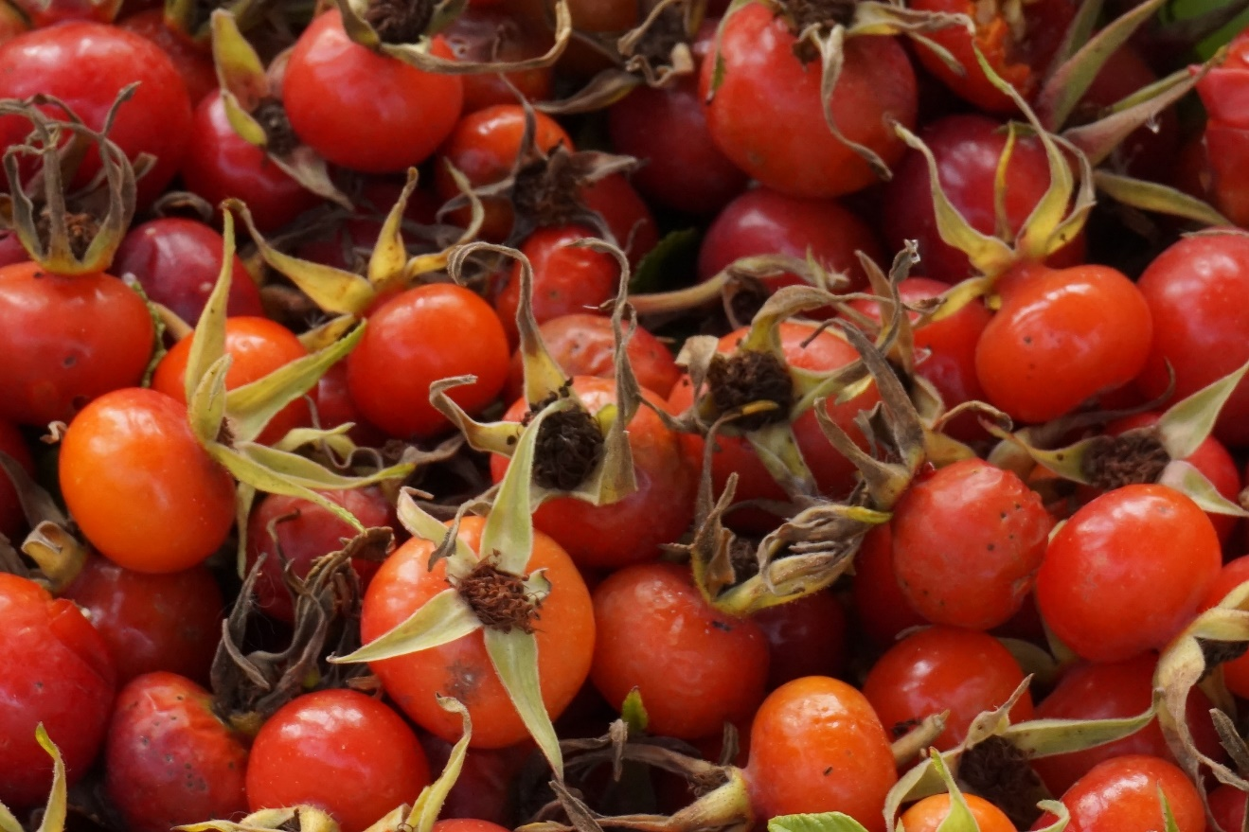
Agricultural residues
A big part of agricultural resources are made up by residues:
  manure
  plant residues, for example, crop straw
  processing residues – barks, peels
  biological waste from households, that can lead to negative consequences due to inadequate utilization
Source: from Institute of Energy Systems and Environment, 2020 [5]

Slide 51

AgroCycle project and benefits from it (I)
The aim of the project is to establish a document that offers options for sustainable residues valorization according to the EU goal to reduce food waste by 50% by 2030, while additionally promoting sustainable development in China
In the framework of the project a study was performed to develop a database of agricultural residues and by-products originated in the EU member countries, where materials are described by:
  energy content
  nutritional value
  mineral content
  concentration of valuable compounds and moisture content
Source: from Patsios S., et.al., 2016 [22]

Slide 52
AgroCycle project and benefits from it (II)
Two quantitatively largest agricultural residues and by-products flows have been studied for each resource, choosing different form flows in different cases, for example, instead of two solid material flows, there is one liquid and one sludge flow
26 most common agricultural products and their residues, by-products in 28 EU countries were studied:
  dairy cows, wheat, potatoes, barley, sugar-beets, corn, grapes, tomatoes, chickens, oats, olives, sunflower seeds, apples, triticale, rye, cattle, oranges, onions, cabbages, tangerines, carrots, cauliflowers, oil seed rape, peaches and rice
Source: from Patsios S., et.al., 2016 [22]

Slide 53
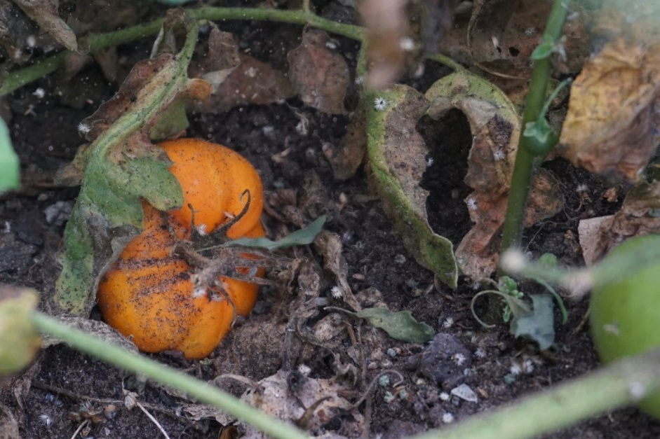
Fruit, berry and vegetable residues (I)
Fruit residues come from cultivation, harvesting, processing activities, insects and animal influence, diseases and climate impact
Approximate rotten fruit amount makes up around 20% from fruit amount for consumption
Vegetable residues also form in the stages of product chains, as well as a result of abundance of vegetables and damages
Fruits for processing can be a raw material for different products depending on selected process and goal
Source: from Institute of Energy Systems and Environment, 2020 [5]

Slide 54
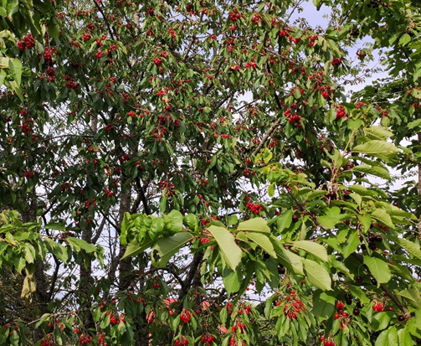
Fruit, berry and vegetable residues (II)
Use is dependent on the origin of the resource
Examples of use:
  source of chemicals, food in anaerobic treatment, bio coal production, electricity generation, water treatment, substrates in fermentation processes, bioethanol production, sound absorbing panels, pigment extraction, vermicomposting, fuels, nutrient source, in synthesis of nanoparticles, etc.
Source: from Institute of Energy Systems and Environment, 2020 [5]

Slide 55
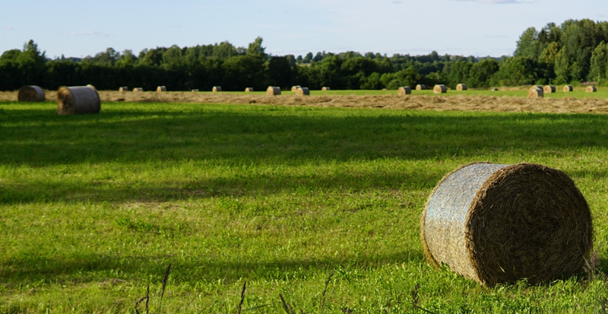
Crop residues
The most significant effects on crops are caused by animals and harvesting activities, which account for the majority of residues – straw, stalks, brans, barks and cob sheaths
Examples of residues use: energy production, construction, absorption materials, production of polymers, biodiesel production, animal food, litter, composting, mulch production, pulp and paper production, fuels, anaerobic fermentation, thermal insulation, cosmetic and pharmaceutical products, lubricants, textile, biofilms, etc.
Source: from Institute of Energy Systems and Environment, 2020 [5]

Slide 56
Cultivated mushrooms
Mushrooms are low in fat, they contain protein, fiber, vitamins and minerals
New uses of the resource are related to the use of biologically active compounds in medicine (phenolic compounds, steroids, etc.)
Mushrooms are a potential raw material for high quality flavorings, natural colorants and functional food, dietary supplements and pharmaceutical ingredients
Source: from Smolskait L., et.al., 2015 [23]

Slide 57
Livestock
Source: from Alao B.O., et.al., 2017 [24]

Slide 58
What to expect in agriculture?
According to OECD and FAO predictions for 2029 decline in demand of products is expected without significant changes in products consumption per capita on a global scale
Achance to provide a more efficient production of resources without significant changes on prices
COVID-19 consequences are with a significant impact on:
  consumption, production, prices, import and export
  changes are expected in consumer’s behavior, plant and animal diseases distribution, mutual agreement terms in the market between countries
In international range agricultural resources are and will be used for food (52%), animal food (31%), fuels, etc.
Source: from OECD and FAO, 2020 [15]

Slide 59
Examples
Use of agricultural resources, innovations in agriculture

Slide 60
Agro-food and bioeconomy policy in the EU
According to a study by Muscat A., et.al. coherence serves as the promotion of synergies across policy areas and domains
Bioeconomy vs agro-food
Key sources of uncertainty for food systems in the future: land use, soil degradation
Waste and residue use with synergies at a local scale
Uncertainty of biomass cascading – what is the highest utility?
The EU has clear guidelines for the uses of waste biomass, but no clear guidelines for biomass in general
Source: from Muscat A., et.al., 2020 [25]

Slide 61
The European agricultural supply model AROPAj
A study by Ben Fradj, N., et.al. offers a technical-economic optimization tool of the European agricultural supply, describing numerous farming activities (from crop production to animal husbandry)
Individual farmers in farm groups according to class, size and orientation
Study of interactions between the environment and agricultural activities, policies and perennial energy crops
Linked with STICS crop model to take into account soil characteristics, agricultural practices and nitrogen uptake of crops
Spatial outcomes at geographical scale
Source: from Ben Fradj, N., et.al., 2020 [26]

Slide 62
Farm-oriented models for assessing CAP impact and biomass supply
Bottom up models to replicate farmers’ decisions and assess policy impacts
Mathematical programming (MP) models for farm-level evaluation of farmers’ choices, following a policy change
MP models for biomass processing, bioenergy production, policy shift impacts on bioenergy at farm levels
MP models for crop and animal activities, several farm types, CAP measures at regional or country level
Source: from Ben Fradj, N., et.al., 2020 [26]

Slide 63
Agricultural biomass value chain and its share in consumption
Source: from Kircher M., 2021 [27]

Slide 64
Bioeconomy strategies in countries (I)
Increasing policy development around the bioeconomy in recent years:
  Focusing on regional and national priorities
  49 countries have strategies related to bioeconomy development
  Sustainable agro-food systems have to meet the challenge of producing growing quantities of biomass, while reducing the negative impact on the environment
  While the agriculture and food sectors are included in almost all bio-economy strategies, the emphasis and the way they are covered differ
Source: from Diakosavvas, D. and C. Frezal, 2019 [28]

Slide 65
Bioeconomy strategies in countries (II)
Focus on agriculture | Focus on the food industry | Focus on the whole food system
Australia | Australia | European Union
European Union | European Union | Germany
Estonia | Finland | Ireland
France | France | Italy
Germany | Germany | Norway
Italy | Italy | Spain
Japan | Netherland | United Kingdom
Latvia | New Zealand
Lithuania | Norway
Norway | Spain
Spain | United States
Sweden
United States
South Africa
Source: from Diakosavvas, D. and C. Frezal, 2019 [28]

Slide 66
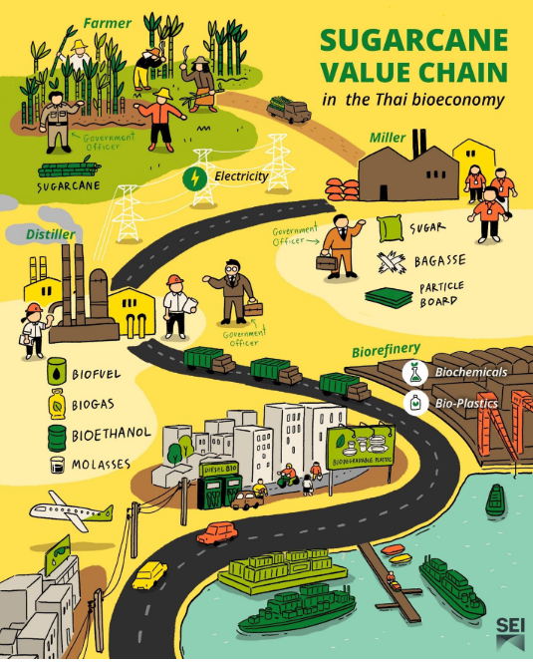
Bioeconomy in Thailand
National development is aimed to overcome the middle-income trap while reducing social inequality and harmful environmental impacts
Main crops for development: cassava and sugarcane to mostly produce bioplastics, biofuels, biochemicals
Source: from Aung, M. T, 2021 [29]

Slide 67
Bioeconomy in Germany
Szarka N., et.al. offers an insight into the bioeconomy development in Germany
Bioeconomy Council, German Research Strategy of Bioeconomy in 2010, National Policy Strategy on Bioeconomy in 2013, A new comprehensive bioeconomy strategy in 2020
A 6% share of the gross value added and a 12% share of the employment in the national economy in 2010
About 47% of the entire land is used for agriculture
Main crops are cereals, followed by roots and oil crops, others include: pulses, fruit, vegetables and industrial crops
Different agricultural resources are greens harvested from plants and permanent grasslands
Source: from Szarka N. et.al., 2021 [30]

Slide 68
Use of blueberry waste
Source: from Liu H. et.al., 2021 [31]
Notes:
Blueberry crop residues for value-added products (polyphenols, antioxidants, biofuels, bioproducts, adsorbents, functional food, compost);
Pomace, leaves, branches, broken blueberries debris created during crop production and harvesting;
Additives for food packaging (films);
Most used conversion processes: hydrolysis, anaerobic digestion, gasification, pyrolysis, hydrothermal liquefaction;
Recycling of blueberry waste could decrease contamination and generate overall revenues.

Slide 69
Use of food waste
Source: from Pleissner D.et.al., 2016 [32]

Slide 70
List of references (I)
National Material Company, Galvanized Steel in The Agricultural Industry, 2021, Online: http://www.nationalmaterial.com/galvanized-steel-in-the-agricultural-industry/
Geography Revision, Different Types of Agricultural Activity, 2021, Online: https://geography-revision.co.uk/gcse/agriculture/types-of-agricultural-activity/
Ferguson College of Agriculture, 2021, Online: https://agriculture.okstate.edu/departments-programs/agecon/index.html?Forwarded=agecon.okstate.edu/isct/labranza/walters/conservation.doc
Rural Support Service of Republic of Latvia, Guidelines for fallows and terms for receiving support, Ministry of Agriculture of the Republic of Latvia, 2016
Institute of Energy Systems and Environment, Photograph archive, Riga Technical University, 2020
Syuaib M.F., Sustainable agriculture in Indonesia: Facts and challenges to keep growing in harmony with environment, Agricultural Engineering International, June 2016
U.S. Department of agriculture, Mixed Crop-Livestock Systems: Changing the Landscape of Organic Farming in the Palouse Region, 2015, Online: https://www.usda.gov/media/blog/2015/09/02/mixed-crop-livestock-systems-changing-landscape-organic-farming-palouse
FAO, Agroecology Knowledge Hub, 2021, Online: http://www.fao.org/agroecology/en/
Barros M., et.al., Mapping of research lines on circular economy practices in agriculture: From waste to energy, Renewable and Sustainable Energy Reviews, August 2019, 2020
European Commission, The common agricultural policy at a glance, last update 25 June 2021, Online: https://ec.europa.eu/info/food-farming-fisheries/key-policies/common-agricultural-policy/cap-glance_en#thecapinpractice
European Commission, European Green Deal, last update 16 July 2021, Online: https://ec.europa.eu/info/strategy/priorities-2019-2024/european-green-deal_en
Notes:
Not in the video

Slide 71
List of references (II)
European Commission, Farm to Fork strategy, DG SANTE/Unit ‘Food information and composition, food waste‘, 2020
Eurostat, Agricultural production – crops, November 2020, Online: https://ec.europa.eu/eurostat/statistics-explained/index.php?title=Agricultural_production_-_crops
Eurostat, Agricultural production – livestock and meat, November 2020, Online: https://ec.europa.eu/eurostat/statistics-explained/index.php?title=Agricultural_production_-_livestock_and_meat&oldid=427096
OECD and FAO, OECD-FAO Agricultural Outlook 2020-2029, 2020
The World Bank, Agriculture and food overview, last updated September 30 , 2020, Online: https://www.worldbank.org/en/topic/agriculture/overview#1
M. J. Adegbeye et al., “Sustainable agriculture options for production, greenhouse gasses and pollution alleviation, and nutrient recycling in emerging and transitional nations - An overview,” J. Clean. Prod., vol. 242, p. 118319, 2020, doi: 10.1016/j.jclepro.2019.118319.
Swamy Krishna K. N., Agro Farming Skills + Agro Farming Culture = 300 % Growth >A Power Packed GDP Growth is Just Possible, April 23, 2018, Online: https://www.linkedin.com/pulse/100-organic-agro-farming-can-make-farmers-super-rich-k-n-krishna
Our World in Data, Agricultural database, March 2020, Accessed: July 2021, Available: https://ourworldindata.org/agricultural-production
Garden Myths, 2015, Available: https://www.gardenmyths.com/compost-microbes-good-soil/
Clever composting, 2015, Available: http://clevercomposting.com/nitrogen-carbon-compost/compost-microorganisms/
Patsios S., et.al., Characterisation of agricultural waste co- and by-products, Agrocycle – EU Horizon 2020, 2016

Slide 72
List of references (III)
L. Smolskait, P. R. Venskutonis, and T. Talou, “Comprehensive evaluation of antioxidant and antimicrobial properties of different mushroom species,” LWT - Food Sci. Technol., vol. 60, no. 1, pp. 462–471, 2015, doi: 10.1016/j.lwt.2014.08.007.
B. O. Alao, A. B. Falowo, A. Chulayo, and V. Muchenje, “The potential of animal by-products in food systems: Production, prospects and challenges,” Sustain., vol. 9, no. 7, pp. 1–18, 2017, doi: 10.3390/su9071089.
Muscat, A., de Olde, E. M., Kovacic, Z., de Boer, I. J.M., Ripoll-Bosch, R., Food, energy or biomaterials? Policy coherence across agro-food and bioeconomy policy domains in the EU, Environmental Science and Policy, July 2020, pp. 21-30
Ben Fradj, Nosra, Jayet, Pierre Alain, Rozakis, Stelios, Georganta, Eleni, Jędrejek, Anna, Contribution of agricultural systems to the bioeconomy in Poland: Integration of willow in the context of a stylized CAP diversification, Land Use Policy, Volume 99, May 2020.
Kircher, Manfred, Bioeconomy – present status and future needs of industrial value chains, New Biotechnology, Volume 60, 2021
Diakosavvas, D. and C. Frezal (2019-09-12), “Bio-economy and the sustainability of the agriculture and food system: Opportunities and policy challenges”, OECD Food, Agriculture and Fisheries Papers, No. 136, OECD Publishing, Paris. http://dx.doi.org/10.1787/d0ad045d-en
Aung, M. T., Bioeconomy in Thailand at a glance, Stockholm Environment Institute, January 2021
Szarka N., et.al., Biomass flow in bioeconomy: Overview for Germany, Volume 150, Issue: June 2020, 2021
Liu H., et. al., Sustainable blueberry waste recycling towards biorefinery strategy and circular bioeconomy: A review, Bioresource Technology, Volume 332, Issue April, 2021
Pleissner D., et.al., Valorization of organic residues for the production of added value chemicals: A contribution to the bio-based economy, Biochemical Engineering Journal, Volume 116, 2016

Slide 73
Synopsis
This lecture gives an insight into the use of the main bioeconomy aspects in the agro-farming sector regarding existing agricultural types
Agro-farming is viewed as a system regarding different agriculture types and uses of resources and residues to obtain value-added products
Several examples of resources and residues uses are given in the lecture
Examples offered in the final section of the lecture include the bioeconomy development in different countries regarding agricultural sector and the use of specific resources

Slide 74
Further reading
OECD-FAO Agricultural Outlook 2020-2029
  The Outlook provides information on the existing system in the agricultural sector with a focus on food demand, consumption with predictions for future tendencies of these indicators. Possible impacts of COVID-19 are considered in predictions
Diakosavvas, D. and C. Frezal (2019-09-12), “Bio-economy and the sustainability of the agriculture and food system: Opportunities and policy challenges”, OECD Food, Agriculture and Fisheries Papers, No. 136, OECD Publishing, Paris. http://dx.doi.org/10.1787/d0ad045d-en
  The publication offers an insight on bioeconomy status at the global level, with summaries on existing policies and strategies regarding bioeconomy and a short description of what is included in them
Patsios S., et.al., Characterisation of agricultural waste co- and by-products, Agrocycle – EU Horizon 2020, 2016
  This is a summary of the study regarding by-products and co-products and their possible uses for 28 popular products in the EU. Most of the offered uses are residues that are transformed to high added-value products

Slide 75

Presenters’ bio
Vivita Priedniece
  researcher and PhD student
  lecturer
  senior laboratory assistant
Institute of Energy Systems and Environment, Riga Technical university
Main research topics:
  value-added use of agricultural and forestry residues
  flue gas treatment technologies
  testing of solid resources, mostly biofuels

Slide 76
Thank you!
Vivita Priedniece
Researcher
Riga Technical University
Institute of Energy Systems and Environment
Āzenes street 12/1
LV-1048,
Riga, Latvia
E-mail: vivita.predniece@rtu.lv
www.rtu.lv
www.videszinatne.rtu.lv

