Slide 1


Sustainable use of bioresources.
A case of aquaculture
Module 2: Bioeconomy, agrobiodiversity, biomass use, strategies and resources for sustainable rural development
Unit 2: Sustainability of bioeconomy and agrobiodiversity
Riga Technical University: M.sc.ing. Zane Indzere, researcher

Slide 2
Aim and objectives
The aim is to understand the sustainable use of primary bioresources through examples, focusing on the example of aquaculture
The objectives are to:
  learn about different types of bioresources
  understand the importance of aquaculture in the fisheries sector
  learn about different types of aquaculture

Slide 3
Learning outcomes
Define the bioeconomy sustainable aspects (i.e. technological, environmental and social aspects) and environmental well-being
Describe and apply the concept of bioeconomy and sustainability based on different models, perspectives, and definitions
Identify the main pros and cons of the application of sustainable bioeconomy solutions within existing case studies

Slide 4
Keywords
Sustainability – «meeting the needs of the present without compromising the ability of future generations to meet their own needs» [1]
Primary bioresources – «generated for a specific application-oriented purpose in forestry, agriculture and aquaculture to enable the production of food, substantial products, or eventually energy» [2]
Aquaculture – «the farming of aquatic organisms including fish, molluscs, crustaceans and aquatic plants» [3]

Slide 5
Content
Sustainable production of primary bioresources, including forestry, agriculture and fisheries sectors
More detailed example of fisheries sector, with focus on aquaculture:
  Sustainable aquaculture
  Different types of aquaculture
  Technological and environmental aspects
  Examples

Slide 6
Sustainable production of primary bioresources

Slide 7
Primary production of bioresources
Primary bioresources
Forestry
Agriculture
Fisheries
Photos prom Pixabay

Slide 8
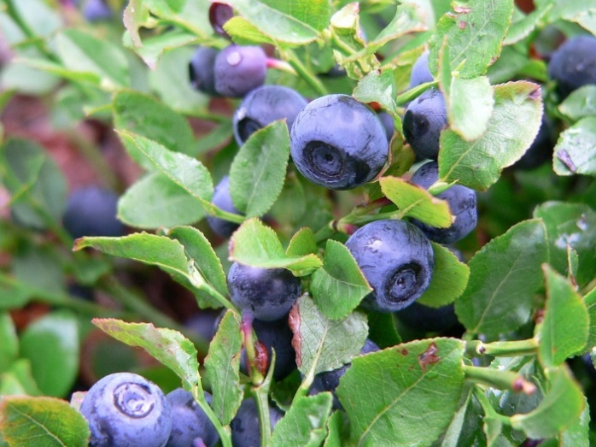
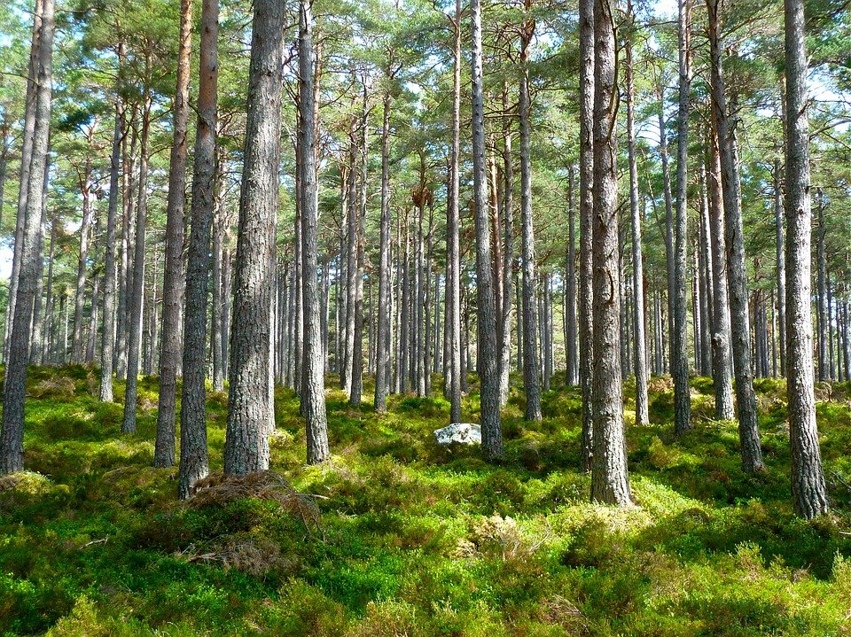
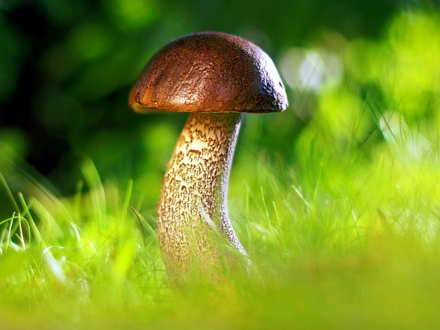
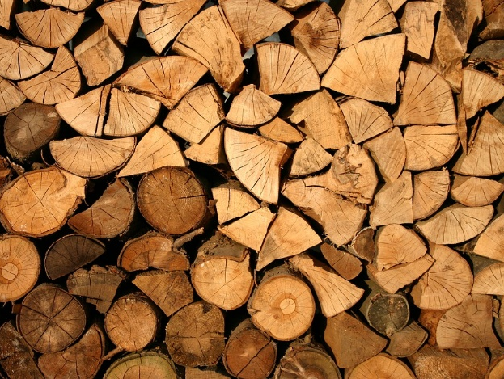
Sustainable forestry
Photos from Pixabay

Slide 9
Progress towards to sustainable forest management (SDG 15.2.1)
Food and Agriculture Organization of the United Nations (FAO) has recognized five sub-indicators for sustainable forest management [4]:
forest area annual net change rate
above-ground biomass stock in forest
proportion of forest area located within legally established protected areas
proportion of forest area under a long-term forest management plan
forest area under an independently verified forest management certification scheme

Slide 10
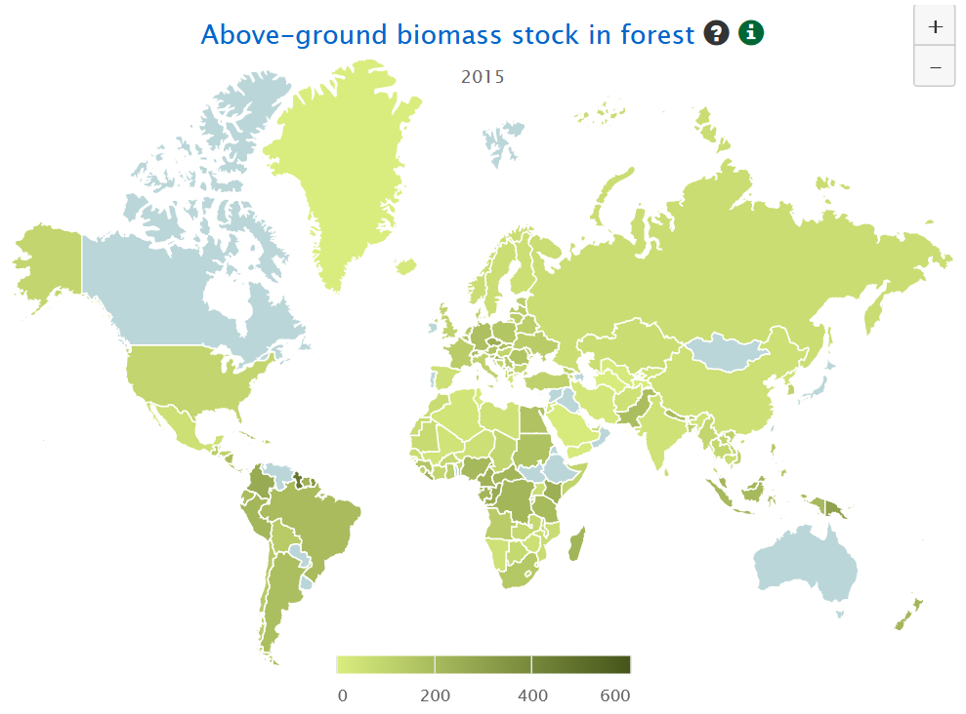
Sub-indicator – above-ground biomass stock in forest
To measure sustainable forest management, an indicator showing biomass stock per hectare is used
If in the longer period of time indicator would increase, then forest management would move towards sustainability
Above-ground biomass stock in forest [2]

Slide 11
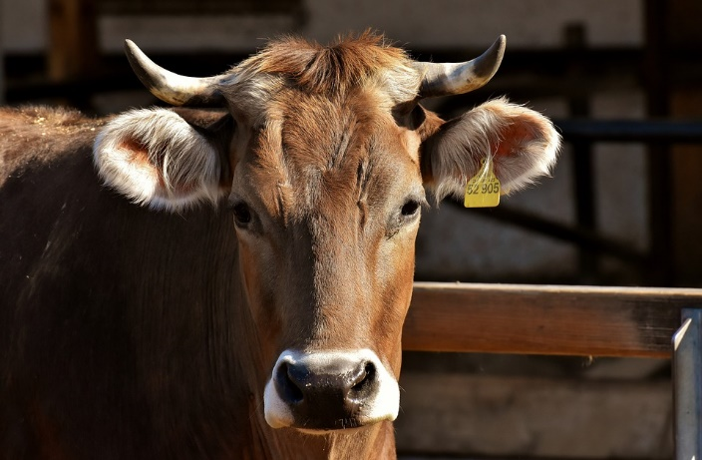
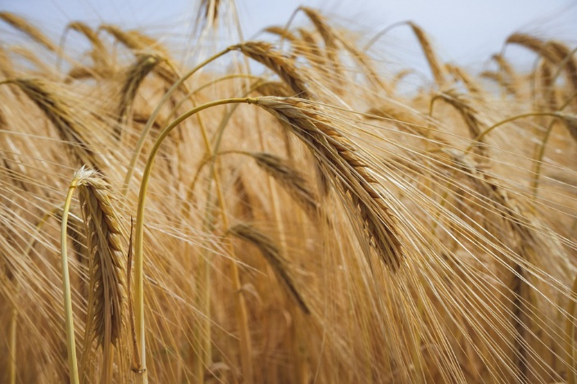
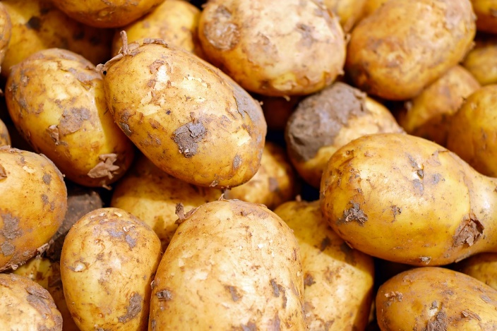
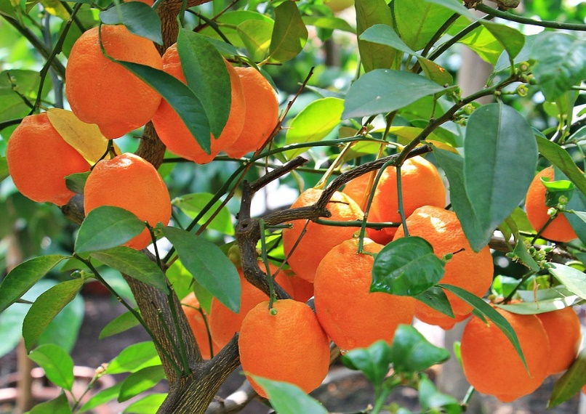
Sustainable agriculture
Photos from Pixabay

Slide 12
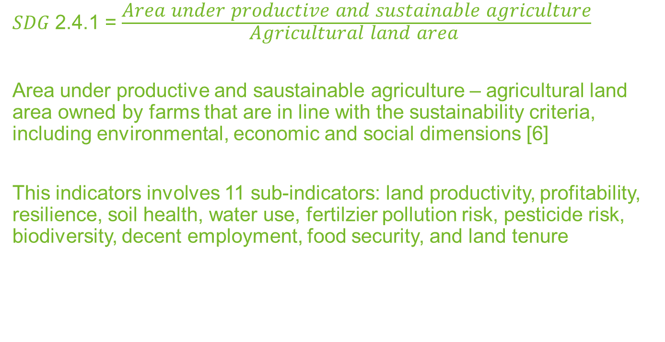
Proportion of agricultural area under productive and sustainable agriculture (SDG 2.4.1.)
𝑆𝐷𝐺 2.4.1 = $\frac{\text{Area} \text{under} \text{productive} \text{and} \text{sustainable} \text{agriculture}}{\text{Agricultural} \text{land} \text{area} }$
Area under productive and saustainable agriculture – agricultural land area owned by farms that are in line with the sustainability criteria, including environmental, economic and social dimensions [6]
This indicators involves 11 sub-indicators: land productivity, profitability, resilience, soil health, water use, fertilzier pollution risk, pesticide risk, biodiversity, decent employment, food security, and land tenure

Slide 13
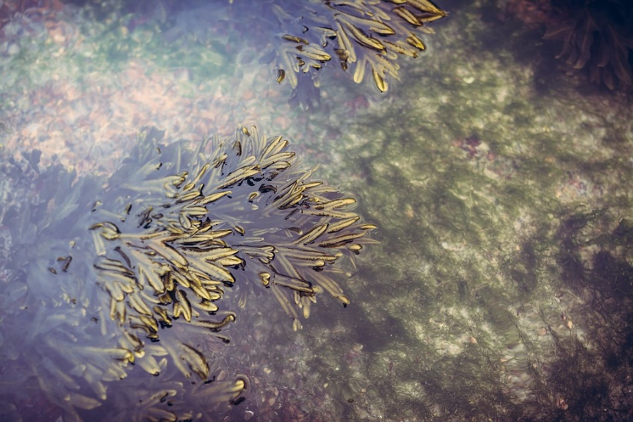
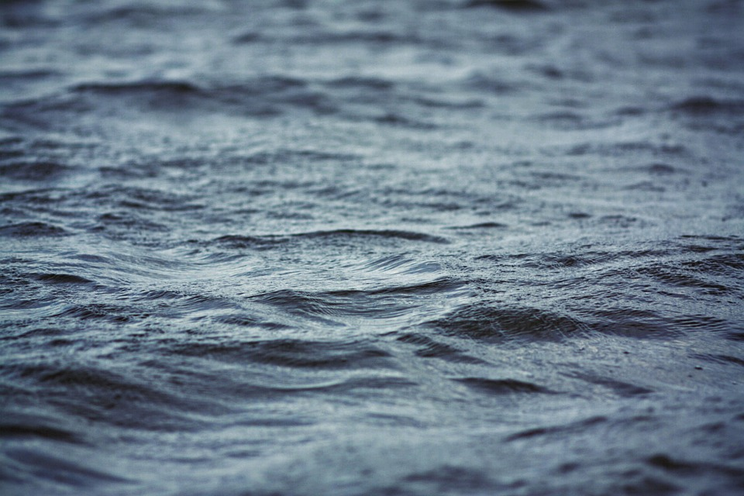
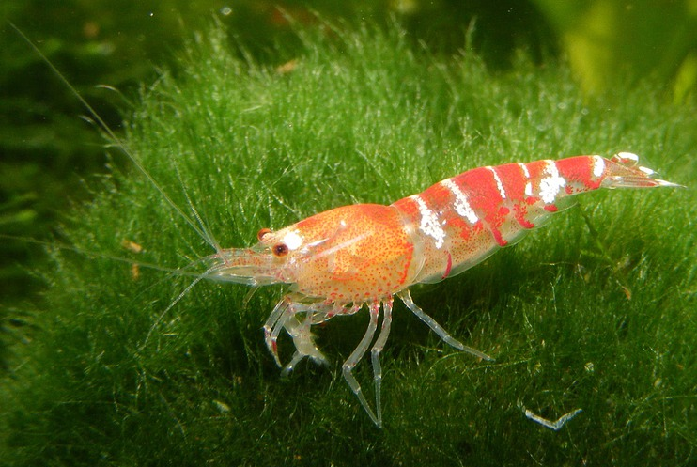
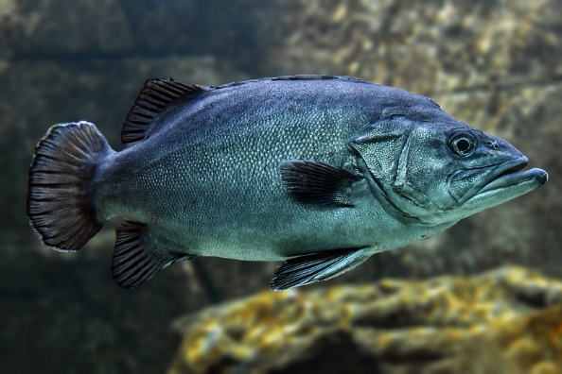
Sustainable fisheries
Photos from Pixabay

Slide 14
Conserve and sustainably use the oceans, seas and marine resources for sustainable development (SDG 14)
SDG 14 includes seven sub-indicators [7]:
coastal eutrophication, and plastic debris density;
number of countries using ecosystem-based approaches to managing marine areas;
marine acidity (pH);
fish stocks within biologically sustainable levels;
protected areas in relation to marine areas;
international instruments aiming to combat illegal, unreported and unregulated fishing;
sustainable fisheries as a proportion of GDP in small island developing States, least developed countries and all countries

Slide 15
Definition of sustainable fisheries
«The U.N. Food and Agriculture Organization defines sustainable fisheries as resources that can be harvested to meet the needs of today’s generation without compromising the ability of future generations to harvest fish for their needs. A sustainable fishery requires the conservation of fish stocks and the preservation of the marine environment but still allows the fishing industry to remain economically viable and fishing communities to maintain their social and cultural heritage.» [5]

Slide 16
Global trends of marine fish stocks
Sustainably managed fish stock [6]

Slide 17
Endangered species – Atlantic cod
Environmental organisation «Greenpeace» has listed 22 marine species which should not be fished in any amount due to overfishing [10]
Atlantic cod (Gadus morhua) lives along the on both sides of the North Atlantic Ocean. Overfishing has led to cod being overfished in U.S. waters and depleted in Canadian waters. In Europe cod population is in unhealthy condition [10]

Slide 18
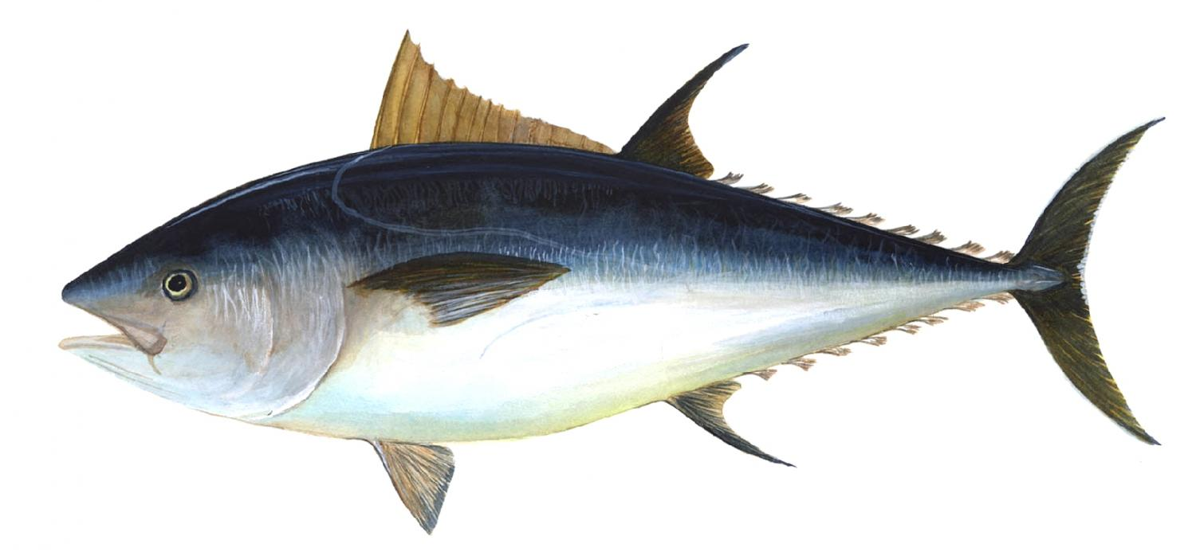
Endangered species – Bluefin tuna
Bluefin tuna (Thunnus thynnus) is the largest species of tuna
High demand product
Lives in the Atlantic ocean, Pacifin ocean, is severely depleted and yet still being overfished [10]
The Atlantic population has declined rapidly in the last decades, however the North Atlantic tuna population is approaching commercial extinction [10]
Bluefin tuna [11]

Slide 19
Southern Bluefin tuna population change
Southern Bluefin tuna population change over the years [12]

Slide 20
What is aquaculture?
OECD (Organisation for Economic Co-operation and Development) defines aquaculture as: «Aquaculture is the farming of aquatic organisms including fish, molluscs, crustaceans and aquatic plants. Farming implies some sort of intervention in the rearing process to enhance production, such as regular stocking, feeding, protection from predators and so forth. It also implies individual or corporate ownership of the stock being cultivated.» [13]
Aquaculture is also used not only to take of burden from capture fisheries, but also to restore habitat of populations who are endangered [14]

Slide 21
Why do we need this transition?
The amount of fish is limited; uncontrolled fishing could lead to overfishing of fish stocks
To have access to bioresources that are grown in a sustainable way
Marine bioresources has great potential, by developing aquaculture it would allow to better understand marine bioresources and their potential
To lessen enlarged problems faced by humans around the world – food security, increasing population etc.

Slide 22
CURRENT TRENDS IN AQUACULTURE

Slide 23
Aquaculture in the world and Europe
Capture fisheries
Current development trends in aquaculture in the world and Europe [15]

Slide 24
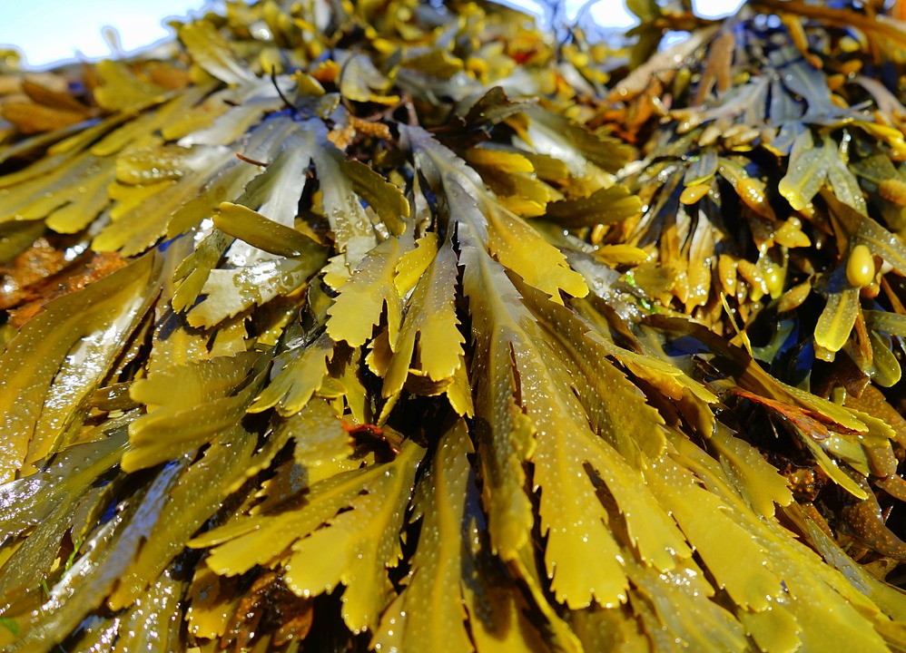
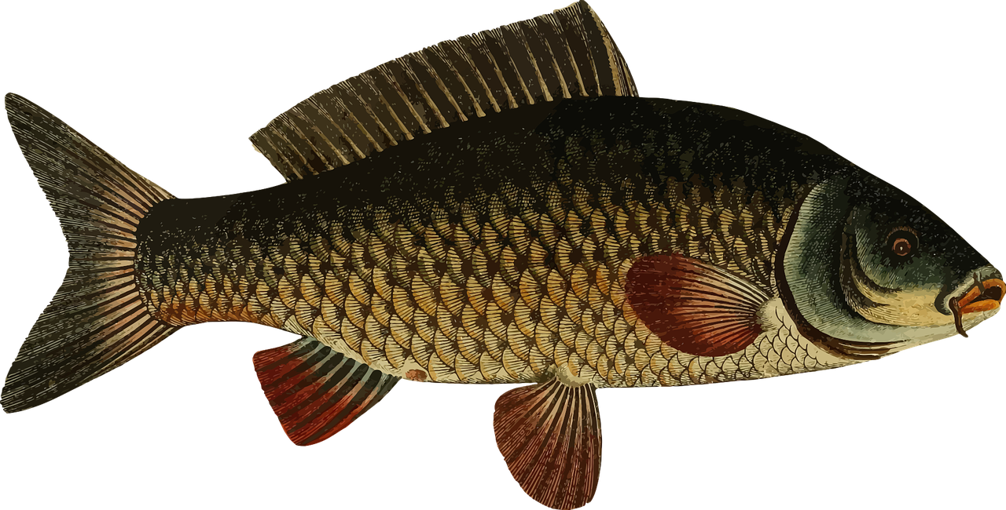
The most farmed species in aquaculture in the world [16]
Seaweed
Carp
Photos from Pixabay
24

Slide 25
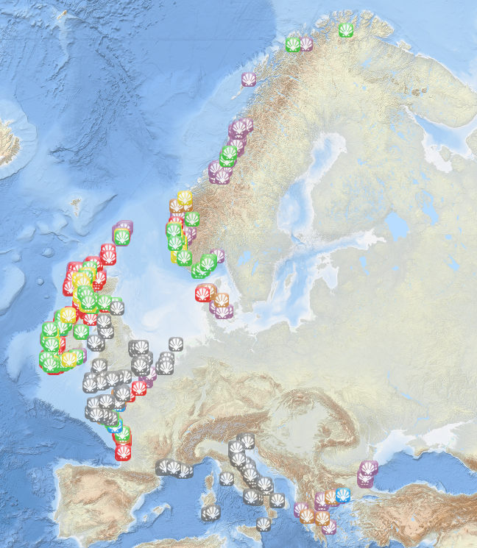
The most farmed species in aquaculture in Europe
In Europe, the most farmed species in aquaculture is molluscs and crustaceans – 46 %, salmonids – 30 %, marine fish – 16 %, freshwater fish – 8 % (2017 data) [17]
Shellfish aquaculture in Europe – European Atlas of the Seas [18]

Slide 26
Types of aquaculture

Slide 27
Why different types of aquaculture is needed?
Different types of aquaculture depends on the animal or plant that needs to be farmed:
  Seaweeds – floating/suspended culture, onshore pond and tank
  Molluscs (clams, oysters, mussels, scallops, cockles) – pole, rack, raft, long-line systems)
  Crustaceans (shrimps, crab, lobster) – pond and tank
Aquaculture systems varies on the replacement (on the land or sea), with or without circulation systems (ponds and tanks), intensity, salinity level etc.

Slide 28
Types of aquaculture
There are four different types of aquaculture:
  Mariculture
  Recirculating aquaculture system
  Ponds
  Aquaponics

Slide 29
Mariculture (I)
Open system aquaculture
Environment: natural environmental conditions, brackish water
Equipment: cages (for fish) or poles (for seaweed, clams)
Disadvantages: external factors (temperature, salinity change etc.), predators
On-land aquaculture vs mariculture [15]

Slide 30
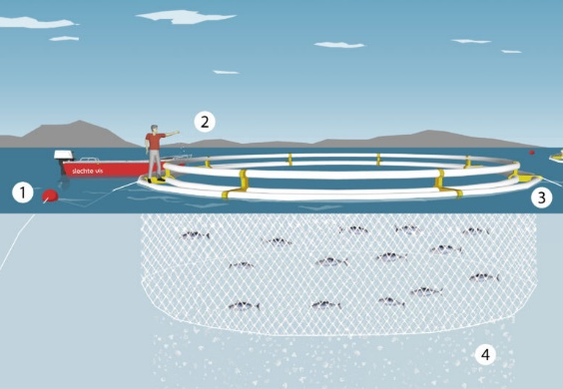
Important components in mariculture
1 – the cage is secured with the ocean floor
2 – fish feeding
3 – buoyant tubes
4 – fish waste
Mariculture [19]

Slide 31
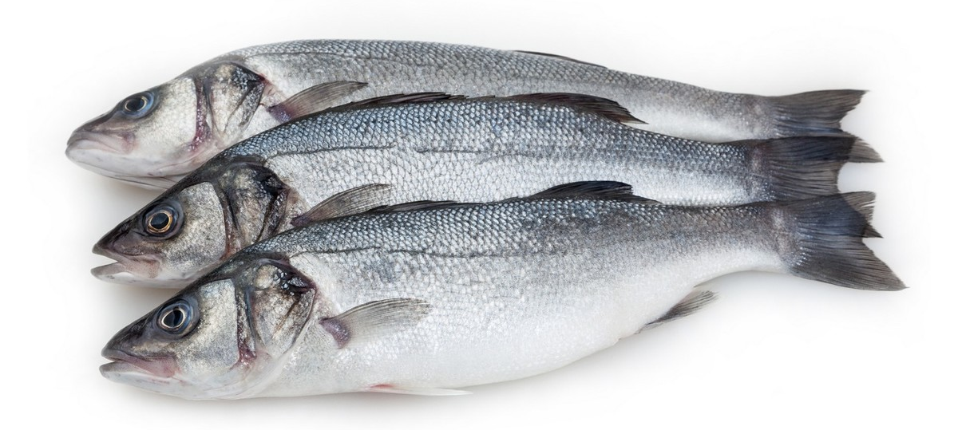
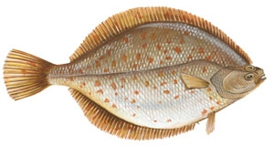
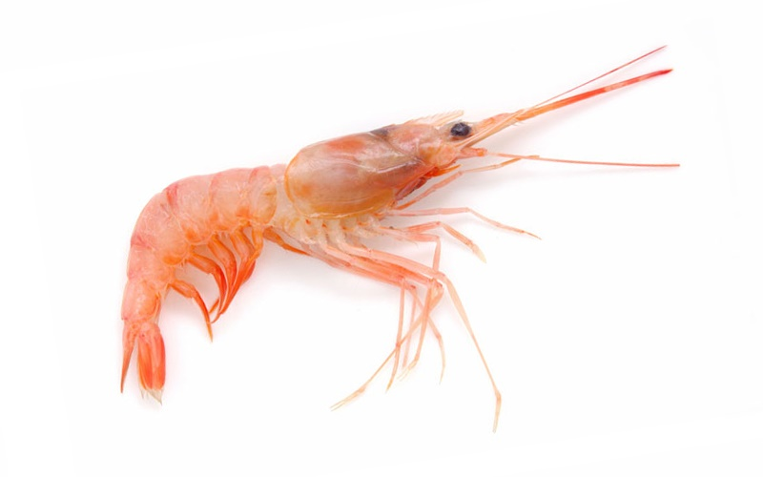
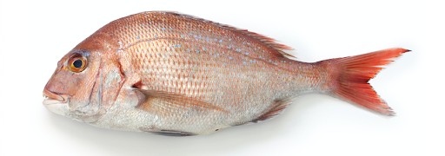
Mariculture (II)
The most popular grown species are sea bass, red sea bream, yellowtail flounder, rabbitfish, sea shrimp, algae and molluscs [20]
Sea bass¹
Yellowtail flounder³
Red sea bream²
Sea shrimp⁴

Slide 32
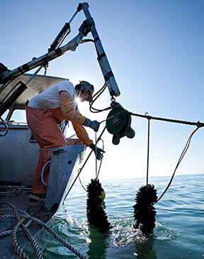
«Santa Barbara Mariculture»
Type: open ocean aquaculture
Shellfish are grown within 80 feet (app. 24 m) deep in the ocean
Equipment: ropes
Shellfish in the open ocean aquaculture [21]

Slide 33
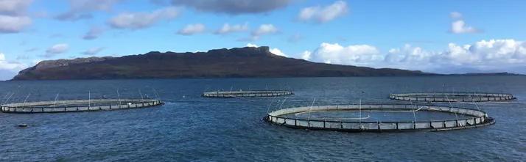
«Mowi»
One of the largest salmon farming company in the world. Branches placed in England, Belgium, Netherlands, Poland, Norway, Finland [22]
Salmon farming in mariculture [22]

Slide 34
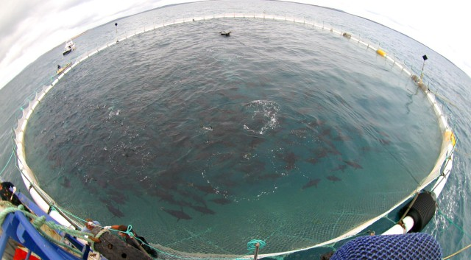
Southern Bluefin tuna mariculture
Bluefin tuna farming in Australia [23]

Slide 35
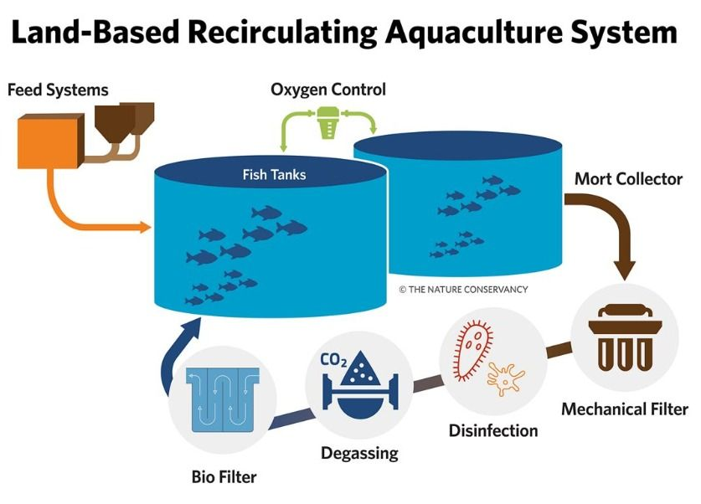
Recirculating aquaculture system (I)
Recirculating aquaculture system (RAS) is on land aquatic animal/plant farming
The system is closed where water is being circulated and the needed oxygen is provided [24]
Recirculating aquaculture system [25]

Slide 36
Recirculating aquaculture system (II)
Recirculating aquaculture system – the most environmentally friendly aquaculture system due to the efficient use of water resources
Advantages for the RAS [26]:
  water circulation (even up to 98 % water is recycled)
  unwanted products can be easily removed
  effective disease control
  conserves the use of land

Slide 37
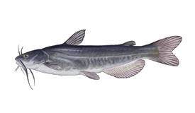
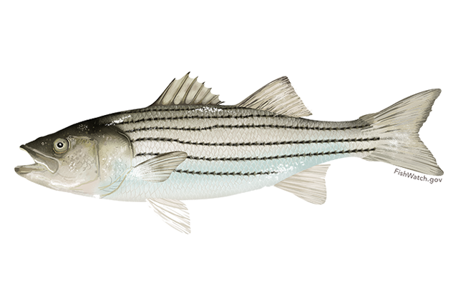
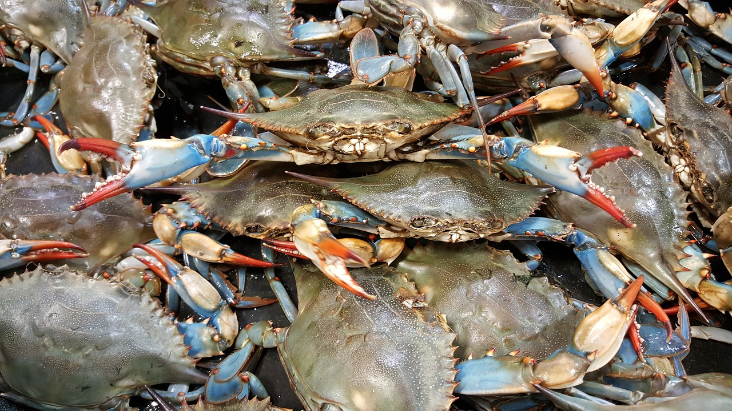
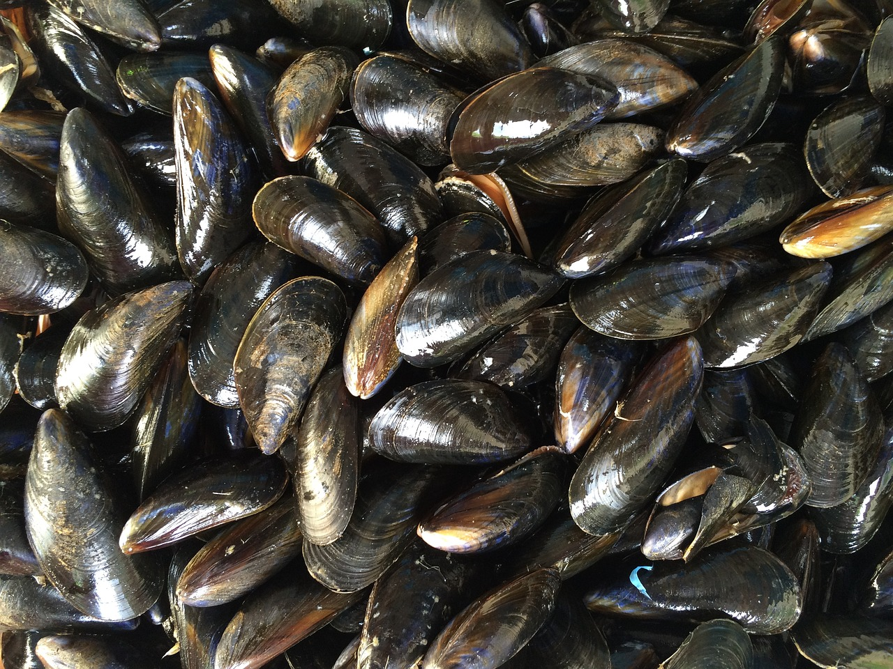
Recirculating aquaculture system (III)
The most popular species grown within recirculation system are catfish, striped bass, tilapia, crawfish, blue crabs, oysters, mussels, and aquarium pets [20]
Catfish⁵
Striped bass⁶
Blue crab (photo prom Pixabay)
Mussels
(photo prom Pixabay)

Slide 38
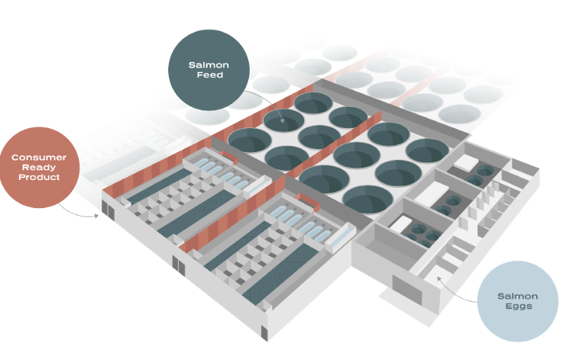
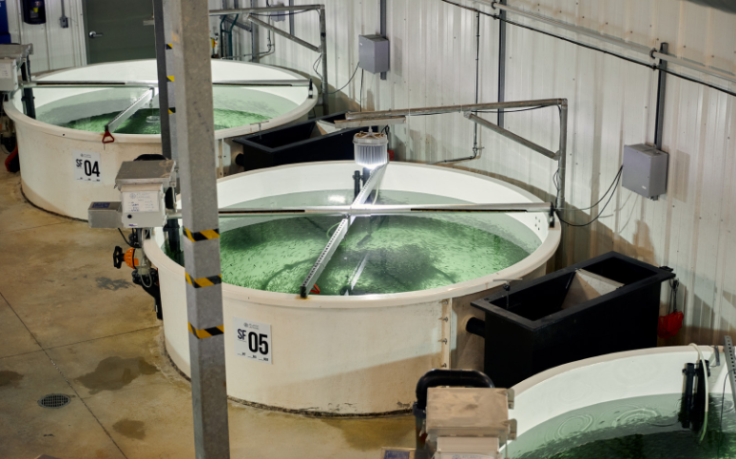
«Atlantic Sapphire»
Founded in 2010
Salmon farms in Denmark and USA
99 % water recirculated
Recirculating aquaculture system. «Atlantic Sapphire» [27]

Slide 39
Ponds (I)
Ponds are static, human made water bodies, with no water exchange during the farming period
Oldest aquaculture type, because of its simplicity, consisting only from few components such as pond walls, and pipes (or channels), aerotor for oxygen increase [26]
Mostly freshwater fish and crustaceans are grown with low stock density level
Important factors: quality of soil, shape, floor

Slide 40
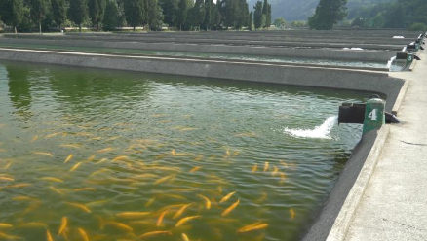
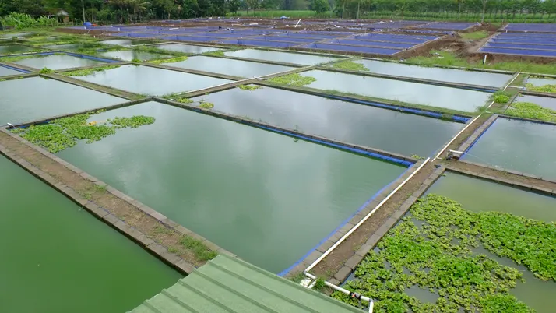
Ponds (II)
The most grown species in ponds are: freshwater fish species (carp, tilapia, catfish), and crustaceans (shrimps) [20]
With higher salinity rate in the pond, various other species can be grown: different types of shrimps, milkfish and mullet
Ponds [28]

Slide 41
Aquaponics system
One of the recent aquaculture type, where fish are grown together with plants, including various types of vegetables and grains [29]
Aquaponics takes advantage of the resources such as water and nutrients shared between aquaculture and plant production
Advantages:
  increase in productivity
  reduced input of nutrients
  reduced water use
  decreased amount of waste
  land conservation

Slide 42
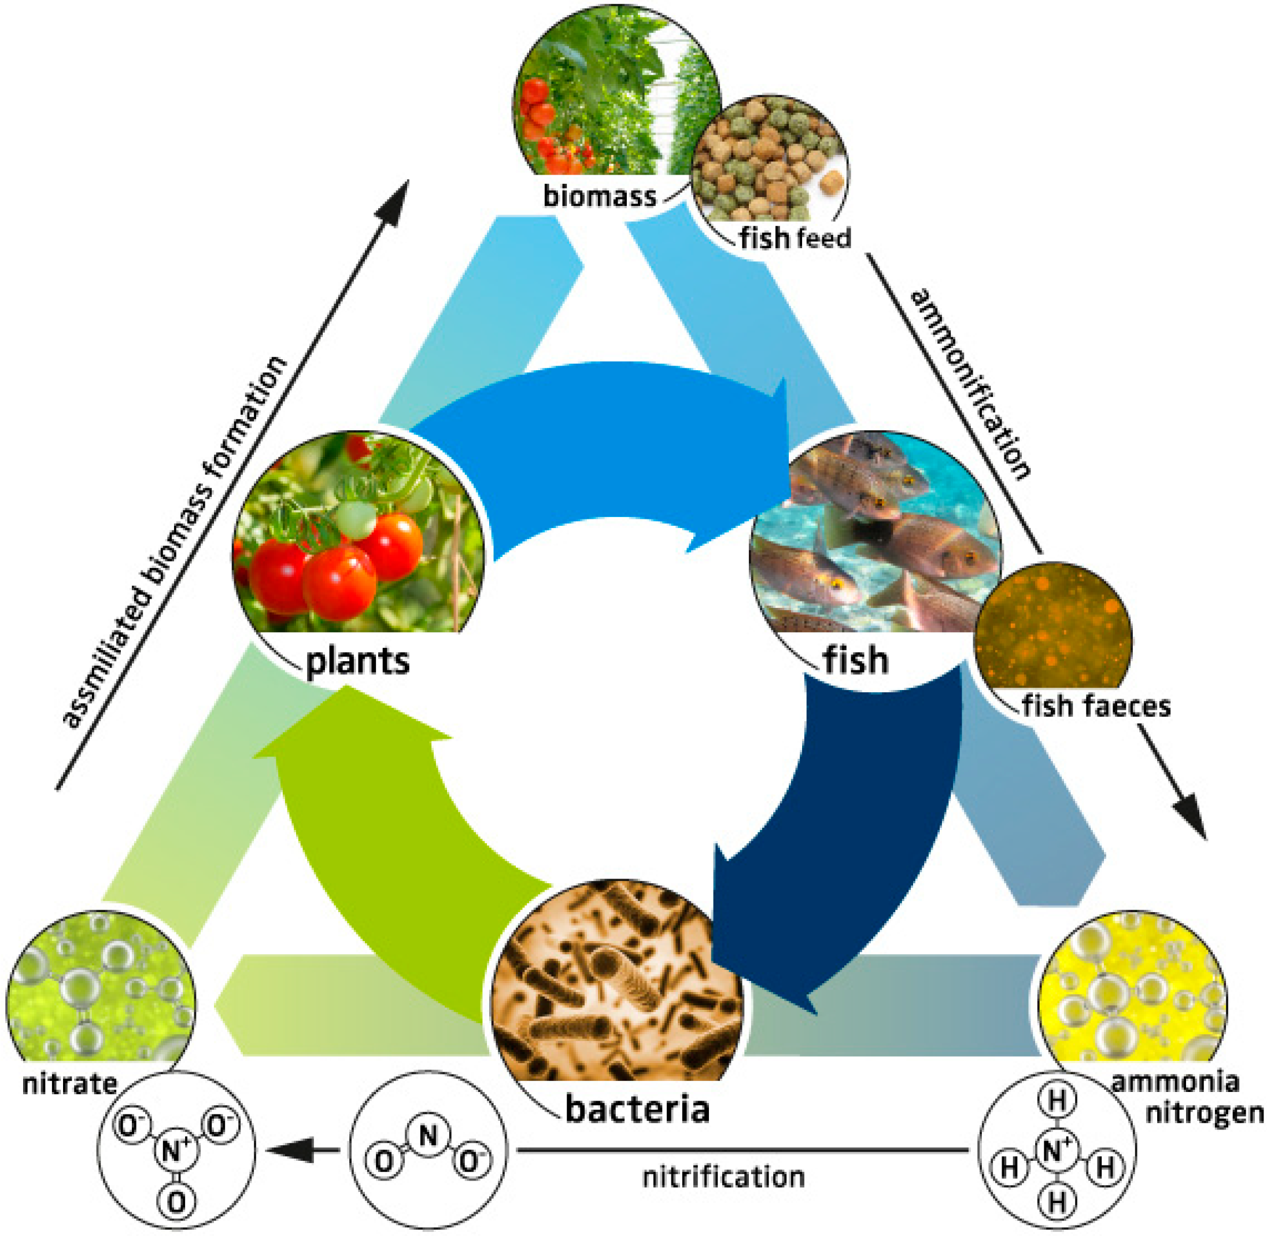
Main components of aquaponics
Three main ingredients of aquaponics: fish, plant and bacteria [29]

Slide 43
Nutrient balance in aquaponics
The optimal ratio between fish and plants needs to be found, they depend on various factors, for example [29]:
  type of fish, composition of feed and amount used per serving (including feeding frequency)
  type of plant
  hydroponic system type and design

Slide 44
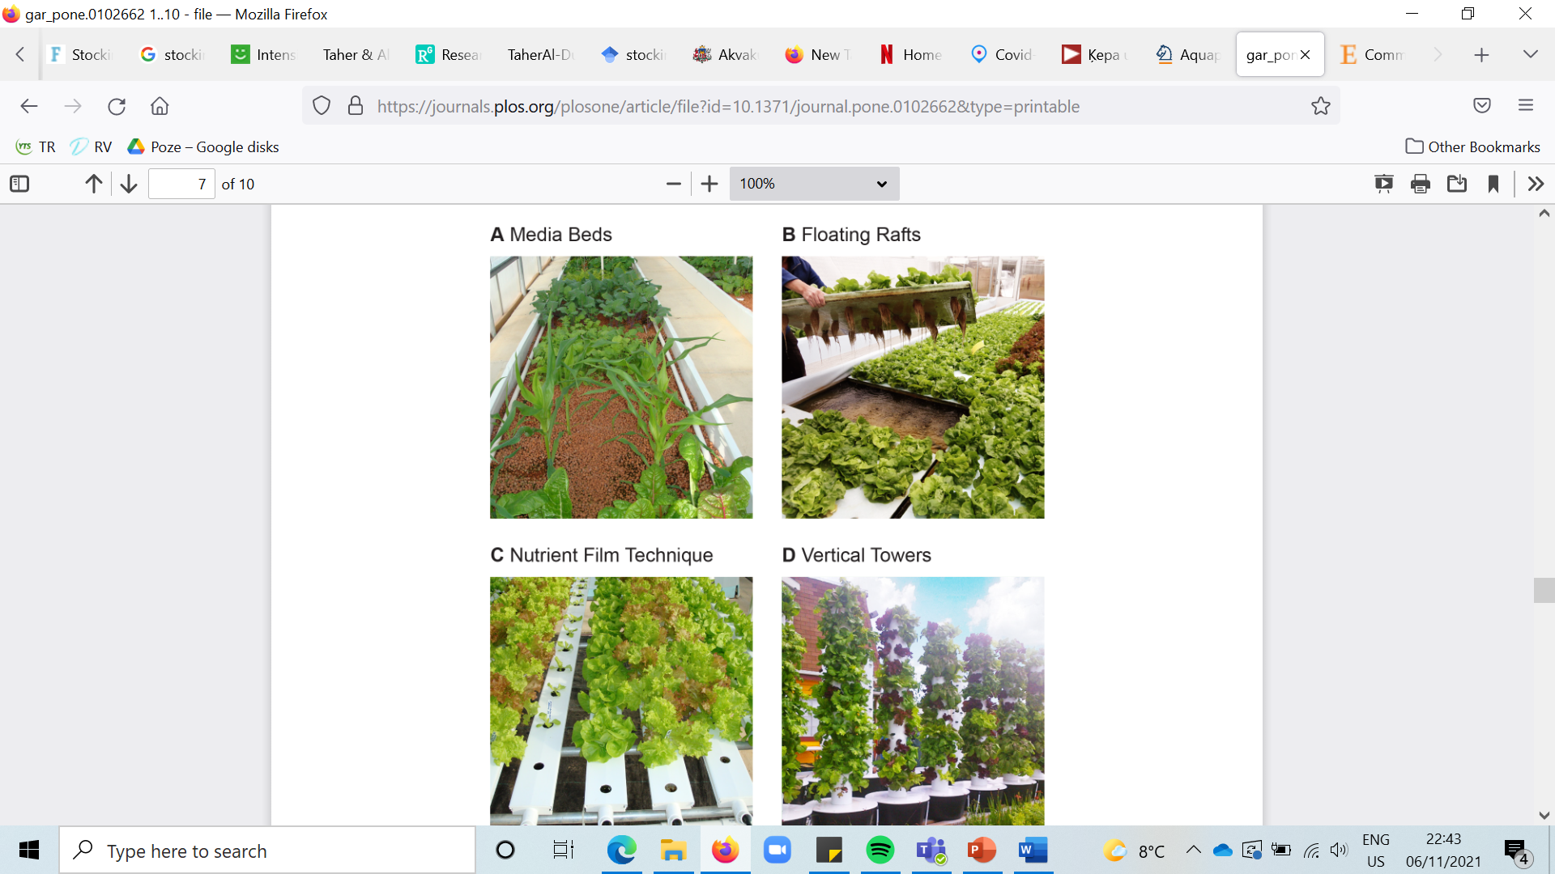
Types of aquaponics system (I)
Types of aquaponics: (a) media beds, (b) floating rafts [30]

Slide 45
Types of aquaponics system (II)
Types of aquaponics: (c) nutrient film technique, (d) vertical towers [30]

Slide 46
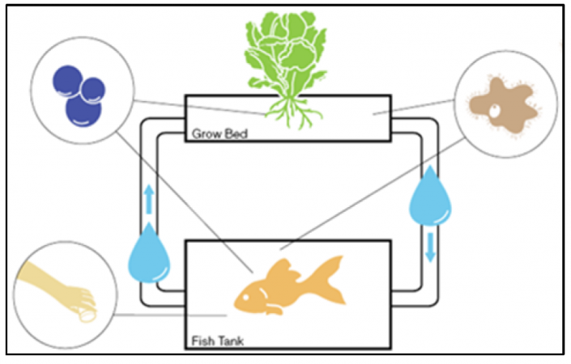
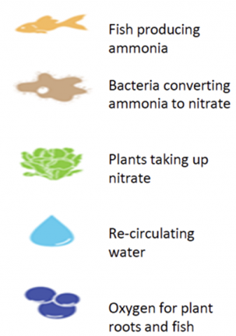
Aquaponics system (I)
Technological structure:
  Fish tank
  Grow bed
  Aerator
  Pipes
  Pump
Aquaculture system – aquaponics [19]

Slide 47
Fish and plants to grow in aquaponics
Fish species: tilapia, ornamental fish, catfish, perch, bluegill, trout, bass, shrimp, crawfish, baramundi etc.
Plants: basil, tomato, salad greens, peppers, head lettuce, cucumbers, kale, chard, strawberries, beans and peas, bok choi, broccoli, cabbage, onions [30]

Slide 48
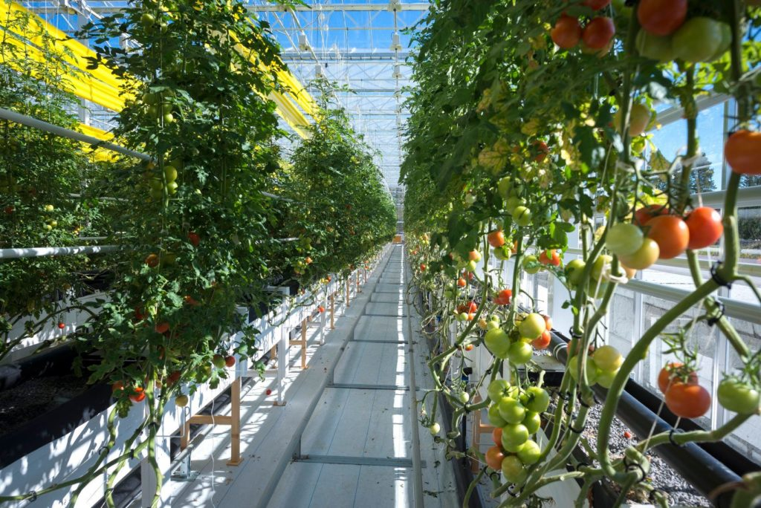
Company «Peckas Naturodlingar»
Company «Peckas Naturodlingar» (founded in 2015) is located near to Stockholm, Sweden
20 tonnes of fish and 200 tonnes of tomatoes are produced each year
Production is held close to consumers (to reduce the need of transportation)
Aquaponics – rainbow trout and tomatoes [32]

Slide 49
Limitation in aquaculture
Some of the limitations are listed below [33]:
  ammonium (greenhouse gas) from fish waste
  some species (as salmon, shrimps) must be fed with fish
  volume of by-products

Slide 50
Future trends in aquaculture
Various types of aquaponics – fish (or molluscs and macroalgae) and wind energy, therefore obtaining qualitative fish resources and producing renewable energy [34]
Development of using algae, for example, fertilizer, biofuel and fish feed

Slide 51
Synopsis
This lecture gives an insight on sustainable use of bioresources (covering forestry, agriculture and fisheries field)
Emphases is put on the fisheries field. Current development tendencies in the world and in Europe are shown
Various types of aquaculture are described

Slide 52
Further reading
Directorate-General for Research and Innovation (European Commission). A sustainable bioeconomy for Europe: strengthening the connections between economy, society and the environment. Updated bioeconomy strategy. 2018.
The State of World Fisheries and Aquaculture 2020. Full digital report. Available: https://www.fao.org/3/ca9229en/ca9229en.pdf

Slide 53
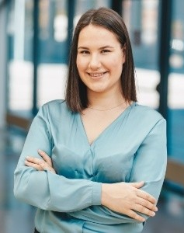
Biography
M.sc.ing. Zane Indzere
Researcher at RTU IESE
Main research topics: ​sustainable use of bioresources, with an emphasis on aquaculture. Fisheries. Fish processing processes and efficiency
Linkedin: https://lv.linkedin.com/in/zane-indzere-413ba0131

Slide 54
Reference I
[1] Commissione mondiale per l'ambiente e lo sviluppo, et al. Our common future. Peterson's, 1987.
[2] Bioresource Innovation BRI. Bioresources. Available: http://bioresource.eu/bioresources/
[3] FAO. Aquaculture, Systems and scale, Rural Aquaculture. Available: https://www.fao.org/3/x6941e/x6941e04.htm
[4] Sustanable development goals indicator metadata. Goal 15. Available: https://unstats.un.org/sdgs/metadata/files/Metadata-15-02-01.pdf
[5] Land portal. Above-ground biomass stock in forest. Available: https://landportal.org/taxonomy/term/8750
[6] Sustainable development goals indicator metadata. Target 2.4. Available: https://unstats.un.org/sdgs/metadata/files/Metadata-02-04-01.pdf
[7] Sustainable development goals indicators. Metadata repository. Available: https://unstats.un.org/sdgs/metadata/
[8] CLME. Sustainable fisheries. Available: https://clmeplus.marinetraining.org/taxonomy/term/18519
[9] Food and Agriculture Organization of the United Nations. Sustainable Development Goals. Indicator 14.4.1 – Fish stocks sustainability. Available: http://www.fao.org/sustainable-development-goals/indicators/1441/en/
[10] Greenpeace. Red list fish. Available: https://www.greenpeace.org/usa/oceans/sustainable-seafood/red-list-fish/
[11] Secchi Disk Foundation. Bluefin tuna are back around the UK and a new study explains why. Available: https://phys.org/news/2019-01-bluefin-tuna-uk.html
[12] Patterson H. Southern Bluefin Tuna Thunnus maccoyii. Available: https://www.fish.gov.au/2012-Reports/Southern_Bluefin_Tuna

Slide 55
Reference II
[13] Food and Agriculture Organization of the United Nations. Definitions (aquaculture, systems and scale, rural aquaculture). Available: http://www.fao.org/3/x6941e/x6941e04.htm
[14] National Ocean Service. What is aquaculture? Available: https://oceanservice.noaa.gov/facts/aquaculture.html
[15] Scientific, Technical and Economic Committee for Fisheries (STECF) - Economic Report of the EU Aquaculture sector (STECF-18-19). doi: 10.2760/45076.
[16] Cai J., Zhou X., Yan X., Lucente D., Lagana C. Top 10 species groups in global aquaculture 2017. FAO, 2019.
[17] European Commission. Oceans and fisheries. Fisheries and aquaculture production. Available: https://ec.europa.eu/oceans-and-fisheries/facts-and-figures/facts-and-figures-common-fisheries-policy/fisheries-and-aquaculture-production_en
[18] European Commission. European atlas of the Seas. Available: https://ec.europa.eu/maritimeaffairs/atlas/maritime_atlas/#lang=EN;p=w;bkgd=1;theme=2:0.75;c=617910.1422549908,6641954.633427013;z=4
[19] An Introduction to Open-Pen Sea Cage Aquaculture. Available: https://goodfishbadfish.com.au/an-introduction-to-open-pen-sea-cage-aquaculture/
[20] FAO Fisheries and aquaculture technical paper – 549. A global assessment of offshore mariculture potential from a spatial perspective. Rome, 2013.
[21] Santa Barbara. Mariculture. Available: http://www.sbmariculture.com/index.html
[22] The Fish Site. Mowi to move contentious salmon sites. Available: https://thefishsite.com/articles/mowi-to-move-contentious-salmon-sites
[23] Australian Southern Bluefin Tuna Industry Association LTD. Ranching Sustainability under the SA Aquaculture Act. Available: https://asbtia.com.au/industry/sustainability-of-southern-bluefin-tuna/ranching-sustainability-sa-aquaculture-act/
[24] Recirculating aquaculture system. Available: https://www.aquacultureid.com/recirculating-aquaculture-system/
[25] Jones R. Catalyzing the Blue Revolution: How Investors Can Turn the Tide on Aquaculture. The Nature Conservancy. Available: https://www.nature.org/en-us/what-we-do/our-insights/perspectives/how-investors-can-turn-the-tide-on-aquaculture/

Slide 56
Reference III
[26] Lucas J. S., Southgate P. C., Tucker C. S. (Eds.). Aquaculture: Farming aquatic animals and plants. John Wiley & Sons, 2019.
[27] Atlantic Sapphire. Annual report 2020. Available: https://atlanticsapphire.com/wp-content/uploads/2021/04/20210414-Atlantic-Sapphire-ASA-Integrated-Annual-ESG-Report-for-2020.pdf
[28] Freshwater aquaculture in EU. EUMOFA, 2021. Available: https://www.eumofa.eu/documents/20178/442176/Freshwater+aquaculture+in+the+EU.pdf
[29] Goddek S., Delaide B., Mankasingh U., Ragnarsdottir K. V., Jijakli H., Thorarinsdottir R. Challenges of sustainable and commercial aquaponics. Sustainability 2015:7(4):4199-4224.
[30] Love D. C., Fry J. P., Genello L., Hill E. S., Frederick J. A., Li X., Semmens K. An international survey of aquaponics practitioners. PloS One 2014:9(7):e102662.
[31] Institute for Systems Biology. Project feed 1010. Sustainable aquaculture 3.0. Available: http://www.projectfeed1010.com
[32] Mittnorde. Peckas Naturodlingar AB får miljöpriset – Nordens Gröna bält. Available: https://mittnorden.org/peckas-naturodlingar-ab-far-miljopriset-nordens-grona-bat/
[33] Directorate-general for internal policies. Policy department structural and cohesion policies. European aquaculture competitiveness: limitations and possible strategies. 2009. Available: https://www.europarl.europa.eu/RegData/etudes/etudes/join/2009/431569/IPOL-PECH_ET(2009)431569_EN.pdf
[34] SUBMARINER. Sustainable Uses of Baltic Marine Resources. Available: http://www.submariner-project.eu/index.php?option=com_content&view=article&id=233&Itemid=384

Slide 57
References of photos
1. Photo of Sea bass (slide 31). Available:
https://www.luluhypermarket.com/en-sa/fresh-sea-bass-1kg-approx-weight/p/462149_EA
2. Photo of Red sea bream (slide 31). Available:
http://products.omanseafood.com/product/red-sea-bream/
3. Photo of Yellowtail flounder (slide 31). Available:
https://www.dfo-mpo.gc.ca/species-especes/profiles-profils/yellowtail-flounder-limande-queue-jaune-eng.html
4. Photo of Sea shrimp (slide 31). Available:
https://www.filippiandsea.com/prodotto/pink-shrimp-of-mediterranean-sea/
5. Photo of Catfish (slide 37). Available:
https://www.ncwildlife.org/Learning/Species/Fish/White-Catfish
6. Photo of Striped bass (slide 37). Available:
https://www.fisheries.noaa.gov/species/atlantic-striped-bass

Slide 58
Thank you!

