Slide 1


Life Cycle Thinking-based methods and quantitative tools
MODULE 2
Bioeconomy, agrobiodiversity, biomass use, strategies and resources for sustainable rural development
UNIT 3
Bioeconomy evaluation methods in the agro-farming sector
Francesco Romagnoli, RTU, Latvia
Maksims Feofilovs, RTU, Latvia
Fabian Diaz, RTU, Latvia
Notes:
Welcome to today lecture. I am Prof. Francesco Romagnoli from the Institute of Energy Systems and Environment at the Riga Technical University. I am happy to share with you the contents of the lecture on “Life Cycle Thinking-based methods and quantitative tools.

Slide 2
Aim/objectives
Get acquainted about the main concepts of the main concept of the Life Cycle Sustainability assessment
Be aware about the main stages about the Environmental Life Cycle Assessment (E-LCA), Life Cycle Cost Assessment (LCCA) and Social Life Cycle Assessment (S-LCA)
Acquire knowledge on:
  main aspects of the Life Cycle Sustainability Assessment for bioconomy solution applied to the agro-farming sector
  use of dedicated assessment tools
  Identifying criticalities within specific case studies
  Be aware on the potential effect of alternative beneficial scenarios within a comparative assessment
  Quantitative evaluate the best option within a given scenario maximizing the circular and bio economy principles meantime strengthening the environmental wellbeing

Slide 3
Learning outcomes
LOut 12. Acquire a basic knowledge on the potential definition of strategic sustainable development of the agro-farming sector;
LOut 16. Analyse different scenarios of bioeconomy implementation for specific situations, find the most optimal solution and make recommendations;
LOut 18. Compare and analyse solutions from the application of LCA-based quantitative assessment and their implication on selecting a specific bioeconomy solution;
LOut 20. Explain the different effects on the application of specific bioeconomy strategies within the agro-farming sector;
LOut 23. Justify and recommend potential improvements solutions following a bioeconomy evaluation approach

Slide 4
Keywords
Life Cycle thinking
Sustainability
Bioeconomy strategy solutions
Economic assessment
Social Assessment
Comparative assessment
LCA tools
Multi Criteria Analysis (MCA)

Slide 5
Table of contents
General introduction about Life Cycle Sustainability Assessment
Environmental Life Cycle Assessment in a nut-shell
Life Cycle Costs Assessment (LCCA)
Social Life Cycle Assessment (S-LCA)
Notes:
This lecture is organized into three main parts: Agrobiodiversity main concepts, Connecting Global Priorities within agrobiodiversity and examples of agrobiodiversity assessment and preservation strategies

Slide 6
General introduction about Life Cycle Sustainability Assessment
Notes:
I am now going to focus on the main aspects and concepts about Life Cycle Sustainability Assessment.

Slide 7
Specific contents
Sustainability definition
Life Cycle Thinking approach
Life Cycle Sustainability Assessment
Environmental Life Cycle Assessment in a nutshell
Notes:
Four main parts will be dedicated to this section:
Sustainability definition
Life Cycle Thinking approach
Life Cycle Sustainability Assessment
Environmental Life Cycle Assessment in a nutshell

Slide 8
Sustainability definition

Slide 9
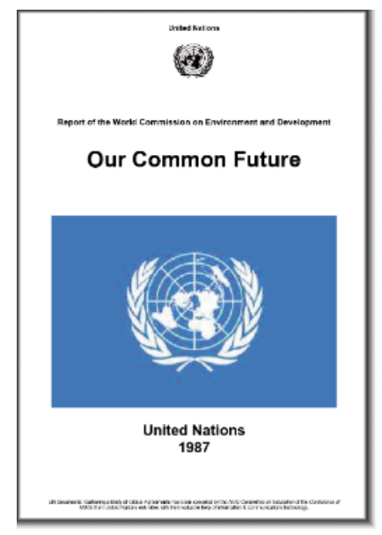
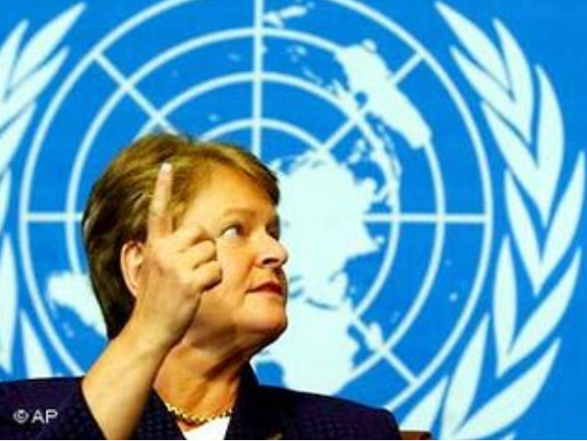
What is sustainability?
“Our common future” – i.e. “Brundtland report” from United Nations’ World Commission on Environment and Development (1987)
  Sustainable development as “…development that meets the need of the present without compromising the ability of future generations to meet their own needs”
Common dimensions of different definition of “sustainable development” and “sustainability”
  welfare
  inter-generational equity
  intra-generational equity
  interspecies equity
Sustainable Development Goals (2015): framework of the 2030 Agenda for Sustainable Development (193 Member States)
Source: ARE [1]; Restorative leadership 2012 [2]
Notes:
Before going on the definition of the Life Cycle Sustainability Assessment we should look at the definition of the term sustainability. The term sustainability firstly appeared within the report of the World Commission on Environment and Development “Our Common Future” in 2017. Also called as Brundtland report the document described a new approach to development which should “meet the needs of the present without compromising the ability of future generations to meet their own needs” (Brundtland et al., 1987, p. 41). This new approach is derived from a progressive acknowledgement of the insufficient progress made to defeat poverty and to ensure well-being to all human beings as well as of the environmental boundaries given by a planet with finite resources.
Different definition of “sustainable development” and “sustainability” have been presented since so far. However, there is a large degree of common ground on definitions addressed to specific key dimensions. The first dimension relates to measures of welfare. The Second dimension relates to the concern for inter-generational equity. The third dimension relates to intra-generational equity and the fourth dimension relates to interspecies equity
Except for these theoretical inferences, the Brundtland definition has been largely criticized for being ambiguous. Nevertheless was the background which brought to the definition of the 17 Sustainable Development Goals in 215 signed by 193 Member States of the United Nations implementing the 2030 Agenda for Sustainable Development

Slide 10
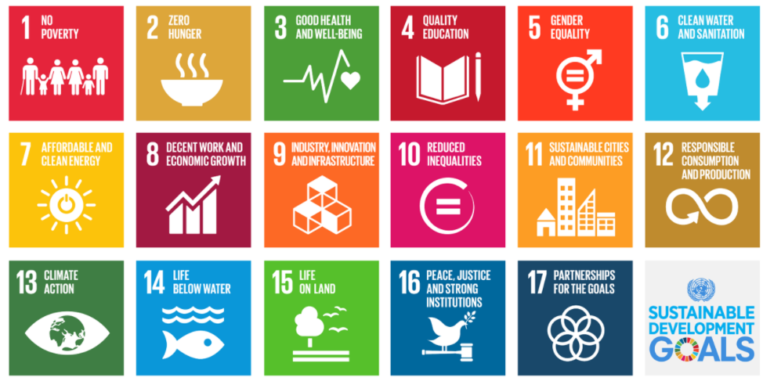
What is sustainability?
Source: Assembly of European Regions [3]
Sustainable Development Goals, United Nations Conference on Sustainable Development (Rio+20, 2012)
During the Conference of the Parties (COP21) signed the Paris Agreement (2015) including SDGs
Notes:
During the United Nations Conference on Sustainable Development (Rio+20) in 2012 was proposed the development of a set of goals and targets aiming at promoting sustainable development: the so called The Sustainable Development Goals (SDGs) . The Sustainable Development Goals (SDGs) – or Global Goals are a collection of 17 interlinked global goals designed to be a "blueprint to achieve a better and more sustainable future for all". The SDGs were set up in 2015 in The Paris Agreement by the United Nations General Assembly and are intended to be achieved by the year 2030. They are included in a UN Resolution called the 2030 Agenda or what is colloquially known as Agenda 2030. The SDGs were developed in the Post-2015 development agenda as the future global development framework to succeed the Millennium development goals which ended in 2015.
In that same year, at the twenty-first session of the Conference of the Parties (COP21) to the United Nations Framework Convention on Climate Change (UNFCCC), Parties to the UNFCCC adopted the Paris Agreement, addressing the need to fight climate change.
The Paris Agreement is a legally binding international treaty on climate change. It was adopted by 196 Parties at COP 21 in Paris, on 12 December 2015 and entered into force on 4 November 2016. Its goal is to limit global warming to well below 2, preferably to 1.5 degrees Celsius, compared to pre-industrial levels. During these day at COP 26 all parties were discussing the new condition of the agreement.

Slide 11
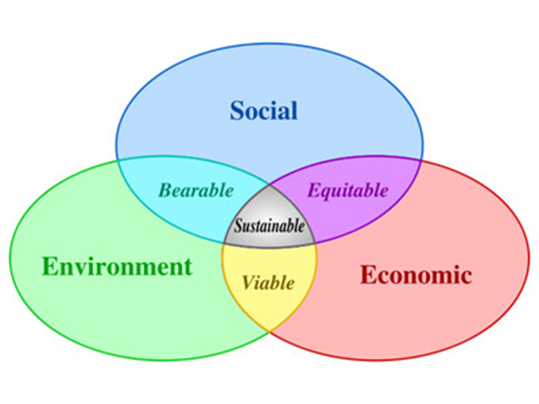
What is sustainability?
Sustainability is “meeting needs of present without compromising our ability to meet future needs”
“Business as usual” can be defined as meeting needs of present without considering future needs or current social costs
Three sustainability pillars model developed by Elkinton (1998) [4]
Notes:
The concept of sustainability defined within the SDGs is also included within the three sustainability pillars model developed by Elkinton (1998). This conceptualization of the sustainability merge three main dimensions to be guarantee the preservation of the future generation needs, namely Environmental, economic, and social. The overarching approach drafted in Elkinton view is also embedding the concept of viability, equity and bearebility embracing only 2 of the 3 sustainable pillars.
The concept of Sustainability is tackling the business-as-usual view which address to meet only the nowadays society needs.

Slide 12
Sustainability and circularity
Closing the loop (humanity’s sweet doughnut)
Mimics nature by cycling resources
Ecodesign
Source: Rikardo Minguez et al., 2021 [5]
Notes:
The sustainability approach is thus supporting the main principles of the Circular- and Bio-Economy. As we already seen in the previous lecture the idea of Circular Economy is an integral vision that helps us to rethink our economy and our society. Therefore, the key aspect is “circularizing” both the economy and society within the aim of decrease primary resources extraction and exploitation (either bio of fossil), phasing down the landfill, and preserve ecological systems.
Therefore, Circular Economy constitutes a driving incentive to this transformation and contributes to achieve the Sustainable Development Goals (SDGs) of UN 2030 Agenda. It offers a holistic framework to redesign the system, a new model that would take us into the “humanity’s sweet doughnut” of social impacts and needs like reported in Figure 1.
In principle, Circular Economy redefines the relationship between economy, society and nature. Its model distinguishes economic growth from natural resource depletion and ecological overload. Circular Economy aims to eliminate accumulated imbalances in the linear system and it combines economic prosperity with environmental caution. The concept of Circular Economy is based on the fundamental and obvious assumption that resources are limited and they must be preserved for future generations. It mimics nature by cycling resources. This requires sustainable consumption and production based on the so-called eco-design or environmentally responsible design.
According to the Ellen MacArthur Foundation, “Economics by design must be restorative and aim to maintain products, components and materials at maximum utility and value, differentiating technical from biological cycles”

Slide 13
Life Cycle Thinking approach

Slide 14
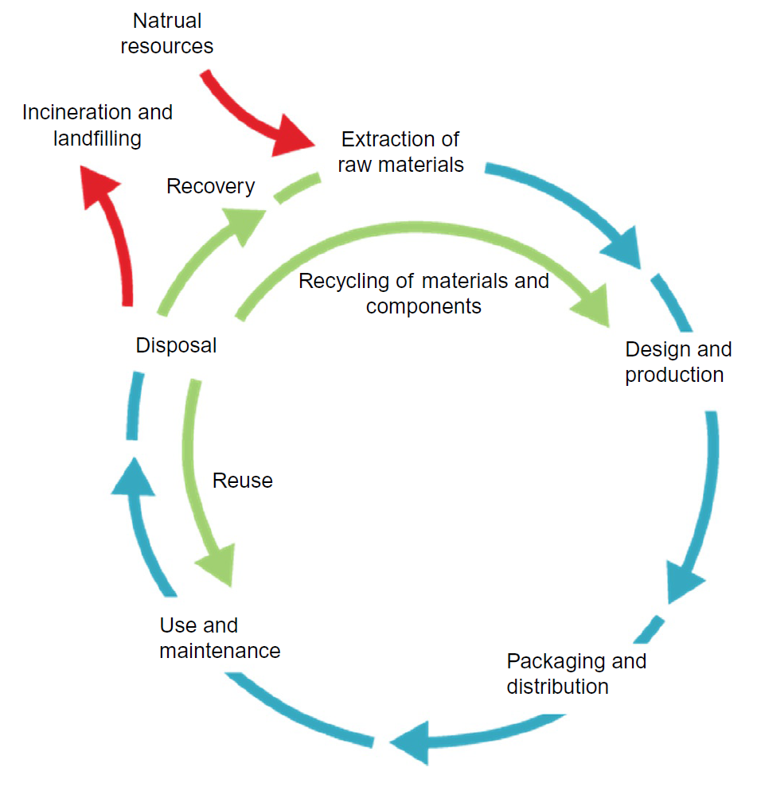
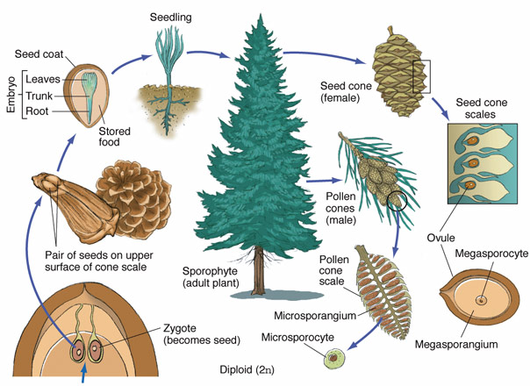
From the environmental concerns to a life cycle perspective
Source: Jingzheng et al., 2020 [6]
Notes:
The issue of environmental sustainability is of course great interest today. The international community encourages companies to adopt cleaner and as much as possible circular production systems and technologies. The market seems to reward environmentally responsible organizations, and many companies around the world are increasingly becoming interested in environmental issues, iintroducing them as strategic variables in their businesses.
With a life cycle perspective, we consider the totality of the system in our analysis, including the evaluation of the product’s entire life cycle, with a long-term time horizon and a multidimensional view.
Life cycle thinking (LCT) offers this totality: a comprehensive analysis of the topic it requires, leading to solutions for reducing impacts in an absolute and not a relative way. As shown in the right figure, a product’s life cycle can begin with the extraction of raw materials from natural resources in the ground, and with energy generation. Materials and energy are then part of production, packaging, distribution, use, maintenance, and eventually recycling, reuse, recovery, or final disposal. In each life cycle stage there is the potential to reduce resource consumption and improve the product’s performance.
The life cycle metaphor is borrowed from the field of biology. For example, the life cycle of a tree starts with a seed, which by its growth evolve into an adult tree to further have the seed cone necessary to have further seeds. In much the same way a man-made object starts its lifecycle by the harvesting and extraction of resources, followed by production, use, and eventually management as waste, which marks the end of the life cycle.
Decisions made considering a full life cycle perspective and broader implications on the environmental, economic, and social pillars of a healthy planet, allow us to address unintended trade-offs between these pillars, and focus attention on the key drivers of change. As a result, progress towards sustainable
development is faster and more efficient than when decisions are isolated.
However, over the years, many environmental management tools have shown an important limit, that is the reduction of environmental impacts of an organization or a process by allocating them at other times, upstream or downstream of the supply chain, thus increasing the environmental loads of other subjects, such as suppliers, distributors, customers. This is because many environmental management tools observe the environmental problem from a single point of view, the one of the single organization, while environmental problems are generated by different subjects that, together, contribute in a closely interconnected way to the overall environmental impact.

Slide 15
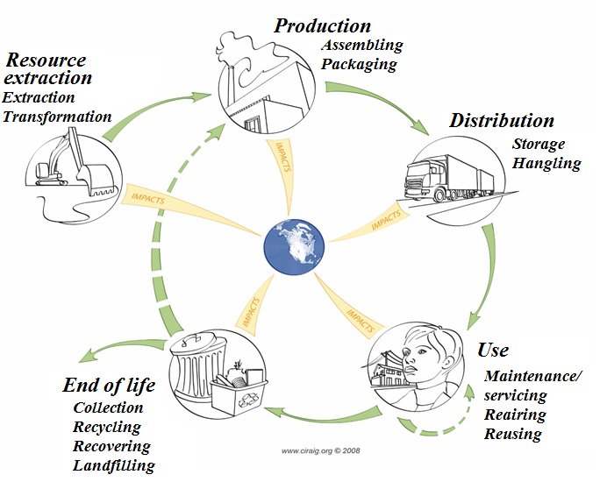
The background of the life cycle thinking
IDEAL “SUSTAINABLE” WORLD: a closed loop
Reduce natural resources extracted
Reduce landfilling or released as emissions
Increase energy efficiency
Cradle-to-grave(cradle)
Source: Manuele Margni, 2015 [7]
Notes:
As mentioned, the aim of an ideal sustainable world is thus a close loop trying to minimize the extraction and landfill, increasing the re-use and re-cycling and minimize the energy use with a higher energy efficiency. But a more quantitative framework is needed to screen and select the more sustainable solutions.
Thinking in terms of the life cycle, businesses recognize that each choice sets the stage for not only how the product will look and function, but also for how it will impact the environment and the community as it is manufactured, used, disposed of, re-used, or recycled. Products can be designed so they will have less environmental impact when they are manufactured, used, and discarded. With a life cycle approach, companies would be to calculate the full life cycle cost of the goods they purchase. This includes the point-of-purchase price as well as the costs of transporting, storing, installing, cleaning, operating, repairing, and eventually discarding those goods.
The life cycle thinking approach promotes relevant innovations in designing, producing and using products and services, and it brings benefits to several stakeholders along the product supply chain.
A life cycle approach identifies opportunities and risks of a product or technology, from raw materials to disposal, named “from cradle to grave” represented in the picture.

Slide 16
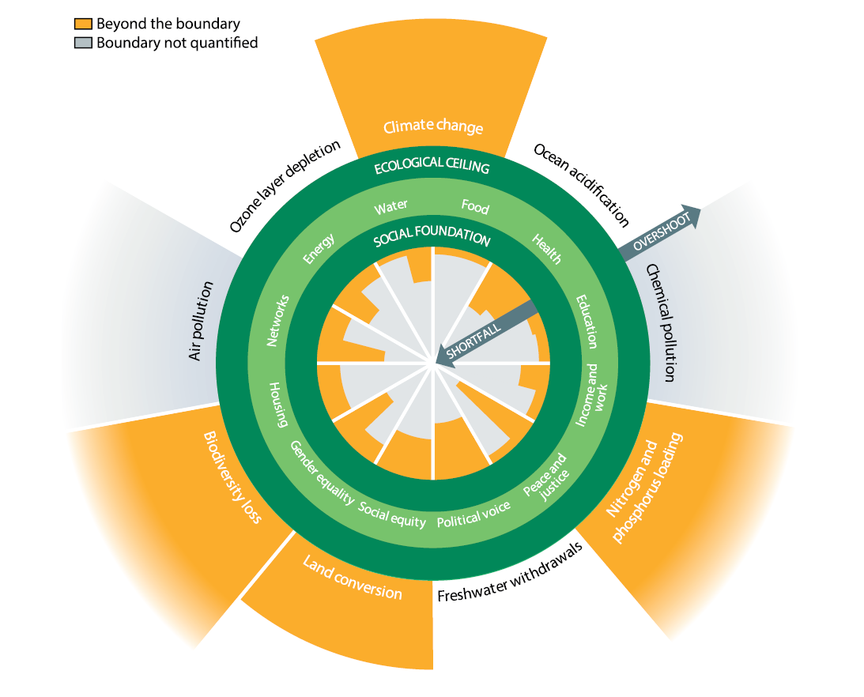
Life Cycle thinking approach
Earth’s resources capacities
“Planetary boundaries”
“Triple bottom perspective”
  Environmental Life Cycle assessment (E-LCA
  Life cycle costing (LCC)
  Social life cycle assessment (SLCA)
Source: Jingzheng Ren, Sara Toniolo, 2020 [8]; Biodiversity international [9]
Notes:
The life cycle thinking approach promotes relevant innovations in designing, producing and using products and services, and it brings benefits to several stakeholders along the product supply chain.
Sustainable development should ideally improve the quality of life for every individual without expending the Earth’s resources beyond its capacity. Without a functioning environment we will not be able to give future generations the same possibilities for achieving the levels of welfare that current generations are experiencing.
Researchers have attempted to quantify carrying capacities of the ecosystem that must not be exceeded to maintain functions, as well as other ecosystem aspects of interest. This is reflected in the frame of the so called Planetary boundaries can be interpreted as carrying capacities for the entire Earth system towards various anthropogenic pressures, such as greenhouse gases and interference with nutrient cycles. According to estimates, this exceedance has already happened for four of the nine proposed planetary Boundaries. The Planetary Boundaries concept identifies nine global priorities relating to human-induced changes to the environment. The science shows that these nine processes and systems regulate the stability and resilience of the Earth.
(animation) A life cycle approach identifies opportunities and risks of a product or technology, from raw materials to disposal, named “from cradle to grave”.
As mentioned Sustainability has three dimensions: economy, society, and environment. In the business community the term “triple bottom line” was coined to explain the importance of achieving Sustainability.
Based on that, the scientific community has developed advanced models of LCA methodology, including the triple bottom line perspective: thus, life cycle costing (LCC) and social life cycle assessment (SLCA), as second and third pillars of sustainability, are born, distinguishing economic and social impacts of product systems along their life cycle.
The figure shows the possible link between LCT and sustainable development through the three pillars of sustainability and the multidimensionality of LCT.

Slide 17
Life Cycle Sustainability Assessment
Notes:
Let’s have a closer look about Life Cycle Sustainability Assessment approach.

Slide 18
LCT and sustainability
LCT can be quantitatively implemented considering 3 life cycle dimensions resulting in an overall LCSA:
Environmental (LCA) => proven – ISO 14040-44
Economic (Life Cycle Costing, LCC) => proven (Conventional LCC, Environmental LCC. Societal LCC) – ISO 15686-5
Social (Social Life Cycle Assessment, SLCA) => developing (UNEP guidelines)
LCSA = E-LCA + LCC + S-LCA
(Kloepffer, 2008, Zamagni, 2012) => developing
LCSA = Life Cycle Sustainability Assessment
Source: Jingzheng Ren, Sara Toniolo, 2020 [8]
Notes:
There could be many initiatives in LCT implementation as presented in the figure according to Maslow's Pyramid of Sustainable Development. We will now mainly focus on the concept propose by Kloepffer and Renner ideally considered the so called Life Cycle Sustainability Assessment as the sum of the three methodological quantitative approach namely E-LCA, LCC, and S-LCA
E-LCA is nowadays is proven and standardized approach by ISO within the Standards 14044;
LCC has become the acronym of the tool which, consistently with the E-LCA model, across the product’s life cycle, includes all costs borne by different actors with different perspectives and at different times - 15686-5 (Life cycle costing) covers the main principles, processes, calculations and definitions for life cycle costing.;
The SLCA is a methodological approach aimed at evaluating social and socioeconomic aspects of products and their potential positive and negative impacts along their life cycle. Social impacts are those that may affect stakeholders along the product life cycle and may be linked to company behavior, socioeconomic processes, and impacts on social capital. Although S-LCA follows the ISO 14040 framework, some aspects differ, are more common or are amplified at each phase of the study. The UNEP Guidelines for Social Life Cycle Assessment of Products proposes a methodology to develop life cycle inventories.
Merging these 3 concept comes The conceptual approach for Life Cycle Sustainability Assessment (LCSA) has been, in fact, summarized by Kloepffer (2003, 2008) as an addition of environmental LCA (LCA), economic LCA (life cycle costing (LCC)), and social LCA (SLCA), based on the very same inventory of material and energy flows
As is commonly acknowledged LCSA can be considered as the integration, or better, as resulting from the addition of the three dimensions of sustainability perspectives, i.e., economic, environmental, social, and according with several authors it can be presented as the following easy equation.
As mentioned the Brundtland definition has been largely criticized for being ambiguous and lacking on quantitative assessment methods.
Nevertheless considering the established concept of “Sustainability”, as proposed by the Brundtland report (United Nations General Assembly, 1987), and the three sustainability pillars model developed by Elkinton (1998), several aspects are to be accounted in the evaluation of products and processes.
By the sustainable development definition such evaluation should be performed over a system the boundaries of which comprise all the element required to avoid the shifting of burdens among generations, over both time and space.
Therefore, the whole range of impacts and effects induced must be assessed, based on the different aspects touched on and the timing in which these effects unravel. For these reasons, on one hand, “intact environment, social justice, and economic prosperity” (Finkbeiner et al., 2010: 3310) should represent the final goal of each application and the yardstick of the assessment, in order to address the horizontal dimension. On the other hand, the application of a life cycle thinking lens is required to explore the longitudinal dimension of the impacts and consider both the direct and indirect impacts triggered throughout the different phases of the product or process life and the time-scale of the impacts, considering the relationship between present needs and future opportunities.

Slide 19
LCSA methods
LCSA approaches:
Multicriteria decision making (MCDM)
Fuzzy
Dynamics
Combined
Key examples from:
Life cycle sustainability triangle (see figure1)
“Dashscore” (see figure 2)
Figure 1: Life cycle sustainability triangle
Figure 2: Dashscore
Source: Jingzheng Ren, Sara Toniolo, 2020 [8]; Marzia Traverso, 2019 [10]
Notes:
As mentioned LCSA consists of LCA for environmental assessment, life cycle costing (LCC) for economic assessment, and social life cycle assessment (SLCA) for social impact assessment. Due to the completeness of overall analysis of sustainability, the studies related to LCSA have increased in recent years.
Examining the sustainability performances for a certain product or a service, the studies related to LCSA focus more on the comparison of multiple objects. LCSA combined with multicriteria decision making (MCDM) has been widely used as assessment framework.
To apply LCSA in more situations, LCSA has been also extended to the fuzzy framework, dynamic system, and by combining with other theories.
As examples of assessment methods as seen in the figure, the three perspectives embodied into LCSA has been translated into a ternary diagram, namely the life cycle sustainability triangle (LCST). By this triple-parameters scheme the environmental impacts, environmental, economic, and social impacts can be visualized, based on the relative weights attributed. The representation of a hypothetical weighting set is given in the picture.
A second example of implemented scheme proposes a life cycle sustainability dashboard (LCSD). As reported in figure this approach reports the visualization of the LCSD, as a composition of three different and free-standing evaluations, separately performed over the three relevant aspects of sustainability.

Slide 20
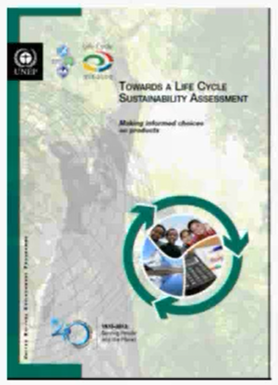
LCSA standardization
LCSA by Maslow pyramid
Source: Marzia Traverso, 2019 [10]
Notes:
As it is largely recognized in LCSA, as in several other topics, a standardization is necessary in order to achieve a common and widely shared description of the principles and framework for formulating, conducting, and reporting LSCA approach and studies. This was made by the Life Cycle Initiative which created the guidelines towards making a LCSA.

Slide 21
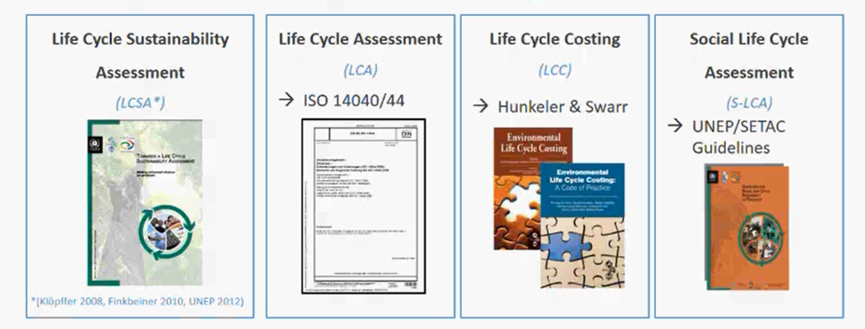
LCSA standardization
Consider all the 3 dimensions of sustainability: Environment – Society - Economy
LCT for assessing product’s or service life cycles
ISO 15686-5
Source: Marzia Traverso, 2019 [10]
Notes:
This standardization still not revcognized as integrated methods involves the 3 dimensions of the sustainability according to specific guidelines of ISO standards as it the case for the Environmental LCA according to the ISO Nr. 14040/44, for LCC in line with the ISO 15686-5 and for the Social following still the ISO 14040/44 but the guideline of UNEP/SETAC namely United Nations Environment Programme (UNEP) and Society of Environmental Toxicology and Chemistry (SETAC).

Slide 22
LCSA basic methodological structure
Goal and scope definition
Inventory analysis
Impact assessment (involving the four steps: classification characterization, normalization, and analysis of data quality)
Interpretation
Boundaries
Functional unit
Inventory data
Impact categories
…
ATTENTION!!! For LCA and LCC a quantitative approach is perfectly recognized more difficult to utilize quantitative inventory data abd indicators for social assessment (i.e. S-LCA)
Notes:
First of all, such as in several other contexts, it is important to speak the same language and for this reason is proposed a general methodological structure for the LCSA.
As for any single assessment component (i.e., LCA, LCCA, SLCA), the LCSA can also be carried out in four steps in a processual and iterative manner, which are composed of: goal and scope definition, inventory analysis, impact assessment (involving the four steps: classification, characterization, normalization, and analysis of data quality) and interpretation.
It is a very important point that different life-cycle based methods for sustainability assessment have to have the consolidated approach. This should regard key components of the process like: the functional unit and the use of consistent - ideally identical - system boundaries for all the 3 dimensions.
The primary purpose of a functional unit is to provide a reference to which the inputs and outputs are related, ensuring the comparability of LCSA results and defining the quantification of the identified function of the product/process/services.
Also, in an LCSA, the inventory and impact indicators must be related to a common product functional unit, which is the basis of all techniques described. Also for the S-LCA it is recommended that the functional unit describes both the technical utility of the product and the product’s social utility.
The assumption that primary data are the best option both from a qualitative and quantitative point of view seems to be definitely true also for LCSA.
Inventory analysis involves data collection and calculation procedures to quantify relevant inputs and outputs of a product system.
If for LCA and LCC a quantitative approach is perfectly recognized as possible and useful, on the contrary, there is a wide debate about the opportunity to utilize quantitative inventory data for social assessment in the SLCA, or to opt for qualitative data and indicators.
For LCSA, such indicators should be chosen in accordance with internationally recognized categorizations/standards.
For an LCSA study, it is recommended that all impact categories that are relevant across the life cycle of a product are selected. These should follow the perspectives provided by each of the three techniques and consider the stakeholder views when defining the impact categories.
Furthermore, by considering all relevant impact categories from a cross-media, multidimensional (social, economic, and environmental), intergenerational, and geographic perspective, potential trade-offs can be identified and assessed.
For the LCA impact assessment, an evolution of several methods during the time can be considered as an abundant basin where it is possible find several calculation methods.
During the last years, also for LCC, several models have been developed for the determination
of the economic impact of a product, concerning its whole life cycle.
For an S-LCA, from a social perspective, following the UN declaration on economic, social, and cultural rights, the potentially most affected stakeholder groups identified are mainly workers and local community groups.

Slide 23
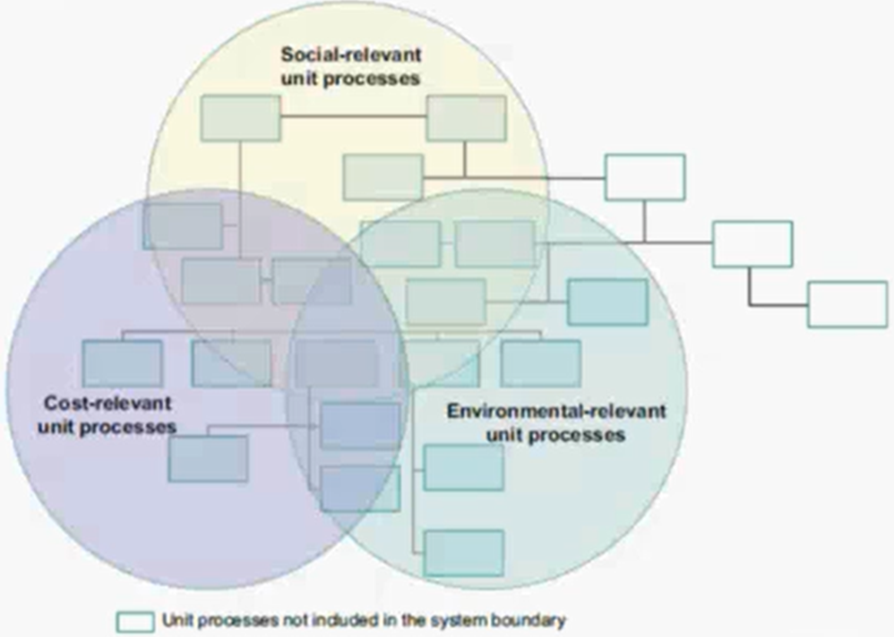
LCSA boundaries
Difficulties for implementation
Differences between the LCA, the LCC, and the S-LCA in system boundary
Recommendations that the boundaries contains all the life cycle stages relevant for at least one technique
Source: Jingzheng Ren, Sara Toniolo, 2020 [8]; Marzia Traverso, 2019 [10]; Marzia Traverso, 2019 [11]
Notes:
As mentioned, the concept of sustainability assessment of a product can be described by three methods entirely. The figure shows the system boundary of an LCSA (Traverso et al., 2012).
Because of the differences between the LCA, the LCC, and the S-LCA in system boundary, data inventory, and evaluation indicator aspects, the research of the LCSA faces many difficulties. Therefore, the theory and models still have no definite standard, and the application of the LCSA is also not common.
It is recommended that the boundaries contains all the life cycle stages relevant for at least one technique. In case of exclusion of life cycle stages the reason should ne justified.
In the past, the LCSA has been expressed by the integration of three or two life cycle assessment methods. The research of two LCA methods integration is more usual while the research of three methods integration is less.

Slide 24
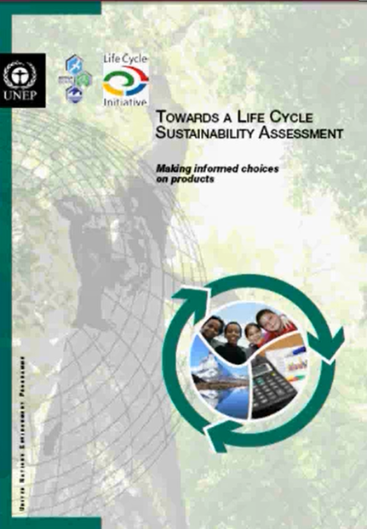
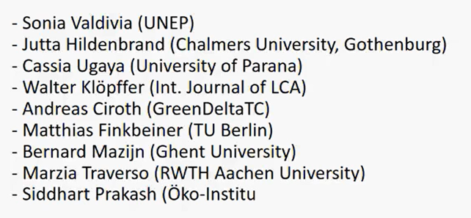
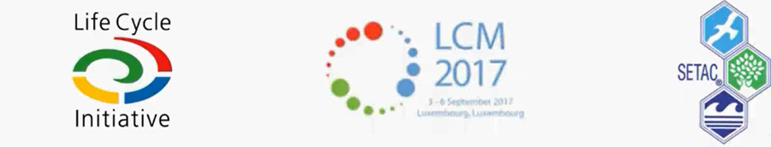
UNEP SETAC LCSA publication
Source: Marzia Traverso, 2019 [10]; Marzia Traverso, 2019 [11]
Notes:
Lyfe Cycle Iniative witihn a inter-univeristy cooperation and SECAP develope a general guidelies about the Life Cycle Sustainability Assessment

Slide 25
LCSA implementation
Key aspects:
Scale of applicability
Use of existing approaches merged consistenly and systematically
Triple ‘’ bottom line’’ of sustainable development for decision-making (i.e. 3P: people, plant and profit)
Contribution to UN Conference on Sustainable Development Rio +20
Source: Marzia Traverso, 2019 [10]; Marzia Traverso, 2019 [11]
Notes:
The implemantion of the Life Cycle Sustainability Assessment approach according to this joined document hase key important aspects on its implementation.
Fir of all, it scale of applicability feasible worldwide
It not re-inventing the wheel so using already existing approach and merging themconsistenly and systematically
While methods for E-LCA, LCC and S-LCA have been developed as stand-alone tools, their contribution in one study allow for integrated decision-making on the triple bottom line of sustainable development (i.e. 3P: people, plant and profit
It was contributing to UN Conference on Sustainable Development Rio +20

Slide 26
LCSA benefits
Clarifying the trade-offs among the three sustainability pillars
Roadmap for enterprises towards social and environmentally responsability
Promoting awareness in the value chain actors on sustainability issues
Prioritization of decision-makers strategic resources use
Screening of sustainable products for decision-makers
Sustainability assessment at consumer level
Notes:
In this slides are summarized the main benefits and thus main reason for the application of Life Cycle Sustainability Assessment approach.
Life Cycle Sustainability Assessment could help in clarifying the trade-offs between the three sustainability pillars, life cycle stages and impacts, products and generations
It could show enterprises how to become more socially and environmentally responsible by taking into account the full spectrum of impacts of their products
It will promote awareness in value chain actors on sustainability issues
It will support decision-makers in prioritizing resources and investing them where there are more chances of positive impacts and less risk of negatives ones
It would also drive decision makers to choose sustainable products and technologies
Moreover it will help consumers to know which products are more cost-efficient, eco-efficient and social responsible and meantime being more responsible

Slide 27
Environmental Life Cycle Assessment in a nutshell
Notes:
I am now going to focus on the main aspects and concepts of Agrobiodiversity.

Slide 28
What is Environmental LCA (E-LCA)?
Science-based methodology used to evaluate the environmental impact associated with a product or service from cradle to grave approach (i.e. entire life cycle of products/services)
Standardized in ISO 14040:2006 and ISO 14044:2006 (i.e. reliability and transparency)
Identificaiton of the potential reductions to improve the envrionemtnal performance of products
ISO 14040:2006 and ISO 14044:2006
Source: EU B@B Platform, 2020 [12]
Notes:
Life Cycle Assessment (LCA) is a science-basemethodology was born in order to face the need for methods for understanding and addressing environmental protection and the impacts of products. In other words, it was born to provide information to show the effects of an activity on the environment and to identify opportunities for making changes to reduce the environmental impacts .
According to SETAC LCA is a methodology to evaluate the environmental burdens associated with a product, process, or activity. It identifies and quantifies energy and materials used and waste released to the environment; it assesses the impact of energy, materials, and releases to the environment; it identifies and evaluates opportunities for environmental improvements.
Today The LCA methodology is a standardized, which ensures its reliability and transparency. Currently, the LCA methodology is standardized by two international standards, namely ISO 14040:2006 and ISO 14044:2006.
In each life cycle stage there is the potential to reduce resource consumption and improve the performance of products.

Slide 29
E-LCA definition by ISO 14044:2006
‘’Technique for assessing environmental aspects and potential impacts throughout a product (or service)'s life cycle from raw material acquisition through production, use and disposal ’’
ISO STANDARDS 14040-44
A life cycle of a product (i.e. Cradle-to-grave) begins with raw materials production and extends to manufacture, use, transport, and waste management (i.e. Impacts extend well beyond the “use” phase)
Notes:
According to ISO 14040-44 E-LCA is defined as a technique for assessing environmental aspects and potential impacts throughout a product (or service)'s life cycle from raw material acquisition through production, use and disposal.
Within this definition is expressed the circularity of product life cycle taking into account the so called Cradle-to-grave (or cradle-to-cradle) perspective, which begins with raw materials production and extends to manufacture, use, transport, and waste management (i.e. Impacts extend well beyond the “use” phase)

Slide 30
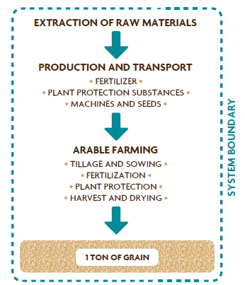
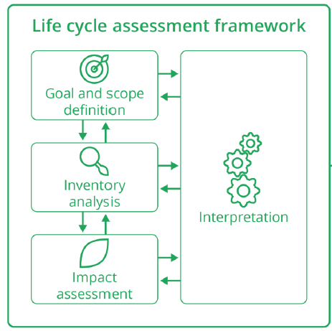
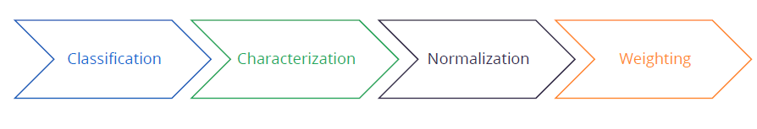
Main stages of the E-LCA
4 LCA stages
Life Cycle Impact assessment
Source: EU B@B Platform, 2020 [12]
Notes:
The first phase of the E-LCA is the description of the goal and scope, which includes defining the objectives of the study and setting the system boundaries. The second phase, called inventory analysis, compiles inputs and outputs for each process in the life cycle and sums them across the whole system. Typically, several hundreds of emissions and resources are quantified.
In the third phase, known as life-cycle impact assessment (LCIA), emissions and resources are grouped according to their impact categories and converted to common impact units to make them comparable. The final phase is the interpretation of the inventory and impact assessment results in order to answer the objectives of the study.
In the picture is reported an example of analyzed system for the production of 1 ton of grain. In the picture are reported the boundaries can considered in such specific LCA study which for example used LCA to determine the environmental impacts of different fertilizer management regimes in wheat production systems .

Slide 31
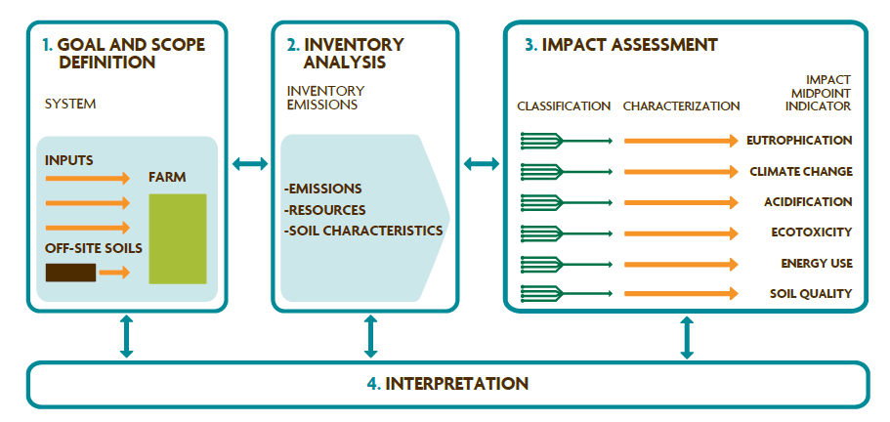
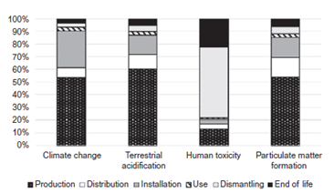
The E-LCA steps towards environmental profiling
Compilation and evaluation of inputs, outputs, and potential environmental impacts
Environmental profile as environmental score
Source: Jingzheng Ren, Sara Toniolo, 2020 [8]; Laurie E. Et al. , 2016 [16]
Notes:
A scheme representing the application of 4 steps of the LCA methodology is shown in the figure. The figure is in line with the currently accepted definition of LCA which is a “compilation and evaluation of inputs, outputs, and potential environmental impacts of a product system throughout its life cycle,” based on four steps.
Typically, in the inventory phase all emissions and resources are quantified.
In the third phase, known as life-cycle impact assessment (LCIA), emissions and resources are grouped according to their impact categories and converted to common impact units to make them comparable.
(animation) As it can be seen in the figure the aim is to return an environmental profile of the investigated product’s system. Specifically, for in the pciture is reported a fictional example focused on 4 main impact categories for a convention cradel-to-grave approach. The selected impact categories for the description of the environmental profile: climate change, terrestrial acification, human toxicuty and particular matter formation. The final phase is the interpretation of the inventory and impact assessment results in order to answer the objectives of the study.
We will talk more in details about the E-LCA in the unit 4 of this module.

Slide 32
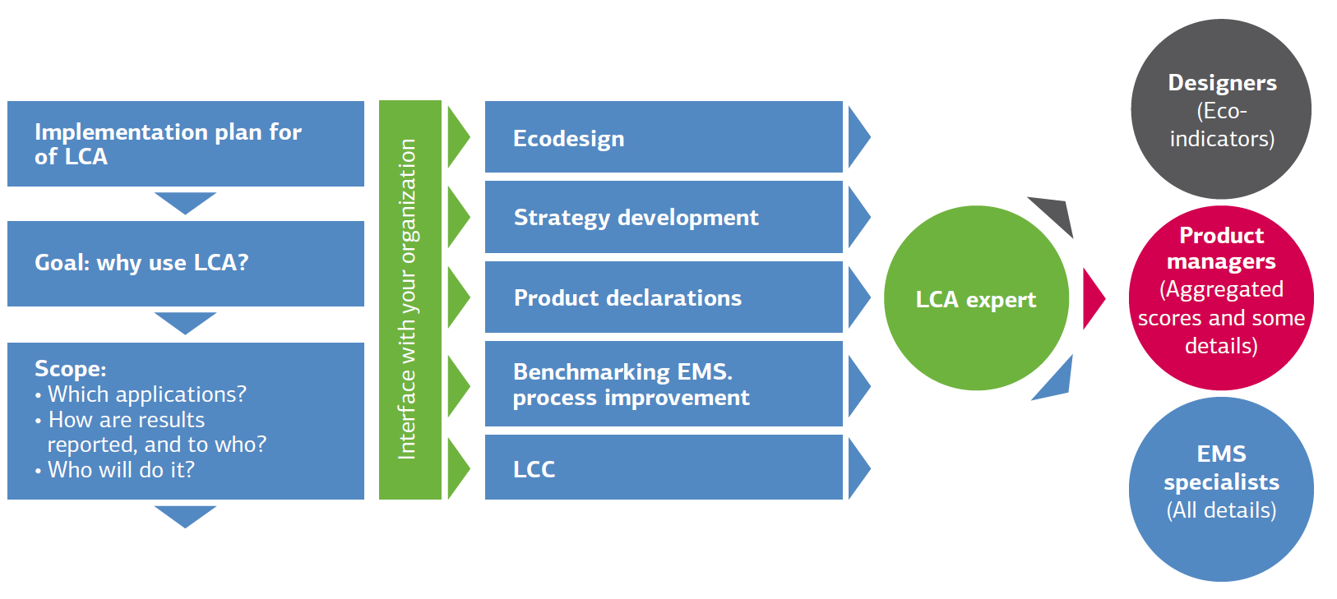
Role of the E-LCA
Source: Mark Jacob Goedkoop et al., Introduction to LCA with SimaPro Environmental Footprint (PEF), Technical Report · January 2016, https://www.researchgate.net/publication/305444131

Slide 33
Synopsis
This lecture gives an insight into:
  Life Cycle Sustainability Assessment
  Environmental Life Cycle Assessment
  Life Cycle Costs Assessment
The lecture includes also the explanation of calculation tool able to provide a quantitative approach for screening scenario applying circular and bio-economy solutions
Notes:
Summary of contents and learners achievments

Slide 34
References
ARE, Switzerland Federal Office for Spatial development ; https://www.are.admin.ch/are/en/home/media/publications/sustainable-development/brundtland-report.html
Restorative leadership, Taking the long view: Gro Brundtland on Leadership and Sustainable Development, 2012, http://restorative-leadership.com/blog/taking-the-long-view-gro-bundtland-on-leadership-and-sustainable-development
Assembly of European Regions; https://aer.eu/sustainable-development-goals-engaging-regions/
Elkington, J. (1998), "ACCOUNTING FOR THE TRIPLE BOTTOM LINE", Measuring Business Excellence, Vol. 2 No. 3, pp. 18-22.
Rikardo Minguez et al., Fostering Education for Circular Economy through Life Cycle Thinking, 2021. DOI: 10.5772/intechopen.98606
Jingzheng Ren, Sara Toniolo. Life Cycle Sustainability Assessment for decision-making Methodologies and Case Studies, 2020
Manuele Margni, Analyse de cycle de vie et arbitrage dans une perspective d'économie circulaire, Pr., CIRAIG – École Polytechnique de Montréal – AMERICANA 2015 conference
Jingzheng Ren et al., Biofuels for a more sustainable future. Life Cycle Sustainability Assessment and Multi-Criteria Decision Making, 2020

Slide 35
References
Biodiversity international, www.bioversityinternational.org, Mainstreaming in sustainable food systems agrobiodiversity
Marzia Traverso. Life Cycle Sustainability Assessment. Seminar organized BY THE Forum for Sustainability, through Life Cycle Innovation, March 2019
M. Traverso, FSLCI webinar 2019, Life Cycle Susteneability Assessment, 2019
EU B@B Platform – Webinar series “Measuring biodiversity for business and finance” Webinar 2: Case studies on product level biodiversity measurement approaches for business, 2020
Laurie E. Drinkwater, Diana Friedman and Louise Buck, Systems Research for Agriculture - Innovative Solutions to Complex Challenges, Published by the Sustainable Agriculture Research and Education (SARE) program, with funding from the National Institute of Food and Agriculture, U.S. Department of Agriculture, 2016

Slide 36
Further readings
Jingzheng Ren, Sara Toniolo. Life Cycle Sustainability Assessment for decision-making Methodologies and Case Studies, 2020
Jingzheng Ren et al., Biofuels for a more sustainable future. Life Cycle Sustainability Assessment and Multi-Criteria Decision Making, 2020
Laurie E. Drinkwater, Diana Friedman and Louise Buck, Systems Research for Agriculture - Innovative Solutions to Complex Challenges, Published by the Sustainable Agriculture Research and Education (SARE) program, with funding from the National Institute of Food and Agriculture, U.S. Department of Agriculture, 2016

Slide 37
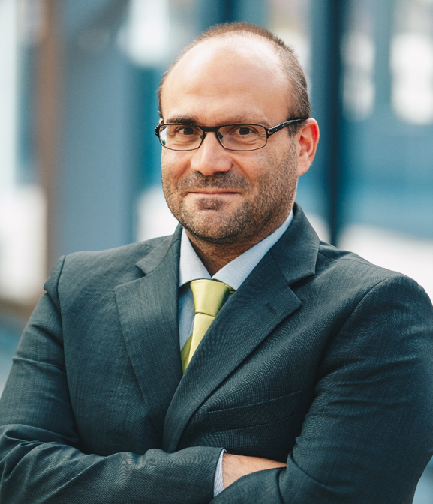
Short-bio
Dr. sc. ing., Francesco Romagnoli, Professor
Scopus Author ID: 36998780600
ORCiD: 0000-0003-1814-7310
H-index = 14
Professor at RTU IESE with a specialization in Eco-design and Life Cycle Assessment
Main research areas: LCA and System Dynamics modelling within techno-feasibility and sustainability evaluations, evaluation of Bio- and circular-economy solutions, overall Life Cycle Sustainability Assessment including environmental LCA (E-LCA), Life Cycle Costs (LCC) and Social LCA (S-LCA), urban system’s resilience evaluation, biogas from seaweeds and microalgae
Leading of the University courses of: LCA and Eocodesign, Risk and Reslience, Applied Geophysics methods.
Head of the Biosystem Laboratory at RTU Institute of Energy Systems and Environment

Slide 38
Thank you

Slide 39
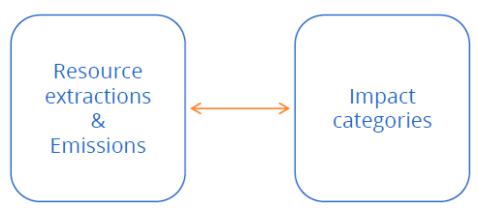
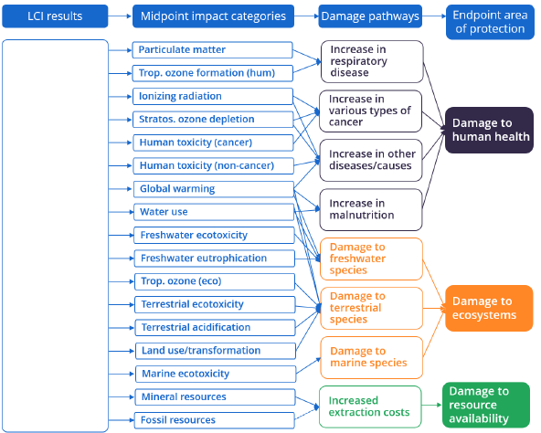
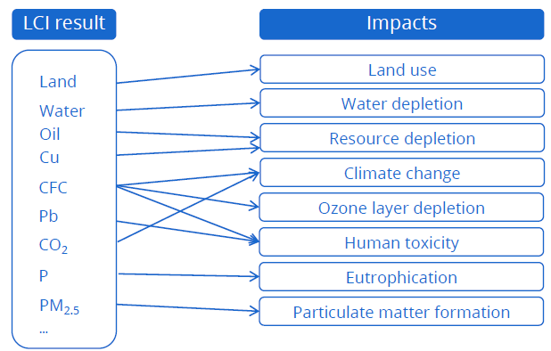
Biodiversity in Life cycle Assessment (LCA)
Characaterization
Mid- or End-point category (ReCiPe emthod)
Source: EU B@B Platform Webinar series “Measuring biodiversity for business and finance”, Webinar 2: Case studies on product level biodiversity measurement approaches for business
Notes:
Characterization:
Identifying the connections between types of environmental pollution and impact Sorting the interventions into classes according to the effect they have on the environment
The potential environmental impact of the product's inventory flows are assessed during the LCIA phase. These potential impacts may be expressed at the midpoint or endpoint level, within a cause–effect chain or environmental mechanism midpoint results are well-characterized in terms of physical units, as shown in Fig 2

Slide 40
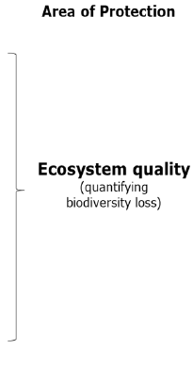
Biodiversity in Life cycle Assessment (LCA)
Potentially Disappearing Fraction of species (PDFs)
Source: EU B@B Platform Webinar series “Measuring biodiversity for business and finance”, Webinar 2: Case studies on product level biodiversity measurement approaches for business; Serenella Sala, The initiative to improve biodiversity coverage in the Product Environmental Footprint (PEF)
Notes:
Biodiversity impacts in LCA are usually assessed at the endpoint level. Currently EF is addressing impacts which ultimately may lead to biodiversity loss, such as climate change, ecotoxicity, land use etc
Current LCIA methods use species richness to quantify potential impacts on biodiversity Potentially Disappearing Fraction of species (PDFs)

