Slide 1
Introduction to OpenLCA
Fabian Diaz, M.Sc. Ing., Researcher
2021
Notes:
Welcome to Today’s lecture. - Introduction to Open LCA

Slide 2
Presenter’s Bio
Fabian Diaz
Chemical Engineer
M.Sc. Environmental Science
Researcher at Riga Technical University
Notes:
My name is Fabian Diaz. – I am chemical engineer with experience in the energy and food sectors. – I havea Master in Environmental Science and currently working as Researcher at Riga Technical University

Slide 3
Aim/Objectives
This module will introduce you to the basics about Environmental LCA tools. At the end of the module, you will be able to identify different software for E-LCA, understand what is a database and recognize the main difference between them.
Other objectives:
First contact with OpenLCA
Install Open LCA software
Notes:
Today’s lecture has a main goal, to introduce you to the basics about LCA software, and identify the main existing databases. You will also be able to download and install the OpenLCA software for a future lecture and practical tasks.

Slide 4
Learning outcomes
Apply the bio economy principles by the use of quantitative approaches, models and tools
Manage the organization of quantitative assessments by the use life cycle thinking approaches.
Notes:
The learning outcomes of this lecture are aligned with the ones from this module. You will apply bio economy principles by the use of quantitative methods and tools.
You will manage quantitative assessments using life cycle thinking approach.

Slide 5
Keywords
E-LCA: Environmental Life Cycle Assessment
ISO: International Standard Organization
LCA tool: A program that simplifies modelling of products
Characterization factor: factor which is applied to convert an assigned life cycle inventory analysis result to the common unit of the category indicator
Notes:
The most recurrent keywords you will find in this presentation are:
Environmental Life Cycle Assessment
International Standard Organization
LCA tool, and
Characterization factor. This definition you already saw it in a previous lecture, although it is important you keep it in mind.

Slide 6
Table of content
LCA tools
Content
Tools comparison
Calculations
OpenLCA description
OpenLCA download and installation
LCA databases
LCIA methods
Notes:
In this lecture we will go through the displayed topics, starting with what is an LCA tool and which are the main ones used. Then we will see what is an LCA tool comprised by, and the main differences between them in terms of content and calculations.
Afterwards we will move to the OpenLCA software with a brief introduction to it, and its download and installation procedure.
Finally, we will see the available databases and the most used life cycle impact assessment methods.

Slide 7
LCA tools
Easier to use than general purpose software
Direct access to material and process databases
Includes life cycle impact assessment methods
Allows to follow the requirements of ISO 14040/14044
Number of publications
Source: A. Lopes Silva, et al. / Sustainable Production and Consumption 20 (2019) 304–315
Notes:
Softwares such as MS Excel, Matlab, or Mathematic, can be set up to do LCA calculations, but software specifically designed for LCA is much more comprehensive in terms of producing LCA calculations. These programs simplify initial modelling of products by providing access to databases of generic LCA material and process information. The software eliminates the effort for creating assessment method in a spreadsheet or math program.
LCA software programs are mainly based on ISO 14040/14044 or are simplified versions toward specific applications.
The software's usually allow access to multiple databases and impact assessment methods.
SimaPRo and Gabi have been the two leading LCA softwares in the world.
History has shown that unfortunately, most free softwares are not persistent. The reasons behind free software premature demise can be explained as lack of time and resources to keep the software updated and running, new regulations making the software obsolete, outdated websites, and in general all the common downfalls associated with free tools. The simplified programs are streamlined versions of LCA, often having only a single database and assessment method available.
Open LCA tries to compete in this open-source software field with commercial software.

Slide 8
LCA tool content
Basically, life cycle analysis tools include:
Data entry system
Databases
Calculation methods
Output of results
Model creation
Data input
Calculation
Result presentation
j
j
j
Notes:
The content in an LCA tool can be divided in 4 stages.
The model creation is probably the one where most specific knowledge on the software arquitecture the LCA practitioner needs. The front end in almost every single LCA tool varies greatly, and while some software allow graphic modelling, other require a deeper understanding of the system boundaries and flows understood from the LCA perspective.
The data input is also highly dependent on the user interface the software provides for the LCA practitioner. However, this step depends also on the database we are using. At this point, we need to be very careful checking our flows are located as they should be, either inflows or outflows, always keeping in mind the mass balance, functional unit, and unit system for each of our items in the model (products or processes)
The calculation, in most of the LCA tools is very straightforward. Such process is fully done by the software and all we need to be certain of, is the chosen Life Cycle Impact Assessment method to use, which will depend on the goal of the study.
The presentation of results is influenced basically by two things: the LCA tool and the chosen LCIA.

Slide 9
LCA tool use by keywords
Source: A. Lopes Silva, et al. / Sustainable Production and Consumption 20 (2019) 304–315
Notes:
In this slide, the results of a bibliographic analysis is displayed for four LCA tools. This analysis shows what are the main topics, the LCA software has been used for. –
As you can see from the keyword weight, for Simapro, the most researched keywords are energy, systems, performance, and emissions. For Gabi, also a leader LCA software, the main keywords are energy, management, systems, and design.
Umberto on the other hand, still not an open source tool, less keywords are found. Nevertheless, the topics are very similar, with emissions, energy, and model leading the researches made on this platform.
Finally, OpenLCA displays energy and greenhouse emissions as the main topics linked to it.
From this, one could believe that one software might for some reason suit better for some specific research topic, but as we will see, this is not entirely true, and the use of one or another tool, depends on different criteria.

Slide 10
LCA tool comparison
Comparison of 11 tools based on facade LCA
Source: Back R., et.al. / Journal of Facade Design and Engineering 7 (2019)
Notes:
In this spider graph, a comparison between the most used LCA tools is displayed considering different aspects such as the required user knowledge, the amount of phases able to model or their settings.

Slide 11
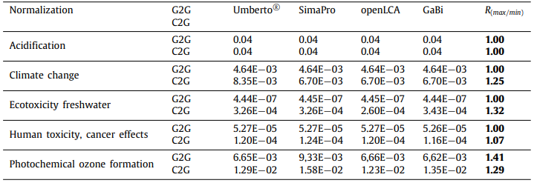
Difference in LCA tool calculations
Source: A. Lopes Silva, et al. / Sustainable Production and Consumption 20 (2019) 304–315
Occurs mainly because of different characterization factors or difference in data source
Source: I.T. Herrmann, A. Moltesen / Journal of Cleaner Production 86 (2015) 163-169
Notes:
In terms of results, differences by using one or other tool should not exist, in case the exact same model with same data input and method are employed. However, it can happen due to different software updates that may affect characterization factors or include new standards in the impact assessment models.

Slide 12
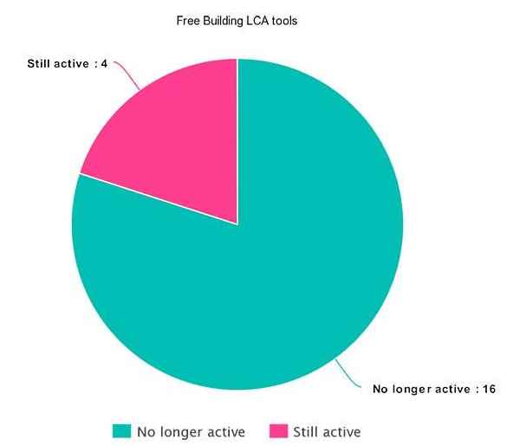
Free LCA tools
Source: OneclickLCA, https://www.oneclicklca.com/
Notes:
Currently, not a lot of free LCA software are still in the market. By 2019 only 4 LCA tools were sill available for free. This is due to the high work that it takes to keep these software up to date and running smoothly. Also, developing companies are constantly expanding their database options to include new methods or even new assessments, like Life Cycle Cost, or Social Life Cycle Assesstment.

Slide 13
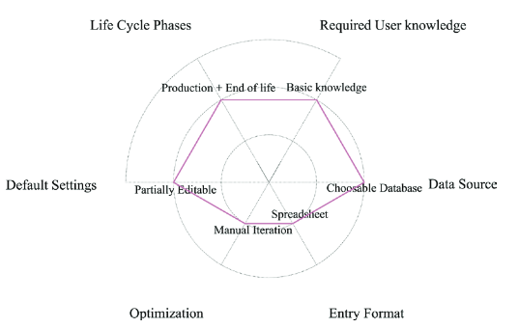
openLCA assessment
based on facade LCA
Source: Avots: Back R., et.al. / Journal of Facade Design and Engineering 7 (2019)
Notes:
From the afore displayed graph, if we focus on the OpenLCA software, which is the one we will be using today and in our future session, we can observe it has a fair score in most of the assessed features. OpenLCA is easy to use, does not require a lot of time to get used to the user interface, is somehow intuitive, and has a strong database availability.
Despite being an open source software, OpenLCA developers have managed to keep the app up to date, and many database developer companies are releasing compatible versions of methods and inventories.

Slide 14
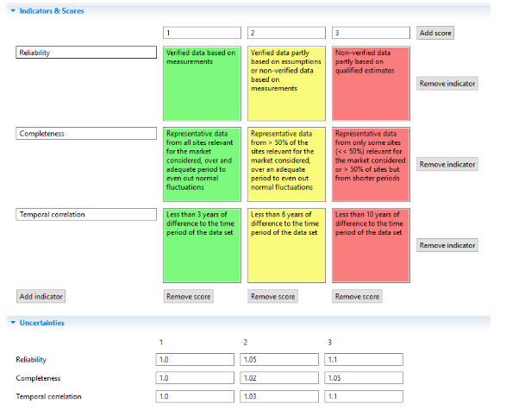
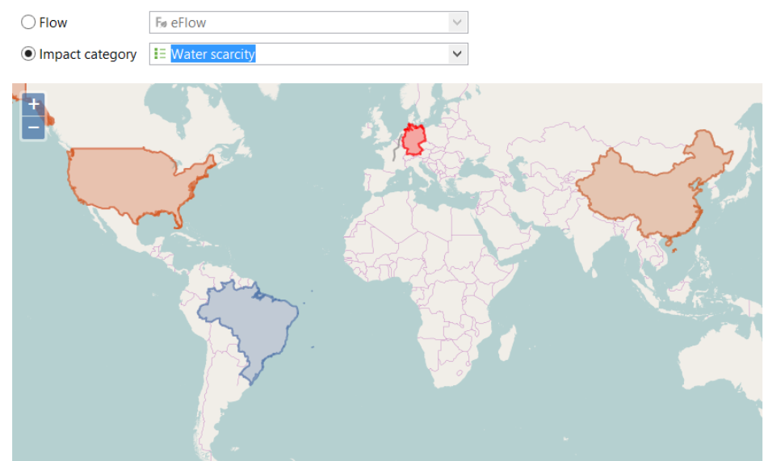
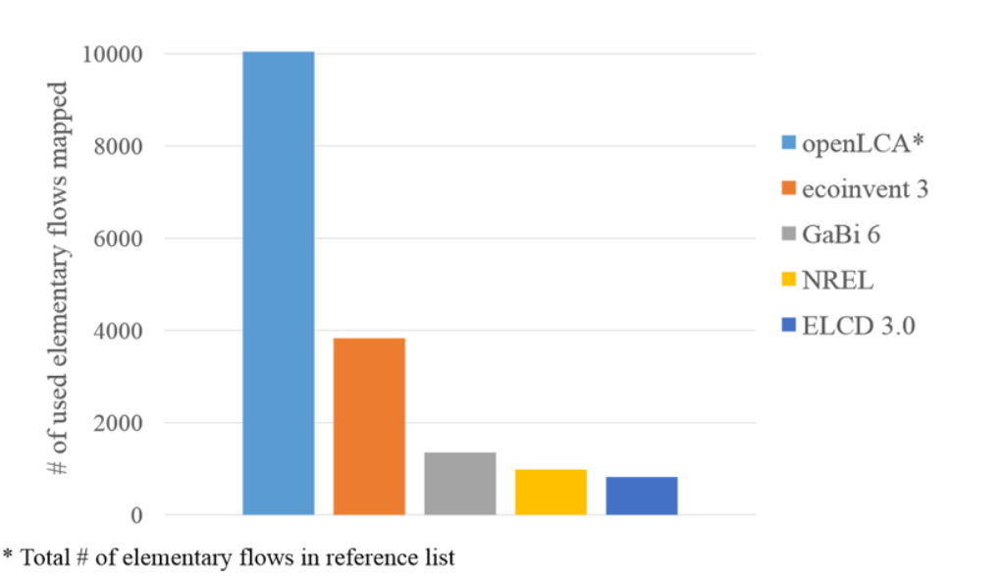
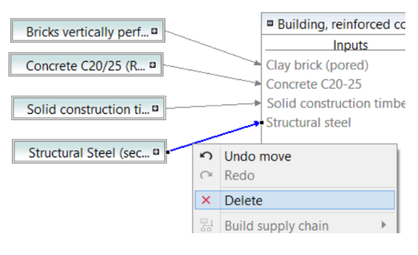
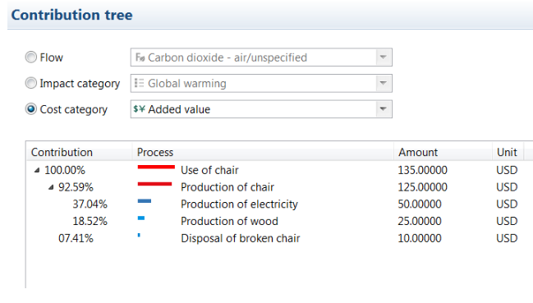
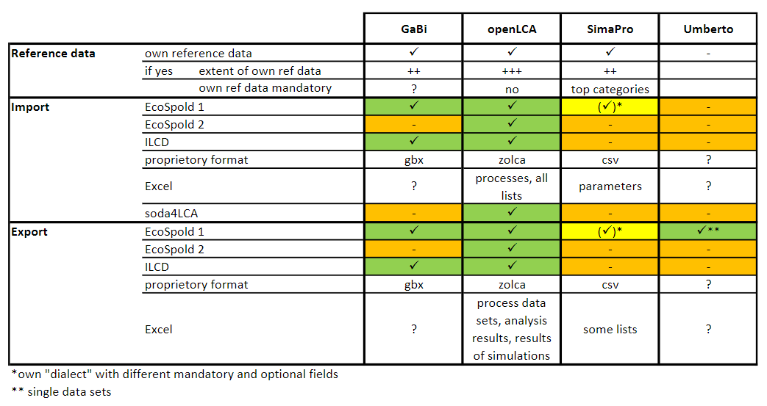
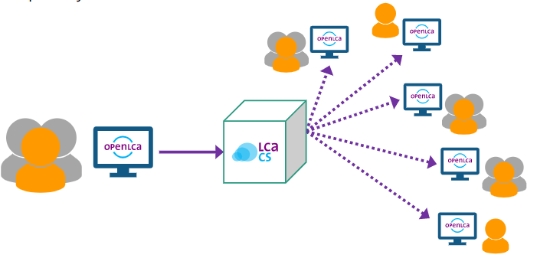
openLCA description
The leading free LCA software developed in 2006
Supports commercial databases
Provides the ability to model at the same level as with SimaPro and GaBi
Supports data dissemination
Supports file formats:
ILCD
EcoSpold
SimaPRo csv (only import)
Excel
LCC
S-LCA
Data output in graphs
Data output in map
Data quality system
Updated periodically
Source: Dreen delta
Notes:
OpenLCA is an attempt at providing a free open-source software package for doing LCA. Today, is still the leading free LCA tool.
OpenLCA is an intended software package with LCA capabilities similar to SimaPro and GaBi. It is used in industry, consultancy, education and research.
The main advantage of OpenLCA, is that there is no need to worry about software codes. It is not a black box software. You can inspect the code for any potential issues including security issues and any malicious behaviour.
OpenLCA has very extensive list of reference elements for elementary flows and other elements.
According to developers of this tool It is at the same level as SimaPro and Gabi. It supports sharing of data and projects online thourgh server , which serves as data hub.
It also has high interoperability compared to other softwares.

Slide 15
openLCA download and installation
1. Go to openLCA
2. Register
3. Select appropriate software format
4. Install
Download | openLCA.org
https://www.openlca.org/download/
Notes:
Now, we will move forward to the software installation procedure.

Slide 16
Step 1. OpenLCA software download
Notes:
Go to the web-page of OpenLCA software provider “GreenDelta” to download the latest version of software
You will be asked to leave contact information to proceed to the download section. In the download section (see figure) you will find option to select OpenLCA software for Windows or Mac. Please download the appropriate file for your type of computer.

Slide 17
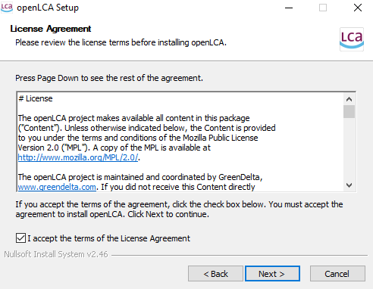
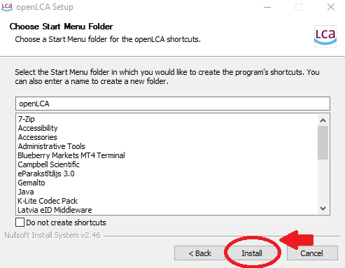
Step 2. OpenLCA software installation
Notes:
Open the downloaded file to install the software.
To proceed with the installation, please accept the terms of the License Agreement. Click “Next” until you will see button “Install” (Figure 3). Select install and wait for the software to be installed on your computer. This can take some time. In case the installation is taking more than 20 minutes, you can end task the installation manually trough task manager option on your computer.

Slide 18
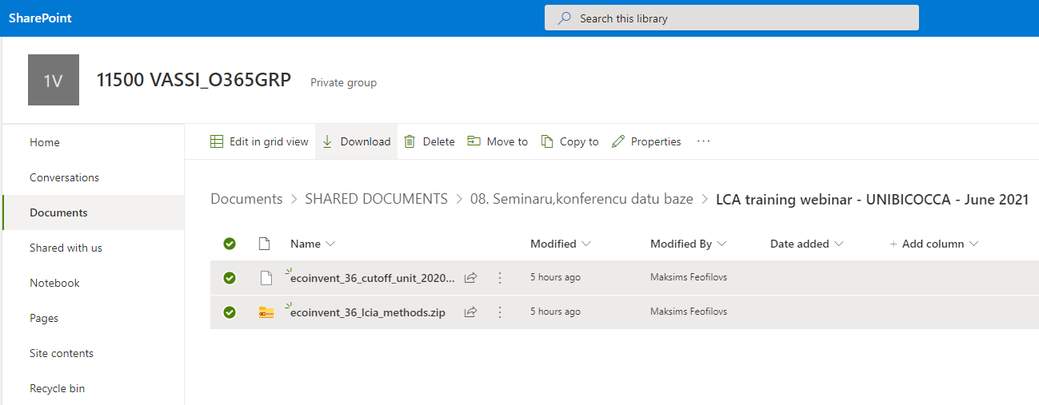
Step 3. Download Ecoinvent database and impact assessment methods
To download Ecoinvent database (ecoinvent_36_cutoff…) and impact assessment methods (ecoinvent_lcia…) use link: https://rtucloud1.sharepoint.com/:f:/s/11500vassi/Etd_KhJihw5HhwpXpDgQpZMB0w5eCGhqNY8F9eKJlSycpg?e=2u6Qyq
Notes:
To download Ecoinvent database (ecoinvent_36_cutoff…) and impact assessment methods (ecoinvent_lcia…) use the link provided:
You will be redirected to RTU online file storage. Download both files in from this folder.

Slide 19
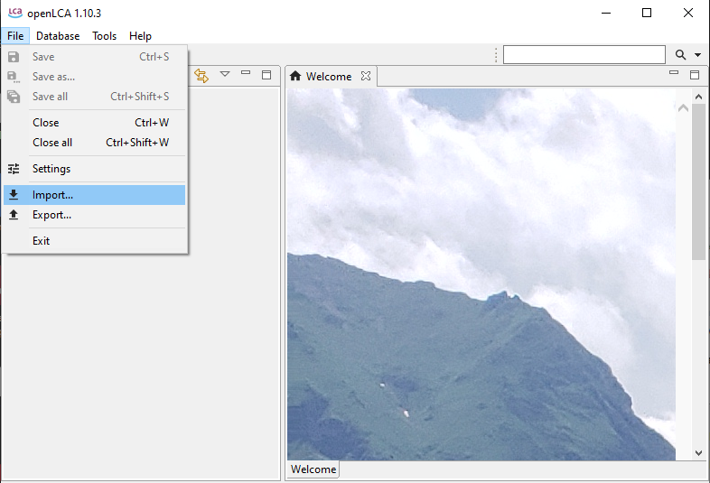
Step 4. Import Ecoinvent database
Notes:
The new database is empty and therefore you need to import the data from Ecoinvent database file that you downloaded. To do that, please select File and Import

Slide 20
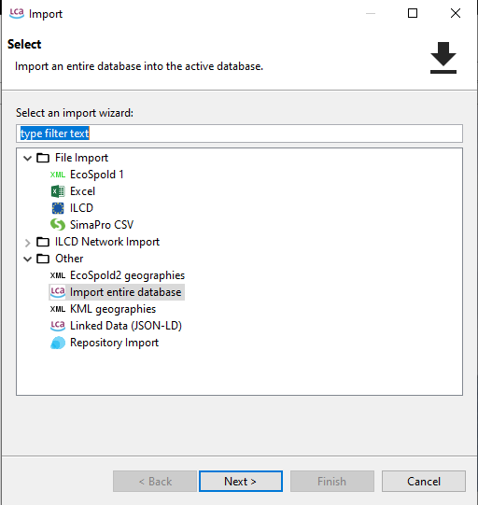
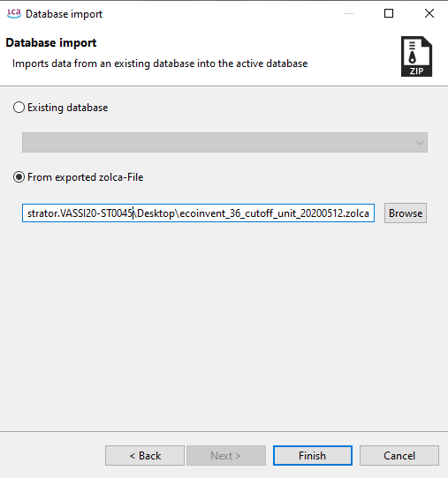
Step 4. Import Ecoinvent database
Notes:
Select Import entire database and click Next.
In the next window please select option “From exported zolca-File” and click on “Browse” to find the downloaded Ecoinvent database. Click finish. The import of database will start and can take some time.

Slide 21
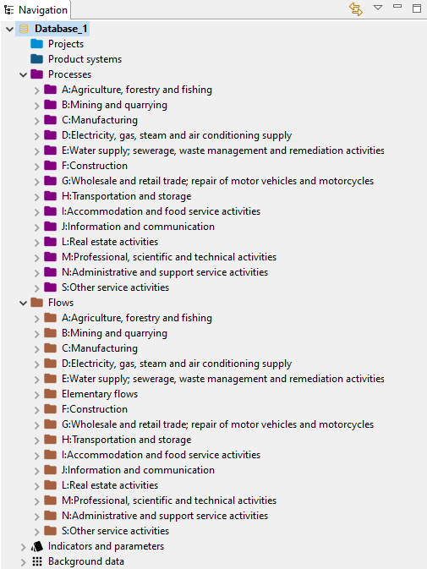
Step 4. Import Ecoinvent database
Notes:
Once the database is imported, you should be able to find processes and Flows as shown in the figure.

Slide 22
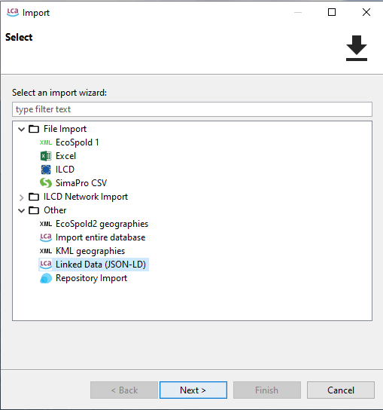
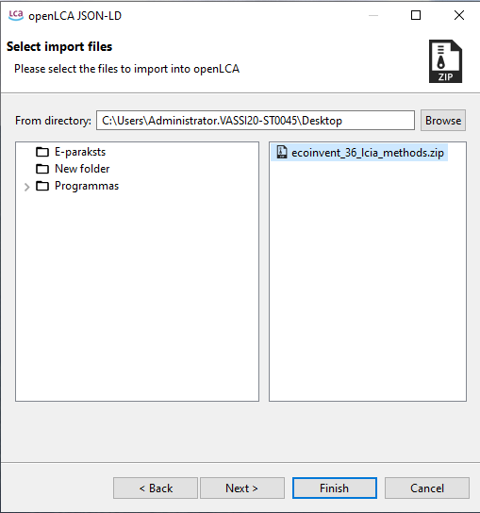
Step 5. Import Impact assessment methods
Notes:
Again, go to File and select import as was already shown. When the window will pop-up, select Linked data (JSON-LD) file and select Next.
Now Browse to find the folder where you downloaded the impact assessment file and select this folder. When the correct folder is selected on the right side of the window you will see .zip type file. Select the file and click Finish.

Slide 23
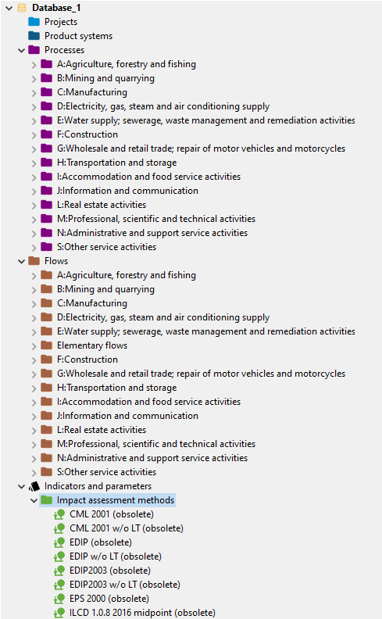
Step 5. Import Impact assessment methods
Notes:
Now you will see the impact assessment methods under indicators and parameters in the navigation panel.

Slide 24
Notes:
Once you run the software, this is the welcome screen you will see. We will work with this software in a future lecture.

Slide 25
openLCA databases
Free databases: https://nexus.openlca.org/databases
Notes:
openLCA offers the largest collection of data sets and database worldwide for LCA software, some for purchase, some for free; altogether, almost 100,000 different data sets are available.
A leading LCA database by the ecoinvent association, Ecoinvent 3.6, he new data covers: agriculture, building and construction materials, chemicals, electricity, fishing, metals, refineries, textiles, tourism, transport, waste treatment and recycling, and water supply.

Slide 26
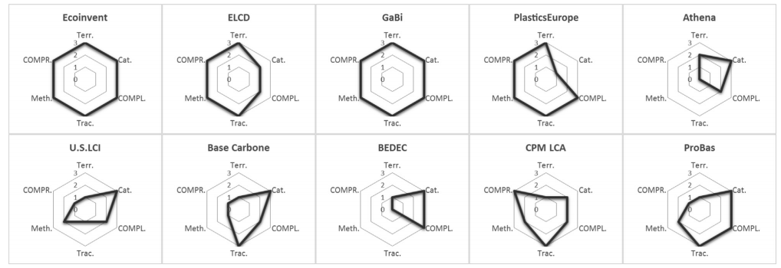
Differences in databases
Different coverage (geographical, product categories)
Data diversity
References to data source, transparency
Methodology for data collection / systematic accounting
The documentation is easy to use
Data update
License requirement
Source: Avots: Back R., et.al. / Journal of Facade Design and Engineering 7 (2019)
Source: A. Martínez-Rocamora et al. / Renewable and Sustainable Energy Reviews 58 (2016) 565–573
Notes:
Several of these databases can be used for environmental impact assessments
Each of the shown LCA database, is developed by an enterprise or organism located in a specific country or territory, and the modelled processes are based on its manufacturing characteristics. Thus, when researchers carry out a study using an LCA database from another country, the results may well be incorrect if the proper databased is poorly selected.

Slide 27
ecoinvent LCIA methods
CML 2001
Cumulative energy demand
Cumulative exergy demand
Ecoindicator 99
Ecological footprint
Ecological scarcity 1997, 2006 and 2013
Ecosystem damage potential
EDIP 2003
EPS 2000
ILCD 1.0.8
IMPACT 2002+
IPCC 2001, 2007 and 2013
ReCiPe Midpoint and Endpoint
TRACI
USEtox
Notes:
The Ecoinvent database, Includes 41 Life Cycle Impact Assessment methods. 31 methods are midpoint methods while the other 10 are endpoint oriented. 14 methods include normalization factors and 17 methods include weighting to allow aggregation among the different impact categories. We will see more about these databases in our next session, practicing real case studies.

Slide 28
Synopsis
OpenLCA software is an open source and powerful LCA tool that brings almost the same features than other paid software. Due to its widespread use, most of the database creating organizations provide resources compatible with it.
The installation process is simple, and databases to be used in this course, are available to download for free from the RTU cloud.
Notes:
OpenLCA software is an open source and powerful LCA tool that brings almost the same features than other paid software. Due to its widespread use, most of the database creating organizations provide resources compatible with it.
The installation process is simple, and databases to be used in this course, are available to download for free from the RTU cloud

Slide 29
THANK YOU

