Slide 1
Social Life Cycle Assessment
Fabian Diaz, M.Sc. Ing., Researcher
2021
Notes:
Welcome to Today’s lecture. - Introduction to Open LCA

Slide 2
Presenter’s Bio
Fabian Diaz
Chemical Engineer
M.Sc. Environmental Science
Researcher at Riga Technical University
Notes:
My name is Fabian Diaz. – I am chemical engineer with experience in the energy and food sectors. - Master in Environmental Science and currently working as Researcher at Riga Technical University

Slide 3
Aim/Objectives
This module will introduce you to the concept of Social Life Cycle Assessment and its latest insights. At the end of the module you will be able to understand how the Life Cycle Thinking approach can be used to identify potential risks for society.
Other objectives:
Recognize all social stakeholders and subcategories
Identify the main social indicators related to the agro-farming sector
Notes:
Today’s lecture has a main goal, to introduce you to the concept of Social Life Cycle Assessment, so you can understand its importance not only for sustainability evaluation, but also from the Social Responsibility side.
You will also be able to understand and recognise the main society “stakeholders” as defined by the United Nations and what are the indicators used to measure the social impacts.

Slide 4
Learning outcomes
Acquire a basic knowledge on the potential definition of strategic sustainable development of the agro-farming sector;
Compare and analyze solutions from the application of LCA-based quantitative assessment and their implication on selecting a specific bioeconomy solution;
Justify and recommend potential improvements solutions following a bioeconomy evaluation approach.
Notes:
The learning outcomes of this lecture are aligned with the ones from this module. You will apply bio economy principles by the use of semi-quantitavive/quantitative methods and tools based on the life cycle thinking approach.

Slide 5
Keywords
S-LCA: Social Life Cycle Assessment
ISO: International Standard Organization
Stakeholder: Is any a party that it is involve or can either affect or be affected by the product (good/service) life cycle.
Social Indicator: are those used to assess how well a product is developing in certain key areas. It is one way of finding out what is happening within a social stakeholder.
Notes:
The most relevant keywords you will need to keep in mind during this lecture are:
Social LCA
ISO
Stakeholder
Social Indicator under the LCA methodology

Slide 6
Table of content
S-LCA definition
Framework
Pathway and steps to perform S-LCA
Stakeholders
Social topics/Sub-categories
Uses of S-LCA
Notes:
In this lecture we will go though the displayed topics, starting with what is a S-LCA and how it is understood nowadays
Then we will see what is the most recent framework described to perform a S-LCA and main differences with the previous proposed framework.
Afterwards we will see what are the main uses so far for S-LCA, which are the stakeholders to consider, the social topics potentially affecting them, and what indicators to use to evaluate those topics.

Slide 7
Definition of S-LCA
Social Life Cycle Assessment is a methodology to assess the social impacts of products and services across their life cycle
It is born as an expansion of the LCA framework to include the impact from a product or system on social entities (workers, consumers, communities, etc.)
Notes:
Social Life Cycle Assessment (S-LCA) is a methodology to assess the social impacts of products and services across their life cycle (e.g. from extraction of raw material to the end-of-life phase, e.g. disposal).
S-LCA rests upon a combination of methods, models, and data.
S-LCA methods can be found in reference documents or manuals usually published by the United Nations, SETAC, and the Social LC initiative.
Models are used to provide a representation of the product life cycles/systems under study; and several types of models can be used, e.g. a process model.
Data, is the information about the product life cycle/system and its potential impacts that enables the assessment to take place

Slide 8
Common issues with S-LCA development
Lack of standardized indicators
Understanding the business social impact as a unified concept
SLCA databases still in the developing and limited stage
Indicators selected for social performance measurement may vary depending on company’s sustainability orientation

Slide 9
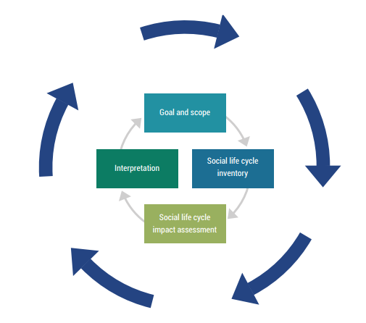
S-LCA Framework
Notes:
S-LCA is in large part based on the ISO 14040 framework for E-LCA. Therefore, it includes four phases: Goal and Scope, (Social) Life Cycle Inventory (S-LCI), (Social) Life Cycle Impact Assessment (S-LCIA) and Interpretation. It is an iterative methodology, which means that we can improve the assessment over time, going through several assessment loops and moving from more generic/potential results to more site- and case-specific ones.

Slide 10
Previous S-LCA Framework
Understanding LCT
Preparation
Goal & Scope
Hotspot Identification
Assessment of impacts on Stakeholders
Social Impacts
Notes:
In the last decade, despite the fact of the methodology was already under use by many researchers and even governmental bodies, the framework was not completely defined. The main difference is that today, with the release of the Guidelines for SOCIAL LIFE CYCLE ASSESSMENT OF PRODUCTS AND ORGANIZATIONS 2020, the framework has been reshaped to meet the same steps as recommended by the ISO 14040 for the conventional Environmental LCA.

Slide 11
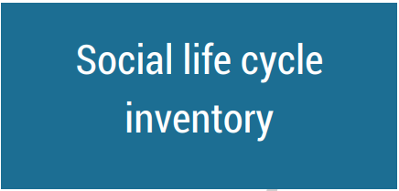
Preparation (Supressed)
Communication context
Determines scope
Determines data requirements
Material Assessment
Provides focus on relevant topics
Data collection readiness
Identify sources based on the goal
Review of data collection tools
Notes:
The main difference is this, the “preparation” step, which is now suppressed in the newest framework. This step was somehow confusing as proposed to start to identify data sources and tools, before actually setting the goal and scope of the study. In the new framework, this activities are conducted in the Life Cycle Inventory. But we will go in more detail later.

Slide 12
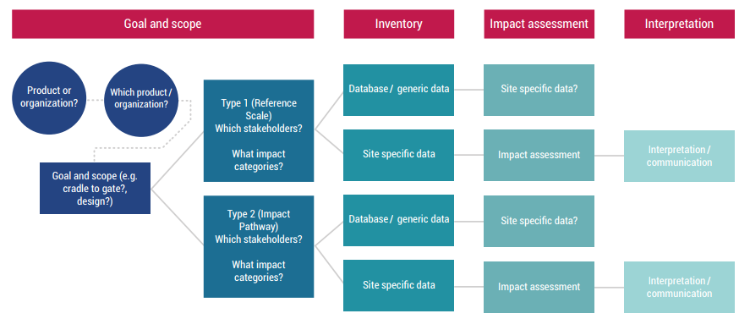
S-LCA decision tree
Notes:
When planning to conduct an S-LCA a number of key decisions have to be made. This Figure illustrates the main decisions by phase that a user needs to make at the onset of a study.
First, it has to be decided if the assessment will focus on a product or organization9. Then the specific product or organization needs to be identified. Next the goal(s) of the study needs to be thought out and described (product design, Human Rights Due Diligence, etc.) as well as the scope (e.g. full life cycle? raw material to assembly (cradle to gate)?)
In addition, the type of impact assessment method to be used needs to be defined as well as the topics that will be the focus of the assessment (stakeholder categories, impact subcategories). A data collection strategy needs to be developed. In particular, will the study use an S-LCA database and/or other sources of generic data (e.g. scientific articles)? If so, will that be followed by the collection of site-specific data? Finally, the impact assessment method(s) selected needs to be implemented and the results interpreted and communicated

Slide 13
SLCA – Goal & Scope
The goals sought by S-LCA case studies can vary. Examples of different purposes are: • To support sustainable design of products; • To support Human Rights Due Diligence of organizations; • To identify main social Hotspots of a product and/or organizations; • To quantify and qualify the potential social performance of products and/or related impacts, in order to support sustainable consumption; • To examine potential social improvement options along the life cycle; To assess the most relevant stages in the social value chain in terms of social impacts/hotspots; • To assess and compare, when possible, potential social performance and/or social impacts of product-systems; • To communicate the potential social performance and/or social impacts of the product to the public; • To understand if the product value chain contributes to the social development of its stakeholders.
Notes:
Goal and Scope (G&S) definition is the first phase of an S-LCA study where the purpose, the object, as well as the methodological framework, are determined. The objective is to provide a clear statement of purpose of the study and define its breadth and depth.
The first step of an S-LCA aims to specify why the study is being conducted. What is its goal? What is its intended use? Who is the target audience? What do we want to assess? Does the study intend to support decision making? On what topic? What are the potential improvement opportunities that are being sought through the knowledge that will be produced by the study? Which stakeholders are affected? The goal(s) should be clearly defined in order to ensure successful outcomes.

Slide 14
SLCA –Scope Definition
The scope clarifies the object of the study and determines its methodological framework. It needs to be related to the goal of the study.
Defining the object of the study, normally a product, a function, or a service;
Defining the reference flow;
Defining the product system;
Identifying the system boundaries;
Choosing activity variables;
Stakeholders included and affected;
Type of impact assessment method, and impact categories and/or subcategories included;
Data collection strategies (inventory indicators, data type and data collection);
Notes:
The Scope must be related to the goal and should clarify the object of the study and the methodological framework
For this purpose, the following elements should be defined within the scope definition phase. Some elements are optional and may be excluded, depending on the goal of the study:
Defining the object of the study, normally a product, a function, or a service;
Defining the reference flow (quantity of materials needed to produce the product or output);
Defining what steps, activities, and organizations are needed to comply with the functional unit (the product system);
Identifying which parts of the product system are part of the assessment (the system boundaries)
Choosing what variable(s) will determine the importance of different activities in the product system (activity variables);
Stakeholders included and affected, and stakeholders’ involvement strategy;
Type of impact assessment method, and impact categories and/or subcategories included;
Data collection strategies (inventory indicators, data type and data collection);
Data quality requirements;
Allocation procedures;
Interpretation planned;
Assumptions and value choices;
Limitations;

Slide 15
SLCA – Life Cycle Inventory
The Social Life Cycle Inventory (S-LCI) is about collecting data for all unit processes within the system boundaries. It involves:
1. Identifying the data to be prioritized for collection; 2. Collecting data for hotspot assessment; 3. Collecting data for the selected/relevant stakeholders and subcategories; 4. Collecting complementary data for the impact assessment; 5. Collecting site specific (primary) and generic (secondary) data for unit processes and activity variables; 6. Collecting data for scoring and/or weighting.
Notes:
The Social Life Cycle Inventory (S-LCI) is about collecting data for all unit processes within the system boundaries (as defined in the G&S). It involves:
1. Identifying the data to be prioritized for collection; 2. Collecting data for hotspot assessment if this is part of the Goal and Scope; 3. Collecting data for the selected/relevant stakeholders and subcategories; 4. Collecting complementary data for the impact assessment (NOTE: This part is heavily dependent upon the Type of S-LCIA chosen); 5. Collecting site specific (primary) and generic (secondary) data for unit processes and activity variables; 6. Collecting data for scoring and/or weighting.

Slide 16
SLCA – Life Cycle Inventory
To obtain the inventory, the following steps are taken:
The studied system is subdivided into interlinked processes (e.g. fertilizer production and agricultural cultivation etc.)resulting in a flow chart;
For each process, flow amounts are obtained, which are commonly normalized to a process output, e.g. 5 kWh electricity to produce 1 kg of fertilizer;
The total amount of the processes and their flows are quantified for the reference flow;
Data on the social inventory data related to the main stakeholders defined in the G&S must be collected for all processes and flows before defined, e.g. salary of workers involved in the production of 2 kg of fertilizer as well as for 5 kWh of electricity.
Notes:
To obtain this inventory, the following steps are taken:
1. The studied system is subdivided into interlinked processes that provide products or services to each other e.g. fertilizer production and agricultural cultivation etc. This results in a flow chart, which is already part of the G&S;
2. For each process, flow amounts are obtained, which are commonly normalized to a process output, e.g. 5 kWh electricity to produce 1 kg of fertilizer. Furthermore, information on the system can be collected;
3. The total amounts of the processes and their flows are quantified for the reference flow, which is commonly done based on a linear relationship, i.e. if 2 worker-hours are needed for 1 kg of fertilizer, then 4 worker hours are needed when 2 kg of fertilizer is indirectly needed;
4. Data on the social inventory data related to the main stakeholders defined in the G&S must be collected for all processes and flows before defined, e.g. salary of workers involved in the production of 2 kg of fertilizer as well as for 5 kWh of electricity.

Slide 17
SLCA – Impact Assessment
Social impact assessment is the phase in S-LCA aimed at calculating, understanding and evaluating the magnitude and significance of the potential social impacts of a product system throughout the life cycle of the product (adapted from ISO 14040 section 3.4).
Notes:
Social impact assessment is the phase in S-LCA aimed at calculating, understanding and evaluating the magnitude and significance of the potential social impacts of a product system throughout the life cycle of the product (adapted from ISO 14040 section 3.4). It can be applied either to analyze current or past potential social impacts associated with a system or to forecast future potential social impacts of an evolving or presently non-existent system.
It is important to note that S-LCIA mainly focuses on evaluating potential social impacts – not social impacts per se. As a reminder, potential social impact is understood as the likely presence of a social impact, resulting from the activities/behaviors of organizations linked to the life cycle of the product or service and from the use of the product itself (for further information see Section 2.3). The term “potential” is important as it conveys relativism. The assessment of potential impacts is supported by a range of hypotheses that, while being rigorous, have their own limitations. For example, the indicators selected to indicate the likely presence of potential social impacts bear a variable level of uncertainty, depending on the methods chosen. Moreover, forecasted potential impacts may not materialize due to unforeseen interferences.

Slide 18
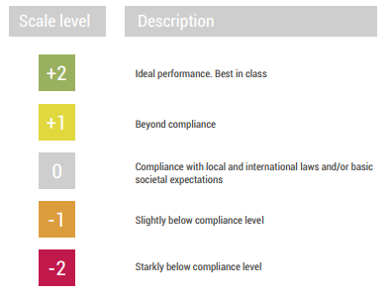
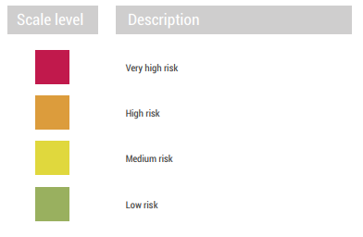
SLCA – Impact Assessment Reference Scale (RS)
Impact assessment methods chiefly focus on evaluating social risks.
Social Risk: is a topic for which there is a probability of adverse social effects on stakeholders through an organization’s activities or business relationships.
Notes:
SLCIA – Reference Scale: The most used approach for assessing social performance, or social risks.
A Social Risk is a topic for which there is a probability of adverse social effects on stakeholders through an organization’s activities or business relationships.
As seen in the figures, there are basically two ways of presenting results:
The ascending reference scale, for social performance evaluation – and the descending reference scale, for social risk evaluation.
Nevertheless, there are more types of reference scale that can be used depending on the goal of the study and the indicators selected.

Slide 19
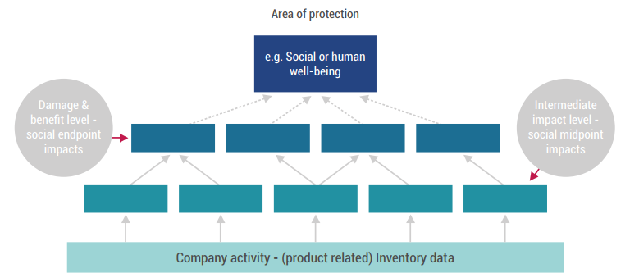
SLCA – Impact Assessment based on Impact Pathways (IP - SLCIA)
Impact Pathway: Assess the relationship between the cause and their effect.
Notes:
There is another way to perform Social Life Cycle Impact Assessments: based on Impact pathways. But what is an impact pathway? - An impact pathway aims to assess and model relations between the cause (social activities/stressors (that may be resulting from a company´s activity)) and their effect. Those Impact Pathways in IP S-LCIA can be established qualitatively and quantitatively.
The scheme represents the qualitative impact pathway that connects social-human wellbeing with a determined company’s activity. Those qualitative pathways typically identify social topics/categories of interest (e.g. Fair Wages) or of concern (e.g. child labor).

Slide 20
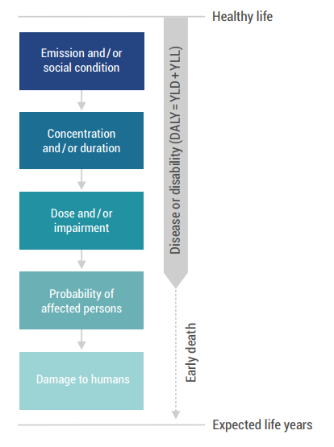
IP – SLCIA (Quantitative pathway)
Quantitative pathways have a focus on measurable numbers and target the explanation of one or more phenomena rather than elaborating about the bigger picture as done in the Qualitative Pathway or in the RS approaches.
Notes:
Quantitative pathways have a focus on measurable numbers and target the explanation of one or more phenomena rather than elaborating about the bigger picture as done in the Qualitative Pathway or in the RS approaches.
These pathways relate to the assessment of human health mostly by means of the DALY approach, which is usually applied in the context of human health impact in E-LCA
Illustration of a DALY (disability adjusted life years) impact pathway representing the mechanistic modelling approach. YLD stands for = years of life disabled and YLL stands for = years of life lost.

Slide 21
SLCA – Interpretation
Notes:
The Interpretation phase is built upon the requirements of ISO 14044 (2006), and it consists of the following steps: • Completeness check; • Consistency check; • Sensitivity and data quality check; • Materiality assessment; • Conclusions, limitations, and recommendations

Slide 22
Uses of S-LCA
S-LCA may be embedded in organizational processes to:
Support companies in building a targeted strategy for future development of social policies;
Support decision-making processes that involve a variety of stakeholders with different knowledge and background;
Manage social risk thanks to the identification of social hotspots;
Provide structure, credibility, and consistency to supply chain materiality assessment;
Support the disclosure of non-financial information
Notes:
To summarize, S-LCA can be applied to calculate a social impact, social footprint, identify social hotspots (location or activity with high risk/impact), social handprinting, or to assess the potential impacts of a policy or investment choice.
S-LCA can be applied for value chain social risk assessment, Human Rights Due Diligence, social handprinting, reporting, communication/labeling, as well as sustainable purchasing. S-LCA is a methodology that supports decision-making in order to improve social conditions in life cycles and value chains worldwide.

Slide 23
Stakeholders
Workers
Local Communities
Value Chain actors
Society
Users/Consumers
Children

Slide 24
Social topics
Workers
Local Communities
Value chain Actors
Users/Consumers
Society
Children
Health and safety
Fair salary
Child labor
Forced labor
Discrimination
Freedom of association and collective bargaining
Work-life balance
Health and safe living conditions
Access to material resources
Access to immaterial resources
Community engagement
Local Employment
Health
Product safety
Responsible communication
Privacy
Inclusiveness
Effectiveness and comfort
Fair competition
Social Responsibility
Suppliers relationships
Respect for intellectual property
Wealth distribution
Public commitments to sustainability issues
Contribution to economic development
Technology development
Education
provided in the
local community
Health issues
for children as
consumers
Notes:
According to the latest guidelines for Social Life Cycle Assessment, there are six main stakeholders (or categories) to consider when performing this evaluation:
Workers,
Local Communities
Value chain actors
Users
Society
And Children
This figure shows some typical impact subcategories for the different stakeholders. However, more subcategories can be added. Common impact categories that can be considered are Human Rights, Working Conditions, Cultural Heritage, Governance, and Socio-economic repercussions

Slide 25
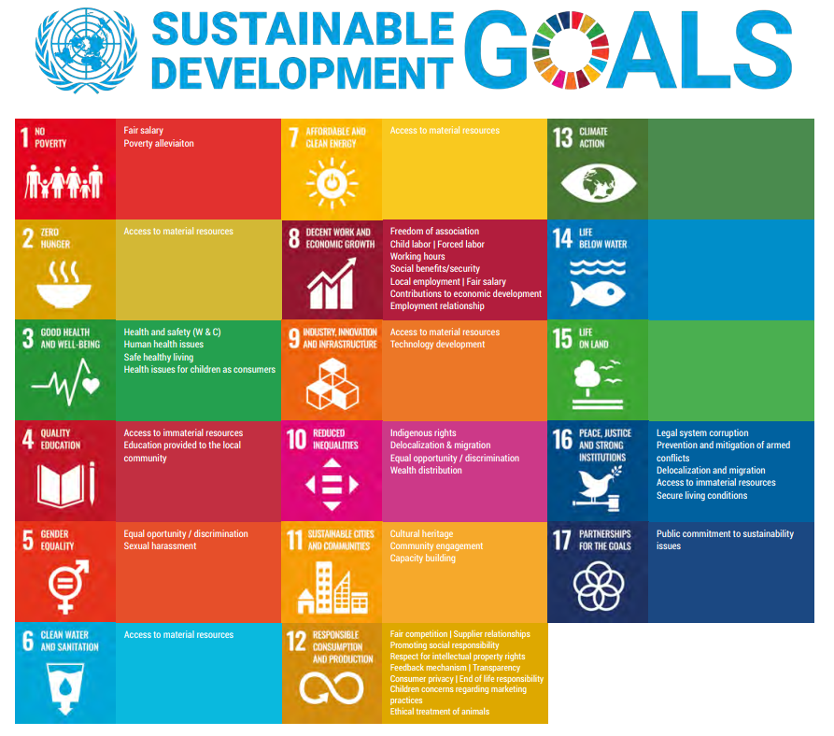
Uses of S-LCA
Notes:
The S-LCA framework, and related stakeholder and impact categories, have connections to the seventeen SDGs that have been internationally accepted by governments, industries, and organizations. These connections are directly related to:
No poverty
Zero hunger
Good health and well-being
Quality education
Gender equality
Clean water and sanitation
Affordable and clean energy
Decent work and economic growth
Industry, innovation and infrastructure
Reduced inequalities
Sustainable cities and communities
Responsible consumption and production
Peace, justice and strong institutions
Partnership for the goals

Slide 26
Uses of S-LCA
Notes:
To summarize, S-LCA can be applied to calculate a social impact, social footprint, identify social hotspots (location or activity with high risk/impact), social handprinting, or to assess the potential impacts of a policy or investment choice.
S-LCA can be applied for value chain social risk assessment, Human Rights Due Diligence, social handprinting, reporting, communication/labeling, as well as sustainable purchasing. S-LCA is a methodology that supports decision-making in order to improve social conditions in life cycles and value chains worldwide.

Slide 27
Synopsis
In summary, S-LCA is a methodology to assess the social impacts of products and services across their life cycle. It may be embedded in organizational processes to:
1. Support companies in building a targeted strategy for future development of social policies;
2. Support decision-making processes that involve a variety of stakeholders with different knowledge and background;
3. Manage social risk thanks to the identification of social hotspots;
4. Provide structure, credibility, and consistency to supply chain materiality assessment
S-LCA Is a flexible methodology able to assess different the product performance on stakeholders, by the use of qualitative and quantitative indicators. It can also be used to evaluate social risks by using a reference scale.
Notes:
In summary, S-LCA is a methodology to assess the social impacts of products and services across their life cycle. It may be embedded in organizational processes to:
1. Support companies in building a targeted strategy for future development of social policies;
2. Support decision-making processes that involve a variety of stakeholders with different knowledge and background;
3. Manage social risk thanks to the identification of social hotspots;
4. Provide structure, credibility, and consistency to supply chain materiality assessment
S-LCA Is a flexible methodology able to assess different the product performance on stakeholders, by the use of qualitative and quantitative indicators. It can also be used to evaluate social risks by using a reference scale.

Slide 28
References
UNEP, 2020. Guidelines for Social Life Cycle Assessment of Products and Organizations 2020. Benoît Norris, C., Traverso, M., Neugebauer, S., Ekener, E., Schaubroeck, T., Russo Garrido, S., Berger, M., Valdivia, S., Lehmann, A., Finkbeiner, M., Arcese, G. (eds.). United Nations Environment Programme (UNEP).
Goedkoop, M.J. Indrane, D.; de Beer, I.M.; Product Social Impact Assessment Handbook - 2018, Amersfoort, September 1st, 2018.
UNEP, 2013. The methodological sheets for subcategories in social life cycle assessment (S-LCA). The Life Cycle Initiative.

Slide 29
THANK YOU

