Slide 1


Bioeconomy evaluation methods and tools in the agro-farming sector
MODULE 2
Bioeconomy, agrobiodiversity, biomass use, strategies and resources for sustainable rural development
UNIT 3
Bioeconomy evaluation methods in the agro-farming sector
Antra Kalnbaļķīte, RTU, Latvia
Ilze Vamža, RTU, Latvia
Notes:
Welcome to today lecture. I am Prof. Francesco Romagnoli from the Institute of Energy Systems and Environment at the Riga Technical University. I am happy to share with you the contents of the lecture on “Real case studies about Life Cycle Thinking -based methods and quantitative tools.

Slide 2
Aim/objectives
Learners will be aware of the general bioeconomy assessment methods and tools with an emphasis on MCDA methods and tools (Value of bioresources based on indicator-based approach), Nexus approach, indicator analysis, and Cascade analysis of biorefinery within the agro-farming sector.

Slide 3
Learning outcomes
LOut 12. Acquire a basic knowledge on the potential definition of strategic sustainable development of the agro-farming sector
LOut 16. Analyse different scenarios of bioeconomy implementation for specific situations, find the most optimal solution and make recommendations
LOut 18. Compare and analyse solutions from the application of LCA-based quantitative assessment and their implication on selecting a specific bioeconomy solution
LOut 20. Explain the different effects on the application of specific bioeconomy strategies within the agro-farming sector
LOut 23. Justify and recommend potential improvements solutions following a bioeconomy evaluation approach

Slide 4
Keywords
Life Cycle thinking
Sustainability
Bioeconomy strategy solutions
Economic assessment
Social Assessment
Comparative assessment
LCA tools
Multi Criteria Analysis (MCA)
Nexus approach
Cascade approach

Slide 5
Table of contents
Multi Criteria Decision Analysis (MCDA)
Nexus and Cascade approaches
Notes:
This lecture is organized into 4 main parts: example of application and case studies on MCA, Nexus and Cascade approached. The last part puts an emphasis on a case study of the Life Cycle Sustainability Assessment for biofuel.

Slide 6
Multi Criteria Decision Analysis
Antra Kalnbalkite, RTU, Latvia

Slide 7
Decision making
Multicriteria Decision Analysis (MCDA) or Multicriteria Decision Making (MCDMaking) is a discipline that aims to support decision makers facing multiple and conflicting assessments.
The MCDA aims to highlight these conflicts and reach a compromise solution in a transparent process.
MCDA methods are designed to improve the quality of decisions by incorporating multiple criteria, making choices clearer, more rational and more effective.
The aim is to create a structured process to set goals, create alternatives and compare them from different perspectives.
The applications of MCDA are diverse and can cover environmental planning, fisheries management, water management, forestry, nuclear accident management, climate policy, life cycle analysis, etc.

Slide 8
Types of decisions:
Roy (1981) has identified 4 main types of decisions:
Choice problem - the goal is to select the single best option or reduce the group of options to a subset of equivalent or incomparable ‘good’ options.
Sorting Problem – Options are sorted into ordered and predefined groups, called categories. The aim is to then regroup the options with similar behaviors or characteristics for descriptive, organizational or predictive reasons.
Ranking the problem options are ordered from best to worst by means of scores or pairwise comparisons
Describing Problem - The goal is to describe options and their consequences. This is usually done in first step to understand the characteristics of the decision problem.

Slide 9
The most popular methods
Choice problems | Ranking problems | Sorting Problems | Describtion problems
AHP | AHP | AHP SORT
ANP | ANP
MAUT/UTA | MAUT/UTA | UTADIS
MACBETH | MACBETH
PROMETHEE | PROMETHEE | FLOWSORT | GAIA, FS - GAIA
ELECTRE | ELECTRE II, III, IV | ELECTRE-Tri
TOPSIS | TOPSIS
GOAL PROGRAMMING
DEA | DEA | Avots: Ishizaka A., Nemery P. Multi-Criteria Decision Analysis. Methods and Software. Wiley & Sons Ltd.: 2013, p. 299, ISBN: 978-1-119-97407-9
AHP – Analytic hierarchy process, ANP – Analytic network process, MAUT – Multi-attribute utility theory, MACBETH – Measuring Attractiveness by Categorical Based Evaluation Technigue, PROMETHEE – Preference Ranking Organization METHod for Enriched Evaluation, ELECTRE – Elimination and choice expressing the reality, TOPSIS – Technique of Order Preferance Similarity to the Ideal Solution, DEA – Data Envelopment Analysis

Slide 10
Problem | MCDA methods | Software
Ranking, description, choice Ranking, choice | PROMETHEE-GAIA | Decision Lab, D-Sight, Smart Picker Pro, Visual Promethee
 | PROMETHEE | DECERNS
 | ELECTRE | Electre IS, Electre III-IV
 | UTA | Right Choice, UTA+, DECERNS
 | AHP | MakeItRational, ExpertChoice, Decision Lens, HIPRE 3+, RightChoiceDSS, Criterium, EasyMind, Questfox, ChoiceResults, 123AHP, DECERNS
 | ANP | Super Decisions, Decision Lens
 | MACBETH | M-MACBETH
 | TOPSIS | DECERNS
 | DEA | Win4DEAP, Efficiency Measurement System, DEA Solver Online, DEAFrontier, DEA-Solver PRO, Frontier Analyst
Choice | Goal programming | -
Sorting, Description | FlowSort – FS - GAIA | Smart Picker Pro
Sorting | ELECTRE - Tri UTADIS AHPSort | Electre Tri, IRIS - ₋ 17

Slide 11
Required inputs for MCDA sorting methods
 | Inputs | Effort input | MCDA method | output
Sorting method | utility function | High | UTADIS | Classification by scoring
 | Pairwise comparison on ratio scale |  | AHPSort | Classification by scoring
 | Indifference, preference and veto thresholds |  | ELECTRE-TRI | Classification with pairwise outranking degrees
 | Indifference and preference thresholds | Low | FLOWSORT | Classification with pairwise outranking degrees and scores

Slide 12
Required input for MCDA rank and choice methods
 | Inputs | Effort input | MCDA method | Output
Ranking/choice problem | Utility function | Very high | MAUT | Complete ranking with scores
 | Pairwise comparisons on a ratio scale and Interdependence |  | ANP | Complete ranking with scores
 | Pairwise Comparison on an interval scale |  | MACBETH | Complete ranking with scores
 | Pairwise comparison on a ratio scale |  | AHP | Complete ranking with scores
 | Indifference, preference and veto thresholds |  | ELECTRE | Partial and complete rating
 | Indifference and preference thresholds |  | PROMETHEE | Partial and complete rating
 | The ideal option and constraints |  | Goal programming | Feasable solution with deviation score
 | The ideal and anti-ideal solution |  | TOPSIS | Complete rating with proximity to ideal rating
 | No subjective input required | Very low | DEA | Partial rating with efectiveness score

Slide 13
Establishment of criteria
Basic principles to be followed when defining the most important criteria:
Systematic principle- Criteria should reflect the main characteristics and functioning of the problem. Evaluating inclusive criteria provides much better results than evaluating one criterion
Principle of consistency - logical justification of choice of criteria
Independence principle - different criteria have to be chosen which are not directly or indirectly repeated
Principle of measurability - criteria must be measurable
Comparability principle - the criteria are comparable
* Alternative options - options from which to choose the best, the most appropriate
* Criteria - affects the choice of alternative

Slide 14
Representation of decision levels /example/

Slide 15
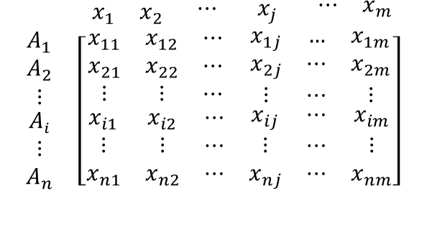
TOPSIS
(Technique of Order Preference Similarity to the Ideal Solution)
TOPSIS matrix
For the environmental strategy and sustainable production and engineering, the TOPSIS method was used in 40% of cases
Advantages of TOPSIS:
  unlimited criteria and range of performance attributes,
  the choice of alternatives to understand the difference and the similarity of the alternative, to avoid double comparison (as in AHP),
  relatively simple calculation process,
  no special program is required
Disadvantage: No correlation between attributes
$$\begin{matrix} \begin{matrix}{ x}_{1} & x_{2} & \begin{matrix}⋯ & x_{j} & \begin{matrix} ⋯ & x_{m}\end{matrix}\end{matrix}\end{matrix} \\ \begin{matrix}\begin{matrix}A_{1} \\ \begin{matrix}A_{2} \\ ⋮ \\ \begin{matrix}A_{i} \\ ⋮ \\ A_{n}\end{matrix}\end{matrix}\end{matrix} & \left[\begin{matrix}\begin{matrix}x_{11} & x_{12} & ⋯ \\ x_{21} & x_{22} & ⋯ \\ ⋮ & ⋮ & ⋯\end{matrix} & \begin{matrix}x_{1j} & … & x_{1m} \\ x_{2j} & ⋯ & x_{2m} \\ ⋮ & ⋯ & ⋮\end{matrix} \\ \begin{matrix}x_{i1} & x_{i2} & ⋯ \\ ⋮ & ⋮ & ⋯ \\ x_{n1} & x_{n2} & ⋯\end{matrix} & \begin{matrix}x_{ij} & ⋯ & x_{im} \\ ⋮ & ⋯ & ⋮ \\ x_{nj} & ⋯ & x_{nm}\end{matrix}\end{matrix}\right]\end{matrix}\end{matrix}$$
A₁, A₂, A₃ … A_{n} – alternatives
x₁, x₂, x_{3…} x_{m} – criteria by which alternatives are evaluated

Slide 16
TOPSIS method
The ideal alternative - the best option
(maximum benefit with minimal cost)
Contrary the (anti) ideal alternative - worst case scenario (minimal benefits, maximum costs)
TOPSIS compares alternatives by defining criteria / indicators for alternatives, determining the weight of each criterion/indicator, normalizing results and calculating the distance between each alternative
Criteria 2
Ideal solution
It is possible to compare alternatives that would otherwise not be comparable
The key concept is that the alternative you choose should be as close as possible to the ideal solution.
Anti-ideal solution
Criteria 1
The ratio between the distance from the negative ideal and the sum of the distance from the ideal to the negative alternative is calculated.

Slide 17


AHP method
Number of comparisons= 4 (4-1)/2=6
6
Number of criteria=n
Number of comparisons= n (n-1)/2
Pairwise comparison
(possibility to compare criteria by determining their significance)
The results are calculated
Consistency check have to be performed, to detect possible contradictions in the entries
C | i1 | i2 | i3 | i4
i1 | 1 | 5 | 7 | 9
i2 | 1/5 | 1 | 4 | 6
i3 | 1/7 | 1/4 | 1 | 4
i4 | 1/9 | 1/6 | 1/4 | 1
Consistency must be evaluated
$$Consistency index, CI=\frac{λ\max{−n}}{n−1}$$
RI – Random Index*
If CR > 0.1, ratings are inconsistent and need to be revised
Consistency ratio, CR$=\frac{CI}{RI}$
*Random consistency index (RI) – dots lielums Saaty scale

Slide 18
Weight determination (AHP) + expert method
Selection of appropriate experts
  > Indicates the number of experts
  > Competence in the field
Additional information confirming the choice of expert method
Establish an expert survey on the criteria or comparison of the importance of the criteria
The arithmetic mean of all experts involved shall be used in the calculation
Degree of importance | Definition
1 | Equal importance
2 | Weak
3 | Moderate importance
4 | Moderate plus
5 | Strong importance
6 | Strong plus
7 | Very strong importance
8 | Very, very strong
9 | Extreme importance
5
1/5
Number of criteria n=3
Number of comparisons= 3(3-1)/2 = 3
Notes:
Uz skalas atzīmē vērtību
Pa kreisi faktiskā, pa labi- apgrieztā
All comparisons are positive
Atbilstošu ekspertu izvēle
> Norāda ekspertu skaitu
> Kompetenci attiecīgajā jomā
Papildus informāciju, kas apliecina eksperta metodes izvēli
Izveido ekspertu aptauju par kritērijiem vai kritēriju nozīmīguma salīdzinājumu
Aprēķinā izmanto vidējo aritmētisko vērtējumu no visiem iesaistītajiem ekspertiem

Slide 19
Multi Criteria Decision Analysis (MCDA) steps
Practical task
Define problem
1. Information about alternatives and criteria
Matrix creation
2. Standardization of decision matrix
3. Determination of criteria weight
4. Weighted decision matrix
5. Ideal and anti-ideal option
6. Relative closeness to ideal- solution
7. Priority determination
8. Sensitivity analysis
Literature
analysis
Data collection
Expert method
TOPSIS
AHP
Notes:
Pirmais solis ir apkopot informāciju par alternatīvām un izvēlētajiem kritērijiem
Otrajā aprēķinu solī šie dati tiek normalizēti
Nākamais solis ir datu normalizēšana ar svaru vērtībām un attāluma aprēķins no maksimālajām un minimālajām vērtībām (attālums no ideālā varianta)

Slide 20
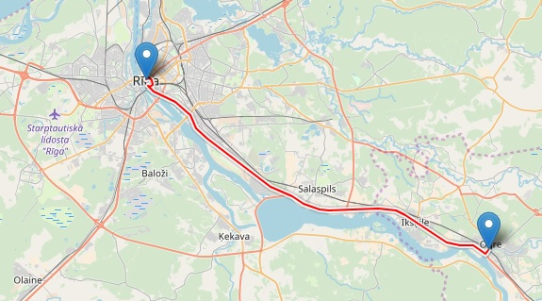
Step 1. Defining decision making problem/ alternatives/ criteria/ data
Input data
Riga-Ogre 35km
Decision - choose most suitable transport for driving from Riga to Ogre
 |  |  | Taxi price | 2+(0,64x35km)
 |  | Alternatives
 |  | x_{a1} | x_{a2} | x_{a3}
 | Criteria | Train | Bus | Taxi
i₁ | Price, Euro | 1.33 | 2.00 | 24.40
i₂ | Time, min | 40 | 50 | 30
i₃ | CO₂ emissions g/km/pas | 0.07 | 17.30 | 206
i₄ | Comfort (evaluation scale 1-10) | 7 | 6 | 10
Information about alternatives
Data collection
Expert opinion
Information about criteria

Slide 21
Step 1.1. Creation of TOPSIS matrix (Overview)
Given m criteria i, n alternatives a are represented in the decision matrix X = (x_{ai}), where i = 1,.., m and a = 1,…, n.
TOPSIS
AHP
Criteria | Alternatives |  |  |  |  | Normalized (Standardized) decision matrix |  |  |  |  | Weight | Weighted standardized decision matrix |  |  |  |  | Ideal | Anti-Ideal
 | x_{a1} | x_{a2} | x_{a3} | … | x_{an} | r_{1a} | r_{2a} | r_{3a} | … | r_{na} | w | v_{a1} | v_{a2} | v_{a3} | … | v_{an} | (v_{A1}…v_{An})
i₁ |  |  |  |  |  |  |  |  |  |  | w₁
i₂ |  |  |  |  |  |  |  |  |  |  | w₂
i₃ |  |  |  |  |  |  |  |  |  |  | w₃
… |  |  |  |  |  |  |  |  |  |  | …
i_{m} |  |  |  |  |  |  |  |  |  |  | w_{n}
 |  |  |  |  |  |  |  |  |  |  | ∑ 1,0

Slide 22

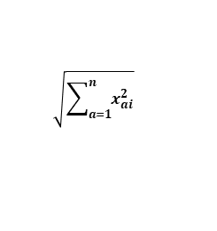
Step 2 Standardization of decision matrix
TOPSIS
Distributive normalization requires that the performances are divided by the square root of the sum of each squared element in a column
$r_{ai}=\frac{x_{ai}}{\sqrt{\sum_{a=1}^{n}{x_{ai}^{2}}}}$ ,
where
a alternative, a= 1,...,n
i criteria, i=1,...,m
r_{ai} normalized criteria value
 | Alternatives |  |  |  | Standardized decision matrix
 | x_{a1} | x_{a2} | x_{a3} |  | r_{ai1} | r_{ai2} | r_{ai3}
Criteria | Train | Bus | Baltic taxi
Price, Euro | 1.33 | 2.00 | 24.40 | 24.52 | 0.05 | 0.08 | 1.00
Time, min | 40.00 | 50.00 | 30.00 | 70.71 | 0.57 | 0.71 | 0.42
CO₂ emissions g/km/pas | 0.07 | 17.30 | 206.00 | 206.73 | 0.00 | 0.08 | 1.00
Comfort (evaluation scale 1-10) | 7 | 6 | 10 | 13.60 | 0.51 | 0.44 | 0.74
$$\sqrt{\sum_{a=1}^{n}{x_{ai}^{2}}}$$
=SQRT(x_{ai}^2+x_{a2}^2+…x_{n}^2)
Notes:
SQRT(x_{ai}^2+x_{a2}^2+…x_{n}^2)

Slide 23
Step 3 Determination of criteria importance
AHP
Actual value
Inverted value
 | Criteria | More important than | Equally important | Less important than | Criteria
Price | i1 | 9 8 7 6 5 4 3 2 | 1 | 2 3 4 5 6 7 8 9 | i2 | Time
Price | i1 | 9 8 7 6 5 4 3 2 | 1 | 2 3 4 5 6 7 8 9 | i3 | CO₂
Price | i1 | 9 8 7 6 5 4 3 2 | 1 | 2 3 4 5 6 7 8 9 | i4 | Comfort
Time | i2 | 9 8 7 6 5 4 3 2 | 1 | 2 3 4 5 6 7 8 9 | i3 | CO₂
Time | i2 | 9 8 7 6 5 4 3 2 | 1 | 2 3 4 5 6 7 8 9 | i4 | Comfort
CO₂ | i3 | 9 8 7 6 5 4 3 2 | 1 | 2 3 4 5 6 7 8 9 | i4 | Comfort
 |  | i₁ | i₂ | i₃ | i₄
 | AHP criteria | Price, Euro | Time, min | CO₂ emissions g/km/pas | Comfort
i₁ | Price, Euro | 1.00 | 5.00 | 8.00 | 5.00
i₂ | Time, min | 0.20 | 1.00 | 3.00 | 2.00
i₃ | CO₂ emissions g/km/pas | 0.13 | 0.33 | 1.00 | 0.25
i₄ | Comfort | 0.20 | 0.50 | 4.00 | 1.00

Slide 24
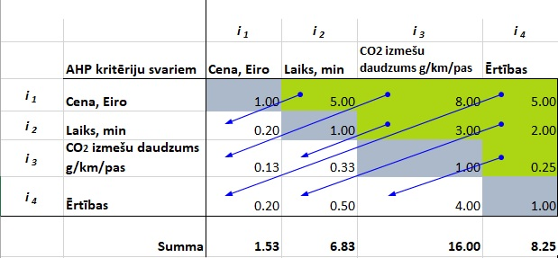
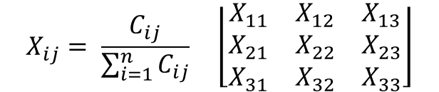
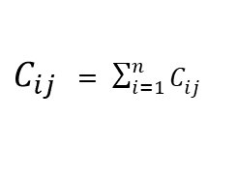
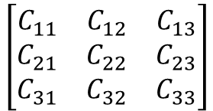
Step 3.1. Creation of AHP comparison matrix
AHP
AHP criteria weights
Price, Euro | Time, min | CO₂ emissions g/km/pas | Comfort
Matrix of pairwise elements:
$$\left[\begin{matrix}C_{11} & C_{12} & C_{13} \\ C_{21} & C_{22} & C_{23} \\ C_{31} & C_{32} & C_{33}\end{matrix}\right]$$
Price, Euro
Time, min
CO₂ emissions g/km/pas
Comfort
Sum the values in each column of the pairwise matrix:
∑Cij
$C_{ij }= \sum_{i=1}^{n}{C_{ij}}$
Divide each element in the matrix by its column total to generate a normalized pairwise matrix:
$$X_{ij}= \frac{C_{ij}}{\sum_{i=1}^{n}{C_{ij}}} \left\lfloor \begin{matrix}X_{11} & X_{12} & X_{13} \\ X_{21} & X_{22} & X_{23} \\ X_{31} & X_{32} & X_{33}\end{matrix}\right\rfloor$$
Notes:
=1/5
=1/8
=1/3
utt

Slide 25
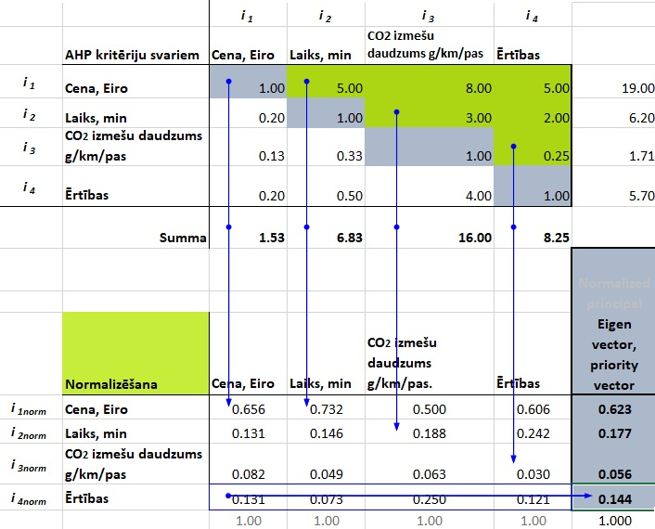

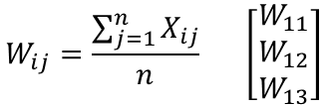

Step 3.2. AHP matrix normalization, weight determination
AHP
AHP criteria weights
Price, Eiro | Time, min | CO₂ emissions g/km/pas | Comfort
Divide the sum of the normalized column of matrix by the number of criteria used (n) to generate priority vector:
Price, Eiro
Time, min
CO₂ emissions g/km/pas
Comfort
$$W_{ij}=\frac{\sum_{j=1}^{n}{X_{ij}}}{n} \left[\begin{matrix}W_{11} \\ W_{12} \\ W_{13}\end{matrix}\right]$$
Priority vector (eigen vector) – used as criteria weights in the TOPSIS method
$λ$max = average (consistency vector)
Normalization
Price, Eiro
Time, min
CO₂ emissions g/km/pas
Comfort
w_{i1}
w_{i2}
w_{i3}
w_{i4}
$$∑w_{i}=1$$
Notes:
Normalized criteria value= existing value/ criteria sum value
Eigen vector =average (normalized criteria value) (sum must be 1)

Slide 26
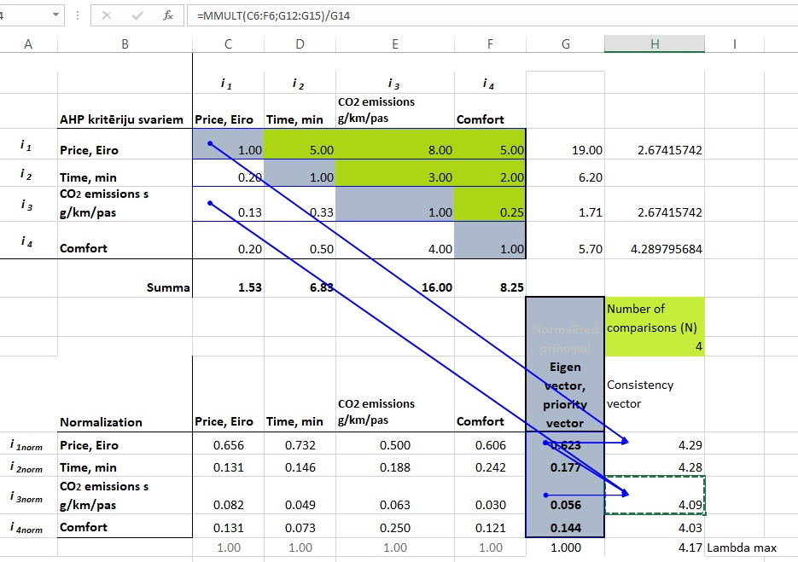


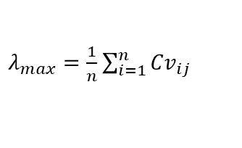


Step 3.3. Verification of consistency of criteria assessments I
AHP
Consistency vector is calculated by multiplying the pairwise matrix by the priority vector:
AHP criteria weights
$${Cv}_{11}=\frac{1}{W_{11}}\left[C_{11}W_{11}+C_{12}W_{21}+C_{13}W_{31}\right]$$
Consistency vector=MMULT(C4:F4;G12:G15)/G12
$λ$max is calculated by averaging the value of the Consistency vector:
$λ_{max}=\frac{1}{n}$ $\sum_{i=1}^{n}{{Cv}_{ij}}$
Cv _{ij}
$λ$max = average (consistency vector)
$λ$max
Notes:
CI1 = sum ((i11*ev1)+(i12*ev2)…)/ev1 (tas pats ar mmult) – sareizina vienas kolonnas vērtību ar otras kolonas vērtību un sasummē visus šos reizinājumus, izdala ar attiecīgā kritērija eigenvectoru
Consistency vector =MMULT(C4:F4;G12:G15)/G12
Lambda max = average (consistency vector)
Alonso and Lamata (2006) have computed a regression of the random indices and propose the formulation (see lambda max regression formula)

Slide 27
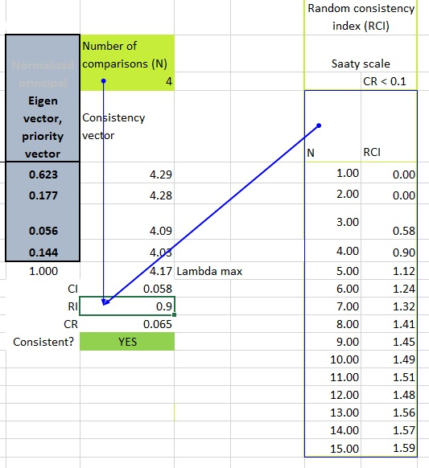


Step 3.4. Verification of consistency of criteria assessments II
AHP
$$Consistency index, CI=\frac{λ\max{−n}}{n−1}$$
Consistency ratio, CR$=\frac{CI}{RI}, CR<0.10$
Criteria weights for further analysis:
RI =VLOOKUP(H10;K11:L26;2)
=IF(H19<0.1;"YES";"NO")
Price, Euro
Time, min
CO2 emissions, g/km/pas
Comfort
Notes:
RI (Random index) =VLOOKUP(H10;K11:L26;2)
{ RI =VLOOKUP(cipars ar ko jāsakrīt (4) ;tabulas sākums:tabulas beigas (abas kolonnas);ņem otro kolonnu)}
Lamda max – eigenvalue
Consistency vector =MMULT(C4:F4;G12:G15)/G12
Lambda max = average (consistency vector)
=IF(H19<0.1;"YES";"NO") var pielikt krāsas – conditional formating, manage rules, format only cells that contains → specific text → iezīmē paraugšūnu [YES] → format → zaļš
ADD --,,-- [NO] → sarkans

Slide 28
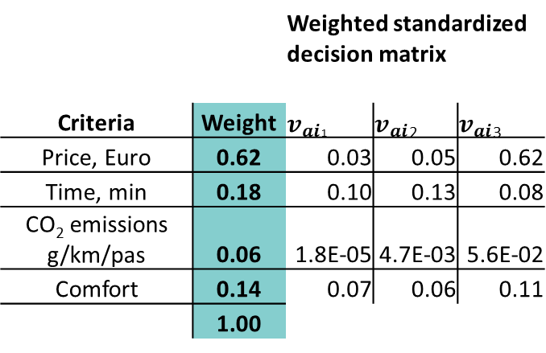
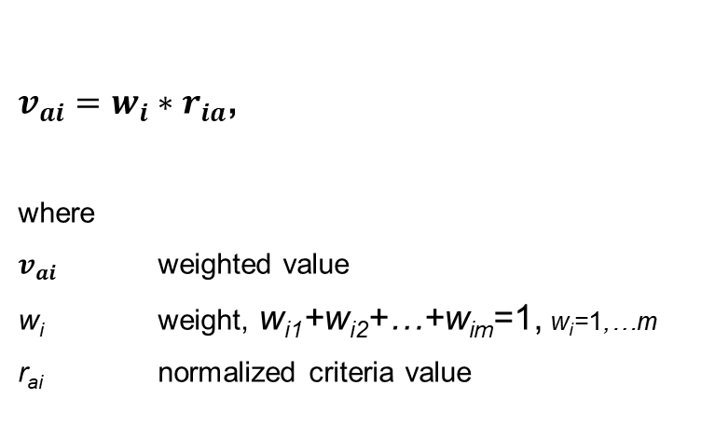
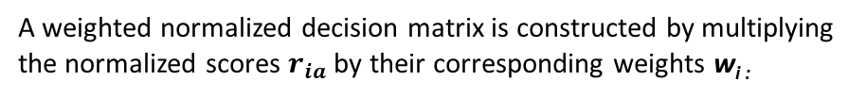
Step 4 Weighted standardized decision matrix
TOPSIS
A weighted normalized decision matrix is constructed by multiplying the normalized scores $r_{ia}$ by their corresponding weights w_{i :}
 |  | Weighted standardized decision matrix
Criteria | Weight | $v_{ai}$₁ | $v_{ai}$₂ | $v_{ai}$₃
Price, Euro | 0.62 | 0.03 | 0.05 | 0.62
Time, min | 0.18 | 0.10 | 0.13 | 0.08
CO₂ emissions g/km/pas | 0.06 | 1.8E-05 | 4.7E-03 | 5.6E-02
Comfort | 0.14 | 0.07 | 0.06 | 0.11
 | 1.00
$v_{ai}=w_{i}∗r_{ia}$,
where
$v_{ai}$ weighted value
w_{i} weight, w_{i1}+w_{i2}+…+w_{im}=1, w_{i}=1,…m
r_{ai} normalized criteria value
Weights derived from AHP method

Slide 29
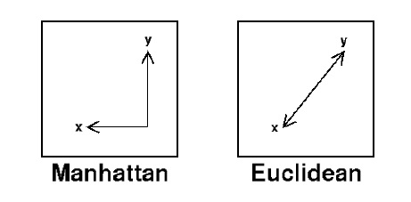
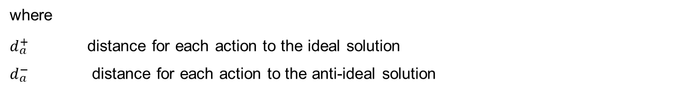
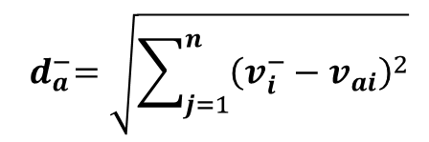
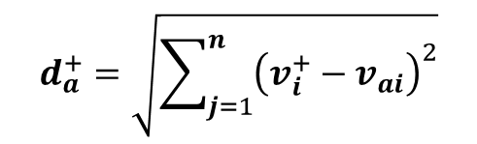
Step 5 Ideal and anti-ideal option
TOPSIS
Weighted results are taken into account to compare the ideal and anti-ideal virtual action.
Each weighted indicator is compared with the maximum and minimum values corresponding to the respective criterion. The sum of the squares of the criteria difference for each alternative from the maximum value is used to determine the total distance of the alternative to the ideal solution.
$$d_{a}^{+}=\sqrt{\sum_{j=1}^{n}{{\left(v_{i}^{+}−v_{ai}\right)}^{2}}}$$
$${ d}_{a}^{−}=\sqrt{\sum_{j=1}^{n}{{\left(v_{i}^{−}−v_{ai}\right)}^{2}}}$$
N-dimensional Euclidean distance (L²) is used here, but also another metric could be adopted (e.g. L¹, the Manhattan metric)
where
$d_{a}^{+}$ distance for each action to the ideal solution
$d_{a}^{−}$ distance for each action to the anti-ideal solution

Slide 30
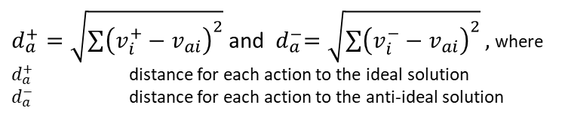



TOPSIS
$d_{a}^{+}=\sqrt{\sum{{\left(v_{i}^{+}−v_{ai}\right)}^{2}}}$ and ${ d}_{a}^{−}=\sqrt{\sum{{\left(v_{i}^{−}−v_{ai}\right)}^{2}}},$where
$d_{a}^{+}$ distance for each action to the ideal solution
$d_{a}^{−}$ distance for each action to the anti-ideal solution
=MAX(v_{a1}:v_{a3})
=MIN(v_{a1}:v_{a3})
$d_{a}^{+}=\sqrt{\sum{{\left(v_{i}^{+}−v_{ai}\right)}^{2}}}$ ${ d}_{a}^{−}=\sqrt{\sum{{\left(v_{i}^{−}−v_{ai}\right)}^{2}}}$
Criteria | Standardized decision matrix |  |  | Ideal solution | Anti-ideal solution | Distance for each action to the ideal solution |  |  | Distance for each action to the anti-ideal solution
 | v_{a1} | v_{a2} | v_{a3}
Price, Euro | 0.03 | 0.05 | 0.62 | 0.03 | 0.62 | 0.0000 | 0.0003 | 0.3441 | 0.3441 | 0.3244 | 0.0000
Time, min | 0.10 | 0.13 | 0.08 | 0.08 | 0.13 | 0.0006 | 0.0025 | 0.0000 | 0.0006 | 0.0000 | 0.0025
CO₂ emissions g/km/pas | 1.8E-05 | 4.7E-03 | 5.6E-02 | 0.00 | 0.06 | 0.0000 | 0.0000 | 0.0031 | 0.0031 | 0.0026 | 0.0000
Comfort | 0.07 | 0.06 | 0.11 | 0.11 | 0.06 | 0.0010 | 0.0018 | 0.0000 | 0.0001 | 0.0000 | 0.0018
 |  |  |  |  |  | 0.04 | 0.07 | 0.59 | 0.59 | 0.57 | 0.07
$$d_{a}^{+}$$
$${ d}_{a}^{−}$$
Notes:
SQRT(SUM(V5:V8))

Slide 31
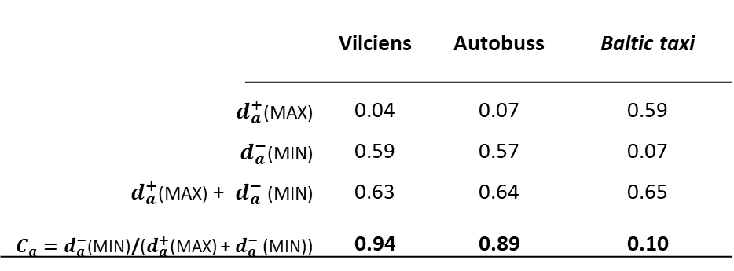
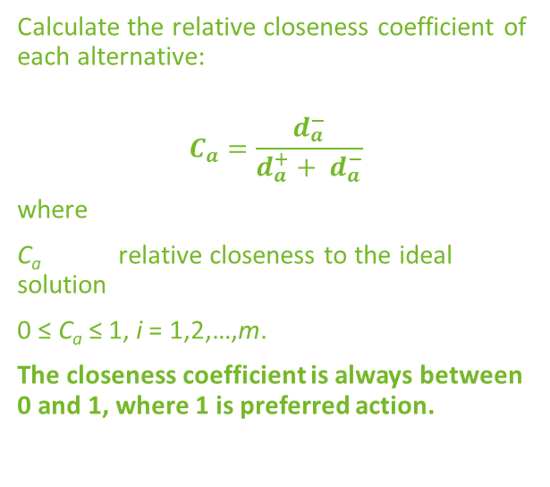
Step 6 Calculate relative closeness
TOPSIS
 |  |  | Vilciens | Autobuss | Baltic taxi
$d_{a}^{+}$(MAX) |  |  | 0.04 | 0.07 | 0.59
${ d}_{a}^{−}$(MIN) |  |  | 0.59 | 0.57 | 0.07
$d_{a}^{+}$(MAX) + ${ d}_{a}^{−}$(MIN) |  |  | 0.63 | 0.64 | 0.65
$C_{a}{=d}_{a}^{−}$(MIN)/($d_{a}^{+}$(MAX) +${ d}_{a}^{−}$(MIN)) |  |  | 0.94 | 0.89 | 0.10
Calculate the relative closeness coefficient of each alternative:
$$C_{a}=\frac{d_{a}^{−}}{d_{a}^{+}+ d_{a}^{−}}$$
where
C_{a} relative closeness to the ideal solution
0 ≤ C_{a} ≤ 1, i = 1,2,…,m.
The closeness coefficient is always between 0 and 1, where 1 is preferred action.

Slide 32


Step 7 Sensitivity analysis
TOPSIS
In order to check the influence of attribute distributions on the results of the TOPSIS method, the significances of equal size attributes are chosen
Initial weights are considered as w’=1/n (where n = number of parameters selected for assessment)
$${\text{ß}\text{k}}^{\text{′} }= \sum_{k=1}^{n}{\text{w}\text{’}}=1$$
W’_{k1} = ß_{k}*w’,k=1,2,3…n
w_{k1} – weight being imposed a disturbance
ß_{k –} this variable is defined as the unitary variation ratio of w_{k} after disturbance
w’=1/n (n = number of factors)
$${w′}_{k21 }={w′}_{k31 }={w′}_{k41 }=\frac{(1−{w^{′}}_{k11})}{n−1}$$
Other weights distribution are changed based on weight imposed to disturbance
Unitary variation ratio ß_{k} | Values less than 1 |  | ß_{k}' | Values larger than 1
 | ß_{k1} | ß_{k2} | 1 | ß_{k3} | ß_{k4} | ß_{k5}
w_{k1} | W’_{k11} = ß_{k1}*w’ | W’_{k12} = ß_{k2}*w’ | w’=1/n | W’_{k13} = ß_{k3}*w’ | W’_{k14} = ß_{k3}*w’ | W’_{k15} = ß_{k3}*w’
w_{k2} | W’_{k21} = (1-w’_{k11})/(n-1) | W’_{k22} = (1-w’_{k12})/(n-1) | w’=1/n | W’_{k23} = (1-w’_{k13})/(n-1) | … | …
w_{k3} | W’_{k21} = (1-w’_{k11})/(n-1) | W’_{k23} = (1-w’_{k12})/(n-1) | w’=1/n | … | … | …
w_{k4} | W’_{k21} = (1-w’_{k11})/(n-1) | W’_{k24} = (1-w’_{k12})/(n-1) | w’=1/n | … | … | …
Unitary variation ratio ß_{k} | 0.01 | 0.5 | 1 (n=4) | 1.5 | 2 | 3
Price, Eiro | 0.0025 | 0.125 | 0.25 | 0.38 | 0.50 | 0.75
Time, min | 0.33 | 0.29 | 0.25 | 0.21 | 0.17 | 0.08
CO₂ g/km/pas | 0.33 | 0.29 | 0.25 | 0.21 | 0.17 | 0.08
Comfort | 0.33 | 0.29 | 0.25 | 0.21 | 0.17 | 0.08
∑ | 1.00 | 1.00 | 1.00 | 1.00 | 1.00 | 1.00

Slide 33

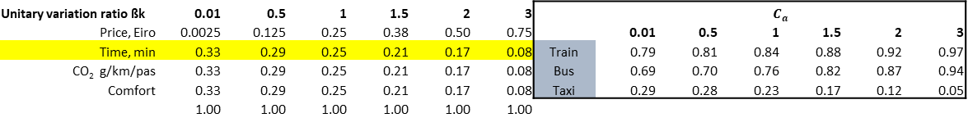
Step 7.1. Sensitivity analysis - obtaining relative closeness to the ideal solution with newly acquired weights
TOPSIS
Replace initial attribute weights with newly acquired weights in TOPSIS matrix
$C_{a}$ (relative closeness to the ideal solution) with newly acquired weights:
Unitary variation ratio ßk | 0.01 | 0.5 | 1 | 1.5 | 2 | 3 |  | $$C_{a}$$
Price, Eiro | 0.0025 | 0.125 | 0.25 | 0.38 | 0.50 | 0.75 |  | 0.01 | 0.5 | 1 | 1.5 | 2 | 3
Time, min | 0.33 | 0.29 | 0.25 | 0.21 | 0.17 | 0.08 | Train | 0.79 | 0.81 | 0.84 | 0.88 | 0.92 | 0.97
CO₂ g/km/pas | 0.33 | 0.29 | 0.25 | 0.21 | 0.17 | 0.08 | Bus | 0.69 | 0.70 | 0.76 | 0.82 | 0.87 | 0.94
Comfort | 0.33 | 0.29 | 0.25 | 0.21 | 0.17 | 0.08 | Taxi | 0.29 | 0.28 | 0.23 | 0.17 | 0.12 | 0.05
 | 1.00 | 1.00 | 1.00 | 1.00 | 1.00 | 1.00
Make sure that sensitivity analysis are done for all criteria
It is possible to use other sensitivity analysis methods:
(Different mathematical calculation approach)
Peiyue Li, Hui Qian, Jianhua Wu & Jie
Chen (2013) Sensitivity analysis of TOPSIS method in water quality assessment: I. Sensitivity to the parameter weights DOI: 10.1007/s10661-012-2723-9
Alinezhad, Alireza. (2011). Sensitivity Analysis of TOPSIS Technique: the Result of Change in the Weight of one attribute on the Final Ranking of Alternatives”. Journal of optimization in Industrial Engineering (OIE),Vol. 7, No. 1, pp. 23-28, 2011..

Slide 34
Sensitivity analysis (SA) results

Slide 35


Comparison of results of three SA methods
W’=1/n (full calculations see in slides before)
W’2 = W2*Wk
$${w′}_{j}=(\frac{w_{j}}{1−w_{2}})(1−{w^{′}}_{2})$$
W’2=w2+∆2
$${w′}_{j}=\frac{1−{w′}_{2}}{1−w_{2}}w_{j}$$
j=1,3,4

Slide 36
References
….
….

Slide 37
Bioeconomy general assessment methods and tools

Slide 38
Specifc aim and objectives
The unit will aim to provide an overview of bioeconomy evaluation methods
  Explain the need for bioeconomy evaluation
  Recognize the issues regarding bioeconomy evaluation
  Identify bio-based product values

Slide 39
Keywords
Bioeconomy
Economic indicators
Evaluation
Development
Data

Slide 40
Contents
Economic activity
Keeping treack of economic activity
Evaluation of bioeconomy
Evaluation of the bioeconomy potential (Nexus and Cascade Approaches)

Slide 41


What is the economy?
It is the whole production and consumption of goods. Usually in specific
Notes:
Let’s start with the basic definition of economy. It is the whole production and consumption of goods and services in specific area. That area might be a country, country, geographical region or specifically established areas. For example Europe Economic Area. Usualy specific rules are set within these areas like taxes and tarifs and so on.

Slide 42

OECD Main Economic Indicators (MEI)
Balance of payments
Business tendency and consumer opinion surveys
Composite leading indicators
Financial statistics
Industry
International trade
Labour market statistics
Consumer price indices
Producer price indices
Purchasing power parities (PPP)
Comparative price level
Quarterly national accounts

Slide 43


How to evaluate bioeconomy?
Industries have differing resolutions. One is tracking its raw material with great precision, other has more rough approach.

Slide 44

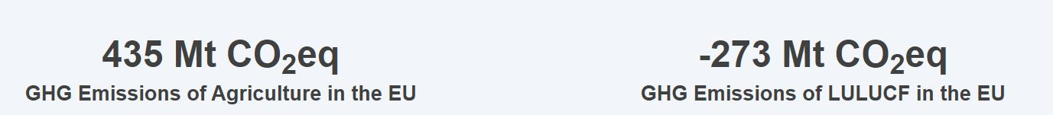
EU Bioeconomy Monitoring System dashboards
https://knowledge4policy.ec.europa.eu/visualisation/eu-bioeconomy-monitoring-system-dashboards_en
Notes:
On the slide you can see how the depicted information is giving insight into sustainability aspect of bioeconomy. Data on social, economic and environmental impact is shown. Nevartheless, indicators are usefull because they allow to track progress. Hence, chosen criteria can be tracked annually and policies can be adjusted acordingly.

Slide 45
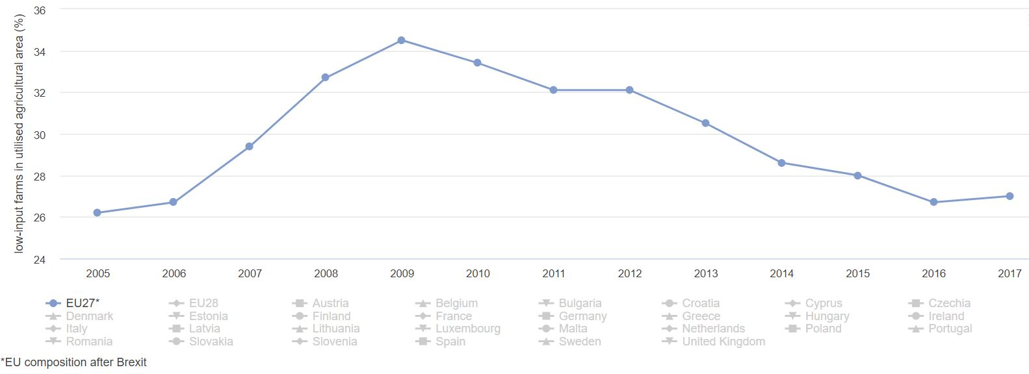
Low input farms

Slide 46
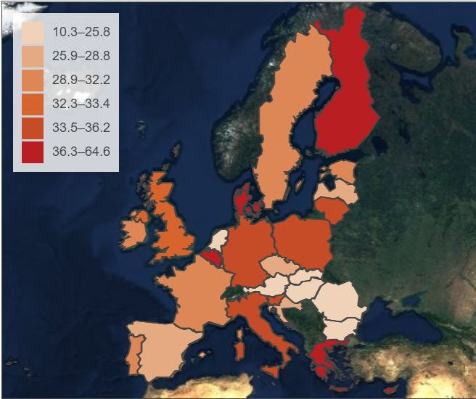
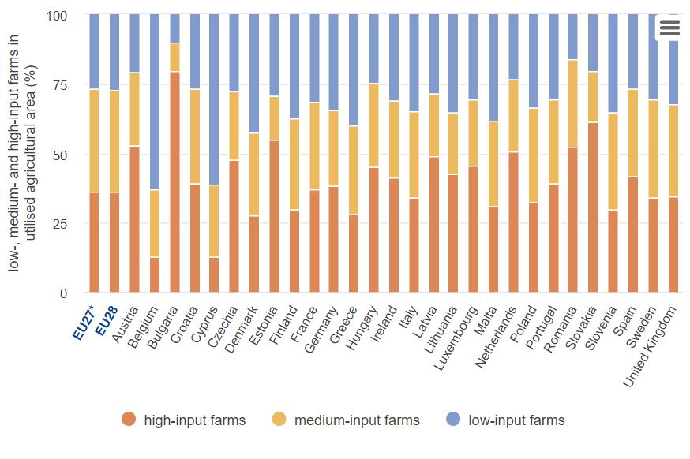
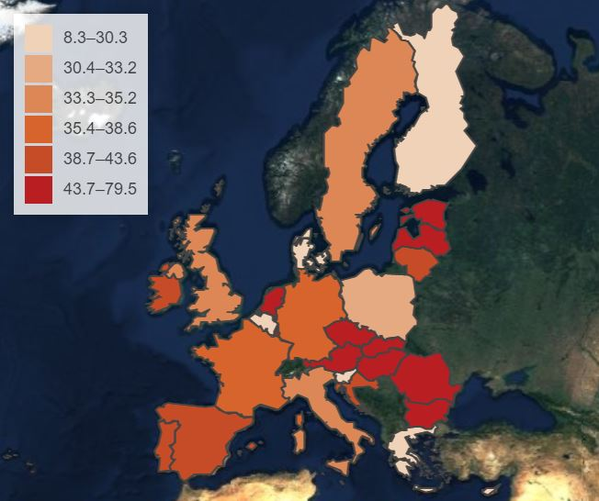
Low vs. High input farms
LOW
HIGH

Slide 47
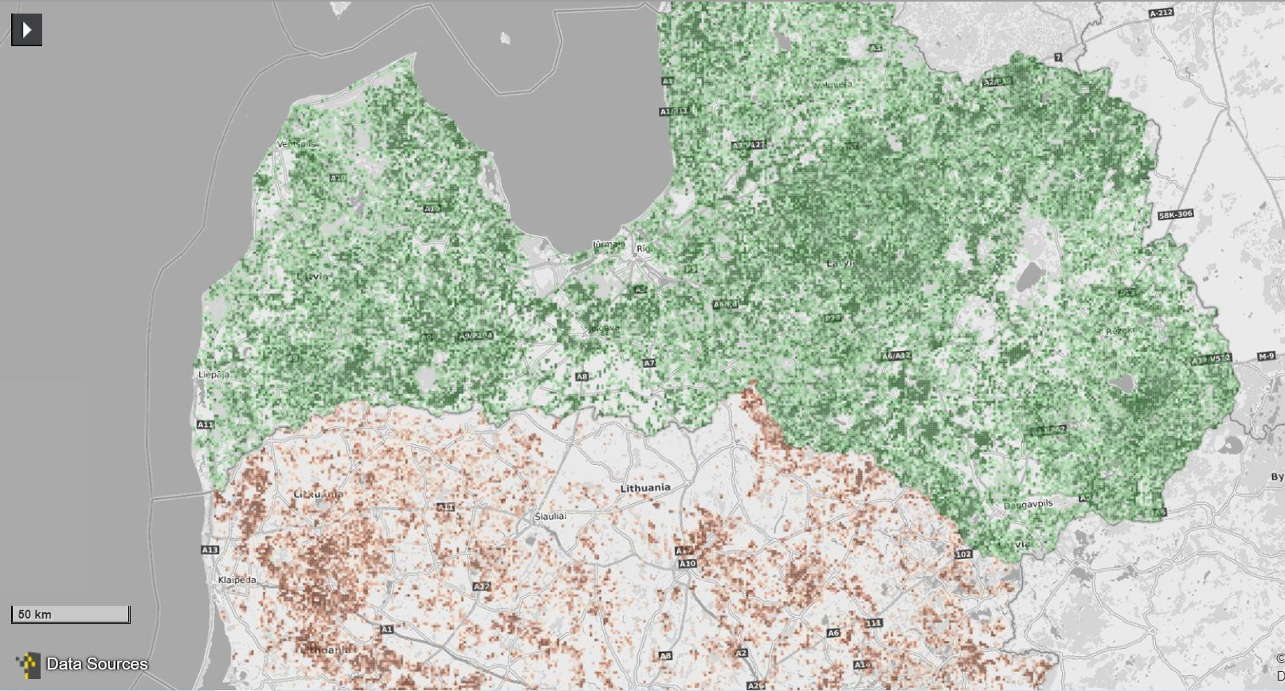
Biomass stock
Logging residues in LV
Firewood in LT
https://forest-energy-atlas.luke.fi/

Slide 48

Green economy
Bioeconomy – trade of bio-based goods and services
Circular economy - The circular economy is a model of production and consumption, which involves sharing, leasing, reusing, repairing, refurbishing and recycling existing materials and products as long as possible. In this way, the life cycle of products is extended and waste is reduced to a minimum.

Slide 49
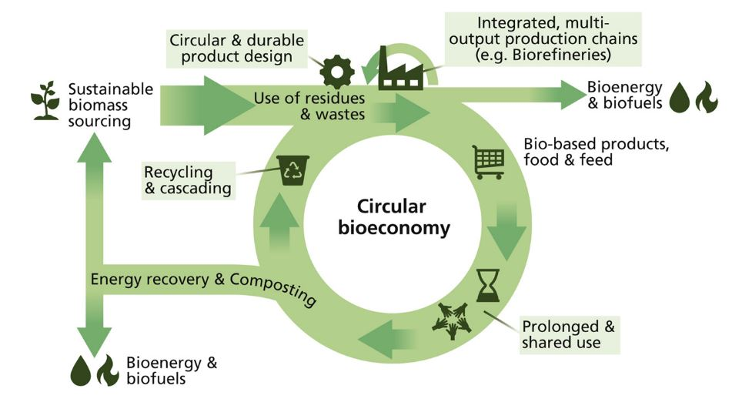
Circular bioeconomy
Although biogas as an energy source falls into the fifth category, its production principle and by-products are very different from the production of other fuels. The production of biogas in special biogas reactors produces both the biogas itself and the digestate, which is a nutrient-rich substrate and can be used for soil improvement
Stegmann et al. 2020 The circular bioeconomy: Its elements and role in European bioeconomy clusters

Slide 50

Soil improvements
ORGANIC FERTILIZER
Adding organic matter and biochar to soil helps to retain moisture and store carbon that otherwise could be released in the atmosphere in the form of CO₂
In addition to organic matter, digestate has many macro and micro nutrients.
ORGANIC MATTER
SOIL NUTRIENTS
MICROORGANISMS
PLANT NUTRIENTS

Slide 51
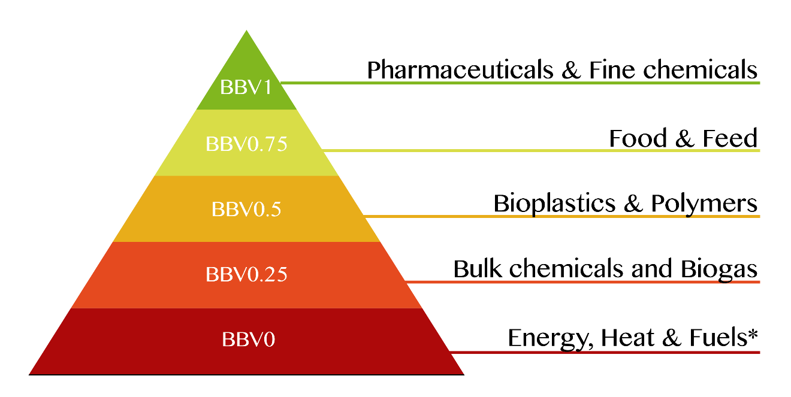
Bio-based value

Slide 52
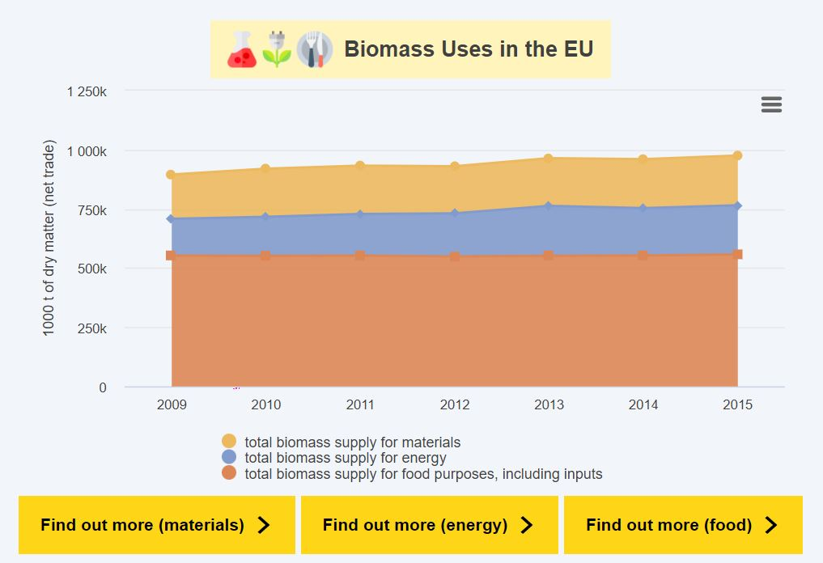
Biomass uses
In the EU Bioeconomy Monitoring System dashboards only three categories have been represented:
Materials
Energy
Food and feed
https://knowledge4policy.ec.europa.eu/visualisation/eu-bioeconomy-monitoring-system-dashboards_en

Slide 53
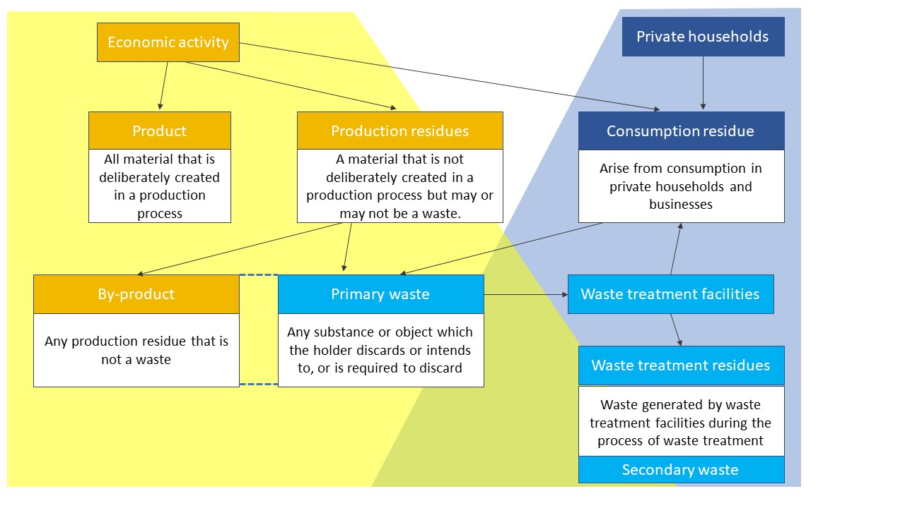
Waste and bioresource streams
53

Slide 54
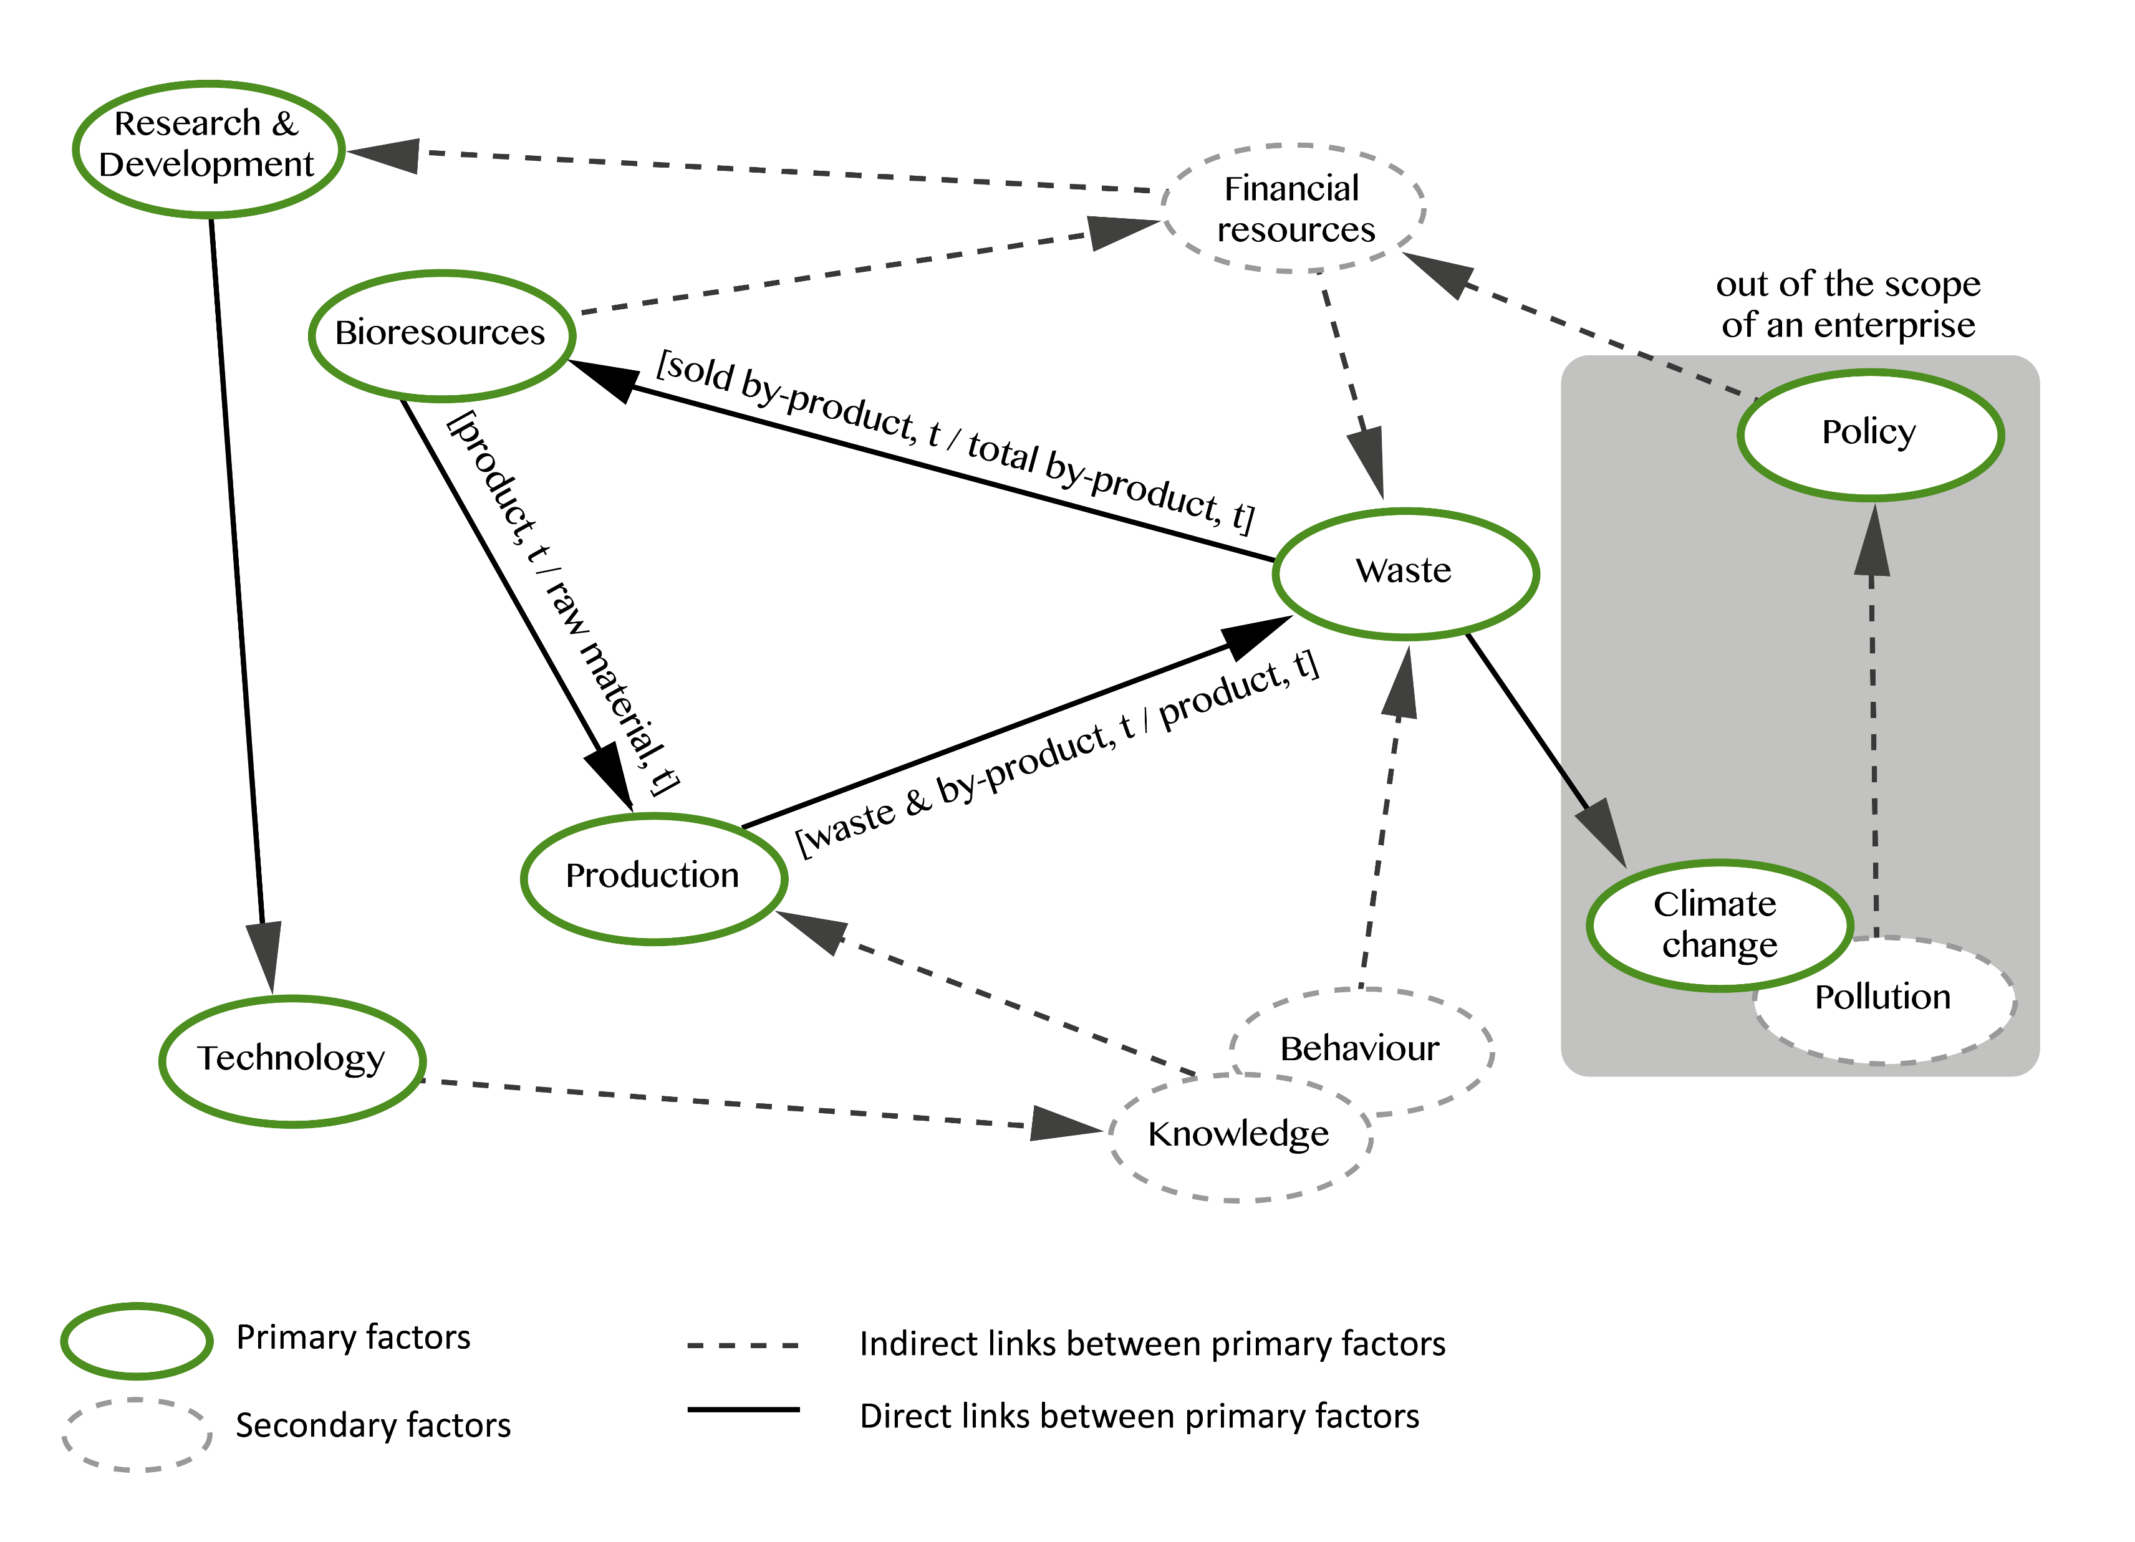

Slide 55
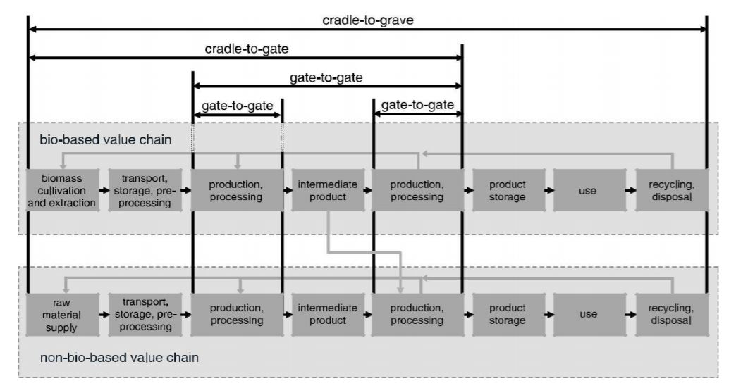
Boundaries

Slide 56
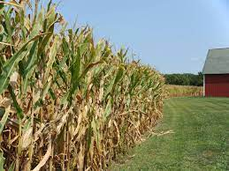

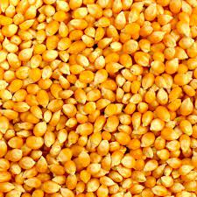

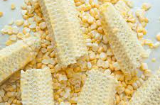
Maze to kernel
product
By-product/waste

Slide 57
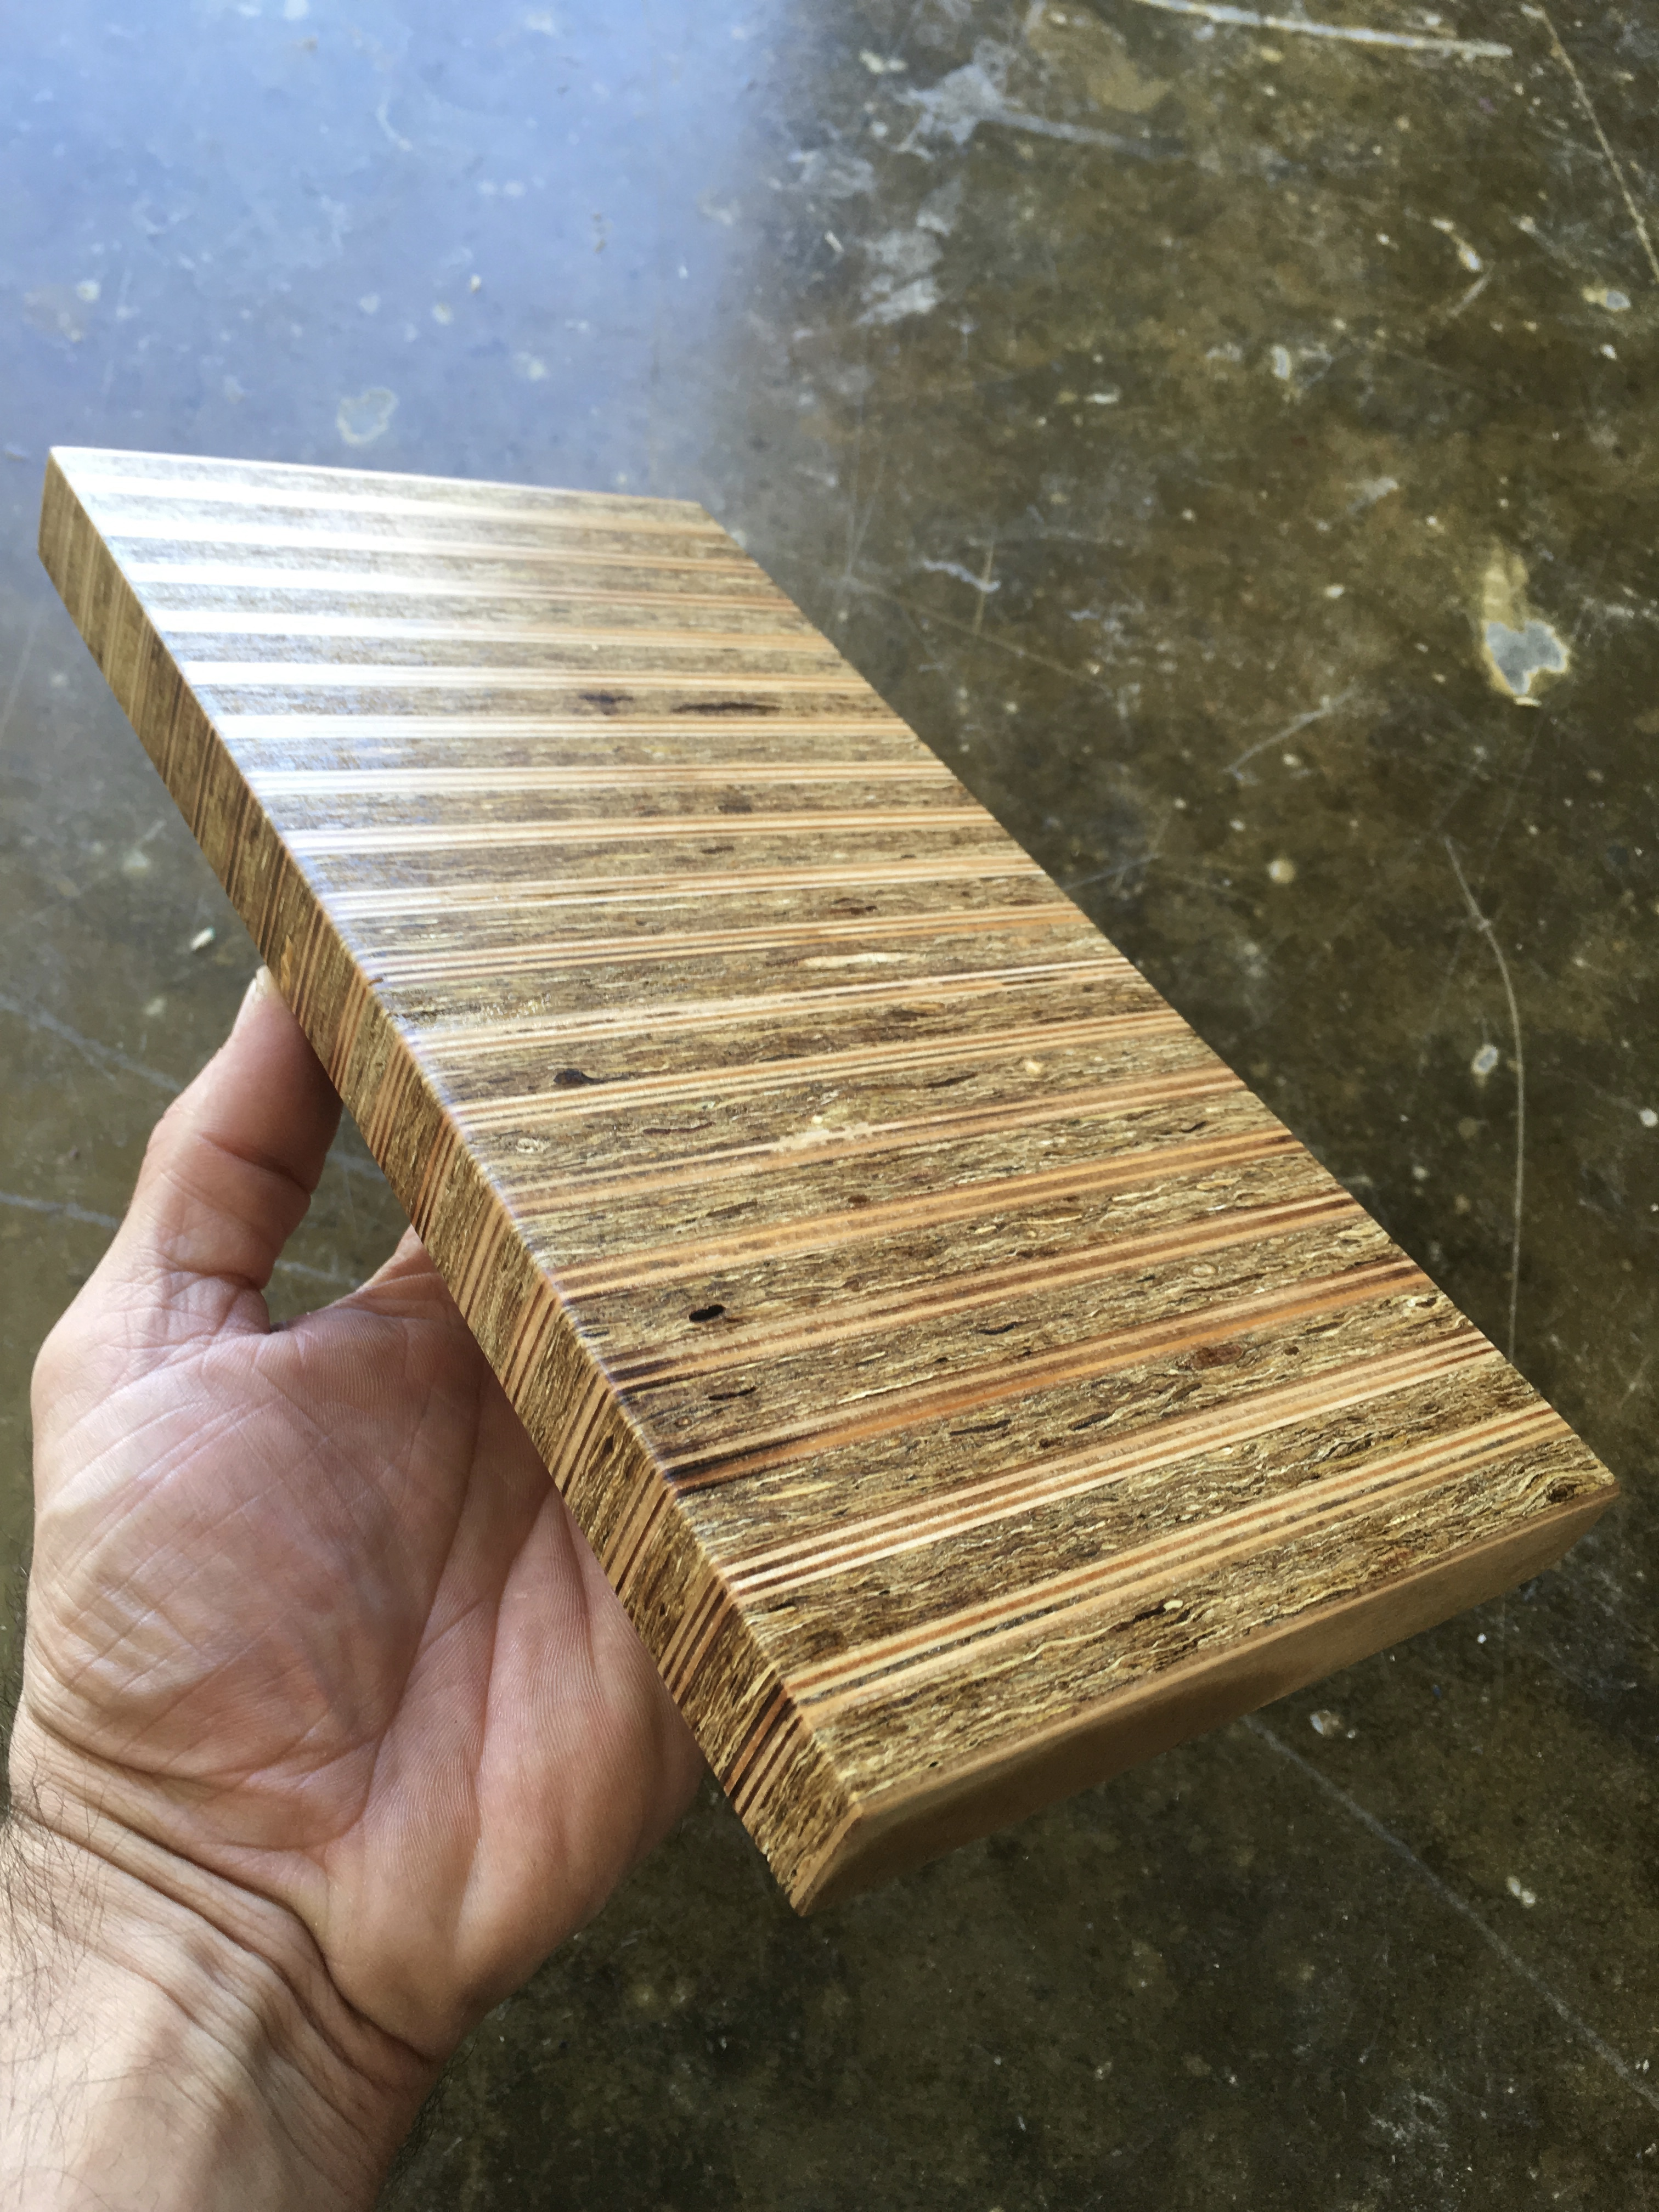
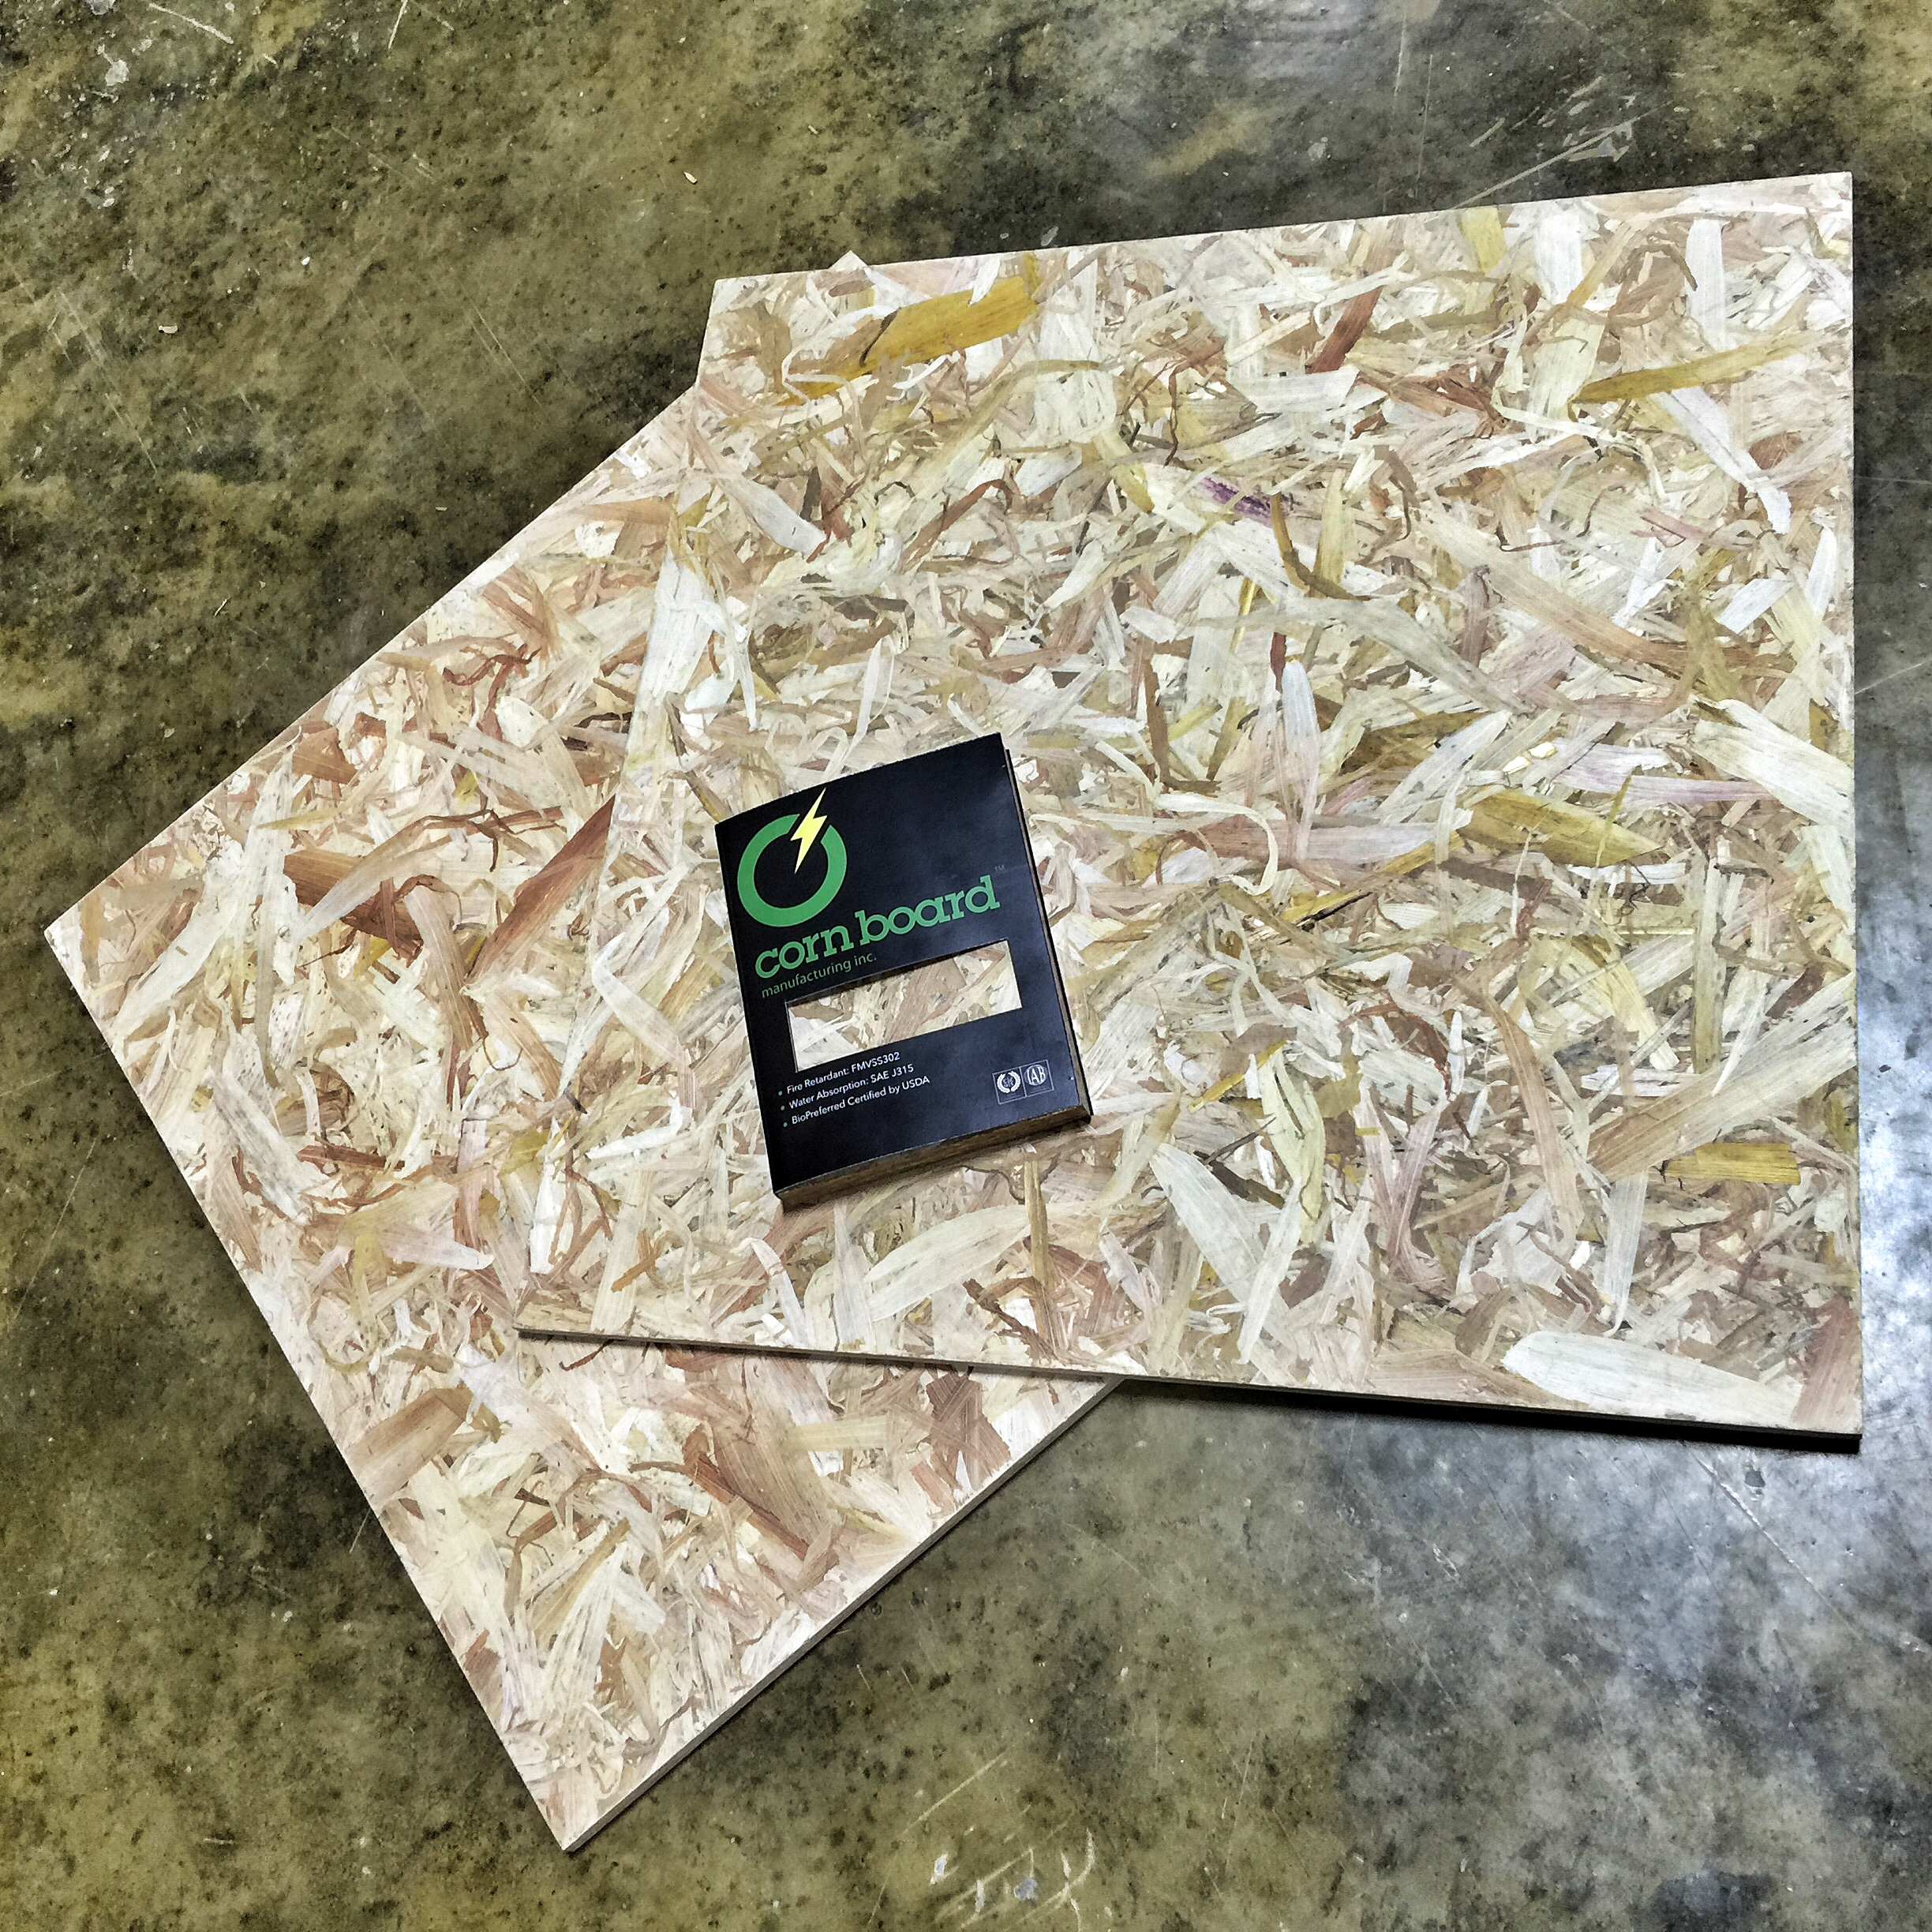
Stover to product
Corn stover can replace lumber for some applications.
By-product/waste
product

Slide 58
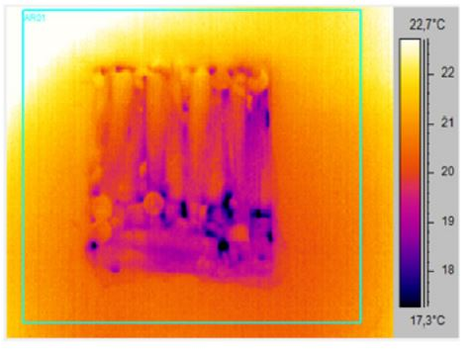
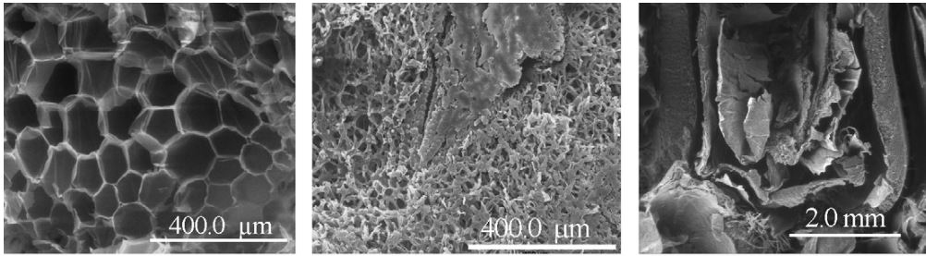
Maze to kernel
Corn cob residues can be used for thermal insulation.
product
By-product/waste

Slide 59
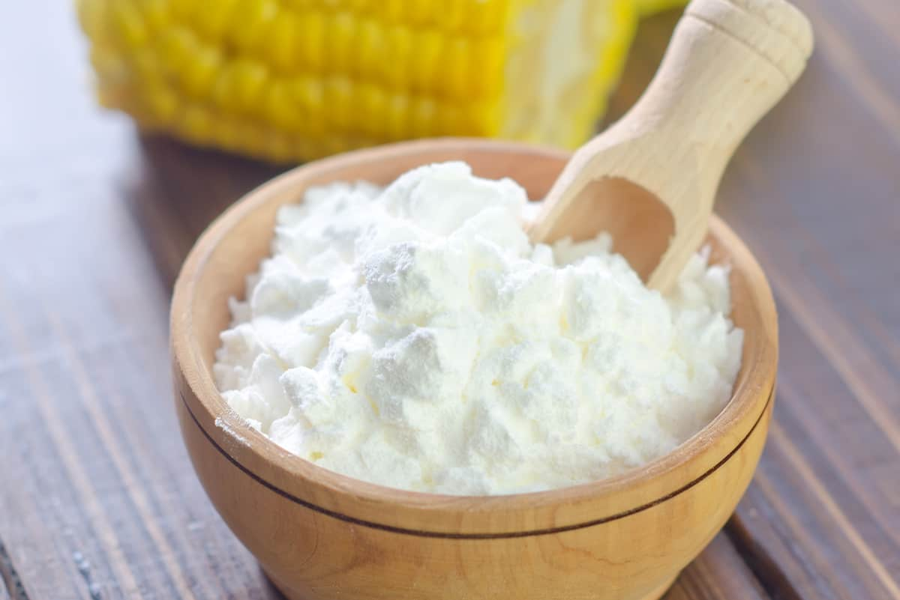
Maze to starch production
Notes:
Pārtika vs 1.paaudzes biodegviela
Kukurūzas graudi pārtikā, pārējais 2. paaudzes biodegvielā
Kukurūzas graudi pārtikā, pārējais 2. paaudzes biodegvielā, vālīšu serdes izolācija (Corn's cob as a potential ecological thermal insulation material) vai ksilāns

Slide 60

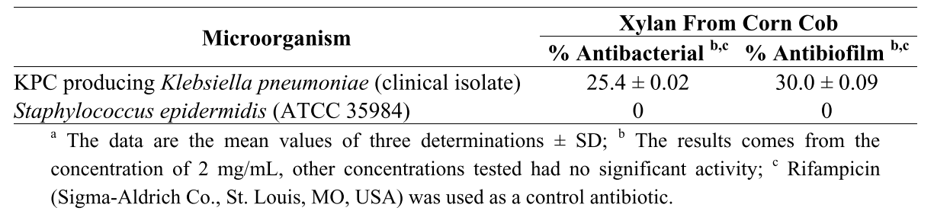
Xylan
Anti-inflamatory
antimicrobial
Alkalyne extraction
(40% xylan yield)
Ultrasonification
CORN COB

Slide 61
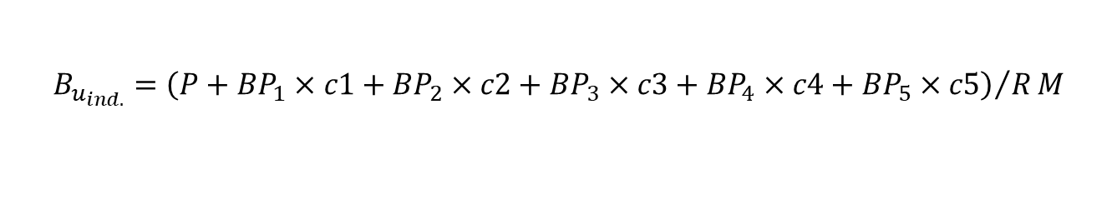
By-product utilization index
Xylan, fatty acids
Kernels, feed
Stover boards, packing peanuts
Biogas
Solid fuel
$$B_{u_{ind.}}={\left(P+{BP}_{1}×c1+{BP}_{2}×c2+{BP}_{3}×c3+{BP}_{4}×c4+{BP}_{5}×c5\right)}/RM$$

Slide 62
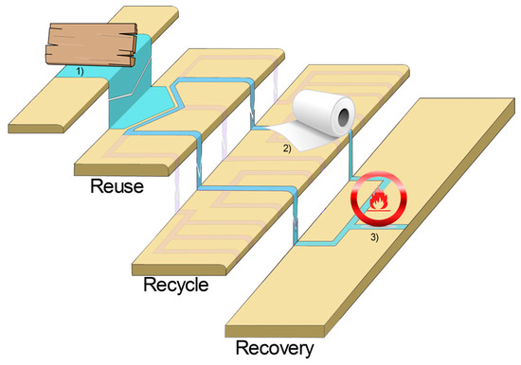

Cascading value
Cascade use and the management of product lifecycles

Slide 63
Investments (CAPEX) | Investment sum | Sum of plant investments including auxiliary plants, additional costs (e.g. financing, land fees), plus extension or optimisation
Investment costs (OPEX) | Write-offs | Under consideration of the respective technical service life
 | Imputed interest | Capital return
 | Maintenance | Costs for service and maintenance, as well as a maintenance reserve for the biorefineries
 | Taxes | Property taxes related to the investment
 | Insurance | Biorefinery plant insurance costs
 | Administration | Administration costs associated with the investment

Slide 64
Material and energy stream costs | Material | Expenses from material purchases
 | Electricity | Expenses from energy consumed
 | Heat | Calculated based on the supplied quantity of heat and the sale price
 | Labour | Labour costs for operations, maintenance and management
 | Other | Other costs not recorded elsewhere
 | Overheads | Additional costs for overhead
Overall evaluation | Operating results | Revenues minus costs (if necessary under consideration of other calculated costs)
 | Net present value | Sum of all discounted net payments (income minus expenses) attributable to the investment at this time

Slide 65

Economic assessment of the project
𝑂 = 𝐸𝑡 − (∑ 𝐼𝑛 + ∑ 𝐶𝑛 )
𝑶 = operating results
𝑬𝒕 = sum of revenues in the period t
𝑰𝒏 = sum of investment related costs in the period t
𝑪𝒏 = sum of operation related costs in the period t
𝐶₀ = −𝐼 + 𝐸_{𝑡} ∗ 𝐴_{𝑡} ∗ (1 + 𝑖) ^{−𝑇} + 𝑇 ∗ 𝐴_{𝑡} ∗ (1 + 𝑖) ^{𝑇}
𝐶₀ = net present value
𝐴_{𝑡} = sum of payments in the period t
𝑖 = discount rate

Slide 66
List of References
[1] “Circular economy: definition, importance and benefits | News | European Parliament.” [Online]. Available: https://www.europarl.europa.eu/news/en/headlines/economy/20151201STO05603/circular-economy-definition-importance-and-benefits. [Accessed: 13-Dec-2021].
[2] P. Stegmann, M. Londo, and M. Junginger, “The circular bioeconomy: Its elements and role in European bioeconomy clusters,” Resour. Conserv. Recycl. X, vol. 6, no. December 2019, p. 100029, 2020, doi: 10.1016/j.rcrx.2019.100029.
[3] E. G. Pellets, “Comparative Energy Properties of Torrefied Pellets in Relation to Pine and Elephant Grass Pellets,” vol. 13, no. 2, pp. 2898–2906, 2018.
[4] JRC, BBI JU, and IEA Bioenergy, “Joint survey on bioeconomy policy developments in different countries,” p. 34, 2018.
[5] eurostat, “Manual on waste statistics A handbook for data collection on waste generation and treatment.” p. 143, 2013, doi: 10.2785/4198.
[6] M. Khanna and N. Paulson, “To Harvest Stover or Not: Is it Worth it?,” Farmdoc Dly., vol. 6, no. 32, pp. 1–5, 2016.
[7] “Corn instead of wood? $15 million CornBoard plant coming to Iowa | Woodworking Network.” [Online]. Available: https://www.woodworkingnetwork.com/news/woodworking-industry-news/corn-instead-wood-15-million-plant-coming-iowa. [Accessed: 14-Dec-2021].
[8] R. Zhang et al., “Comprehensive utilization of corn starch processing by-products: A review,” Grain Oil Sci. Technol., vol. 4, no. 3, pp. 89–107, Sep. 2021, doi: 10.1016/J.GAOST.2021.08.003.
[9] I. Vamza, A. Kubule, L. Zihare, K. Valters, and D. Blumberga, “Bioresource utilization index – A way to quantify and compare resource efficiency in production,” J. Clean. Prod., p. 128791, Aug. 2021, doi: 10.1016/J.JCLEPRO.2021.128791.
[10] M. Kalverkamp, A. Pehlken, and T. Wuest, “Cascade use and the management of product lifecycles,” Sustain., vol. 9, no. 9, 2017, doi: 10.3390/su9091540.
[11] S. Chovau, D. Degrauwe, and B. Van Der Bruggen, “Critical analysis of techno-economic estimates for the production cost of lignocellulosic bio-ethanol,” Renew. Sustain. Energy Rev., vol. 26, pp. 307–321, 2013, doi: 10.1016/j.rser.2013.05.064.

Slide 67
Synopsis
This lecture gives an insight into:
The Multi Criteria Decision Analysis (MCDA) and specific practical applications
The explanation of the need for bioeconomy evaluation
Recognization of the issues regarding bioeconomy evaluation
Identification of bio-based product values
Presentation of the Cascade and Nexus approaches
Notes:
Summary of contents and learners achievments

Slide 68

Short-bio
M.sc.ing. Antra Kalnbaļķīte
Scopus Author ID: 57194541789
H-index = 2
Reasercher and lecturer in Institute of Energy Systems and Environment at Riga Technical University
Main research area: sustainable education, bioeconomy

Slide 69

Short-bio
M.sc.ing. Ilze Vamža
Researcher Ilze Vamža is an environmental scientist with biology background.
Assistant at the Riga Technical University’s course Environmental technologies 2
Lecturer on Biotechnology course
69

