Slide 1
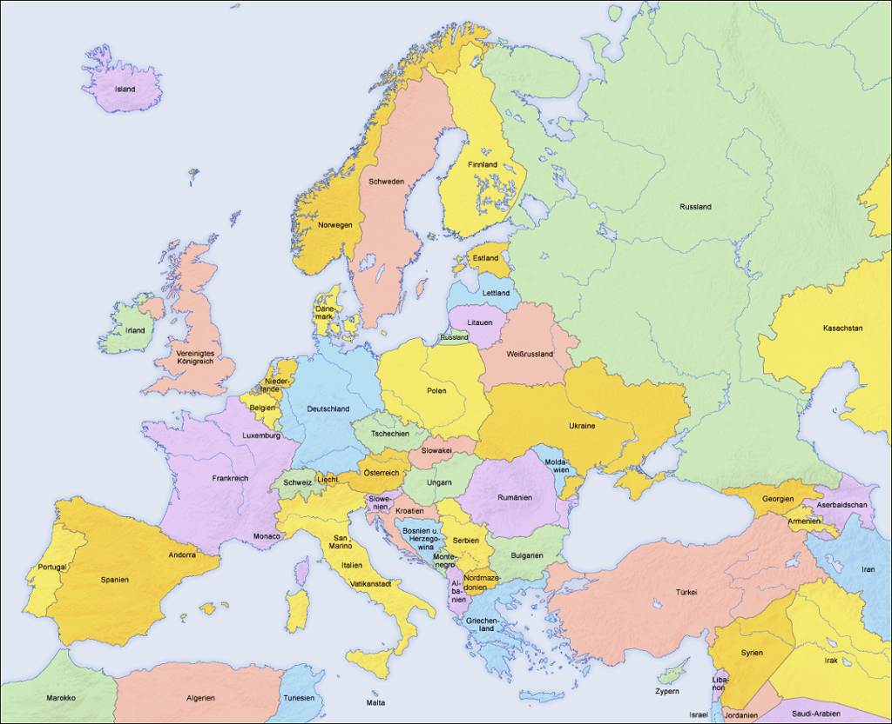


Social farming across Europe
Unit 3.2.
Module 3: Methods, techniques and experiences of Social Farming
Larissa Nagorka
http://cdn.thinglink.me/api/image/498245129388163074/1024/10/scaletowidth/0/0/1/1/false/true?wait=true

Slide 2
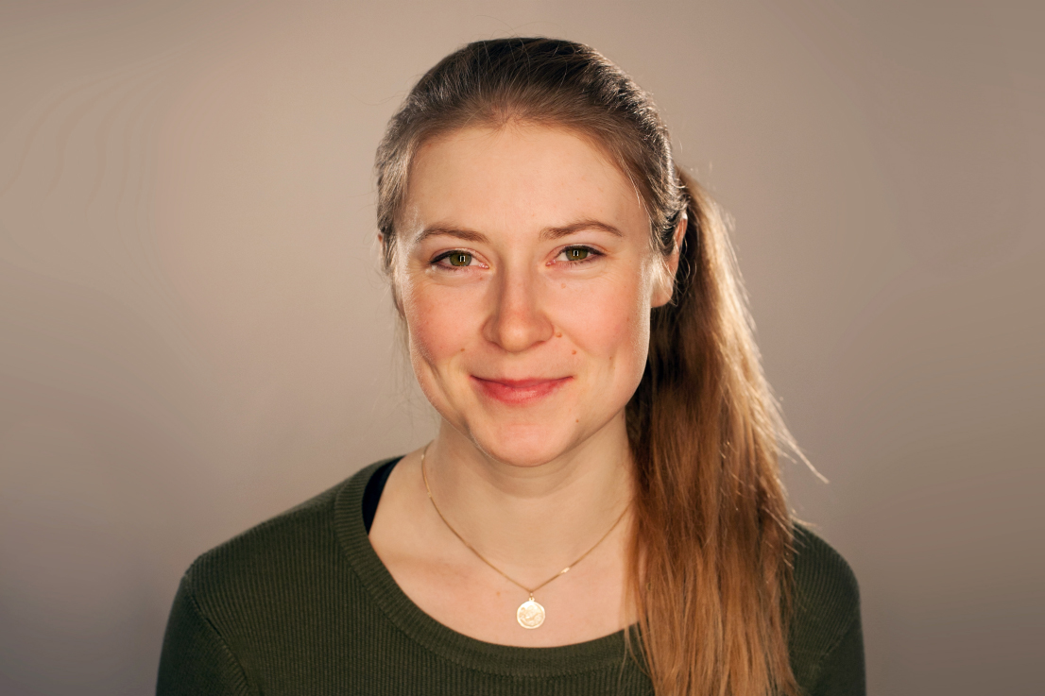
Presentation of myself
Larissa Nagorka
B. Sc. Organic Agricultural Sciences
Employed at Petrarca since 2021
Bachelor thesis: The effect of gardening activities on people with a psychiatric disorder
B.Sc. Psychology (4th semester)
Notes:
Einfach noch mehr dazu sagen

Slide 3
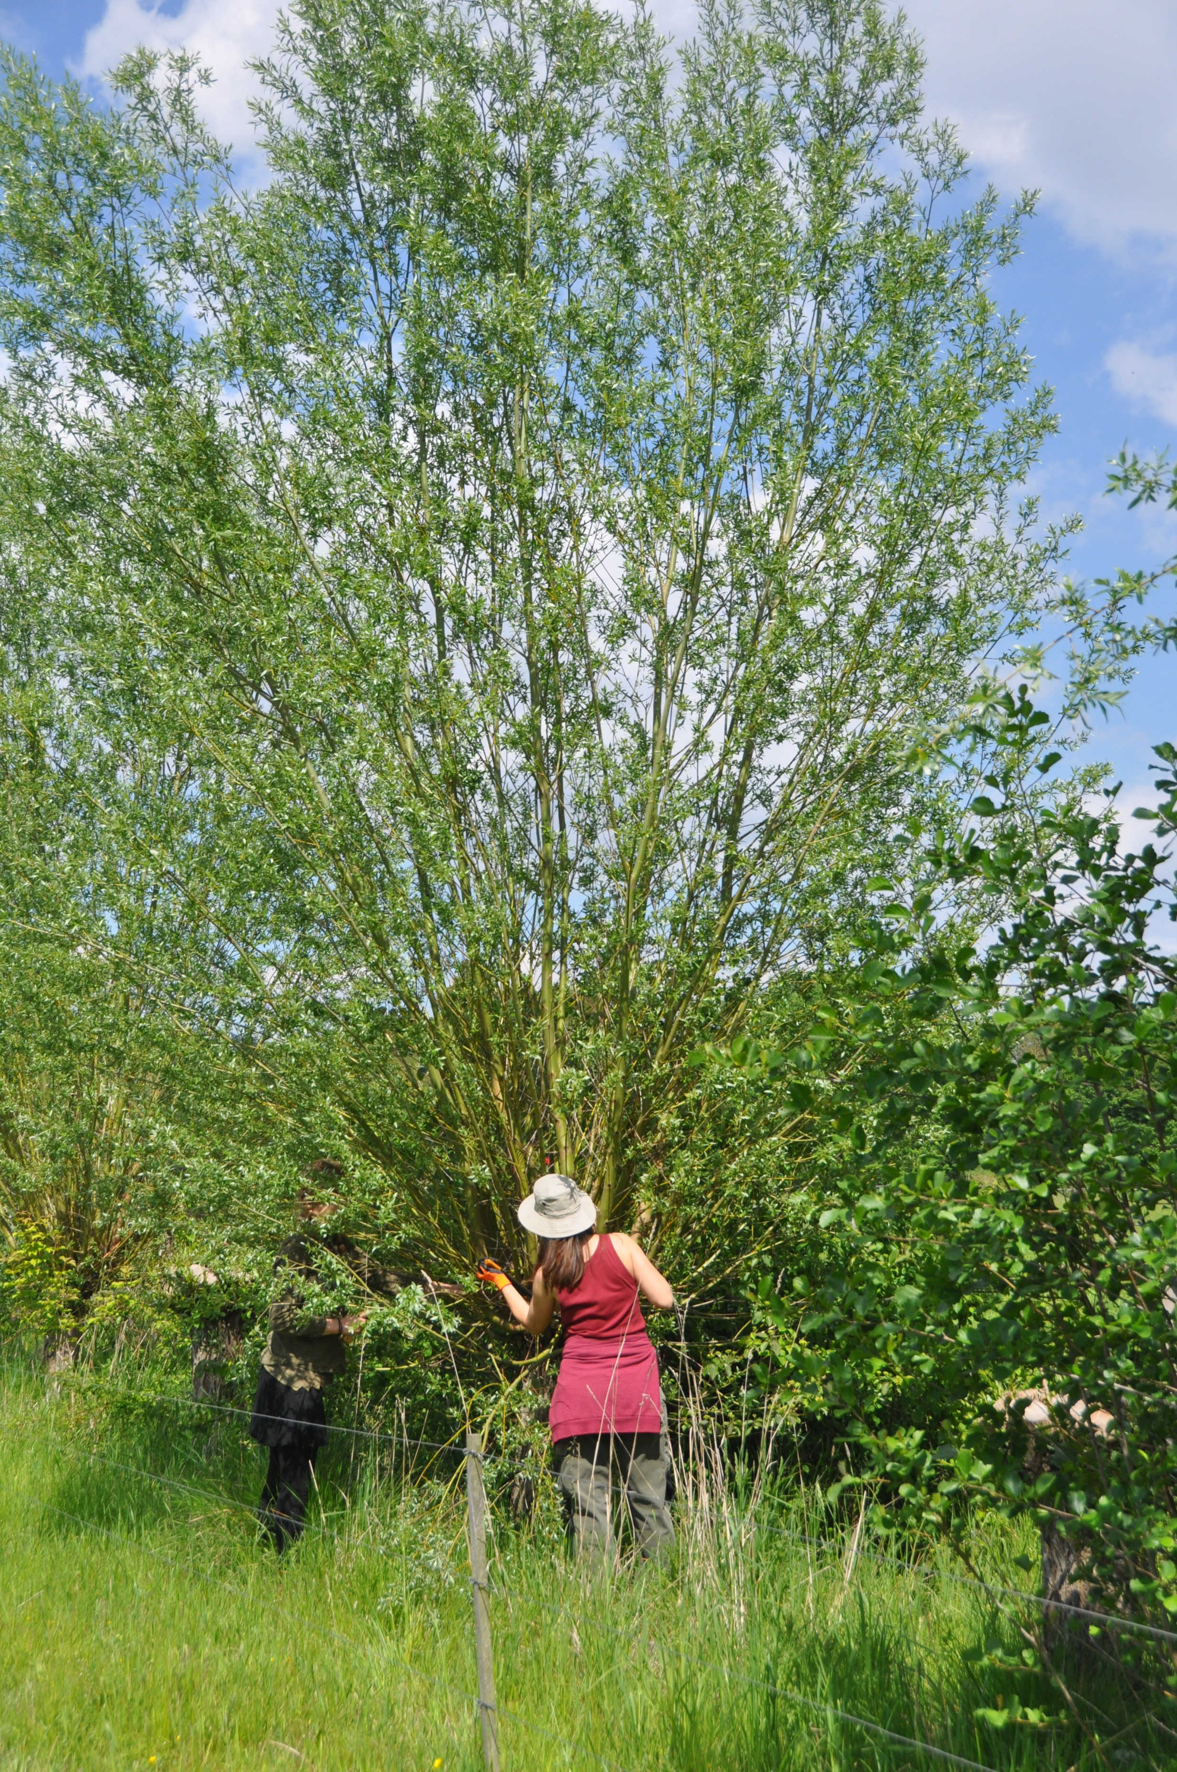
Content of this Unit:
To provide facts about the reality of Social Farming across Europe
To present examples related to challenges in social and health systems in the countries
Social Farming development in the different countries involved in the SWEDA project
Thomas van Elsen

Slide 4
Learning outcomes
Recalling and remembering facts about the reality of Social Farming across Europe
Transfer of basic knowledge on concrete examples
Assessing structures on social farms
Comparing different work sequences on farms and applying them to the special needs of people being integrated
Analyzing and comparing farms and places in relation to their work and environment (kind of activities, buildings, distance to a city, surrounding environment,…) to appraise if they are suited for special target groups
Classifying differences among Social Farming approaches across Europe related to challenges in social and health systems in the countries

Slide 5
Similarities of Social Farming in Europe
National organizations and Social Farms are working on promoting its development
Most common target groups: people with disabilities and elderly people
Educational farms are widespread in all countries
Notes:
Viele bilder etc

Slide 6
Differences of Social Farming across Europe
Differently widespread and developed
Various specifications and many similarities
Italy and the Netherlands: Most developed and more anchored in society than it is the case in other countries, might be due to supportive national law on Social Farming in Italy as well as the policy in the Netherlands
Poland, the Czech Republic and Portugal: Currently established but still in its infancy
Austria and Germany: various target groups but the participation of politicians and the financing possibilities for the initiatives are still limited

Slide 7
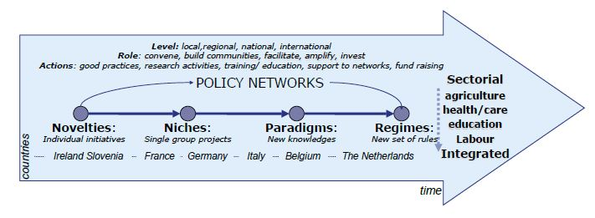
Stages of development of SF in different European countries
Fig.: Policy networks and pathways of change in Social Farming
(Source: SoFar Project)

Slide 8
Important components to promote and strengthen
Social Farming in Europe
Political support
Supporting national associations of Social Farms
Transfer of knowledge between countries

Slide 9

SWOT-Analysis
Strengths-Weaknesses-Opportunities-Threats of Social Farming in:
1. Italy
2. Netherlands
3. Austria
4. Germany
5. Czech republic
6. Poland
7. Portugal
__________
8. Norway
(Tornier, 2020)
https://www.kompyte.com/wp-content/uploads/2017/12/competitor-swot-analysis.jpeg
Notes:
Other countries such as France, Great Britain, Hungary are not included . Are nor listed cause too little is known. Great Britain has a lot of horticultural social activities, know for garden therapy

Slide 10
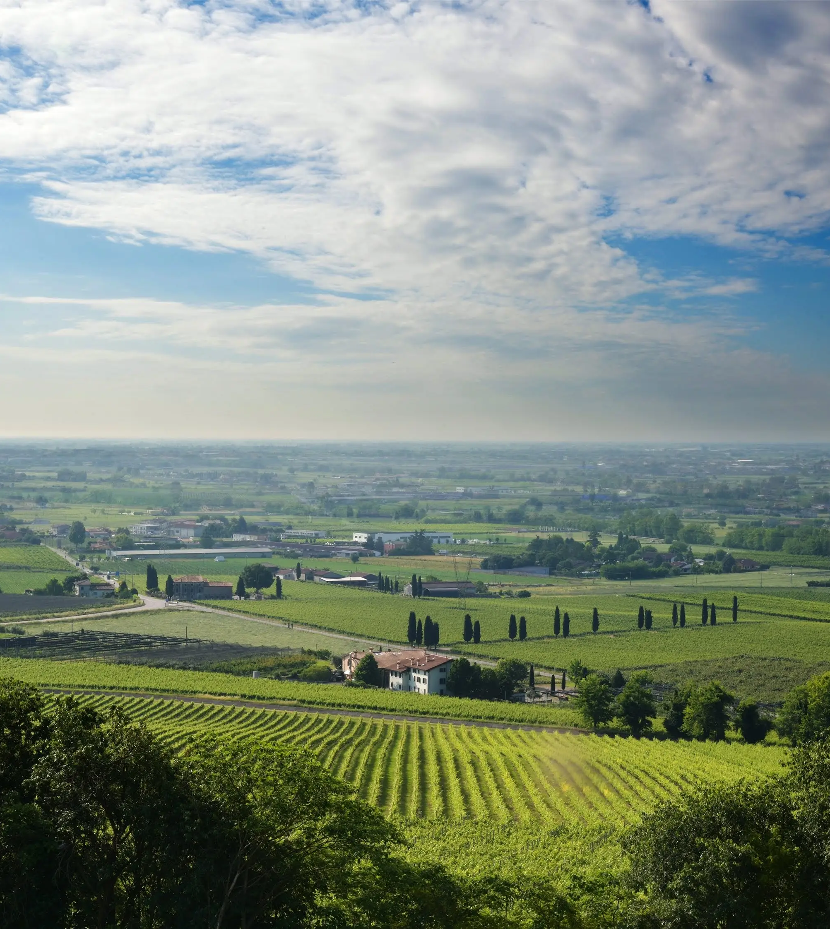
1. Italy
Located in the South- central Europe
One of the founding members of the European Economic Community
Social Farming is well established in Italy
https://i0.wp.com/hardcoreitalians.blog/wp-content/uploads/2020/06/countryside-farm-italy-landscape-1575820.jpg?ssl=1

Slide 11
SWOT-Analysis Italy
STRENGTHS • Law for Social Farming • Umbrella organization exists • Farms spread over the whole country • Well known in the society • In use to fight mafia • Chart of principles • Standard criteria for assuring the quality • Education at different universities • Guide for Social Farming • Map of Social Farming practices • member and also initiator of multiple European projects | WEAKNESSES • Finances sometimes linked to a time-limited project and therefor difficult to implement Social Farming activities in a long run
OPPORTUNITIES • Law for school inclusion • Law for work inclusion • Different funding opportunities | THREATS • Advertised as solution for everything
Tornier, 2020

Slide 12
History of Social Farming in Italy
In 2015: national law on Social Farming → framework of principles and procedures for recognizing Social Farming practices
2011: founding of The Forum Nazionale Agricultura Sociale
  Multifunctional association to promote the idea of Social Farming, coordinate projects and interact with the ministries and stakeholders
  → Contributed mainly to the development of Social Farming in Italy
But: beginning of Social Farming in Italy was years ago:
Change of law 180 in 1978: shut down of the large state-run hospitals and set up of smaller community-based facilities (MOSHER 1982)
  → Milestone enabled farms to open their gates
  Since then, Social Farming has been growing very fast (SIGNORIELLO, intvw.)

Slide 13
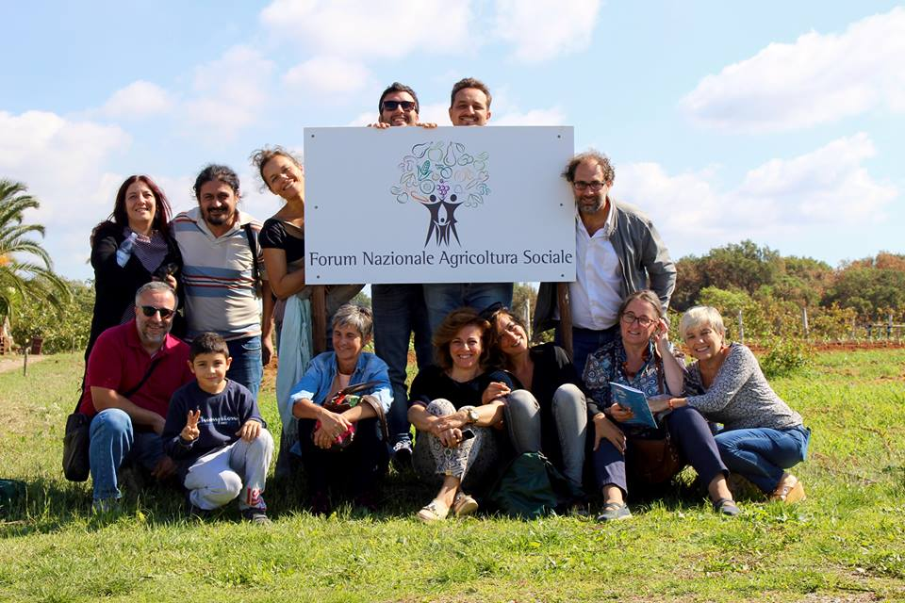
https://www.forumagricolturasociale.it/agricoltura-sociale/storia-dellagricoltura-sociale/

Slide 14
Forms of Social Farming in Italy
Most of the institutions doing Social Farming are social cooperatives (SIGNORIELLO, intvw.)
Social cooperatives account for app. 50 % of the total number of Social Farms (GIARÉ (intvw.))
Other half mainly consists of small-scale farms
Two kinds of social cooperatives (CREA PB. LANFRANCHI et al. (2015)):
Type A:
Managing health and educational services for people with disabilities
For rehabilitation, educational purposes or for socialization
Type B:
→ Focus on the employment of disadvantaged people, which are working
on the farm (LANFRANCHI et al. 2015)
Notes:
Überwiegend biologische Bewirtschaftung,

Slide 15
Financing of SF in Italy
Many enterprises invest money in social activity since Social Farming is very popular in Italy right now
The support is often linked to a time-limited project, which makes it difficult to implement Social Farming activities in a long run (GIARÉ, intvw.)

Slide 16

Advertisement for products from a Social Farm
In Italy, many products of Social Farming are advertised as such
The high quality of the products, which also contain a social value motivates customers to buy "socially" produced food
van Elsen, 2021

Slide 17
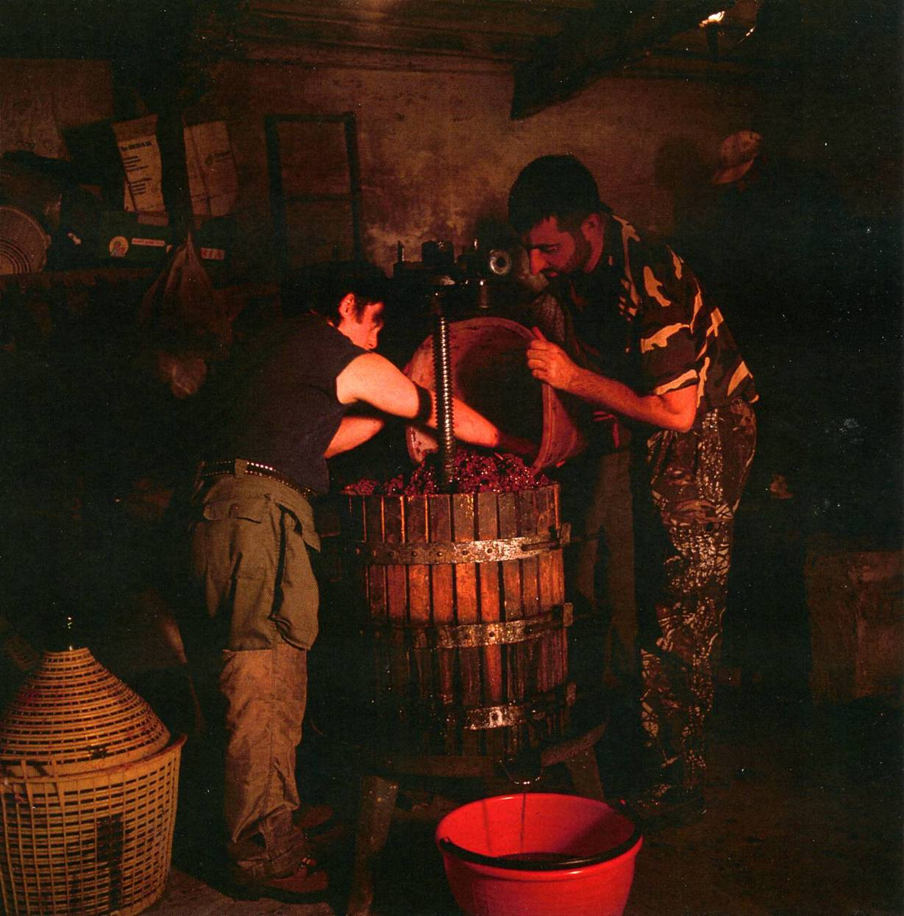
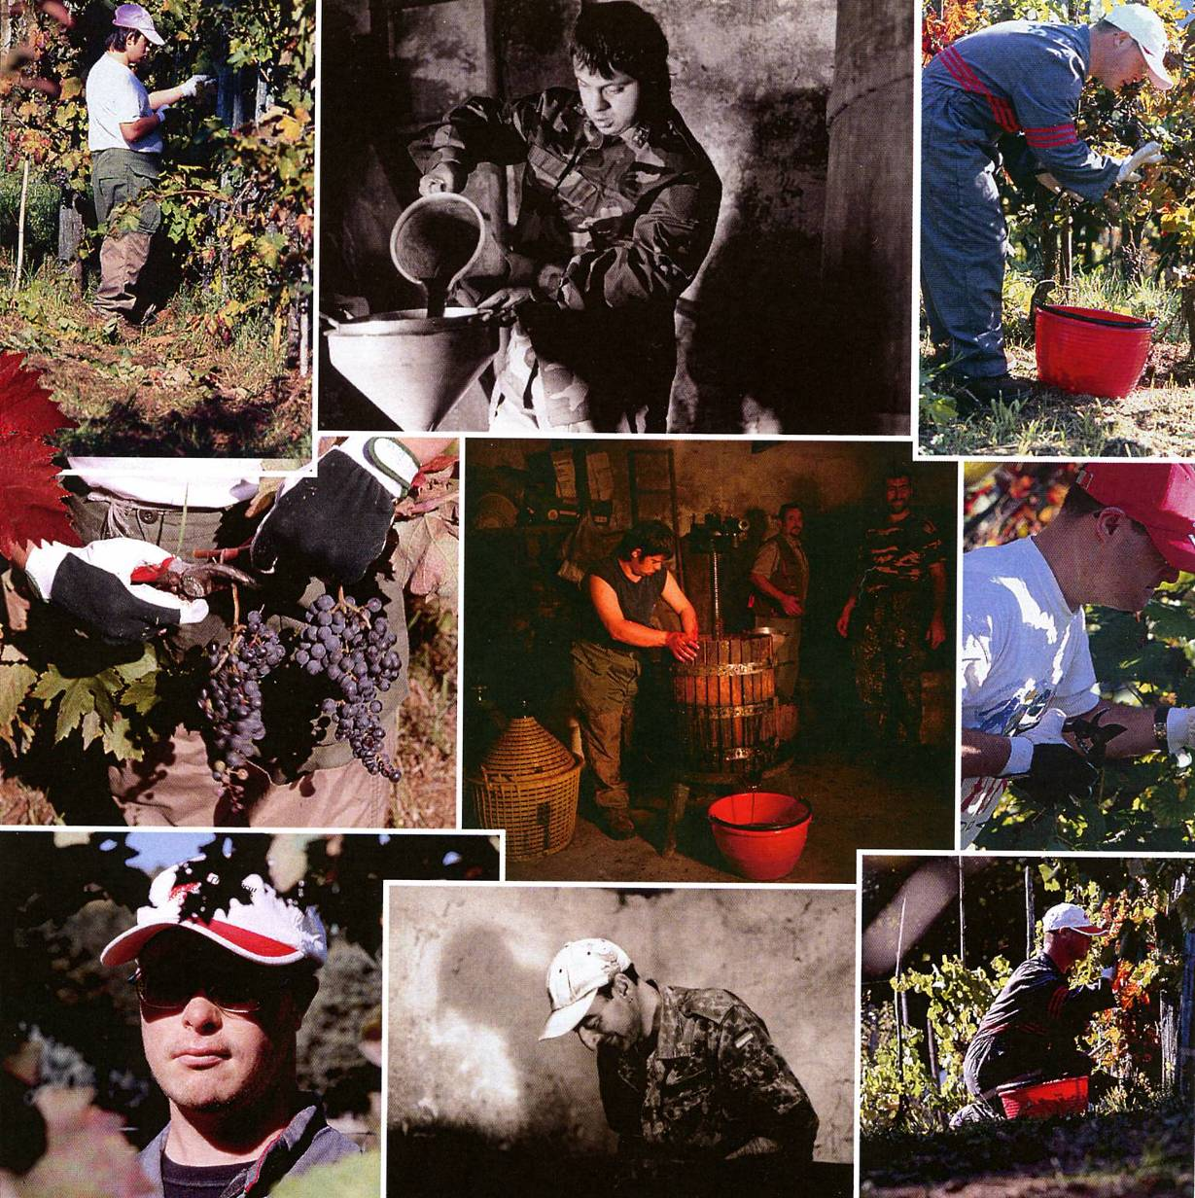
Van Elsen, 2021

Slide 18
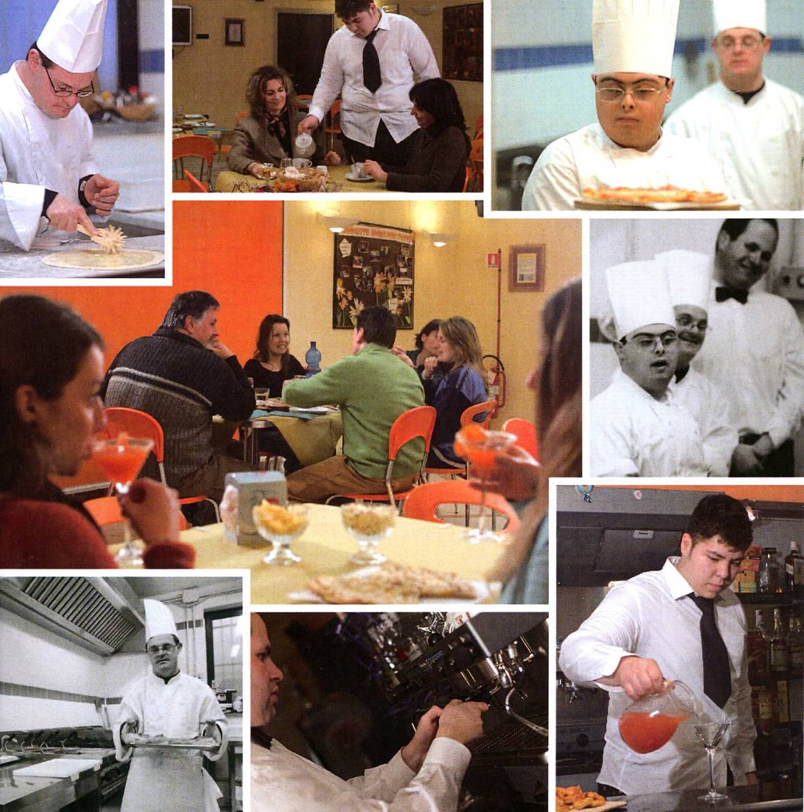

Van Elsen, 2021

Slide 19
Number and target groups of Social Farms in Italy
Approximately 3000 Social Farms all over Italy
CREA PB has 1500 addresses or names of cooperatives and farms (GIARÉ, intvw.)
Some regions even have public lists of Social Farmers, but most of them are incomplete
Difficult to determine the exact number
Largest target group are people with disabilities, refugees, prisoners and elderly people (SIGNORIELLO, intvw.)
Educational farms are very common

Slide 20
Locations of Social Farms in Italy
Mainly located in the North of Italy (GIARÉ, intvw.)
Also many farms in the South and on Sicily (FOTI et al. (2013))
Website of the association also provides a map with information about the existing Social Farms (shown on the right)
Figure: Map of Social Farms in Italy (https://www.forumagricolturasociale.it/esperienze/ )

Slide 21
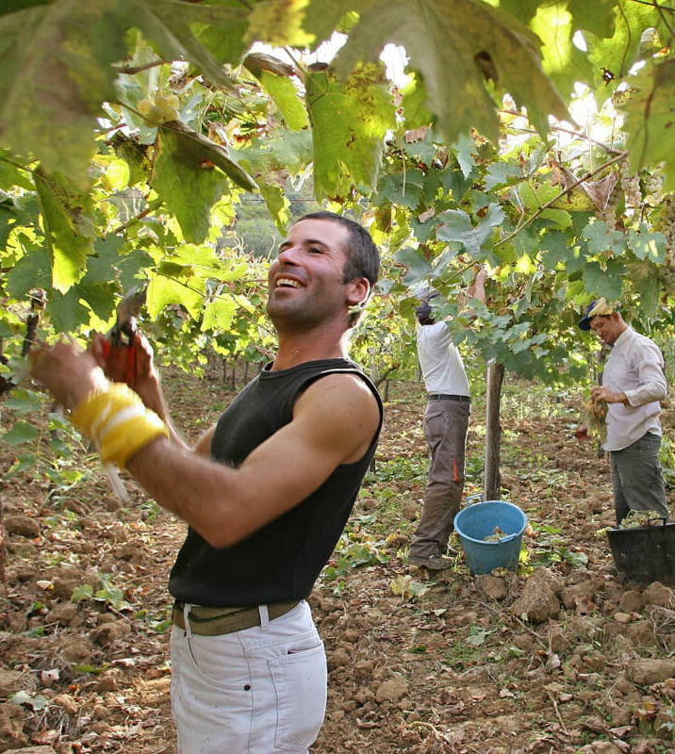
Social Farming in Italy and the Mafia
A special feature in Italy is the influence of the Mafia
To fight their negation of the human rights, initiatives started Social Farming on the land to work with children of the mafia and to give confiscated land to organic farmers
The concept is quite a success, even though the farms sometimes get into trouble with the mafia as they burn down or steal equipment such as a tractor (SIGNORIELLO, intvw.)
https://modernfarmer.com/2014/02/giving-mafia-land-farmers/

Slide 22
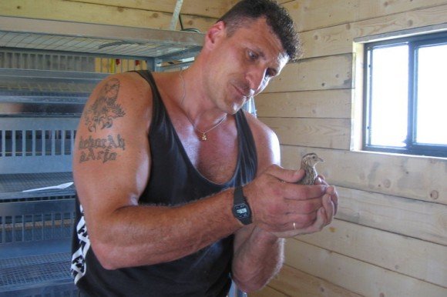
Social Farming for Prisoners in Italy
Focus on working with prisoners
Rehabilitation of prisoners through Social Farming
Employment law for prisoners, which allows their employment in agriculture (inside and outside the prison walls)

Slide 23
Educational offers
As one of the principles is the Network and Community Development, the farms can learn from each other
The National Forum is also offering training courses for the farmers and other people who are interested in Social Farming
At universities in Italy people can take courses about this topic in the framework of the bachelor study as well as in the master programs
Research centers offer workshops and seminars
(SIGNORIELLO, intvw., GIARÉ, intvw.)

Slide 24

Further reading
Fotografia dell'Agricoltura Sociale in Italia:
rica.crea.gov.it/APP/agricoltura_sociale/
Modern farmer:
https://modernfarmer.com/2014/02/giving-mafia-land-farmers/
Notes:
In besprechung sagen was man dort findet

Slide 25
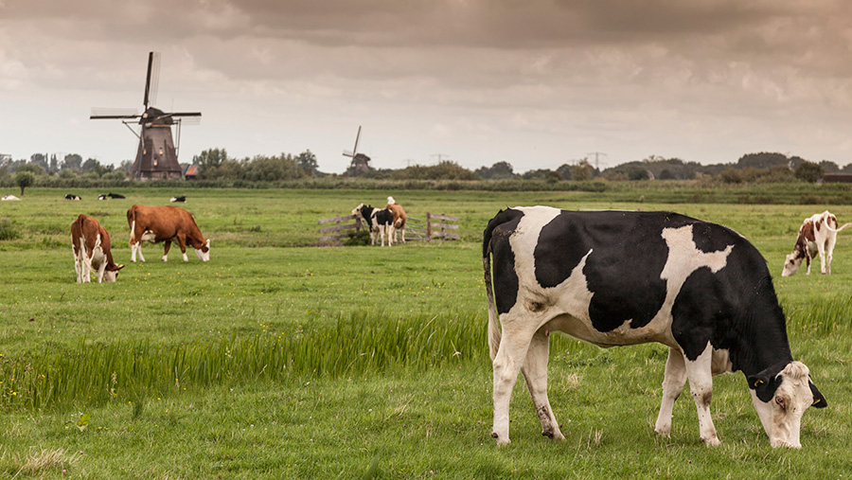
2. The Netherlands
Located in north-west of Europe
Considered as a pioneer of Social Farming
Social Farming is known as Care Farming because of the connection between the health care sector and agriculture
https://stmaaprodfwsite.blob.core.windows.net/assets/sites/1/2016/11/231116-cows-and-windmills-c-Cultura-REX-Shutterstock-rexfeatures_3418445a.jpg

Slide 26
SWOT Analysis Netherlands
STRENGTHS • Started already in the 1960s • Spread all over the Netherlands • Well known in the society • Positive image • Quality assessments • Certification • Training possibilities • Handbook available • Financial support from regions and state • Member and initiator of multiple European projects | WEAKNESSES • Not everyone uses certification • Not every farm is in the system • Most are dependent on financial support • No need for professional know-how to start a Care Farm
OPPORTUNITIES • Law for work inclusion • Contracts with municipalities • Politics are involved • Changes in the social sector • Professionality in the sector | THREATS • Stagnation • Economic benefits may become more important than the social ones • Relationship of the social and agricultural sector are instable
Tornier, 2020

Slide 27
History of Social Farming in the Netherlands
The development of Care Farming started in the 1960s or 1970s (HASSINK, intvw.; HASSINK 2017)
1997: interest in Care Farming increased
Decisive factor for this growth: anthroposophist organization named Omslag, the national farmers´organization
  → Tried to mobilize political support for this matter (HASSINK 2017)
1999 the National Support Center Agriculture and Care was created, subsidized by the ministry of agriculture and the ministry of health, welfare and sports (ROEST et al. 2010)
  → Spreading of information about care farming over newsletters and a website
  (HAUBENHOFER et al. 2012)
  Publishing a handbook about setting up a Care Farm
  Creating a quality system for Care Farming
2008: the financial support of the ministries came to its end, therefore the work of the center stopped (ROEST et al. 2010)
  The ministries tried to push the Care Farming sector in a direction of independency
  The National Federation of Care Farms was established and financed by the Care Farmers themselves (HASSINK 2017)
2000: regional foundations of Care Farms were created
In 1995, farmers could either function as a social institution or be part of a social institution to receive the AWBZ accreditation and to be financed through them (HAUBENHOFER et al. 2012)
Notes:
AWBZ is a Dutch health care law that provides a general insurance for specific target groups

Slide 28
Target groups in the NL
In the beginning, most of the Care Farms welcomed people with intellectual disabilities
Nowadays the farms are more open to different kind of target groups (ELINGS, intvw.; HASSINK et al. 2020)
Main target groups: Elderly people with dementia and youth with behavior or learning problems and people with intellectual disabilities (ELINGS, intvw.)
Different target groups are often mixed on one farm (van Elsen, 2021)

Slide 29
Number of Care Farms in the NL
In 1998: approximately 75 Care Farms
The highest increase happened from 1999 until 2001, due to the development of the National Support Center
From 2007-2018 around 1250 Care Farms estimated (VAN DER MEULEN et al. 2019)
2003: second increase of Care Farms took place after the implementation of the personal budget which was made available for a variety of target groups
In 2008 the number increased above 800 (ELINGS & HASSINK 2008)
Decline of Care Farms after 2011 might be due to the limited agricultural economic activity or because of the fact, that only certified Care Farms were registered by the Federation of Care Farms and other farms are not listed anywhere (VAN DER MEULEN et al. 2019)

Slide 30
Further reading
(Pflege)Höfe in den Niederlanden (Seite mit Links zu über 100 Höfen der Sozialen Landwirtschaft in den Niederlanden):
http://zorgboerderij.startpagina.nl
www.zorgboeren.nl/
www.zorgboerderijgids.nl/

Slide 31
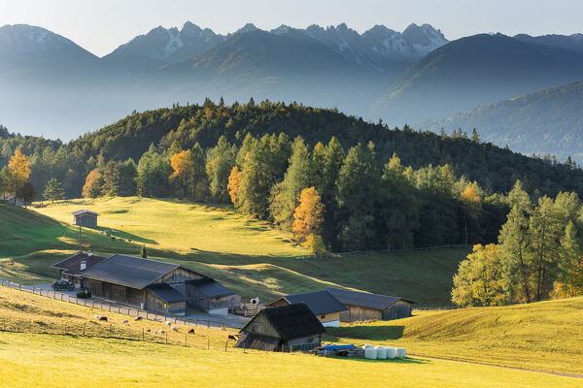
3. Austria
Landlocked country in the middle of Europe
Divided into 9 federal states
Relatively sparsely populated
Social Farming in Austria is estimated as a part of Green Care, which is a well-known term in the society
Many small-scaled agricultural businesses
https://www.mediastorehouse.com/p/251/typical-austrian-farm-europe-austria-innsbruck-15235436.jpg
Notes:
Many organic farms

Slide 32
Austria
STRENGTHS • Studies about the situation of Social Farming in Austria • Journal “Green Care” • Umbrella organization • Education at universities/colleges • Advisory centers in every region • Well known by the society • Educational farms • Member of multiple European projects | WEAKNESSES • Scandal in 70s is still in the people’s mind • Educational farms are declining • Great bureaucratical effort to receive existing funding
OPPORTUNITIES • Politics involved • Funding opportunities from different sectors • Law for work inclusion • Trend towards outsourcing of therapies • High percentage of organic and small- scaled farms | THREATS • Migration from the countryside • Medium-sized farms are declining • Low recognition in health sector
Tornier, 2020
Notes:
Scandal in 1970: people with mental disabilities were forced to live and work on farms under inhumane conditions;
these were external workplaces of a psychiatric clinic, a cheap alternative,

Slide 33
History of Social Farming in Austria
Cost Action Green Care in agriculture played an important role for the development of Social Farming
The definition of Social Farming as a subsection of Green Care was adopted from the project (WIESINGER, intvw.)
Before 2006 the number of Social Farms was estimated at 200-300
Most of the Social Farms were integrated into a family structure (WIESINGER et al. 2011)
Until the middle of the last decade, it was widespread in rural regions of Austria that poor, sick, old or disabled people worked in different farms, changing periodically as an economic support for the farm
→ This was an obligation for farmers in specific communities and the target group
had to work on the farm, which sometimes led to exploitation
(WIESINGER et al. 2013)
→ Scandals in 1970 still in people´s minds (HAUBENHOFER, intvw.)
In the beginning of the current century the ´Österreichische Gartenbaugesellschaft´, a horticultural corporation organized a well-attended conference about garden therapy
Three years later the association ´GartenTherapieWerkstatt´ was founded by the University College for Agrarian and Environmental Pedagogy (WIESINGER et al. 2011)

Slide 34
Main target groups in Austria
Largest field: pedagogy (educational sector, school on the farm)
2nd most frequently represented area is integration (of people with mental problems, children and young people with social problems)
Few projects with prisoners and long-term unemployed women were also identified
The last area is Care (dedicated to disabled and elderly people)
(WIESINGER et al. 2013)

Slide 35
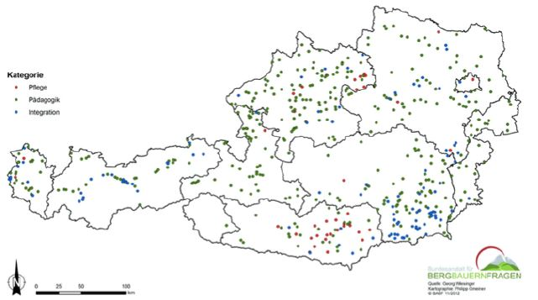
Locations of Social Farms in Austria
Located all over the country
In some federal states more farms can be found
Often located around hotspots of huge social facilities
Educational Farms are located close to cities
The figure presents the different farms on the maps, classified according to their orientation (care, education and integration)
(HAUBENHOFER, intvw)
Fig.: WIESINGER et al. 2012)
Notes:
quellen

Slide 36
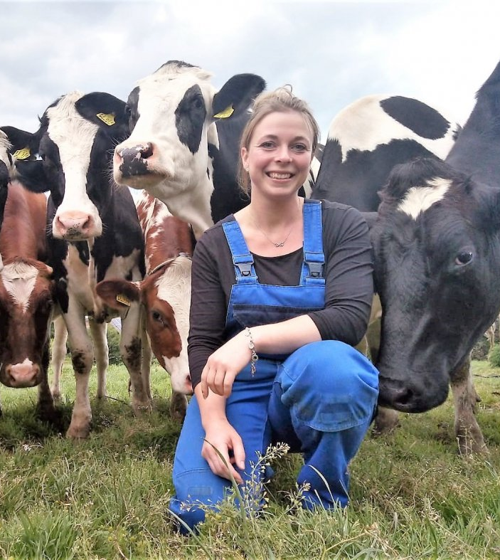
Comparison of Social Farms with ordinary farms in Austria
Most of the Social Farms are bigger and more intensively managed (more animals per hectare)
The farmer´s family is mostly larger
More people are employed
The management consists of younger people
More women are in charge as it is the case on general farms
(WIESINGER et al., 2012)
https://www.nw.de/_em_daten/_cache/image/1xTUlyckRyY2RlVjdMaC9mL3B0eisxVXBPek9FNFVrT0ZwOGg1a1F3dWlVczRPQXloSHVRMXh5NEFYbnd5eThMUQ/201127-1410-310573815.jpg

Slide 37

Support for Social Farming in Austria
Dense consulting network→ Help to initiate new projects
Association of Social Farming was founded: “Green Care Austria” was established to develop the idea with the help of the chambers
  →Supports and consults farmers to start
  Social Farming
  Assists existing farms to link demand
  and supply
  National network with advisors in
  each region
  Successfully spreading the idea
  through radio and TV
Journal ´Green Care´, published by the University College for Agrarian and Environmental Pedagogy
(HAUBENHOFER, intvw.)
https://www.greencare.at/wp-content/uploads/sites/6/2020/09/2020_gcm_02_COVER-768x1086.jpg
Notes:
Journal GREEN CARE: published four times a year

Slide 38
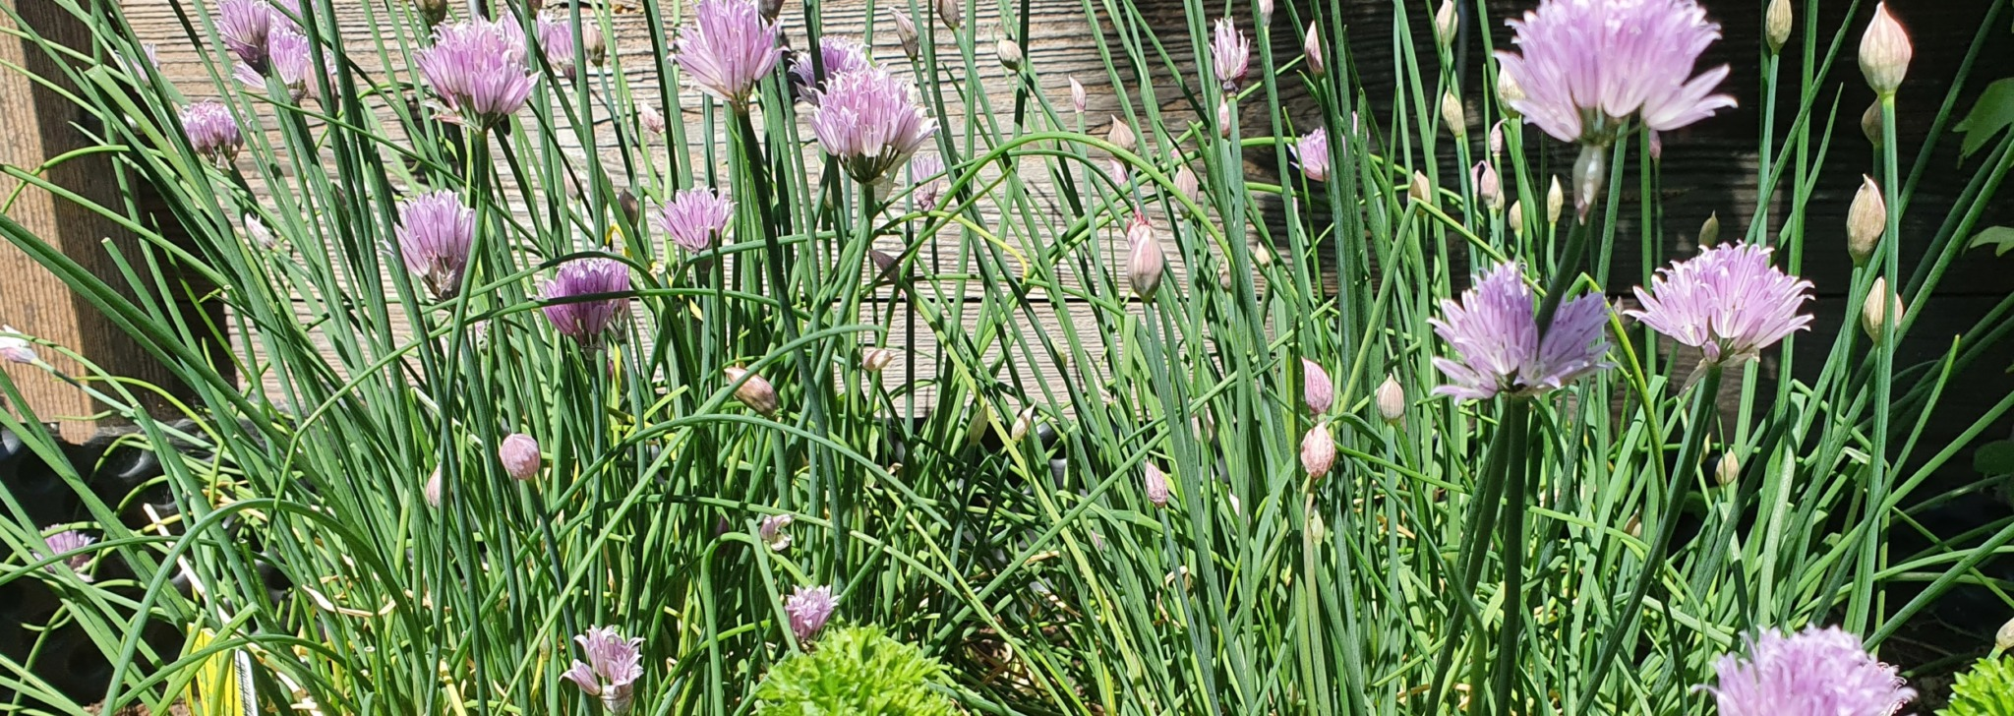
Financial support of Social Farming in Austria
Big involvement of the politics (WIESINGER, intvw.)
→ National Green Care strategy
Financial support by:
  Rural development funds
  Training attendance
  Allowances for the development of social services in the rural
  development program
(WIESINGER et al. (2013)
https://www.greencare.at/wp-content/uploads/sites/6/2021/06/20210604_143735-scaled-e1623096826772-2048x728.jpg
Notes:
Big political involvement: Together with the national network, a national green care strategy was created in 2014. It includes the cooperation with social services and the involvement of NGOs. It also promotes the scientifically aspect of social farming.
Financial support: However, the study of WIESINGER et al. (2013) figured out that only 17,3 % of the people who participated in the study receive funding or financial support. Educational farms receive payments from either the schools themselves or from the federation of schools (HAUBENHOFER, intvw.).

Slide 39

Educational offers for Social Farming in Austria
Training opportunities for Social Farming are well developed in Austria
Different study programs at the University College for Agrarian and Environmental Pedagogy
Other institutions are offering training possibilities in the field of Social Farming and animal- assisted interventions
These courses are officially certified
(HAUBENHOFER 2017)
Notes:
The University College for agrarian and environmental pedagogy offers a master study program since 2012 and also a course for academic experts in gardening therapy.
(HAUBENHOFER 2017).

Slide 40

Certification of Social Farming in Austria
The Association Green Care Austria provides its own voluntary certification
  → To ensure the quality of social
  services on agricultural and forestry
  enterprises
  To recognize and support social
  service providers and
  To establish Green Care as part of
  diversification in agriculture and
  forestry
(SCHARRE 2016)
Notes:
certification for agricultural and forestry companies that offer products and services in the field of education, health or social affairs with certain quality standards
This Certification defines business, organizational, legal and social standards that must be met by the companies and employees and are regularly evaluated and audited by an accredited certification body
The aim is to ensure the quality of social services on agricultural and forestry enterprises, to recognize and support social service providers and to establish Green Care as part of diversification in agriculture and forestry, in addition to direct marketing and tourism
´where people thrive´

Slide 41
Further reading
University College for Agrarian and Environmental Pedagogy:
https://www.haup.ac.at/en/
Website of the Green Care Section of the University:
https://www.greencare.at/
Association Green Care Austria:
www.greencare-oe.at
Notes:
Austria ausbildungs websites siehe vorherige folie,
Green care Austria, you find there farms in Austria, news, handbooks, information about training possibilities and many other things

Slide 42
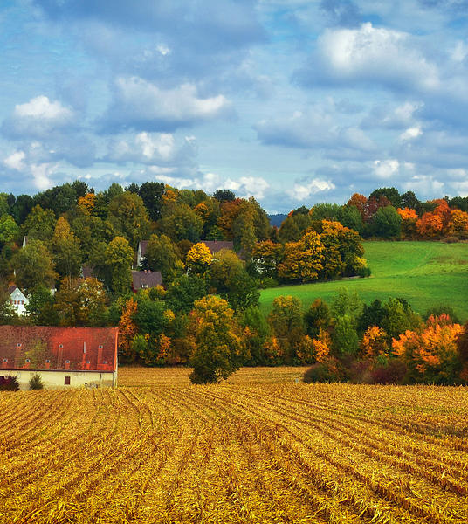
4. Germany
Federal state located in the middle of Europe
Social Farming in this country is scientifically on a good level
Motivated pioneers can be found in every region
https://duckduckgo.com/?q=germany+farm&t=ffab&iar=images&iax=images&ia=images&iai=http%3A%2F%2Fimages.fineartamerica.com%2Fimages%2Fartworkimages%2Fmediumlarge%2F1%2Fgerman-farm-in-autumn-romi.jpg

Slide 43
SWOT Analysis of Social Farming in Germany
STRENGTHS • Manuals for Social Farmers • Personal budget of people with disabilities • Cooperations with sheltered workshops • Nationwide associations for Social Farming • Newsletter • Regional networks • Training possibilities • Member and also initiator of multiple European projects | WEAKNESSES • Little publicity • Not well known in the society • No regulated quality assurance • High documentary work when receiving funds • Sheltered workshops with a minimum of people • Mostly only one target group on a farm
OPPORTUNITIES • Increasing interests of the target groups • Federal participation Act • New approaches of social services required • Participation in international projects | THREATS • Federal states with different rules and regulations • Sheltered workshops
Tornier, 2020
Notes:
Federal participation Act from 2016 ´Bundesteilhabegesetz´

Slide 44
Social Farming in Germany
With the help of the SoFar Project research about the state of Social Farming in Germany was carried out
Two fields are well established: Educational Farms under the supervision of an association called ‘Bundesarbeitsgemeinschaft Lernort Bauernhof’ and ‘green sheltered workshops’ (approximately 150 of 800 ) (VAN ELSEN 2016)
Social Farming could be found on biodynamic farms working with disabled people in a Camphill-like environment
Farms dealing with youth, drug addicts or long-term unemployment people were also present at this time, just to a lesser extent (VAN ELSEN 2016)
Notes:
Approximately 150 of 800 sheltered workshops are green sheltered workshops offering horticultural or agricultural work opportunities
(BRUDER et al. 2015)

Slide 45
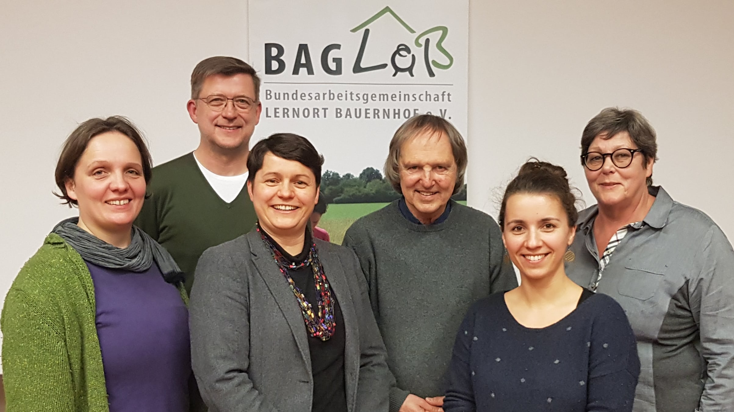
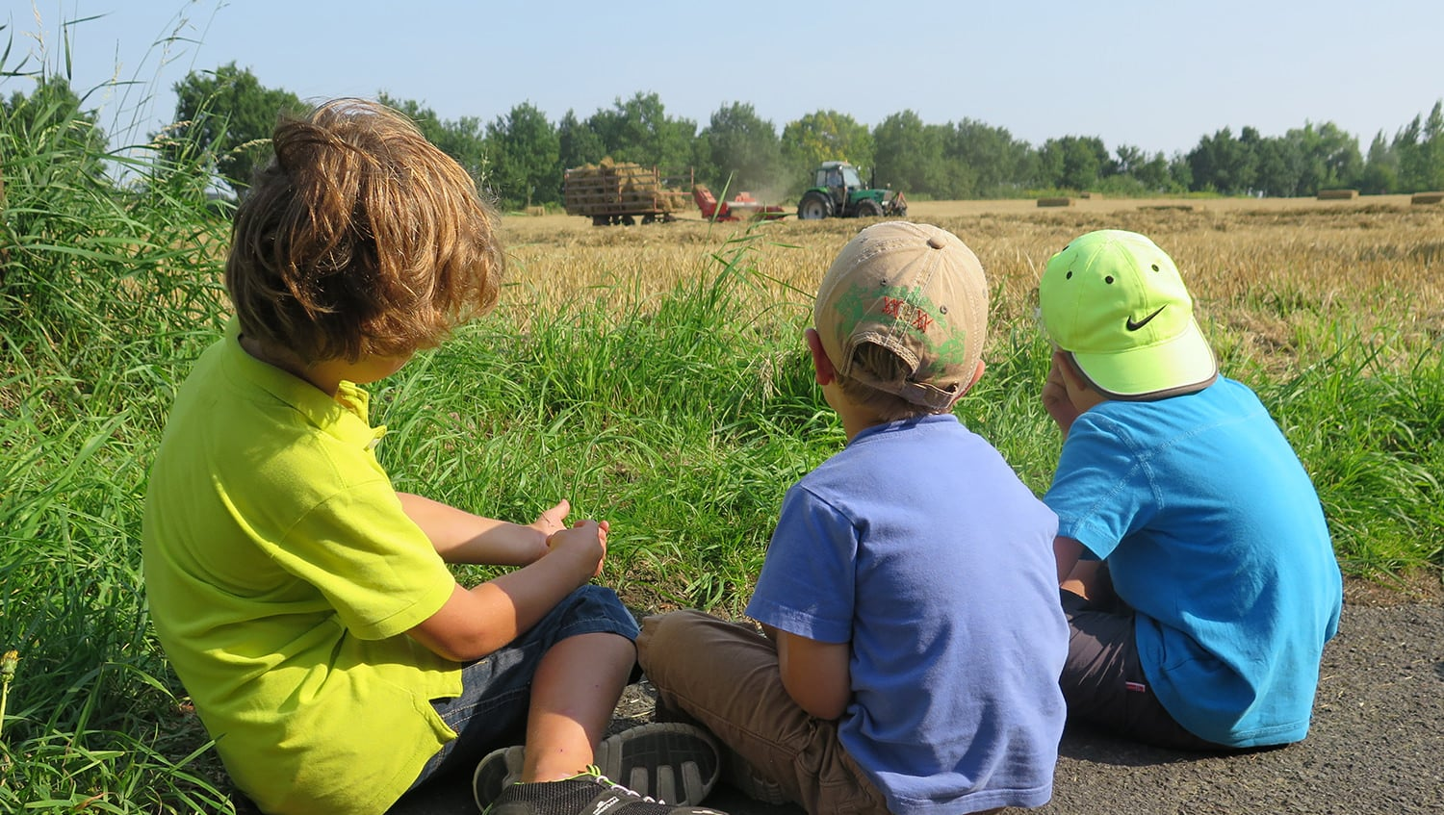

https://baglob.de/baglob/#mitgliedschaft
Notes:
The abbreviation "BAGLoB" stands for "Bundesarbeitsgemeinschaft Lernort Bauernhof e. V.". It is an association of pedagogically working persons, initiatives and organizations that jointly pursue the goal of making everyday agricultural life and the origin and processing of food tangible for children, adolescents and adults.

Slide 46
History of Social Farming in Germany
When the federal republic was founded, supervised places for people with disabilities were regulated by law as their lives were unworthy during The Third Reich
  → As a result workshops for disabled people must have a minimum number of 120 supervised
  places in order to ensure a humane treatment of these people
  → This regulation, regardless of its positive features, made the development of Social Farming
  in Germany with the involvement of people with disabilities more difficult especially in the
  sense of financing and recognition
A farm could enter a cooperation with a sheltered workshop, but mostly the workshops are not very interested in submitting skilled clients to so-called external workstations (VAN ELSEN 2016)
With the adoption of the federal participation Act from 2016, people with disability shall now easier be included in the first labor market
The budget for work and other service suppliers provides alternatives to the work in a sheltered workshop (FAHNING et al. 2017).
In addition to the personal budget, which was implemented in 2004 nation-wide, these new rules are strengths of Social Farming (LIMBRUNNER 2010)
‘The budget for work’ is for people who are entitled to have a job in a sheltered workshop but are willing to work in another place
Companies offering a vacancy may receive up to 75% of the salary as a wage subsidy (LEBENSHILFE)
  → This legislative change provides opportunities for Social Farming
Notes:
Vacancy = offene Stelle

Slide 47
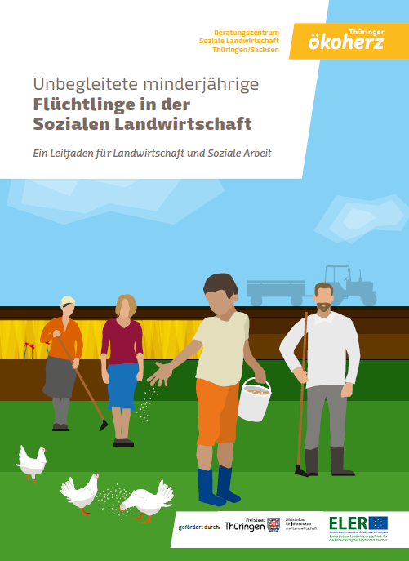
Main target groups of Social Farming in Germany
Type of target group depends on the federal state in which the farm is located as they are involved in projects or part of a regional network
Target groups are people with disabilities, people with psychic problems, addicts, long-term unemployment people, seniors and asylums.
Initiatives with unaccompanied minor refugees launched
→ This represents a new branch which is
hardly represented in other European
countries
(VAN ELSEN & RETKOWSKI 2019)
Fig.: Tornier, 2020
Fig.: https://bio-thueringen.de/publikationen/leitfaden-unbegleitete-minderjaehrige-fluechtlinge-in-der-sozialen-landwirtschaft/
Notes:
On the right you see a manual about the work with unaccompanied minor refugees in a farm-context publishes by Thüringer Ökoherz
Initiatives with unaccompanied minor refugees e.g. launched by the association Ökoherzin Thuringia (VAN ELSEN & RETKOWSKI 2019), represent a new branch which is hardly represented in other European countries
another exception are the initiatives launched by the target groups themselves (WIESINGER 2013), such as Hof Fleckenbühl, where people with addiction problems live and work without outside care or therapists.

Slide 48

Agents of Social Farming in Germany
Network ‘Alma’, founded by farmers, family
and friends of people with special needs and
caretakers in 2009
  → Objectives: Connecting farms and
  interested people, financing opportunities
Regional networks are present in Germany, but unevenly distributed, depending on the regional government
The politics especially the chambers of agriculture of other federal states are involved in the topic and try to improve the situation with advisory and financial work (LOFNER-MEIR, intvw.)
Agencies are engaged in the field on regional level
Diaconia, Caritas, churches or other religious orders are playing a national role as stakeholders in Social Farming (LIMBRUNNER 2010)
Notes:
Regional networks: For example, in Bavaria social farming is part of a sub authority of the ministry of agriculture, there is a contact person for social farming in each administrative district

Slide 49

Association ´DASoL´
The Association ‘Deutsche Arbeitsgemeinschaft Soziale Landwirtschaft’ (DASoL) was founded in 2009 as a result of the SoFar project
→ Important agent of Social Farming in Germany
Objectives:
  Support and connect Social Farms
  Participate in research
  Offer education opportunities
  → Newsletter published four times a year
  → www. soziale-landwirtschaft.de
Notes:
→ website about social farming (www. soziale-landwirtschaft.de)
including a search function for social farms; it informs about latest news, meetings, events and provide information about regional networks. Also, publications, papers and degree theses about the topic can be downloaded and links to books and journals are displayed. In addition,
the head of the association sends a
→ quarterly newsletter to all interested parties, in which he informs about events and meetings, including reports about the recent development of social farming or information about individual farms or projects.

Slide 50




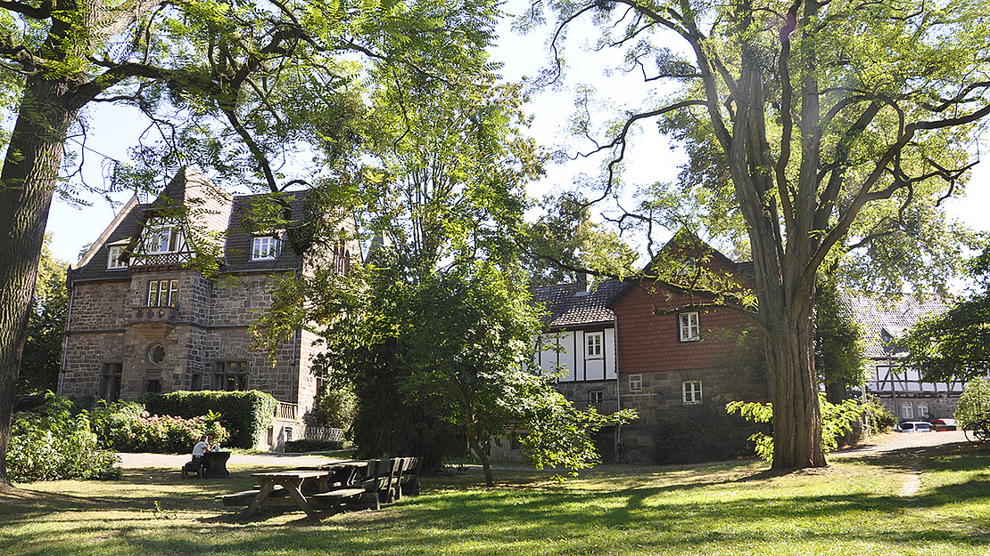
Educational offers
University of Kassel, Faculty of Agricultural Sciences, Witzenhausen
University of Applied Sciences for Sustainable Development, Eberswalde
Other privately offered training possibilities
https://www.uni-kassel.de/uni/universitaet/kontakt-und-standorte/standort-witzenhausen/
Notes:
Modules in the bachelor and master studies in Witzenhausen,
Eberswalde offers an additional course which people can do besides or after their studies
Other private offers such as the the institute for social learning with animals where one can do a course in animal-assisted therapy

Slide 51
Further reading
Deutsche Arbeitsgemeinschaft Soziale Landwirtschaft (DASoL):
www.soziale-landwirtschaft.de/
Bundesarbeitsgemeinschaft Lernort Bauernhof:
https://baglob.de/
Netzwerk Alma:
http://www.netzwerk-alma.de/
Thüringer Ökoherz:
https://bio-thueringen.de/
University of Applied Sciences for Sustainable Development Eberswalde
www.hnee.de
University of Kassel, Faculty of Agricultural Sciences:
https://www.uni-kassel.de/uni/universitaet/kontakt-und-standorte/standort-witzenhausen/
Institute for social learning with animals:
https://lernen-mit-tieren.de

Slide 52
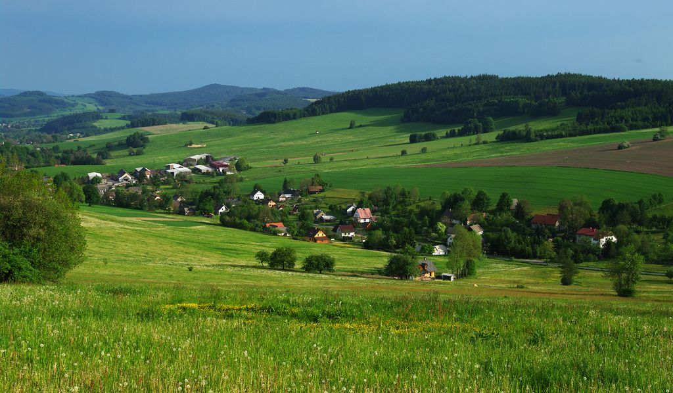
2. Czech republic
Small, landlocked country
Located in the center of Europe
Hilly landscape
Joined the EU in 2004
Czech republic: https://i.pinimg.com/originals/06/38/53/06385377d4b9dd95286cc7b5a0673504.jpg

Slide 53
Czech Republic
STRENGTHS • Existing of umbrella organization • Map of Social Farms • Handbook for starting Social Farming • Supportive politicians • Working committee of Social Farming in ministry of agriculture • Courses on Social Farming at different universities/colleges | WEAKNESSES • Still in the beginning • People are skeptical towards Social Farming • No existing quality assurance • Established mainly by private people
OPPORTUNITIES • EU Funds • Connected with non- profit organizations • Need for rural development • Different funding opportunities | THREATS • People working in agriculture is declining • Bureaucratic effort • Potential of NGO´s not used • Lack of available land
Tornier, 2020

Slide 54
Social Farming in Czech Republic
Social Farming in this country is still in its beginning
In general there are two forms of Social Farming:
Farms offering social activities
Social enterprises that use agricultural activities as a therapy option
    → The second form is more spread in Czech Republic (MOUDRY et al. 2017)
The initiators of Social Farms are the farmers, NGO´s or social enterprises, who are already working with the target groups (MOUDRY, intvw.)
Mostly Social Farms are established by private people on a voluntary basis
  → This leads to a low number of farms
  Implementing social activities on a farm presents financial and personal
  difficulties
  The bureaucratic effort must also be taken into account
  When a public body such as local government supports the establishment of
  Social Farms, the burden is less high (HUDCOVA et al. 2018)
Notes:
Potential of NGO´s is not used very well

Slide 55

Support of Social Farming in Czech Republic
Support comes from:
Working Committee of the Ministry of Agriculture
Thematic Working Group
Also involved in Social Farming: non-profit organizations and churches , but potential is not used very well (MOUDRY et al. 2017)
Missing consideration of Social Farming in the Rural Development Programs (KUCEROVA (2018)
  Changes in social inclusion are coming from communities and individual
  people instead of the state
  State continues to support well established practices of employment
  policies rather than helping innovative ideas
  (HUDCOVA, intvw.)
Notes:
In 2015, an agenda of social farming gained a particular prominence as a new opportunity for rural development, and it comes under the Ministry of Agriculture of the Czech Republic. An interdepartmental Working Committee on Social Farming consisting of representatives from the Ministry of Agriculture, the Ministry of Labour and Social Affairs, from the European Economic and Social Committee, representatives from academic, non-profit and profit sector was established and meets regularly since there. This Working Committee aims to promote this agenda and find specific programmes of support in different policy chapters.
In 2017, the National Social Agriculture Association was established as a non-profit body for the connection, cooperation, and the support of social farmers, academics, researchers in this area.
Finally, at the end of 2017 co-called Thematic Working Group on Social Farming was founded for the similar purpose as the Committee but on the regional level.

Slide 56
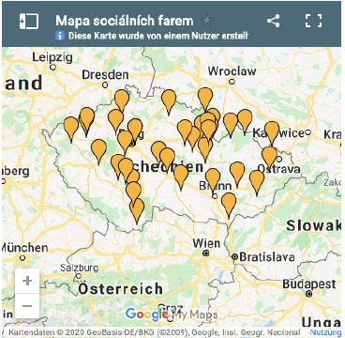
Social Farms in Czech Republic
There are about 100 Social Farms but only 40 of them, which officially adopted the ideas of the concept
Those farms can be found on
the Czech website of Social
Farming
Size of the farms is mostly less
than 10 hectars
(MOUDRY et al. 2017; MOUDRY, intvw.)
Fig.:http://www.socialni- zemedelstvi.cz/

Slide 57
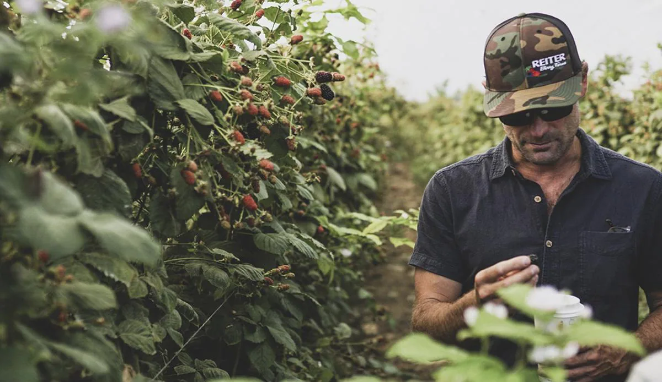
Main target groups of Social Farming in Czech Republic
Work inclusion is the biggest pillar
→ The largest target group are long-term unemployed people
2nd are social services with people with disabilities
(MOUDRY et al. 2017,
MOUDRY,
HUDCOVA, intvw.)
https://www.bayer.com/en/news-stories/how-farmers-are-keeping-us-fed-through-the-global-crisis

Slide 58
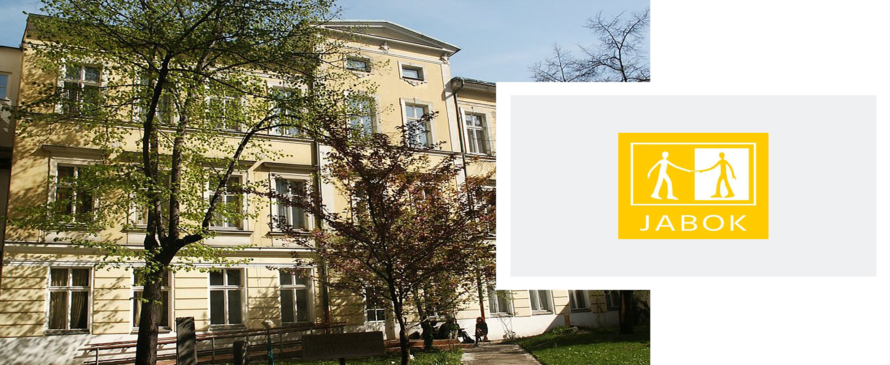
Educational offers
First long educational course on Social Farming at Jabok – Institute of social pedagogy and theology in Prague
The topic regularly emerges in the context of multifunctional agriculture, landscape ecology or regional development at the Universities as well
(www.sofaredu.eu)
https://ius-sdb.com/ius-world-networks/europe/jabok-institute-of-social-pedagogy-and-theology-czech-republic/
Notes:
In 2015 the very first long educational course on social farming was accredited at the Ministry of Labour and Social Affairs and is taught at Jabok – Institute of social pedagogy and theology in Prague.
The topic of social farming regularly emerges in the subjects of multifunctional agriculture, landscape ecology or regional development at the University of South Bohemia in České Budějovice, the Czech University of Life Sciences in Prague, or Mendel University in Brno.

Slide 59

Further reading
Czech website for Social Farming:
www.socialni-zemedelstvi.cz/
University of České Budějovice, Faculty of
Agricultural Sciences:
https://www.zf.jcu.cz/cz/

Slide 60
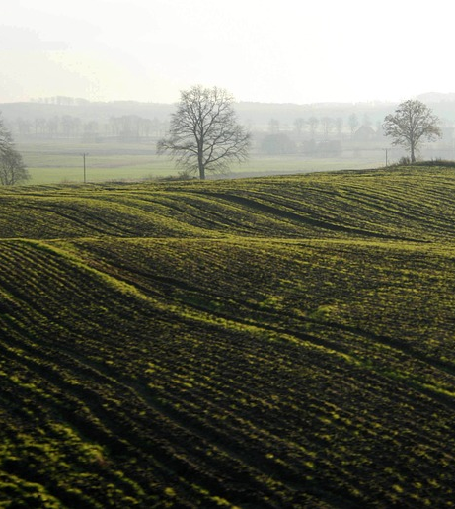
6. Poland
Poland is the eight biggest European country based on the population number
Located in the middle of Europe
Member of the European Union since 2004
Social Farming in Poland is still in its infancy, while agriculture itself plays an important role in the country with agricultural advisory centers in every region
Practicing Social Farming under its term began approximately in the beginning of this century, probably by entering the EU (STEPNIK, intvw.)
https://duckduckgo.com/?q=poland+farm&t=ffab&iax=images&ia=images&iai=https%3A%2F%2Fwww.arc2020.eu%2Fwp-content%2Fuploads%2F2019%2F02%2Fpoland-nature-3377523_960_720.jpg

Slide 61
SWOT Analysis Poland
STRENGTHS • 300 Educational Farms • Label • Day Care for elderly • Interacting with the ministry of agriculture | WEAKNESSES • Still in the beginning • Not very known in the society • Only educational farms are spread over the whole country • No permanent funding • No quality assurance • No diversity on farms
OPPORTUNITIES • Aging population • Development of the rural areas • Only few people earn money with agriculture • Farmers looking for additional income opportunities • EU funds • Politics are interested in the topic | THREATS • Equal rights for people with disability are not established in the labor market • Legal barriers • Modern agricultural production technologies • Dependent on EU funds • Lack of workers
Tornier, 2020

Slide 62
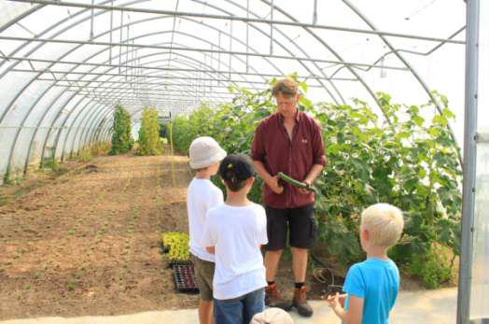
Target groups in Poland
Quiet high number of Educational Farms
Less farms caring for people with disabilities or elderly
  Due to the strict legal regulations (KRÓL, intvw.)
  Another factor: low level of popularity of Social Farming in society
  Educational Farms are on a different stage than care (STEPNIK (intvw.)
  Some farms exist which
  offer daycare to older people
  or people with disabilities
http://www.learningonbiofarm.eu/lesson-3-rural-project-at-the-stanislaw-karlowski-foundation-in-poland
Notes:
farms in Poland as the farmers need to obey different standards, which is why there is
no diversity of target groups on one farm . When dealing with elderly people, the farmers need
to cooperate with the ministry of social affairs, caring for disabled people, they need to collaborate
with the institutions funding those services, when offering work for people with mental
diseases, the ministry of health needs to be involved and at educational farms the ministry of education is implicated (STEPNIK, intvw.).

Slide 63
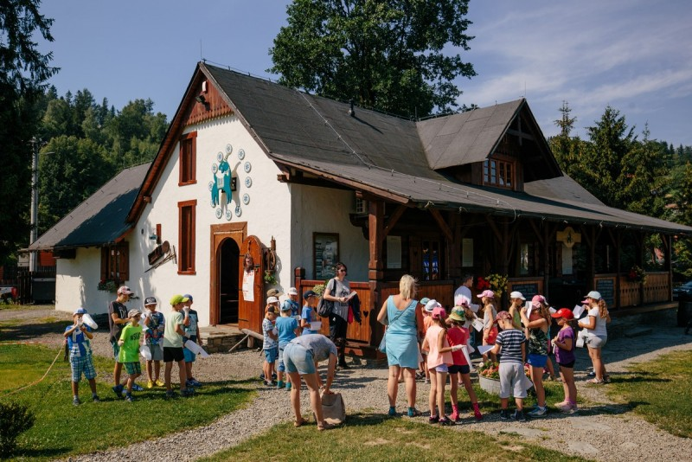
Educational farms in Poland
Educational Farms are one of the strengths in Poland
Big network of about 300 farms, offering educational services
Located all over the country
Own label, which shows the customer that this farm is providing service in addition to the production of food
Farms are self-sufficient, parents pay for their kids to visit the farms
(STEPNIK, intvw.)
https://www.gospodarstwaedukacyjne.pl/gospodarstwo/zagroda-edukacyjna-kozia-zagroda-19

Slide 64
Financing of Social Farming in Poland
Farms are dependent on funds from the European Union
  → Unclear what will happen with the farms when the funds are
  depleted
No regulatory system to support Care Farms (PARZONKO 2015)
Farmers expect the local government to pay for their offered services
  → But it is a bureaucratic problem as farms are entrepreneurs and the
  government is not allowed to fund private entrepreneurs directly
  (KAMINSKI 2017)
https://www.arc2020.eu/cap-poland-small-farms-big-farms-eu-relations/

Slide 65
Further reading
Website of Educational Farming in Poland:
www.gospodarstwaedukacyjne.pl/
Youtube channel of Educational Farms:
www.youtube.com/channel/UC_YrlGIHTQP-rc_SKZsQqgg

Slide 66
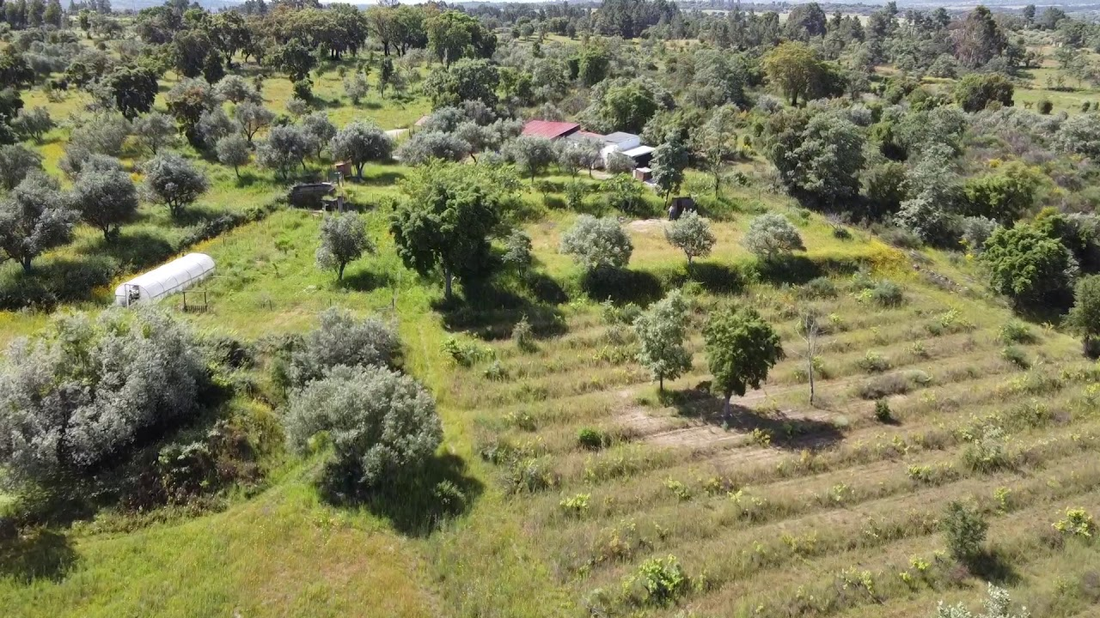
7. Portugal
Located in the westernmost part of Europe´s mainland
Rare information about Social Farming in this state
Slow but steady growth of Social Farming
https://i.ytimg.com/vi/X5CysFVk3IY/maxresdefault.jpg

Slide 67
SWOT Analysis Portugal
STRENGTHS • Umbrella organization • Some municipalities are involved • Part of European projects | WEAKNESSES • Still in the beginning • Growing slowly • No legal framework • Quite unknown in the society • No guidelines to assure quality • No certification • Mainly financed by private people • Inequal distribution of IPSS
OPPORTUNITIES • Big demand • Law for work inclusion • Economic growth • Changes in the way of farming | THREATS • Mixing up the terms with urban gardening • Bureaucratic effort • Demographic trend • Weak dynamism in most depopulated areas -> less IPSS
Tornier, 2020

Slide 68
History of Social Farming in Portugal
Social Farming started in the 70s in Portugal
Concept with the name Social Farming was established
Portugal has and still is participating in different international projects (BRITES et al. 2012)
Umbrella organization Portuguese Federation of Social Agriculture (FEDPAS) (2017)
  Aims to achieve the mobilization of stakeholders and politicians
  Share the knowledge about Social Farming
  Interact between institutions
(FIRMINO, intvw.)
Notes:
Social Farming started in the 70s in Portugal with pioneers coming back from Holland, started anthroposophical institutions
The Concept with the name Social Farming was established during the Cost Action in 2009
Portugal has and still is participating in different international projects such as DIANA, MAIE

Slide 69

Initiators of Social Farming
Romi´s Way
The Holy House of Mercy (FIRMINO, intvw.)
Nearly 14 000 IPSS across Portugal (VINCENTE n.d.)
→ Mostly this kind of institutions are setting up a Social Farm, only a few
farmers are among the initiators (FIRMINO, intvw.)
Notes:
There are different initiators of SF in Portugal.
Romi´s Way is an organization which was founded in 2019 and is trying to start agricultural activities with schools (BRITES, intvw.)
Other initiators of Social Farm projects are the Holy House of Mercy, IPSS and ASTA.
The Holy House of Mercy has 388 active institutions all over Portugal and is the most important partner for social work and has a long history (FIRMINO, intvw.)
Mostly this kind of institutions are setting up a Social Farm, only a few farmers are among the initiators (FIRMINO, intvw.)
Nearly 14 000 IPSS across Portugal (IPSS stands for Instituicao Particular de Solidariedade Social and is a big network that offers services for various target groups from children to elderly people) (VINCENTE n.d.)

Slide 70
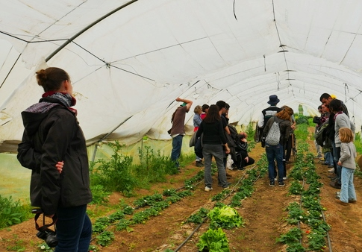
Target groups of SF in Portugal
Only a few Social Farming projects
Small initiatives are found all over the country
Some large ones are located in the South and in the North of Portugal
In the North the school garden and gardening with seniors are well established
In the South, there are farms that work with troubled youth from Germany
(FIRMINO, intvw.)
http://socialinnovation.lv/en/urban-farming-and-ecofarming-visit-to-famous-ecofarm-herdade-do-freixo-do-meio-in-portugal/

Slide 71
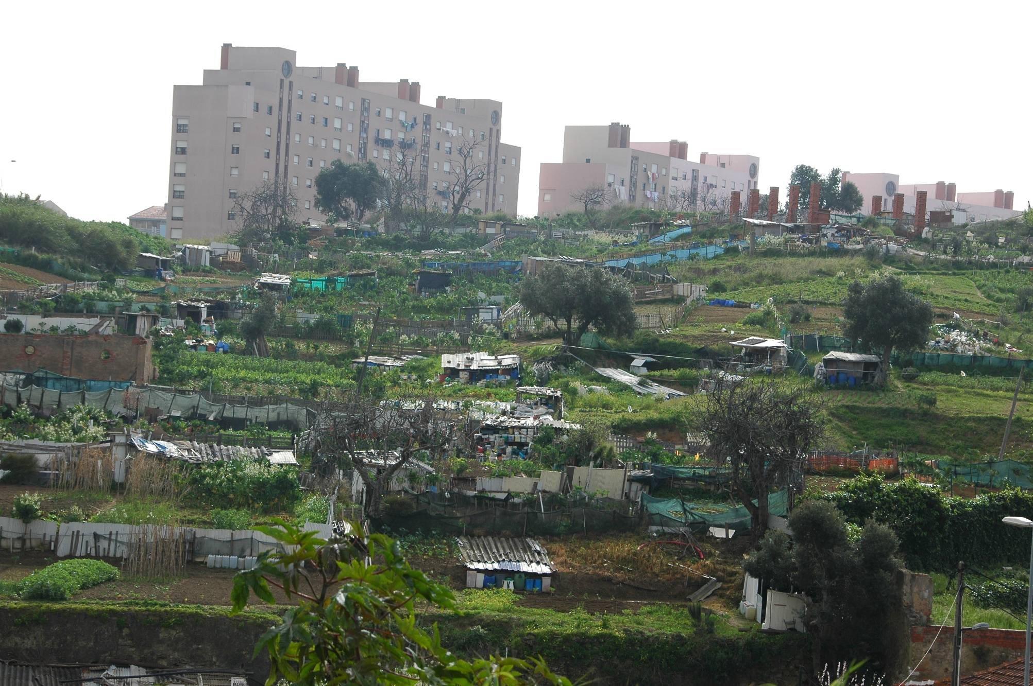
Thomas van Elsen

Slide 72
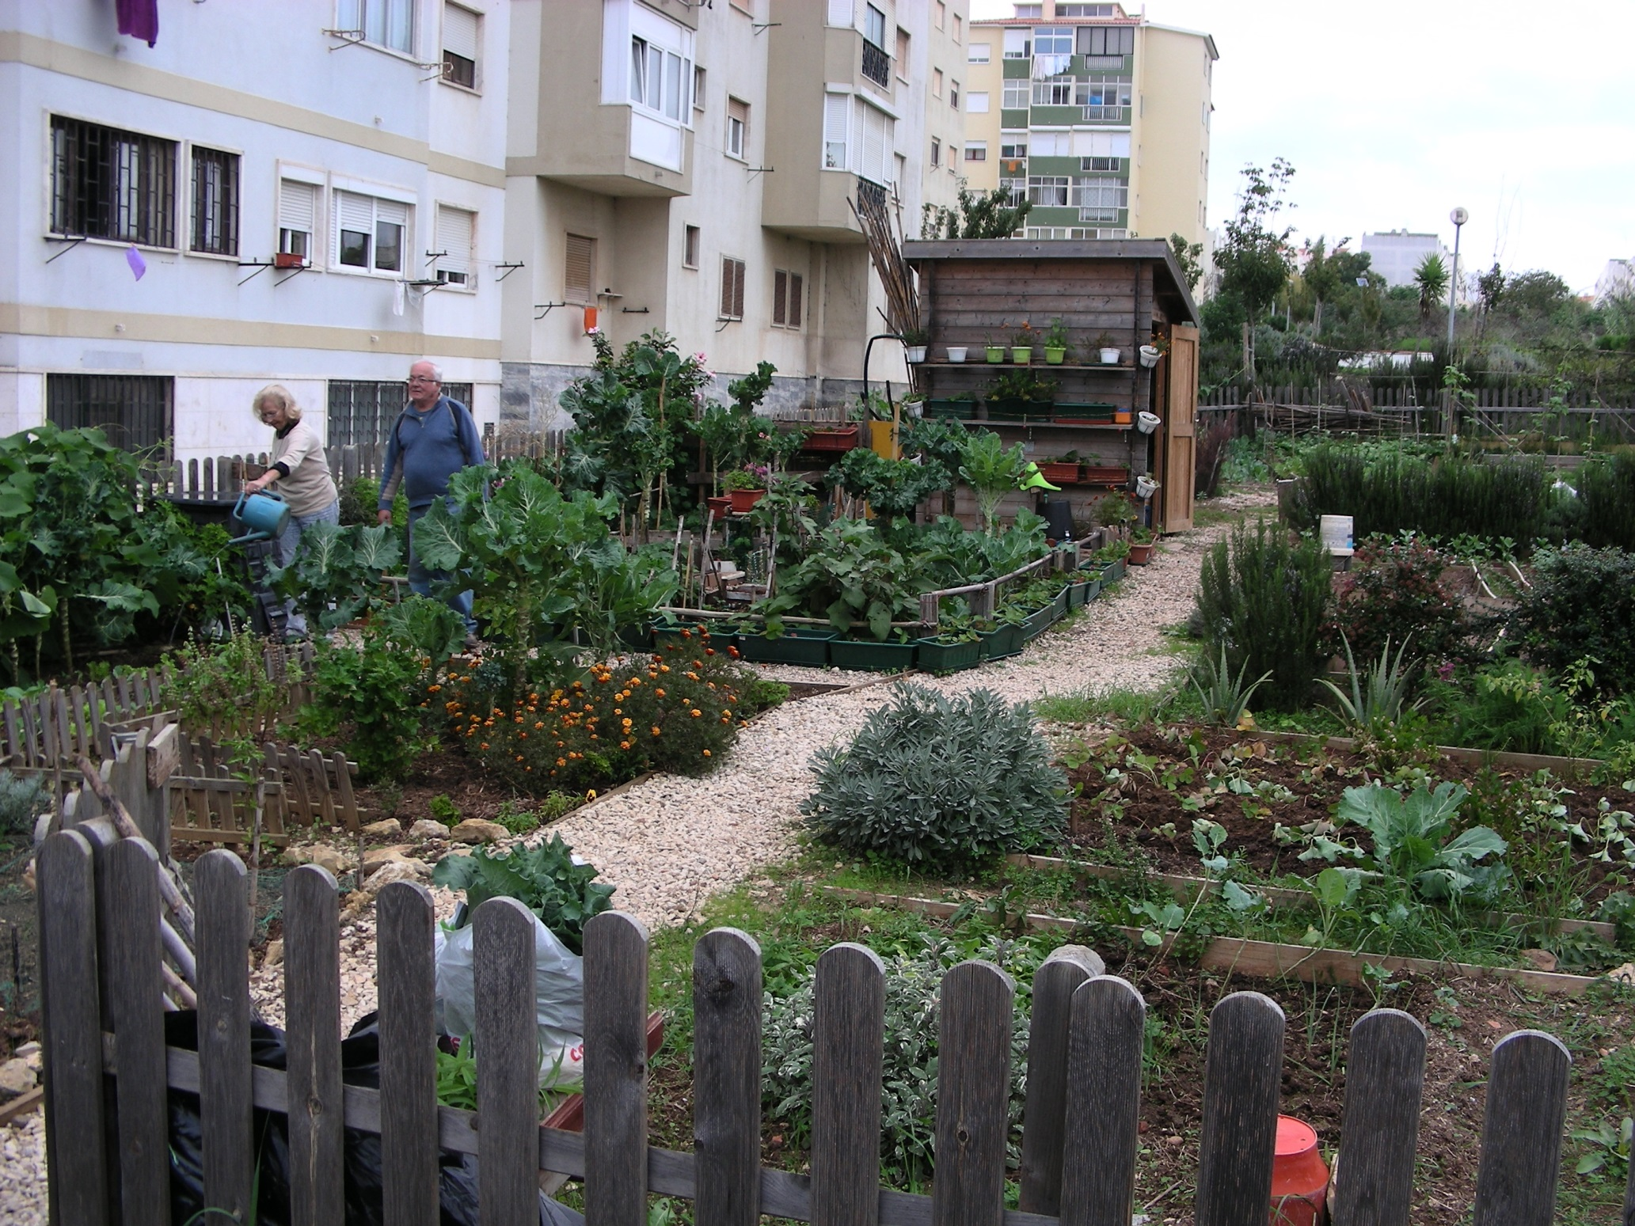
Thomas van Elsen

Slide 73
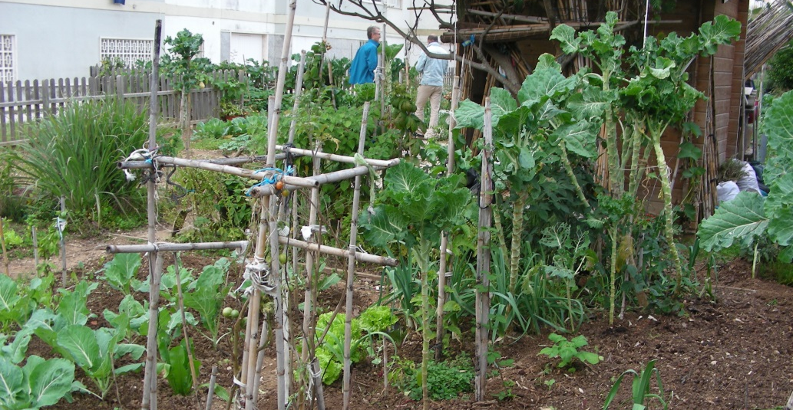
Thomas van Elsen

Slide 74
Further reading
Romi´s way:
www.romisway.net/
https://iphone.facebook.com/romisway/

Slide 75
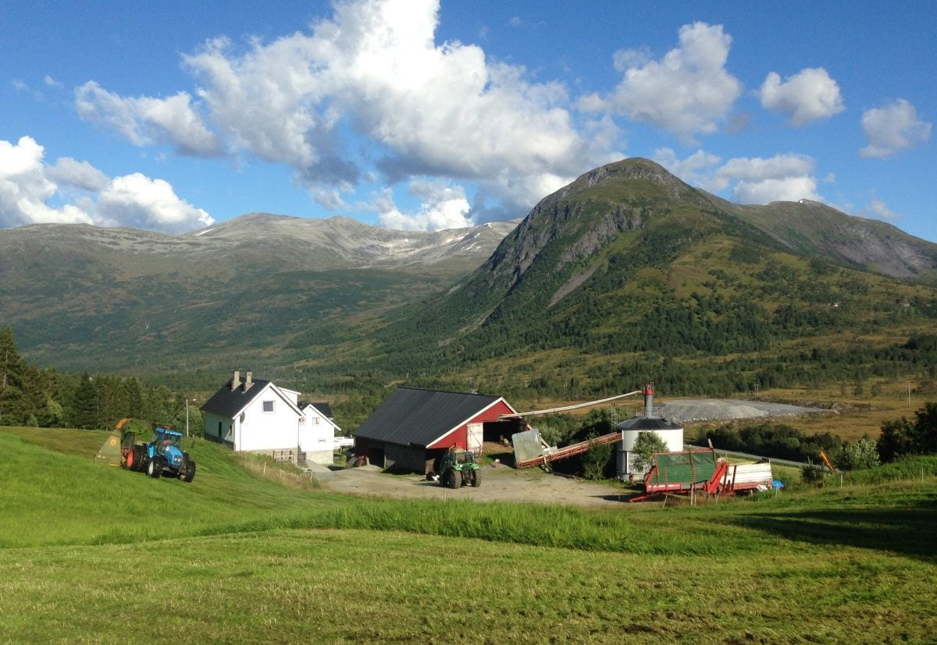
9. Norway
Country of northern Europe that occupies the western half of the Scandinavian peninsula
Nearly half of the inhabitants of the country live in the far South, around Oslo, the capital
About two-thirds of Norway is mountainous
(www.britannica.com/place/Norway)
https://duckduckgo.com/?t=ffab&q=farm+norway&iax=images&ia=images&iai=https%3A%2F%2Fs3-eu-west-2.amazonaws.com%2Flifeinnorway%2Fwp-content%2Fuploads%2F2017%2F08%2F28093358%2Ffarm-in-norway-1200x827.jpg
https://www.lifeinnorway.net/wp-content/uploads/2017/08/farm-in-norway-1200x827.jpg

Slide 76
Social Farming in Norway
Many small farms in remote areas where municipalities face the challenge of financing social tasks
Social Farming/ Green Care is based on contracts of the municipalities with the farms
Payment is a matter of negotiation in each case
In 2004, 600 Social Farms were counted in Norway
Childcare as well as environmental education are part of Green Care in Norway
Reintegration of long-term unemployed people through Social Farming is supported in Norway
Interministerial Working Group on Social Farming with participation by the Ministries for Agriculture, Education, Research, Social Affairs, Health, Family/Children
(van Elsen, 2021)

Slide 77
Current developments of SF in Norway
With the conversion of the allocation of direct payments to the level of municipalities a few years ago, there was a "neoliberal wave of intensification" with regard to land management
While in 2011 1.100 Social Farms were registered, today only half of them are registered – often the generational change is associated with the abandonment of previously "socially active" family farm
Although 80% of the national agricultural production is produced by 20% of the farms in favored regions, it is precisely at the municipal level that the focus is on classic intensification of agricultural production, which is in stark contrast to the need for social innovation and entrepreneurship
(Rhys Evans)

Slide 78
Further reading
Norwegian website on Social Farming:
http://www.innpatunet.no/

Slide 79
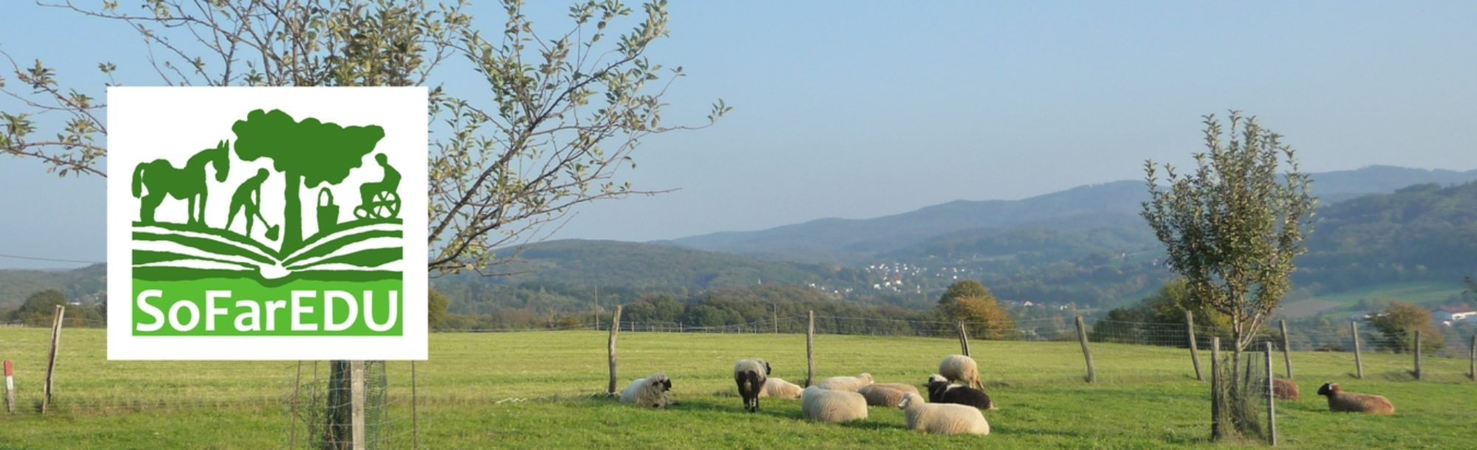

Further reading international
Social Farming in higher education:
https://sofaredu.eu/
https://www.soengage.eu/

Slide 80
Thank you for your attention!

Slide 81
Bibliography
Tornier, A. (2020): Master Thesis "Sustainable International Agriculture”, Faculty of Agricultural Sciences, Georg-August-University Göttingen, Germany
AUTHORITY OF HOUSE OF LORDS (pub.) (2010): Adapting to climate change: EU agriculture and forestry. Volume 1: Report. European Union Committee. 8th Report of Session 2009-10. London.
BAUMGART, L (2006): Sichtweisen und Problemwahrnehmungen ausgewahlter Akteure im Projekt „Die Integration von Naturschutzzielen in den Okologischen Landbau am Beispiel der Hessischen Staatsdomane Frankenhausen“
BERGET B. & B.O. BRAASTAD (2011): Animal-assisted therapy with farm animals for persons with psychiatric disorders. In: Ann ist super Sanita, Vol. 47, No. 4, pp. 384-390.
BERGET, B. & C. IHLEBAEK (2011): Animal-Assisted Interventions; Effects on Human Mental Health – A Theoretical Framework. In: Dr. T. Uehara (ed.): Psychiatric Disorders - Worldwide Advances, InTech, 2011, pp. 122-138

Slide 82
BOCK, B.B. & S.J. OOSTING (2010): A classification of Green Care Arrangements in Europe. In: DESSEIN, J., BOCK, B.B. (eds.): The Economics of Green Care in Agriculture. COST866 Green Care in Agriculture. Loughborough University. Chapter 2, pp. 15-26.
BOTTCHER, L. & VAN ELSEN, T. (2019): Case Management – Teilhabebegleitung als Innovation in der Sozialen Landwirtschaft. In: Beitrag 15. Wiss.-Tagung Okol. Landbau: 538-541, Kassel.
BRAASTAD, B. O., GALLIS, C., SEMPIK, J., SENNI, S. & VAN ELSEN, T. (2007). COSTAction 866 “Green Care in Agriculture” – a multi-disciplinary scientific network. In C. Gallis (Hrsg.), Green care in Agriculture: Health effects, Economics and Policies (S. 13–24). Proceedings from 1st European COST Action 866 conference, Vienna. Thessaloniki: University Studio Press
BRAGG, R.E., BARTON, J. & J.N. PRETTY (2008): Care Farming in the UK: Contexts, Benefits and Links with Therapeutic Communities. In: Therapeutic Communities, Vol.29, No.3, pp. 245 – 260
BRAGG R.E. (2014): Nature-based interventions for mental wellbeing and sustainable behaviour: the potential for green care in the UK. University of Essex.
BRITES, C., MIGUENS, F., SANTOS, D., VERISSIMO, M. & P.M. MOREIRA (2012): Green Care and Social Farming: Future Perspectives in Portugal. Conference Paper. April 2012.
BRUDER, V., GATZERT, X., HERMANOWSKI, R. & A. WIRZ (2015): Beratung fur „Grune Werkstatten“. In B&B Agrar, No. 3, pp. 22.
ČURNA, V., CHOVANEC, T., CSAPO & A. KLEGER (2017): Social Farming Best Practice Collection in Visegrad Countries. In: UJJ, A. (ed.): Social Farms in Visegrad Countries. 1st edition. 2017. ISBN: 978-963-269- 665-2.
DESSEIN, J. & B.B. BOCK (eds.) (2010): The Economics of Green Care in Agriculture. COST866 Green Care in Agriculture. Loughborough University.
DIAMANT, E. & A. WATERHOUSE (2008): Gardening and belonging: reflections on how social and therapeutic horticulture may facilitate health, wellbeing and inclusion. In: British Journal of Occupational Therapy, Vol. 37, No.2, pp. 84-88.

Slide 83
DI IACOVO, F.D. & D. O ́CONNOR (2009): Priority areas and innovation strategies for further developing Social Farming in Europe. In: Supporting policies for Social Farming in Europe. Progressing Multifunctionality in Responsive Rural Areas. ARSIA, Firenze.
ELINGS, M. (2006): People-Plant Interaction -The physiological, psychological and sociological effects of plants on people. In: Hassink, J. & M. Van Dijk (ed.): Farming for Health – Green Care Farming across Europe and the United States of Amerika. Springer, pp. 43-55.
ELINGS, M. & J. HASSINK (2008): Green Care Farms, A Safe Community Between Illness or Addiction and the Wider Society. In: Therapeutic Communities, Vol. 29, No. 3, pp. 310-322.
FAHNING, I., MOSER, A., Agrarsoziale Gesellschaft (ed.) (2017): Abschlussbericht Projekt „Menschen mit Betreuungsbedarf im „grunen Bereich“ – Soziale Landwirtschaft in Niedersachsen.
FAZZI, L. (2010): Social Co-operatives and Social Farming in Italy. In: Sociologia Ruralis, Vol. 51, No. 2, pp. 119-136.
FERRUCCI, F. (2014): Disability and work inclusion in Italy: between unfulfilled promises and new disability culture. In: Modern Italy, Vol. 19, No. 4, pp. 183-197.
FERWERDA-VAN ZONNEVELD, R., OOSTING, S. & J. ROMMERS (2008). Green Care farms for children with Autistic Spectrum Disorder, Pp. 113-121. In: J. Dessein (ed.), Farming for Health, proceedings of the Community of Practice Farming for Health, November 2007, Ghent, Belgium, Merelbeke: ILVO.
FINE, A.H. (2006): Handbook on animal-Assisted Therapy: Theoretical Foundations and Guidelines for Practice. Academic Press, 2nd Edition.
FLICK, U., VON KARDORFF, E., STEINEKE, I. (2005): Was ist qualitative Forschung? Einleitung und Uberblick. In: KONIG, B. (ed.): Qualitative Forschung, Ein Handbuch. 5. Auflage, Rowohlt Taschenbuch Verlag, Reinbek.
FOTI, V.T., SCUDERI, A. & G. TIMPANARO (2013): Organic Social Agriculture: A Tool for Rural Development. Quality – Access to Success, 2013, Supplement, pp. 266-271.

Slide 84
GUREL, E. & M. TAT (2017): SWOT analysis: A theoretical review. In: The Journal of International Social Research, Vol. 10, No.51, pp. 994-1006.
HASSINK, J. (2003): Combining agricultural production and care for persons with disabilities: a new role of agriculture and farm animals. In: Farming and rural systems research and extension. Local identities and globalization, pp. 332- 341, Fifth IFSA European Symposium, Florence, Italy, 8-11 April 2002, ISBN 9788882950439.
HASSINK, J. (2017): Farming with care: the evolution of care farming in the Netherlands. In: (HASSINK (ed.)): Understanding Care Farming as a swiftly developing sector in The Netherlands, PhD Thesis.
HASSINK, J., AGRICOLA, H., VEEN, E. J., PIJPKER, R., DE BRUIN, S.R., VAN DER MEULEN, H.A.B. & L.B. PLUG (2020): The Care Farming Sector in The Netherlands: A Reflection on Its Developments and Promising Innovations. In Sustainability, Vol. 12, No. 9.
HAUBENHOFER, D. K., ELINGS, M., HASSINK, J. & R. HINE (2010): The development of green care In Western European countries. In: Explore, Vol. 6, pp.106-111.
HAUBENHOFER, D., DEMATTIO, L. & S. GEBER (2012): Analyse unterschiedlicher Green Care Finanzierungsmodelle in Osterreich und dem europaischen Ausland. Ein Bericht fur das Landliche Fortbildungsinstitut und die Landwirtschaftskammer Wien, Marz 2012.
HAUBENHOFER, D. (2017): Entwicklung von Green Care in Osterreich. In: (OsENBRINK, O. & C. PETERMANN (Hrsg.): Landschaftsarchitektur und Gesundheit –Freiraum und Landschaft im Kontext menschlichen Wohlbefindens. Hochschule Osnabruck. Sammelband. September 2017.
HELMS, M.M. & J. NIXON (2010): Exploring SWOT analysis – where are we now? A review of academic research from the last decade. In: Journal of Strategy and Management, Vol. 3, No. 3, pp. 215-251.
HINE, R., PEACOCK, J. & J. PRETTY (2008): Care Farming in the UK: Contexts, Benefits and Links with Therapeutic Communities. In: Therapeutic communities, Vol. 29, No. 3, pp.245- 260.
HUDCOVA, E., CHOVANEC, T. & J. MOUDRY (2018): Social Entrepreneurship in Agriculture, a sustainable Practice for social and economic Cohesion in rural areas: the case of the Czech Republic. In: European Countryside, Vol.10, No. 3, pp. 377-397.
HUSAK, J. & H. HUDEČKOVA (2018): Utilisation of the natural potential of rural areas for social inclusion. In: Agricultural Economics – Czech, Vol. 64, No. 4, pp. 149-162.

Slide 85
KALISCH, M., VAN ELSEN, T. (2007): Social Farming in Germany: Outcomes of the national experts meeting organised within the European SoFar project. In: GALLIS, C. (Hrsg., 2007): Green care in Agriculture: Health effects, Economics and Policies. 1st European COST Action 866 conference. Proceedings (Vienna, Austria), University Studio Press: 207-220, Thessaloniki.
KAMINSKI, R. (2017): Polish experience of social farming in Bory Tucholskie area. In Rural Areas and Development, Vol. 14, pp. 229-239.
KAMINSKI, R., MARCYSIAK, T. & P. PRUS (2018): The Development of Green Care in Poland. In: Proceedings of the 2018 International Conference "ECONOMIC SCIENCE FOR RURAL DEVELOPMENT", No. 49, pp. 307-315, Jelgava.
KLEINING, G. (1982). Umriss zu einer Methodologie qualitativer Sozialforschung. Kolner Zeitschrift fur Soziologie und Sozialpsychologie, 34(2), 224-253.
KUCEROVA, E. (2018): Social inclusion in the context of Czech rural development policy. In: Agricultural Economics – Czech, Vol.64, No.9, pp. 412–422
KORCOVA, R., KOTASKOVA, S.K & S. ŠVEJDORVA (2017): Social farming in the legal and economic environment of the Czech Republic. In: Tomšik, K. (ed.): Agrarian Perspectives XXVI. Competitiveness of European Agriculture and Food Sectors, Proceedings of the 26th International Conference, 13-15 September 2017 Prague, pp.167-173
KRUGER, K.A. & J.A. SERPELL (2006): Animal-Assisted Interventions in Mental Health: Definitions and Theoretical Foundations. In: A.H. Fine (ed.): Handbook on Animal-Assisted Therapy: Theoretical Foundations and Guidelines for Practice, Academic Press, 2nd Edition, 2. Chapter, pp. 21-38.
LANFRANCHI, M., GIANNETTO, C., ABBATE, T. & V. DIMITROVA (2015): Agriculture and the social farm: Expression of the multifunctional model of agriculture as a solution to the economic crisis in rural areas. In: Bulgarian Journal of Agricultural Science, Vol. 21, No. 4, pp. 711-718.
LEBENSHILFE. - https://www.lebenshilfe.de/informieren/arbeiten/arbeitsmoeglichkeiten/ (Access on 08.07.20 11:29).
LECK, C., EVANS, N. & D. UPTON (2014): Agriculture – who cares? An investigation of ´Care Farming`in the UK. In: Journal of Rural Studies, Vol. 34, pp. 313-325.
LIMBRUNNER, A. (2010): Ein starkes Gespann. Wie sich Landbau und Sozialarbeit verbundeten, die Soziale Landwirtschaft erfunden wurde und dabei etwas zukunftsweisend Neues entstehen konnte. In: Info3, No.2, pp. 43-46.
MAIE. - https://www.maie-project.org/index.php-id=22&L=3.html (Access on 26.03.20 14:33)

Slide 86
MIND WEEK REPORT (2007): Ecotherapy – The green agenda for mental Health. Mind Week Report. For better Mental Health. (https://www.mind.org.uk/media/211255/Ecotherapy_ The_green_agenda_for_mental_health.pdf. 2007. Accessed 22.5.19).
MOSHER, L. R. (1982): Italy's revolutionary mental health law: An assessment. In: The American Journal of Psychiatry, Vol. 139, No.2, pp. 199–203.
MOUDRY, J., PROCHAZKOVA, H., CHOVANEC, T & E. HUDCOVA (2017): Social Farming – Introduction of the Concept and the current Situation in the Czech Republic. In: A. RAUPELIENE (ed.): Proceedings of the 8th International Scientific Conference Rural Development 2017, ISSN: 1822-3230.
MOUDRY, J., HUDCOVA, E. & T. CHOVANEC (2018): Opportunities of developing social farming for social service providers, Methodology I. 1st Edition. Centre for Community Work South Bohemia. ISBN 978- 80-87809-51-8.
PARZONKO, A. J. & A. SIECZKO (2015): The innovative Forms of Rural Entrepreneurship: Care Farms. In: Social Sciences, Vol. 4, No. 90, pp. 44-54.
PETPARTNERS (n.d.): https://petpartners.org/about-us/who-we-are/ (20.07.19 13:23)
PROFARM (n.d): Social Farming in Italy – The multifunctionality of agricultural enterprises. http://www.profarmproject.eu/articles/2 (03.06.20 10:44)
PUTZ, M. (2006): Garden and plants as therapy – the dynamics of a unique medium in OT practice. In:
Ergotherapie und Rehabilitation, Vol.45, No.11, pp. 8-16.
PRETTY, J., PEACOCK, J., SELLENS, M. & M. GRIFFIN (2005): The mental and physical health outcomes of green exercise. In: International Journal of Environmental Health Research, Vol. 15, No. 5, pp. 319- 337.
REBEIRO, K. (2001): Enabling occupation: the importance of an affirming environment. In: Canadian Journal of Occupational Therapy, Vol. 68, No. 2, pp. 80-89.
RELF, D. (1973): Horticulture: A therapeutic Tool. In: Journal of Rehabilitation, Vol. 39, No. 1, pp. 27-29.
ROEST, A. E., OOSTING, S. J., FERWERDA-VAN ZONNEVELD, R. T & J. F. CARON- FLINTERMAN (2010): Regional platforms for green care farming in the Netherlands. In: WS1.2 – Care Farming: Challenges in innovations across the domains of agriculture and social care, 9th European IFSA Symposium, 4-7 July 2010, Vienna (Austria)

Slide 87
RUSSELL, K.C. (2001): What is Wilderness Therapy. In: Journal of Experiential Education, Vol. 24, No. 2, pp. 70-79.
SCHARRE, C. (2016): Green Care - Wo Menschen aufblühen. Soziale Landwirtschaft in Österreich.- Bayerisches Staatsministerium für Ernährung, Landwirtschaft und Forsten. Fachinformation aus der Landwirtschafts-verwaltung in Bayern. Schule und Beratung 9-10/2016: 35-38, Landshut.
SEMPIK, J., ALDRIDGE, J. & S. BECKER (2002) Social and Therapeutic Horticulture: evidence and messages from research, Thrive (in association with the Centre for Child and Family Research): Reading.
SIN, A., NOWAK, C., BOGUSZ, M., KMITA-DZIASEK, E. & M. KOWALSKA (2018): Education in rural areas in the selected EU countries on the example of educational farms. In: Scientific Papers Series Management, Economic Engineering in Agriculture and Rural Development, Vol. 18, No. 2, pp. 417.420.
SINECKA, J. (2007): Disability Law in the Czech Republic: A case study. In: Disability Studies Quarterly. Vol. 27, No. 1-2.
SOFAR. - http://www.sofar-d.de/?Projekt_SoFar
SoFarEdu: www.sofaredu.eu , Zugriff: 4.12.2021
SOZIALE LANDWIRTSCHAFT-COST. - http://www.soziale-landwirtschaft.de/veranstaltungen/veranstaltungsberichte/ cost-conference-2010/ (Access on 26.03.20 14:22).
SOZIALE LANDWIRTSCHAFT-PROFARM.- http://www.soziale-landwirtschaft.de/forschung/projekte/profarmprojekt/# c4203
STOLARCZYK, P. (2016): Equality of chances for people with disabilities in the labour market. In: Oeconomia, Vol: 15, No. 2, pp. 139-149.
TEMPESTA, T., VECCHIATO, D., NASSIVERA, F., BUGATTI, M. & B. TORQUATI (2019): Consumers Demand for Social Farming Products: An Analysis with Discrete Choice Experiments. In Sustainability, Vol. 11. No. 23, pp. 1-17.
UN GENERAL ASSEMBLY (2007): Convention on the Rights of Persons with Disabilities. A/RES/61/106, Annex I, available at: https://www.refworld.org/docid/4680cd212.html (23.03.20 11:44).
VAN DER MEULEN, H.A.B, JAGER, J., DE JONG, D., STOKKERS, R., VENEMA, G. & M. VIJN (2019): Kijk op Multifunctionele Landbouw: Omzet 2007–2018. In: Wageningen Economic Research rapport 2019-054; Wageningen Economic Research.
VAN ELSEN, T. (2016): Soziale Landwirtschaft. In (B. FREYER (Hrsg.): Okologischer Landbau – Grundlagen, Wissensstand und Herausforderungen. Haupt Verlag.
VAN ELSEN T. (2018): SOFARNET (2018): First Draft, Thematic network on Social Farming, RUR-15. Unreleased.

Slide 88
VAN ELSEN T. (2018): Soziale Landwirtschaft in Europa. Von Entwicklungen im Ausland lernen. Lebendige Erde, Vol.1, pp.12-13, Darmstadt.
VAN ELSEN, T., RETKOWSKI, A. (2019): Neue Perspektiven fur Grune Sozialarbeit. Gesundheitsforderung durch Soziale Landwirtschaft hat Entwicklungspotenzial. In: Forum sozialarbeit + gesundheit, No. 2, pp. 30-32.
VAN ELSEN, T. (2020): Soziale Landwirtschaft als okologische Inklusion. In: BOSSERT, L., VOGET-KLESCHIN, L. & S. MEISCH (Hrsg): Damit gutes Leben mit der Natur einfacher wird. Suffizienzpolitik fur Naturbewahrung. Metropolis-Verlag, pp. 119-131, Marburg.
VERNOOJI, M.A. & S. SCHNEIDER (2008): Handbuch der Tiergestutzten Intervention. Quelle & Meyer, 3rd Edition.
VINCENTE, M. A. M. (n.d.): Relatorio de Investigacao e Avaliacao do Impacto da Agricultura Social no Contexto Socioeconomico em Portugal em Conjugacao com a Pratica da Agricultura Biologica. Estagio curricular. Universitade NOVA de Lisboa. Unpublished.
WIESINGER, G. (ed.), HAASE, T., HAUBENHOFER, D., NEUHAUSER, F., SCHOLL, S., STEININGER, B. & E. THUNTAUBERT (2011): Green Care in Landwirtschaft und Gartenbau. Resumee der COST Aktion 866 „Green Care in Agriculture“. Bundesanstalt fur Bergbauernfragen. Wien.
WIESINGER, G., QUENDLER, E., HOFFMANN, C., DI MARTINO, A., EGARTNER, S., WEBER, N. & J. 1HAMBRUSCH (2013): Soziale Landwirtschaft: Situation und Potenziale einer Form der Diversifizierung land- und forstwirtschaftlicher Betriebe in Osterreich, Sudtirol und Trentino. Bundesanstalt fur Bergbauernfragen. Wien.
WOJCIESZAK, M. (2018): Welfare farms in Poland as an example of entrepreneurial activities in rural areas. In: Proceedings of the 2018 International Scientific Conference ‘Economic Sciences for Agribusiness and Rural Economy’, No.2, pp. 161-166, Warsaw. 7.1 Index of the interviewee

Slide 89
Index of the interviews
BRITES, C. (03.10.19): University of Lisbon, Portugal: Interview
ELINGS, M (04.11.19): University of Wageningen, Netherlands: Interview.
FIRMINO, A. (02.10.19): University of Lisbon, Portugal: Interview.
GIARE, F. (06.11.19): CREA PB, Italy: Interview.
HASSINK, J. (15.10.19): University of Wageningen, Netherlands: Interview.
HAUBENHOFER, D (04.10.19): University College for Agrarian and Environmental Pedagogy, Austria: Interview.
HUDCOVA, E. (07.10.19): Jabok Academy Prague, Czech Republic: Interview.
KROL, J. (30.09.19): agricultural advisory centre Krakow, Poland: Interview.
LOFNER-MEIR (02.10.19): Germany: Interview.
MOUDRY, J. (08.10.19): University of South Bohemia, Czech Republic: Interview.
SIGNORIELLO, I. (03.19.19): Forum Nazionale Agricoltura Sociale, Italy: Interview.
STEPNIK, K. (18.10.19): agricultural advisory centre Krakow, Poland: Interview.
WIESINGER, G. (14.10.19): Federal Institute for Agriculture and Mountain Farming, Austria: Interview.

