Slide 1
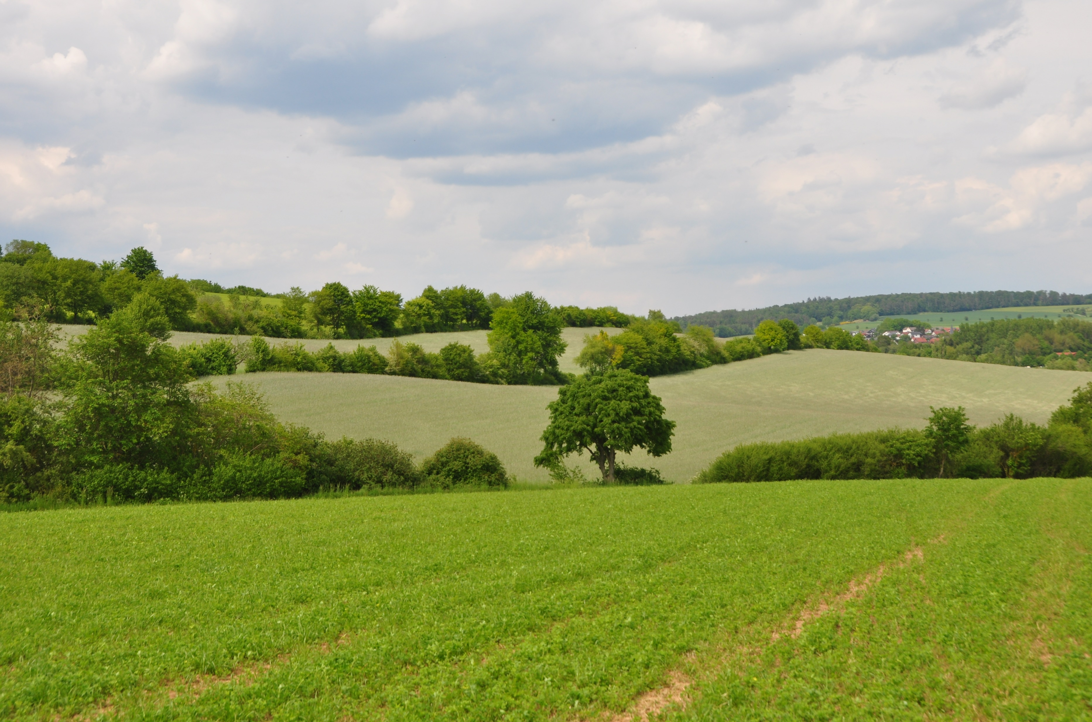
How to start a Social Farm?
Unit 3.4.
Module 3:Methods, techniques and experiences of Social Farming
Larissa Nagorka
Thomasvan Elsen

Slide 2
Presentation
Larissa Nagorka
B. Sc. Organic Agricultural Sciences
Employed at PETRARCA e.V. since 2021
Right now studying B.Sc. Psychology in the 4th semester

Slide 3
Learning outcomes
Transfer of basic knowledge on concrete examples
Identifying basic aspects of Social Farming relevant for an own projects
Elaborating a concept for an own project
Construction of a Social Farm combining the demands of target groups with the conditions on farms
Planning a system of interactions and communication structures in order to develop the whole farm organism
Appraising the ongoing implementation, possibly together with other participants of the course (building a network of support and exchange).
Comparing different concepts of Social farming

Slide 4
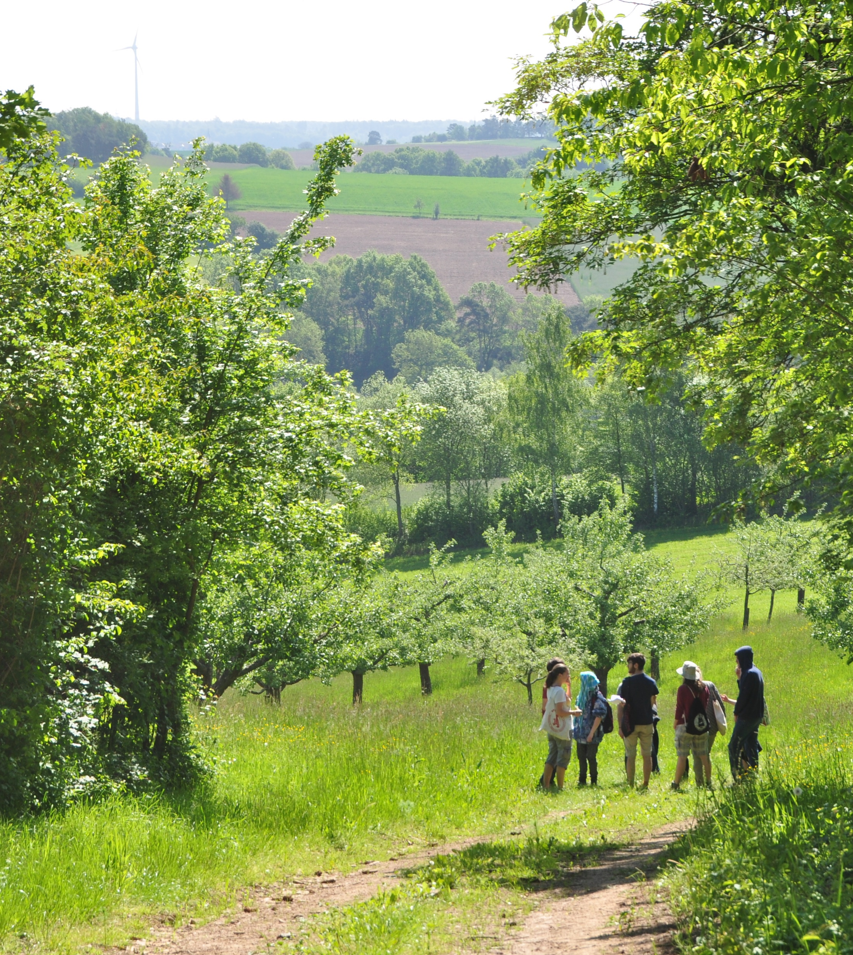
Overview
Does Social Farming fit to me?
Does Social Farming fit to my farm?
Which target group can be integrated on my farm?
Which employment and care opportunities are there?
Who bears the costs? Who takes care of the clients? Who receives the funding?
Thomas van Elsen

Slide 5
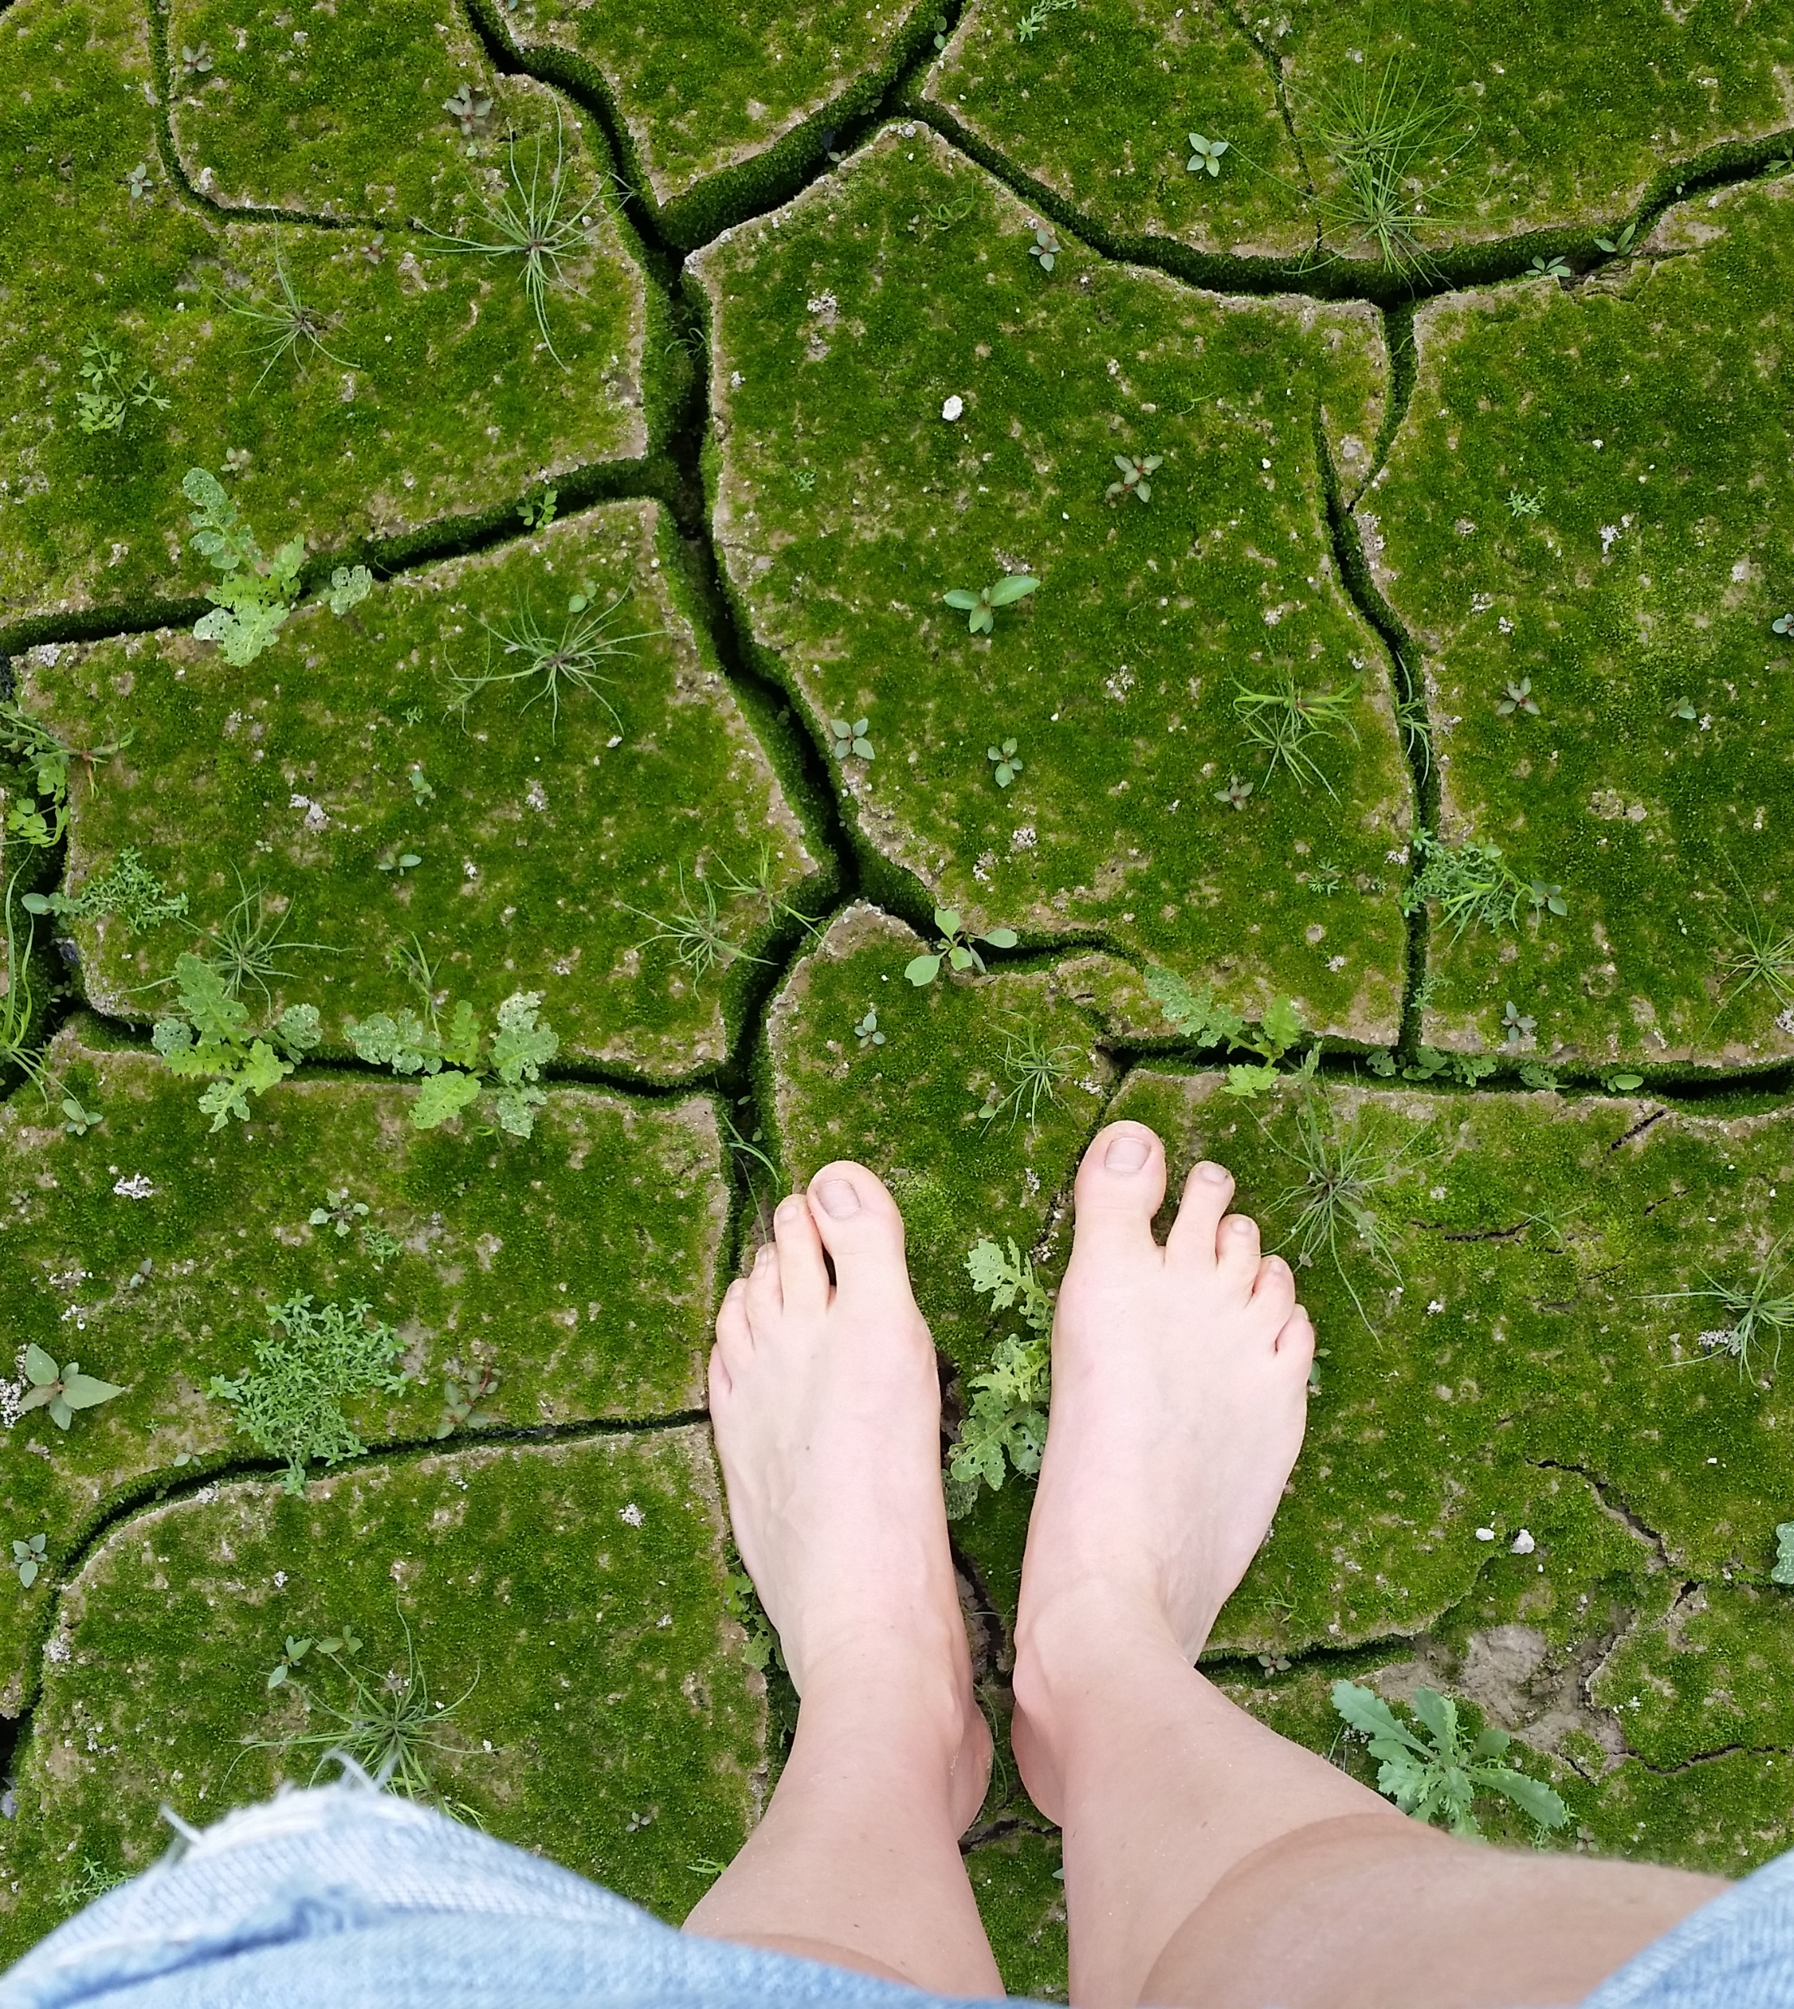
1. Does Social Farming fit to me?
Analysis of personal qualification for Social Farming
To start a Social Farming is a development process, which amongst others requires a contention with one´s self
The following questionnaire helps you to get into the topic of Social Farming and to find out whether it suits you, your family and your employees
Larissa Nagorka

Slide 6
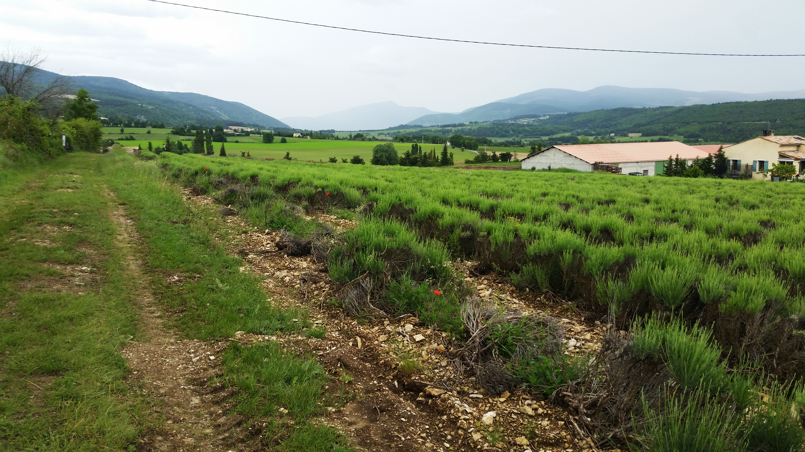
What is my motivation to start Social Farming?
Which imaginations and ideas do I have?
Which personality traits define me?
Can I imagine caring for clients?
Do I fulfil the technical requirements to lead a Social Farm?
Which are the technical requirements to lead a Social Farm? (Degrees, further trainings, additional qualifications)?
Is there an employee on my farm who does already have a degree in the field of pedagogy, social work, or care?
Larissa Nagorka

Slide 7
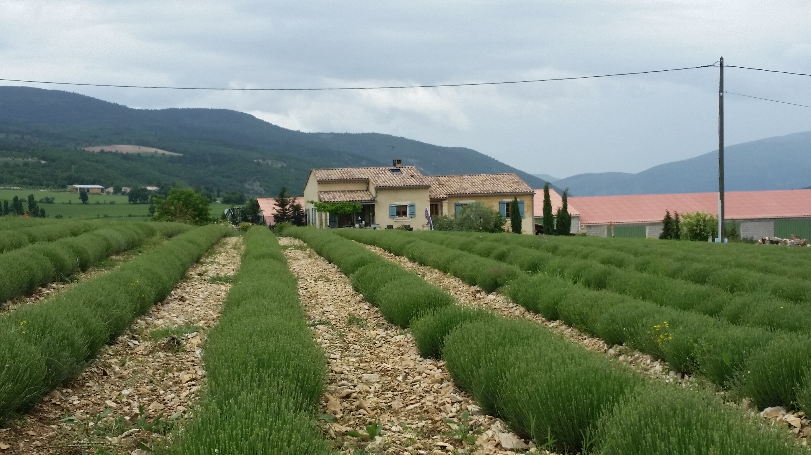
Can I imagine working together with qualified staff (such as social workers, occupational therapists, or caretakers)?
With which target group can I imagine working with? Or with which not? Why?
What does the connection between social work and farming mean to my surroundings (family, employees, neighbors, regional cooperation-partners)?
Can I expect support by my surroundings?
Do I already work together with public authorities, agencies, or facilities (e.g., youth welfare office, labor office…)?
Larissa Nagorka

Slide 8
2. Does Social Farming fit to my farm?
Take a closer look at the given conditions on the farm
Exchange of ideas with social work institutions
Exchange with (future) people living or working on the farm
The needs and ideas of all those involved become clear
These ideas can be a basis for further development of your concept in the case of initial contact with an institution
The following questionnaire is a reminder of how Social Farming might fit into your farm

Slide 9
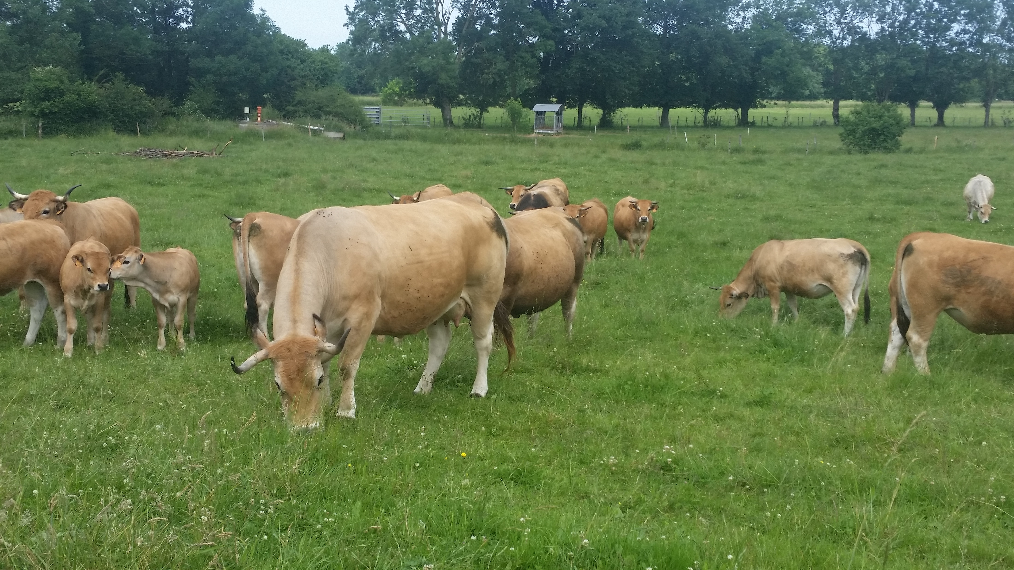
Which operational characteristics dominate on the farm / in the company?
What employment opportunities are there, outdoors and indoors?
Is there a sufficient range of activities over the whole year or only seasonally?
Which areas of activity are suitable for the cooperation of people with a disability?
How much time is available for induction and support in everyday working life?
Is there space for social activities (break rooms, rest and retreat possibilities, etc.)?
Does the company have accommodation facilities?
Larissa Nagorka

Slide 10
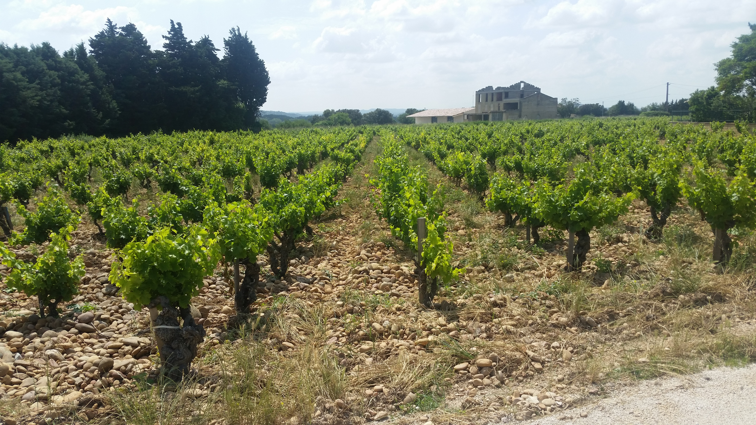
How is the social environment on the farm? Are the employees and clients integrated into the family inheritance or is there a strict separation between employees and family members? Are there ways to get involved in daily interaction?
Is the company easily accessible by public transport? What are the directions? How can travel and home or mobility be organized in general?
Which social work institutions (e. g. schools, retirement homes, workshops for disabled people, hospitals, charities, etc.), social security institutions or non-profit associations are located in the surroundings of the farm?
Larissa Nagorka

Slide 11
Overview
Does Social Farming fit to me?
Does Social Farming fit to my farm?
Which target group can be integrated on my farm?
Which employment and care opportunities are there?
Who bears the costs?
Who takes care of the clients?
Who receives the funding?
Thomas van Elsen

Slide 12
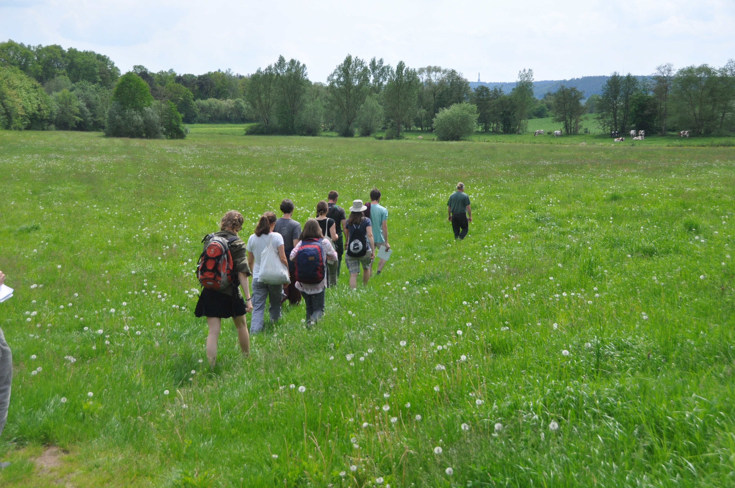
3. Which target group can be integrated on my farm?
The following presentation of different groups of people shows how diverse the social work on a farm can be
Primary orientation of which target group to chose
Help to gain insight into the different possibilities of working together with different target groups
Which target group(s) are you thinking of first when imagining a Social Farm?
van Elsen
Notes:
Kein client!!

Slide 13
Different target groups
Mentally disabled people
Former addicts
Children and youngs-ters
Former offenders
Mentally or psycho-logical disturbed people
Elderly people
Long-term unem-ployed people
People with a physical disability
People with burn-out-syndrome

Slide 14
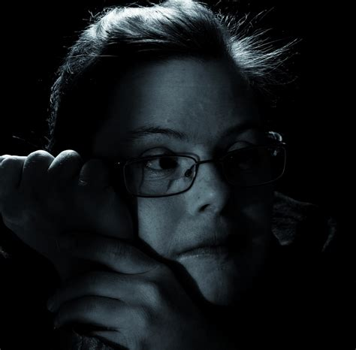
1. People with a mental disability
Intellectual impairment
Difficulties in interacting with their environment
Distinction between different grades of severity
https://external-content.duckduckgo.com/iu/?u=https%3A%2F%2Ftse3.mm.bing.net%2Fth%3Fid%3DOIP.JNev2VyU4RjTiwci9iA-NAHaHS%26pid%3DApi&f=1
Notes:
These people have an intellectual impairment (verringerung) or difficulties in interacting with their environment.
A distinction is made between different grades of severity, such as mild, moderate, severe or undefineable intellectual disability.
Down syndrome is the most common genetic cause of intellectual disability.

Slide 15
2. Mentally or psychological disturbed people
Tasks can no longer be mastered
The confrontation with their environment is problematic
Cause: Manifold play of external influences and the inner, mental state.
Difficult to do reliable work on a Farm
https://bilder.t-online.de/b/66/05/99/68/id_66059968/610/tid_da/die-zahl-von-psychischen-erkrankungen-steigt-enorm-an-das-wird-den-kassen-zu-teuer.jpg
Notes:
The behavior and experience of people with a mental or emotional disorder means that tasks can no longer be mastered.
The confrontation with their environment is problematic.
The development of mental illnesses is due to a manifold play of external influences and the inner, mental state.
Common mental illnesses are depressions, anxiety disorders, psychologically conditioned complaints, addiction disorders.
Difficult to do reliable work on a Farm

Slide 16
3. People with burnout syndrome
No disease in the true sense
Result of personal and professional overload
Fatigue on an emotional, mental and physical level, reduced performance, listlessness and frustration
https://cdn2.hubspot.net/hub/2217929/file-4087060064-jpg/blog-files/stressed-out-banker-300x200.jpg
Notes:
Burnout syndrome is not recognized as a disease in the true sense. It´s rather a depression the people face. Being burned out is the result of personal and professional overload. Fatigue on an emotional, mental, and physical level, reduced performance, listlessness and frustration can lead to psychosomatic disorders, depression or various dependencies in people with burnout.

Slide 17
4. People with a physical disability
Some basic functions of the body are permanently limited
paralysis, malformations, wear and tear diseases or damage caused by accidents
Often multiple disability
https://www.gruenewirtschaft.at/assets/uploads/2017/08/iStock-860895364_lr-e1536322390332.jpg
Notes:
Some basic functions of the body of people with physical disabilities are permanently limited.
Among other things, a distinction can be made between paralysis, malformations, wear and tear diseases or damage caused by accidents. Often several forms of restriction occur at the same time, which is a multiple disability.

Slide 18
5. Long-term unemployed people
Unemployment that lasts longer than 12 months
Reintegration into the first labor market is difficult
Opportunities for gradual integration into working life can be created
https://img.myjob.ch/04fbda25b39bb53de81f_788x788bgFFFFFFcolorspacesRGB.jpeg
Notes:
Long-term unemployment = unemployment that lasts longer than 12 months. Reintegration into the first labor market is difficult or even impossible. By working together or living in a company, opportunities for gradual integration into working life can be created.

Slide 19
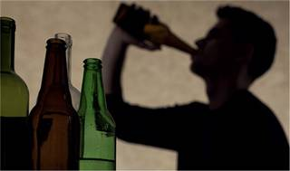
6. Former addicts
Withdrawal treatment
Substances: alcohol, medicines, stimulants, sedatives, sleeping pills, hallucinogens
Social integrate through various preventive measures
Often accompanied by a psychiatric illness.
https://ptaforum.pharmazeutische-zeitung.de/fileadmin/_processed_/1/4/csm_alkohol_istock-492456096_fiviwc5mv.tiff_id1757113_s54_x-581_w367_h217_ddcd3d4f1e.jpg
Notes:
People who have undergone withdrawal treatment after becoming addicted to substances. Substances such as: alcohol, medicines, stimulants, sedatives, sleeping pills, hallucinogens. They get enabled to integrate socially through various preventive measures. An addiction is often accompanied by a psychiatric illness.

Slide 20
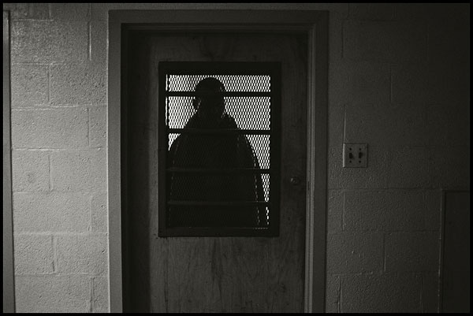
7. (Former) offenders
People released from prison
Aim to assume responsibility and to lead a life without relapse into delinquency
Charitable work, e. g. on a farm instead of a prison sentence
https://www.photoscala.de/grafik/2013/MZ300_5_6.jpg
Notes:
Former offenders are people released from prison.
They have been in prison for violating the law. The aim of the execution is the ability to assume responsibility and to lead a life without relapse into delinquency. In some cases, instead of a prison sentence, people can also do charitable work, e. g. on a farm.

Slide 21
8. Children and youngsters
Very complex working field
Fields can be:
→ Child and youth welfare in special situations
→ Promotion of development and integration assistance for people who are mentally handicapped
→ Educational offers
https://www.jugendhilfe-elisabeth.de/files/jugendhilfe-st-elisabeth/slider-header/jugendhilfe-elisabeth-fachliche-ausrichtung-der-einrichtung.jpg
Notes:
Working with children and young people is very complex.
It ranges from child and youth welfare in special situations to development promotion and integration assistance for children and young people who are mentally handicapped or threatened by such a disability.
Educational or educational offers for children and young people can also be part of the work in a company, such as on kindergarten or school farms.

Slide 22
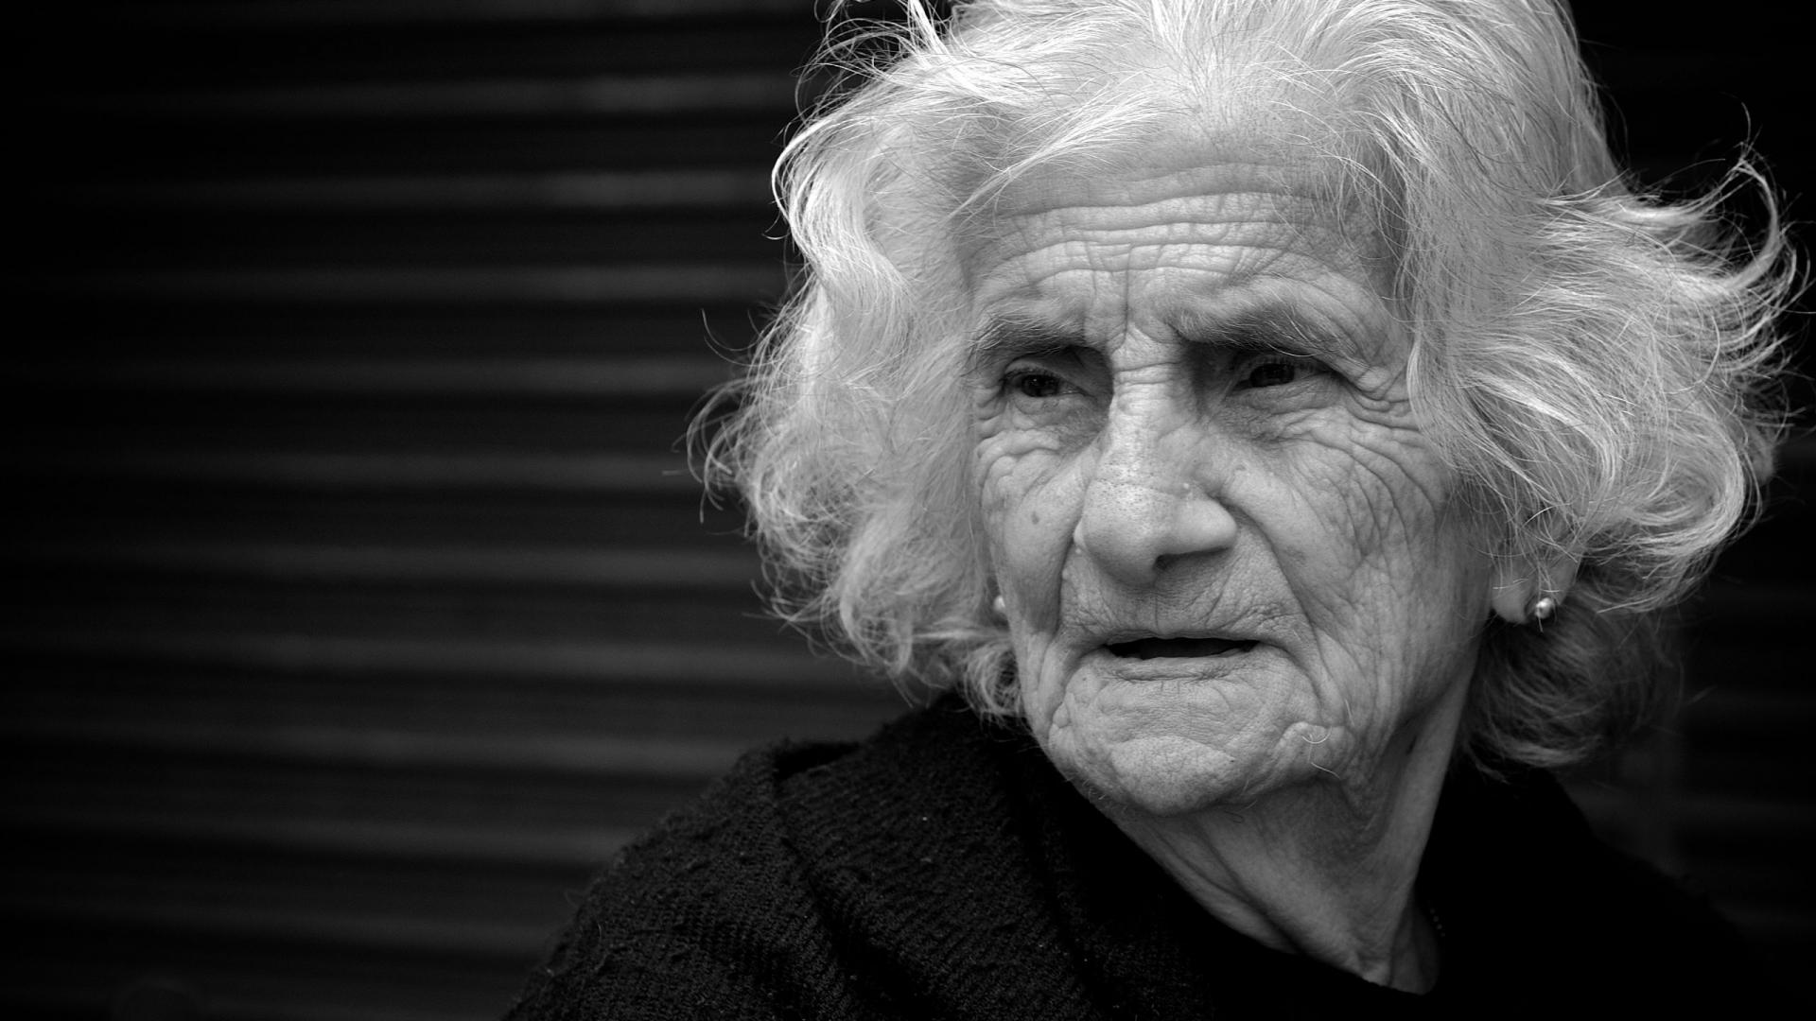
9. Elderly people
Increasing loneliness in old age → Can lead to illnesses → New concepts are needed
Inclusion in everyday farm life
Support of older people with e. g. dementia
Wide range of individual cases, employment and support opportunities
https://wallpapercave.com/wp/wp2285428.jpg
Notes:
Due to the increasing loneliness in old age, which can often lead to illnesses such as depression or age-related diseases, such as e.g., dementia, new concepts are also in demand in the field of senior citizen work. From inclusion in everyday farm life to support older people with dementia, there is also a wide range of individual case studies and employment and support opportunities.

Slide 23
What is important?
Taking into account the needs and possibilities of the individual human
Close cooperation with social work institutions that have experience in caring for or promoting people
Providing optimal professional and human framework conditions for social work on the farm
Fig.: https://cdn2.vectorstock.com/i/1000x1000/84/51/sprout-plant-graphic-icon-design-template-vector-23278451.jpg
Notes:
To summarize the important aspects when working with different target groups of people in need for care, it is important to consider the needs and possibilities of the individual human, to provide optimal professional and human framework conditions for social work on the farm and to have a close cooperation with social work institutions that have experience in caring for or promoting people. One should not forget that the work with people takes a lot of attention. The individual person should always be on the first place.

Slide 24
4. Which employment and care models are there?
Local conditions
Employment and care model
Way of financing
Notes:
In this chapter we will have a closer look at which employment and care models there are. As you see in the graphic, we take the information we collected before about the situation of the farm, the people working there and it´s surroundings. Additionally, we must do research about different ways of financing. We will learn more about that in chapter 5. From this perspective we might already have an impression of which opportunities are there and which is the most reasonable way to go. When we add the local conditions with the way of financing that is possible in our case, we get the employment and care model which can be adapted on our farm.

Slide 25
The models presented in the following are:
Strongly based on the current situation in Germany
Serve only as a rough orientation and impression of what is possible
→ It is necessary to check the current situation in each country at the given time individually as it varies between states and can change quickly!
Notes:
It is very important to take into the account that the models presented in the following are strongly based on the current situation in Germany and serve only as a rough orientation and impression of what is possible. They can give you an impression for what to look for also in other countries and to gain insight into organization of such structures. Yet it is necessary to check the current situation in each country at the given time individually as it varies between states and can change quickly!

Slide 26
Possible employment and care models
Ordinary employment
Integration projects
Outdoor workplace in a workshop for disabled people
Assisted living in families
Living and working community
Measures to promote employment
Other employment models
Notes:
Here you see an overview of what employment and care models there are. We will have a closer look at each one of them in the following chapter.

Slide 27
1. Ordinary employment
salary includes social security contributions
Subsidy, integration subsidies or a so-called underperformance compensation to the wage costs for the employer
Investments subsidy for the workplace
consultation by the Employment Agency or the responsible integration office
Notes:
“Ordinary employment in connection with integration grants, benefits to compensate for extraordinary burdens or investment cost subsidies. The employee with a disability is hired and receives a salary that includes the corresponding social security contributions.
As a subsidy to the wage costs, the employer can receive integration subsidies or a so-called underperformance compensation.
In addition, investments for the workplace can be subsidized.
A consultation is carried out by employees of the Employment Agency or the responsible integration office.”

Slide 28
2. Integration projects
Integration project = economically and legally independent company
Legally assigned to the general labour market
Subsidies, tax benefits, free assistance and other subsidies can be claimed
Notes:
An integration project is an economically and legally independent company and can be legally assigned to the general labour market. In addition to the above-mentioned subsidies, tax benefits (non-profit status), free assistance and other subsidies can be claimed.”

Slide 29
3. Outdoor workplace in a workshop for disabled people
Offer services for participation in working life for people who are unable to work on the primary labor market
Aim to enable suitable persons to transition to the general labor market
Wide range of vocational training and jobs, qualified staff and an accompanying service
More and more workshops are cooperating with normal companies in the form of outsourced workplaces → Close cooperation with a workshop for disabled people
https://www.stiftung-liebenau.de/teilhabe-und-familie/angebot/wangen-schauwies/wfbm-1929/
Notes:
Workshops for disabled people offer services for participation in working life for people who are unable to work on the primary labor market due to their disability (total disability).
Appropriate measures are intended to enable suitable persons to transition to the general labor market.
The workshop for disabled people has a wide range of vocational (beruflich) training and jobs, qualified staff and an accompanying service.
In addition to workplaces within the workshop, more and more workshops are cooperating with normal companies in the form of outsourced workplaces. This form of employment is based on close cooperation with a workshop for disabled people. The employee with a disability works completely on the external company and the latter pays a fee to the workshop for this. The workshop will continue to be responsible for the payment of social security contributions as well as for administration and support.

Slide 30
4. Assisted living in families
Integration of a person with a disability into family
Mentally or emotionally handicapped people are individually cared for in the family unit
Care includes the everyday way of life, the organization of leisure time, the organization and structuring of the daily routine and talking to each other
The host family should be a stable cohabitation and integrate the disabled person into family life
Living space should be available for the person to be cared for
No professional training in Care necessary
Accompanying specialist service ensures quality
Notes:
Assisted living in families means the integration of a person with a disability into family life. Superficially, mentally, or emotionally handicapped people are individually cared for in the family unit. They are given space to unfold, develop or recover freely. The care includes the everyday way of life, the organization of leisure time, the organization and structuring of the daily routine and talking to each other. The host family should be a stable community and integrate the disabled person into family life. Furthermore, living space should be available for the person to be cared for. All costs (rent, clothing, care) are covered, and an additional expense allowance is paid. A professional training is not necessary in this case of supervision. Quality assurance is ensured by the accompanying specialist service. This also decides on the assignment of the people to the respective host families. It depends on the personal ideas, the local conditions, sympathies, manners, habits, and interests of the host family.

Slide 31
5. Living and working community
Form of living together and working together between people with disabilities and caretakers
Different areas of work
Everyday life is structured and lived together
Classified as a workshop for disabled people or comparable place of employment
Often based on an anthroposophical image of man
Notes:
A living and working community is a form of living together and working together between people with disabilities and caretakers. There are different areas of work in which the residents can contribute with their different strengths and interests. In the adjoining living areas, everyday life is structured and lived together. From a legal point of view, the living and working groups can be classified as a workshop for disabled people or as a comparable place of employment. Living and working communities are often based on an anthroposophical image of man.

Slide 32
6. Measures to promote employment
Employment of people with the aim of reintegrating them into the labour market
Close cooperation with the local employment agency
The job opportunities must be in the public interest
Notes:
People with working capacity, but problems to find a job, can be employed with the aim of reintegrating them into the labour market. Close cooperation is carried out with the local employment agency, with which integration agreements are defined before the start of the measure. A special feature of this type of employment is that the job opportunities must be in the public interest, e.g.. serve the public.

Slide 33
7. Other employment models
Therapy instead of punishment
Trial employment of disabled people
Medical and social rehabilitation
Notes:
Other employment measures include: Therapy instead of punishment, trial employment of disabled people and medical and social rehabilitation.

Slide 34
5. Who?
Who bears the cost?
Who takes care of the people in need?
Who receives the funding?
Again:
→ Based on the system which currently exists in Germany!
Notes:
In this chapter we will take a closer look at who exactly is involved in the whole process and work field of SF. In this context we have a deeper look at who bears the cost, who takes care of the people in need and at who receives the funding. Again, you must take into consideration that the following information are based on the current system in Germany, and it is necessary to find out the specific situation in each country by research. Yet, the following information can serve as a rough orientation of what to look for.

Slide 35
Who bears the cost?
In social work in Germany, the provision of services is divided into two types of institutions. → Cost bearers and → Service providers
Cost bearers: Institutions of the federal, state and local governments and the social security institutions → Bear the costs of the services
Service providers: Provide the actual social service
Notes:
Who bears the cost of the social service provided to people by Social Farming? In social work in Germany, the provision of services is divided into two types of institutions, the cost bearers and the service providers. The cost bearers are institutions of the federal, state and local governments and the social security institutions (health, long-term care, unemployment, pension and accident insurance). They bear the costs of the services (care, housing, work assistance, rehabilitation, care services, etc.), which are provided by the second type of institutions, the service providers (or social service providers).

Slide 36
Who takes care of the people in need?
The service providers, in turn, are divided into three different types:
1. Public agencys (youth welfare offices, social welfare offices and job centres)
2. Private-charitable (welfare associations, social aid organisations)
3. Private-commercial providers (old people's homes, day-care centres)
Farms that offer clients a place to work are also service providers in the field of social work in the sense of Social Farming.
Notes:
Who takes care of the clients? The service providers, in turn, are divided into public, private-charitable and private-commercial providers. 1. Public agencies include youth welfare offices, social welfare offices and job centers. 2. Non-profit institutions are e.g., welfare associations and social aid organizations. 3. private-commercial providers for example run old people's homes or day-care centers. Farms that offer clients a place to work are also service providers in the field of social work in the sense of Social Farming.

Slide 37
Who receives the funding?
The recipient of the services is the insured person of a social security system, who makes use of benefits regulated by the Social Security Law. A service is provided to the recipient and the cost bearer transfers the money directly to the service provider. For example social security institutions such as cooperatives and the health insurances can cover the costs of rent and meals for the people cared for.
Notes:
The recipient of the services is the insured person of a social security system, who makes use of benefits regulated by the Social Security Law. A service is provided to the recipient and the cost bearer transfers the money directly to the service provider. For example social security institutions such as cooperatives and the health insurances can cover the costs of rent and meals for the people cared for.

Slide 38
Thank you for your attention!

Slide 39
References
Kleinheitz, R., Kleinschulte, N., Krüger, M., Seyboth, A., Weber, E., van Elsen, T., in Soziale Landwirtschaft: Ein Praxishandbuch für EinsteigerInnen, Hrsg.: Thüringer Ökoherz e.V., Weimar

