Slide 1


Agrobiodiversity and ecosystem services main concepts
MODULE 2
Bioeconomy, agrobiodiversity, biomass use, strategies and resources for sustainable rural development
UNIT 2
Sustainability of bioeconomy and agrobiodiversity
Francesco Romagnoli, RTU, Latvia
Maksims Feofilovs, RTU, Latvia
Notes:
Welcome to today lecture. I am Prof. Francesco Romagnoli from the Institute of Energy Systems and Environment at the Riga Technical University. I am happy to share with you the contents of the lecture on “Agrobiodiversity and ecosystem services main concepts.

Slide 2
Aim/objectives
Get acquainted about the main concepts of the agrobiodiversity its assessment
Be aware about agrobiodiversity and ecosystem services
Acquire knowledge on:
  main aspects of agrobiodiversity,
  agro-biodiversity preservation,
  decreasing of climate change effect, and
  efficient use of biomass resources preserving ecosystem services
  agrobiodiversity and global priorities

Slide 3
Learning outcomes
LOut6 – Explain the major concepts in agrobiodiversity and explain their role in preserving ecosystem services;
LOut11 – Find innovative, economically sound, environmentally and climate friendly solutions for the use of bio-resources in the agro-farming sector;
LOut15 – Identify alternatives to the sustainable use of bio-resources in the agro-farming sector to create higher value-added products;
LOut19 – Argue about the overall sustainable aspects of bioeconomy within a real case implementation;
LOut15 – Identify the main pros and cons of the application of sustainable bioeconomy solutions within existing case studies within the agro farming sector;
LOut22 – Argue and summarize the main stages associated with the application of the bioeconomy principles to the agro-farming sector from a technological, environmental, economic, social and policy point of view;
LOut24 – Choose and recommend ideal strategies of bioeconomy principle applied to the agro-farming sector in real cases.

Slide 4
Keywords
Agrobiodiversity
Ecosystem services main concepts
Global Priorities
Assessment
Preservation strategies
Examples

Slide 5
Table of contents
Agrobiodiversity main concepts
Connecting Global Priorities: Human Health and economic development Agrobiodiversity
Examples of agrobiodiversity assessment and preservation strategies
Notes:
This lecture is organized into three main parts: Agrobiodiversity main concepts, Connecting Global Priorities within agrobiodiversity and examples of agrobiodiversity assessment and preservation strategies

Slide 6
Agrobiodiversity main aspects
Notes:
I am now going to focus on the main aspects and concepts of Agrobiodiversity.

Slide 7
Specific contents
An introduction about biodiversity
  definition, dimensions, trends, drivers, importance
Overview about agrobiodiversity
  Biodiversity vs agrobiodiversity, complexity, trends, importance, sustainability, components, functional agrobiodiversity, status of agrobiodiversity, loss and threats, dimensions, benefits
Holistic concepts of Agrobiodiversity and assessment methods
  Human-environment interactions, mainstreaming agricultural biodiversity, visualization of the expanded definition of agrobiodiversity, agrobiodiveristy and ecosystem services, agrobiodiversity knowledge concepts
Notes:
Four main parts will be dedicated to this section:
An introduction about biodiversity
Overview about agrobiodiversity
Management of agrobiodiversity
Holistic concepts of Agrobiodiversity and introduction to assessment methods

Slide 8
Biodiversity: introduction

Slide 9
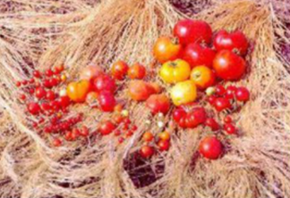
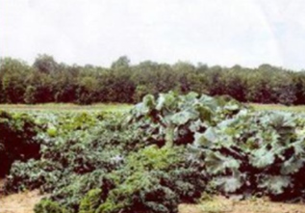
Biodiversity: definitions
“Variability among living organisms from all sources including inter alia, terrestrial, marine and other aquatic ecosystems and the ecological complexes of which they are part; this includes diversity within species, between species and of ecosystems.”
Convention on Biological Diversity, Article 2
Defined as:
the richness and beauty of all life on earth
the diversity of all life on earth
integral to sustainable development
Source: project LIFE „Biodiversity in Standards and Labels for the Food Sector - Biodiversity: Status quo [1]
Source: https://slideplayer.com/slide/13495817/ [2]
Notes:
According to the definition from the Convention on Biological Diversity, Article 2 Biodiversity means “Variability among living organisms from all sources including inter alia, terrestrial, marine and other aquatic ecosystems and the ecological complexes of which they are part; this includes diversity within species, between species and of ecosystems”
Biodiversity (also called Ecological or biological diversity refers to diversity in plants and animal and are a major point of discussion encompassing the future of biology and agricultural activities .”
Basically it can be represented as:
.. the richness and beauty of all life on earth
from ants to whales, genes to ecosystems. Its quality, diversity and functioning is the world’s natural capital and builds the basis of our economic and social well-being and that of all future generations.
...the diversity of all life on earth
It varies over time and place. For example, fewer birds live in Scandinavia in winter than in summer and a different number of organisms can be found in the tundra and the savannah. Biodiversity is not limited to national parks: it is everywhere.
... integral to sustainable development
by providing vital goods and services, such as food, timber, carbon sequestration and flood regulation.

Slide 10
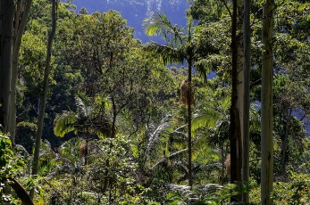
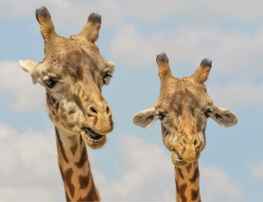
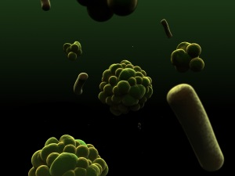
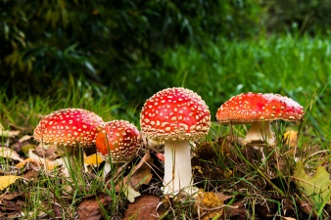
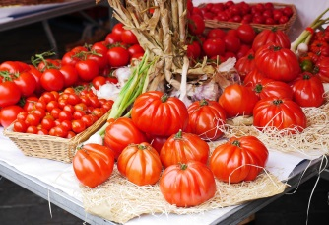
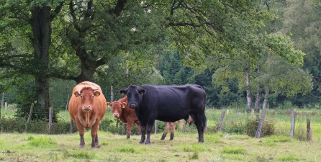

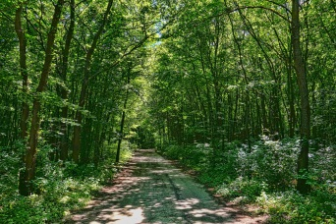
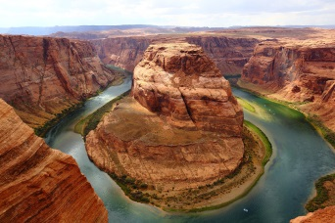
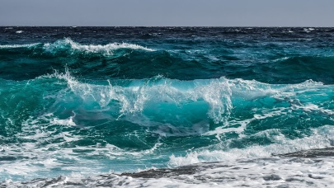
Biodiversity: main dimensions (1)
Diversity between species (plant, animal, microorganism, fungi)
Diversity within species (genes, e.g. different species of tomato, cattle, carnation)
Diversity of ecosystems (forest, rivers, ozeans, ….)
Source: project LIFE „Biodiversity in Standards and Labels for the Food Sector - Biodiversity: Status quo [1]
Notes:
Diversity can be considered in different forms and scales in terms of :
diversity between species;
Diversity within species
Diversity of ecosystems

Slide 11
Biodiversity: dimensions (2)
Ecological diversity (Bioregions, landscapes, Ecosystems, Habitat, Niches, populations)
Genetic diversity (population, individuals, chromosomes, genes, nucleotides)
Organismal diversity (kingdoms, phyla, families, genera, species, subspecies, population, individuals)
Source: project LIFE „Biodiversity in Standards and Labels for the Food Sector - Biodiversity: Status quo [1]
Notes:
Biodiversity can also be identified as other types of dimensions, namely ecological, genetic and organismal.
Ecological diversity includes a larger scale in terms of Bioregions, landscapes, Ecosystems, Habitat, Niches, populations
Genetic diversity includes population, individuals, chromosomes, genes, and nucleotides
When we refer to organismal diversity, we talk about kingdoms, phyla, families, genera, species, subspecies, population, individuals.
As you can see population is an overarching key aspect.

Slide 12

Trends and figures (1)
In US 31% decrease since the 15th century
71% of fish species extincted in Europe/Central Asia
87% of wetlands lost
More than 25,000 species threatened or endangered animal and plant species
8 out of 18 ecosystem services defined by MEA:
    E.g. pollination, drinking water purification, and protection against erosion and flooding
Some ecosystem services intensified:
    E.g.: production of agricultural goods, animal husbandry, and the harvesting of timber from forests
Ecosystem services
Benefits people receive from ecosystems. These include:
provisioning services (food, water);
regulating services (regulation of floods, drought,...);
supporting services (soil formation);
cultural services (recreational);
and other non-material benefits (health and well being)
Source: What are ecosystem services? https://www.youtube.com/watch?v=r7UCAsBT5Yg [3]
Source: Project LIFE „Biodiversity in Standards and Labels for the Food Sector - Biodiversity: Status quo [1]
Notes:
SLIDE 12
Let‘s now tal about Some data and general trends
In the United States, biodiversity has declined by 31% since the 15th century.
71% of fish species have become extinct in Europe/Central Asia
87% of wetlands have been lost since the beginning of the modern era
More than 25,000 species are on the list of threatened or endangered animal and plant species around the globe
Eight out of 18 ecosystem services defined by Millennium Ecosystem Assessment (MEA) have substantially decreased since 1960.
But what are Ecosystem services (which we will in-depth see in the continuation of this presentation)?
Ecosystem searvice means benefits people receive from ecosystems. These include:
provisioning services (like food, water);
regulating services and service (regulation of floods, drought,...);
supporting services (soil formation)
cultural services (recreational) and other non-material benefits (health and well being)
The most impacted ecosystem services amongst others are: pollination, drinking water purification, and protection against erosion and flooding
But some ecosystem services have been intensified, like producing agricultural goods, animal husbandry, and harvesting timber from forests.

Slide 13
Trends and figures (2)
Estimated total number of species on Earth: 6.5 million species *
86% of all species on land and 91% of those in the seas still to be catalogued
Extinction rate: 50 – 300 species per day
  total species number of 130.000
Only a marginal number of species and their role in providing ecosystem services can be described
Source: Project LIFE „Biodiversity in Standards and Labels for the Food Sector - Biodiversity: Status quo [1]
Source: Camilo, M. et al. , 2011. [4]
Notes:
Looking on other figures towards about the overall status of biodiversity worldwide, we found that
the actual estimated total number of species on Earth is about 6.5 million species
86% of all species on land and 91% of those in the seas have yet to be discovered, described and catalogued
The actual species extinction rate is in the range of 50 – 300 species per day, with a total species number in 130.000 years equals to 0
With the current extinction rate, only a marginal number of species and their role in providing ecosystem services can be described and discovered.
It should be highlighted that this loss is anthropologically caused and has little to do with natural variations.

Slide 14
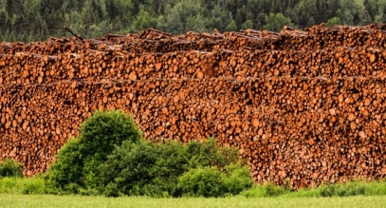
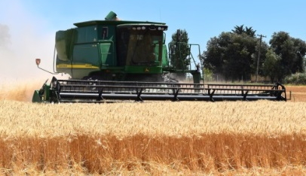
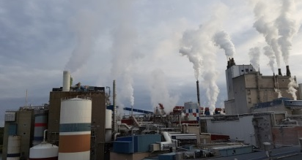
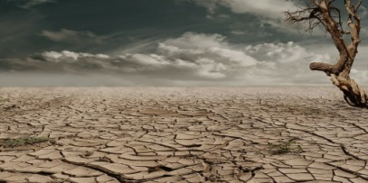

Main drivers for the loss of biodiversity (immediate causes)
Destruction and degradation of ecosystems
Land use change: conversion of pristine forest ecosystems to agricultural systems
burning of natural vegetation
Overexploitation of natural resources
overstraining of soils
overfishing of fish species
depletion of fresh water resources
Contamination
of water, air and soil with pollutants (GHGs, chemicals, garbage etc..)
Climate change
number and range of species will decline greatly as temperatures continue to rise
Invasive, alien species
… next slide
Source: Project LIFE „Biodiversity in Standards and Labels for the Food Sector - Biodiversity: Status quo [1]
Notes:
The factors more affecting the current level of biodiversity are related to immediate or underlined causes. About immediate cause the more relevant factors can be summirezed in terms of:
Destruction and degradation of ecosystems, in terms of expansions of agriculture, forest and aquaculture and thus land use change as well as involving habitat losses and ist fragmentation
Overexploitation of natural resources including overuse of soild, overfishing and deplitation of water resrouces together with too high exploitation of wild living organisms
Contamination, icluding pollutions of soil water and atmoshpere
Climate change in terms of number and range of species will decline greatly as temperatures continue to rise
Biodiversity is a non-detachable part of the concept of sustainability. Biodiversity is essential for agricultura producution, as agricultura should be for biodiversity conservation
As well new species introductions could rapresent a drivers on biodiversity loss how we will see better in the next slide..

Slide 15
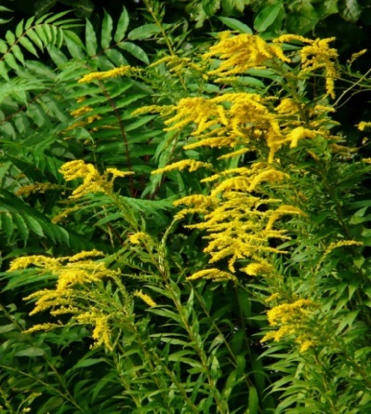
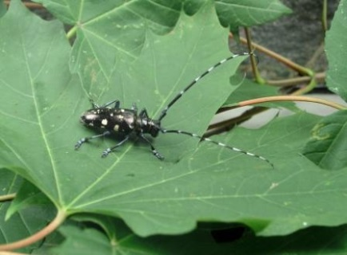
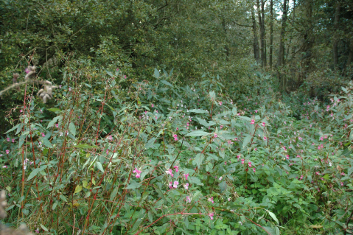
Invasive species
Invasive, alien species
Non-native species causing damage to the environment and potentially cause species extinction, modify ecosystem processes and act as disease vectors.
Potentially large economic consequences
Native to Himalayas countries;
Invasive in temperate Europe and northern North America
Native in North America; Invasive in Germany
Native to China and Korea;
Invasive in USA, Austria
Canadian and Late Goldenrod (Solidago canadensis/gigantea L.)
Asian longhorn beetle
(Anoplophora glabripennis)
Himalayan balsam
(Impatiens glandulifera)
Source: Project LIFE „Biodiversity in Standards and Labels for the Food Sector - Biodiversity: Status quo [1]
Source: pixabay [8]
Notes:
Invasive alien species are non-native species causing damage to the environment and potentially causing species extinction, modifying ecosystem processes and acting as disease vectors. In addition, the problems caused by alien invasive species have potentially large economic consequences.
In the slide, we coud see 3 different types of invasive spesies in EU from North Korea, China and Himalayan countries.

Slide 16
Main drivers for the loss of biodiversity (underlining causes)
Human social organization
Growth of human population
Patterns of natural resource consumption
Global trades
Economic systems and policies that fail to value the environment
Inequity in ownership, management and flows of benefits
Source: https://slideplayer.com/slide/13495817/ [9]
Notes:
Understanding the drivers behind the trends in biodiversity losses is essential to address the causes of its loss and, at the same time, to seize opportunities for biodiversity in supporting schemes.
The main factors affecting the current level of biodiversity consided as underlying causes can summirezed in terms of:
Human social organization
Growth of human population
Patterns of natural resource consumption
Global trades
Economic systems and policies that fail to value the environment
Inequity in ownership, management and flows of benefits

Slide 17
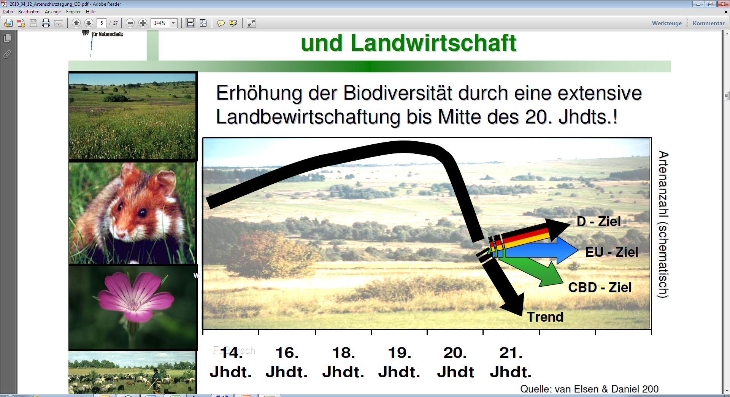
Trends
Increasing biodiversity through extensive land management until the middle of the 20th century
Changes of biodiversity on farmland due to intensification of farmland use
Number of species (schematically)
GER trend
EU trend
CBD trend
14th 16th 18th 19th 20th 21st
Centuries
Source: Project LIFE [1], ECA 2019 [39].
Notes:
Agriculture is the largest contributor to biodiversity loss. The current biodiversity situation in Europe reflects the impact of the development and expansion of farming in the past few centuries. Biodiversity is also affected by land-use change, habitat fragmentation and destruction, climate change, and invasive alien species.
The result has been increased use of chemicals and machinery, and more open and homogeneous landscapes. As it possible to see from the picture on the right, losses of diversity increase the risk of declining yields due, for example, to loss of disease resistance or environmental tolerance, or to decreasing vitality, fertility or fitness caused by inbreeding (the production of offspring from the mating or breeding of individuals or organisms that are closely related genetically). Losing genetic diversity means irretrievably losing future breeding options. This may also reduce the capacity of ecosystem to adapt to unforeseeable disease risks or to environmental variations like climate change. Thus Intensive livestock farming is claimed to have an undesirable effect on biodiversity
In the pictures are reported 3 different scenarios for the loss of number of species beyond the 21st century: the EU, the German and the one of the Convention on Biological Diversity. Two of them are more optimistic but the one of on Biological Diversity is still adverse. This is why the Convention on Biological Diversity (CBD) post-2020 global biodiversity framework encourages countries to take action for safeguarding agrobiodiversity by making better use of the vast number of species and varieties available for human consumption.

Slide 18
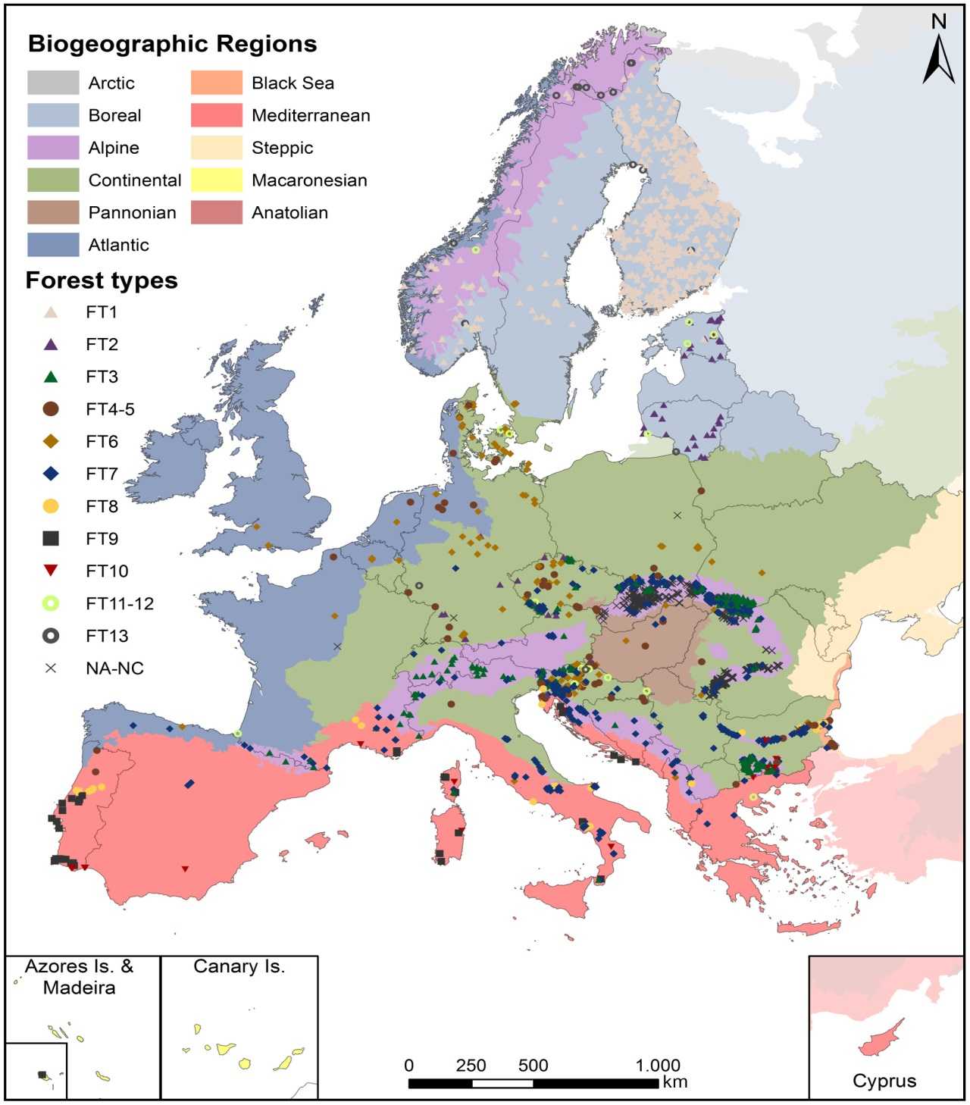
Biodiversity in forests
Natural (primary) ecosystem services
flowing and still water bodies (streams, rivers, ponds, …)
wetlands
forests (rainforest, lowland, needle leaf forest, …)
other native terrestrial ecosystems (woodlands, scrublands, … )
Source: Project LIFE „Biodiversity in Standards and Labels for the Food Sector - Biodiversity: Status quo [1]
Source: Sabatini, F. et al. , 2018 [5].
Notes:
Some background information…
Natural (primary) ecosystem services can be found in a given area in the absence of significant human management impacts.
This includes all naturally occurring:
flowing and still water bodies (streams, rivers, ponds, …)
wetlands
forests (rainforest, lowland, needle leaf forest, …)
other native terrestrial ecosystems (woodlands, scrublands, … )
The distribution of primary forest patches retrieved for Europe by forest type are presented in the picture.
Primary forests occurred mostly in the boreal (1 Mha, 1% of that biogeographical region) and the alpine regions (0.4 Mha, 0.6%).
With regard to the forest types (FTs), boreal forest (FT1) accounted for the highest share of the mapped primary forests (1.09 Mha), followed by mountain beech forest (FT7—0.15 Mha) and, to a minor extent, alpine coniferous forest (FT3—0.07 Mha)
The map of biogeographical regions in the background follows Map of natural vegetation of Europe from (BfN, 2003). Forest types follow European forest types. Categories and types for sustainable forest management reporting and policy (EEA Technical Report 2006): FT1—boreal forest, FT2—hemiboreal and nemoral coniferous‐mixed forest, FT3—alpine coniferous, FT4‐5—mesophytic deciduous and acidophilus forest, FT6—beech forest, FT7—mountainous beech forest, FT8—thermophilus deciduous forest, FT9—broadleaved evergreen forest, FT10—coniferous Mediterranean forest, FT11‐12—mire and swamp forests and floodplain forest, FT13—nonriverine alder, birch or aspen, NA‐NC—no data/unclassified [Colour figure can be viewed at wileyonlinelibrary.com]

Slide 19
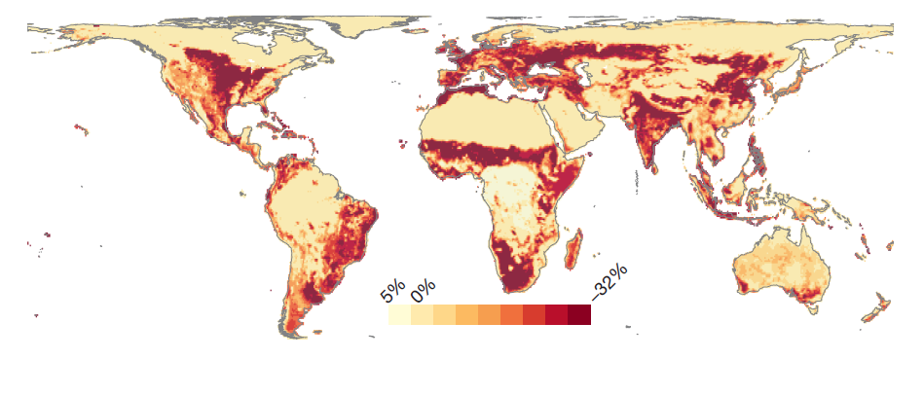
Biodiversity and changes by land use
Net change in local biodiversity richness caused by land use and related pressures by land use
Source: Newbold, T. et al., 2015. [6]
Source: Project LIFE „Biodiversity in Standards and Labels for the Food Sector - Biodiversity: Status quo [1]
Notes:
A new study published today in the journal Nature gives a global view of this damage since the 1500s. It shows that by 2005, worldwide land use change had caused a drop of 14 per cent in the average number of species found in local ecosystems. Most of this loss came in the last 100 years.
The study is the first global analysis of human impacts on local biodiversity. Scientists submitted data from more than 70 countries and considered around 27000 species. The team's figure of a 14 per cent drop in species in local ecosystems is a global average. So local biodiversity in some areas is still quite intact, but others - including Western Europe - have had losses of 20-30 per cent.
This is important because 20 per cent is widely considered the tipping point beyond which an ecosystems' ability to provide the natural services like flood protection or control of pest outbreaks are compromised.
'For example as biodiversity declines, outbreaks of crop pests become more likely,' said Andy Purvis, the study's lead scientist and Museum biodiversity expert. 'We can spray crops and spend money to reduce that risk but that is basically compensating for something that biodiversity used to provide before'. (https://phys.org/news/2015-04-major-biodiversity-losses-reversed.html#jCp)

Slide 20
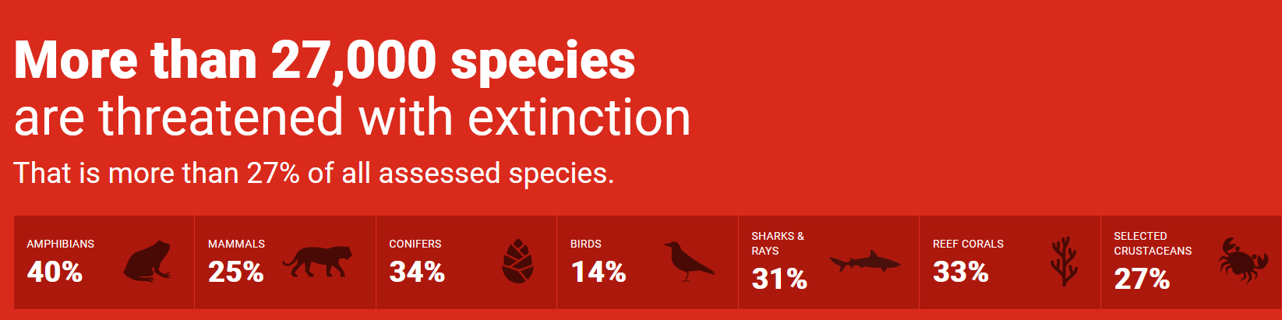
Species extinction
IUCN Red List (IUCN = International Union for Conservation of Nature)
Established in 1964, IUCN Red List is the world´s most comprehensive information source on the global conservation status of animal, fungi and plant species.
It provides information about range, population size, habitat and ecology, use and/or trade, threats and necessary conservation actions
Source: Project LIFE „Biodiversity in Standards and Labels for the Food Sector - Biodiversity: Status quo [1]
Source: Homepage ICUN Red List, 2019 [7]
Notes:
The International Union for Conservation of Nature (IUCN) redlist provides information about range, population size, habitat and ecology, use and/or trade, threats and necessary conservation actions
Established in 1964, IUCN Red List of Threatened Species has evolved to become the world´s most comprehensive information source on animal, fungi, and plant species' global conservation status.
To date, IUCN assessed 98,500 species for the IUCN Red List, detecting 27 00 species with extinction risk rapresent more that the 27% of the assessed species
This trend is because less space and resource means smaller number of individual in total and potential diversification, which is an irreversible change!

Slide 21
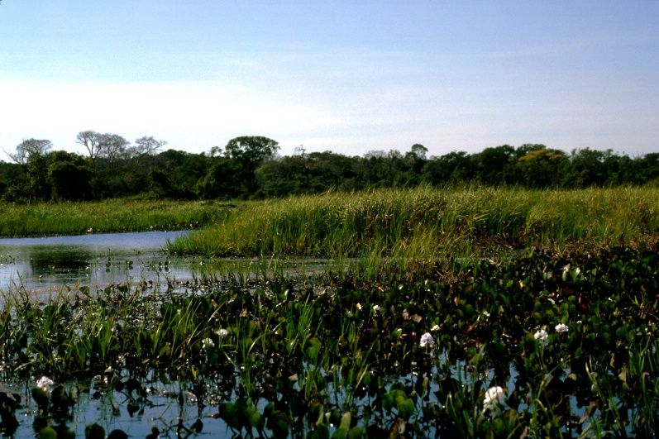
Why biodiversity is important?
Intrinsic/inherent value
Extrinsic/utilitarian/instrumental value
Land planner
Local communities
Lobbies
Government agency
Environmental group
Aquaculture company
Source: Center for Biodiversity and Conservation of the American Museum of Natural History, 2003 [10]
Notes:
Why biodiversity is important? This is mostly due to its intrinsic (also called inherent value) and extrinsic (also called utilitarian or instrument value.
Intrinsic value is in general The value of something independent of its value to anyone or anything else. It is a value independent of any benefit to humans.
Intrinsic value of biological diversity is initially ambiguous to which objects or characteristics of biological diversity have to being valued. For example if we are talking about all aspects of biological diversity in terms of species or ecosystems we can argue that intrinsic value of one species is often in conflict with the intrinsic value of other species.
Extrinsic in general defined all values that derive from something external to the thing valued.
Extrinsic value for biodiversity differs on the basis of external factors. Some species have trivial or negative extrinsic values. Moreover extrinsic value varies across human cultures and societies and with such factors as socioeconomic conditions, individual experiences, and educational backgrounds.
This way the extrinsic value is affected by several stakeholders or actors having a direct effect on biodiversity resource exploitation of use like: local communities, land planner, different lobbies, governmental and non-governmental agency.

Slide 22
Categorizing Values in biodiversity
Direct Use Value(Goods) | Indirect Use Value (Services) | Non-Use Values
Food Medicine Biological control building/industrial materials Fiber Fuel Ecotourism | Atmospheric and climate regulation Hydrogeological regulation Pollination Nutrient recycling Pest control Photosynthesis Genetic library Soil formation and maintenance Cultural, Spiritual and Aesthetic Community resilience | Potential (or Option) Value | Future value either as a good or service
 |  | Existence Value | Value of knowing something exists
 |  | Bequest Value | Value of knowing that something will be there for future generations
Source: Center for Biodiversity and Conservation of the American Museum of Natural History, 2003 [10]
Notes:
Talking about about direct use values we see in this slide an overall summary. Food and medicine represents one of those
About food production today, most people rely on aournd 20 types of plants, and only 3 to 4 are stable crops, and diversity is critical for developing new strains and breeds.
Regarding medicine about 80% of the people in developing countries use plants as a primary source of medicine. 57% of the 150 most-prescribed drugs have their origins in biodiversity
Indirect Use Values can be defined as both eco- and other types of services and regulating global processes, such as:
atmosphere and climate
Soil and water conservation
Nutrient cycling
Pollination and seed dispersal
Control of agricultural pests
Genetic library
Inspiration and information
Cultural, spiritual, and aesthetic
Community Resilience planning
Strategic

Slide 23
Agrobiodiversity
Notes:
Let’s not more concretely move to the concept of agrobiodiversity…

Slide 24
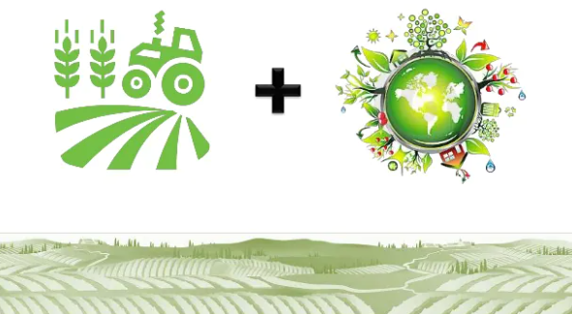
Biodiversity and Agrobiodiversity (1)
Agriculture
Biodiversity
Origin of all species of crops and domesticated livestock
Crop and livestock biodiversity result of human intervention
Biodiversity is critical for agriculture, and viceversa agriculture contributes to conservation and sustainable use of biodiversity
Sustainable agriculture both promotes and is enhanced by biodiversity
Ecosystem services essential to sustain agriculture and human well-being
Source: Threats to agrobiodiversity (Agricultural Biodiversity) - https://pt.slideshare.net/RaihanathusSahdhiyya/threats-to-agrobiodiversity-agricultural-biodiversity
Source: from Filipa Monteiro, Agrobiodiversity from definition to application, Training course
Notes:
We have seen as Biodiversity is essential to:
ensure the production of food, fibre, fuel, fodder;
maintain other ecosystem services;
allow adaptation to changing conditions - including climate change
sustain rural peoples' livelihoods .
Certainly, Biodiversity and agriculture are strongly interdependent for several in terms of different perspective.
Origin of all species of crops and domesticated livestock and the variety within them. it is also the foundation of ecosystem services essential to sustain agriculture and human well-being.
Today's crop and livestock biodiversity are the result of many thousands years of human intervention.
Biodiversity and agriculture are strongly interrelated because while biodiversity is critical for agriculture, agriculture can also contribute to the conservation and sustainable use of biodiversity.
Sustainable agriculture both promotes and is enhanced by biodiversity.
Ecosystem services essential to sustain agriculture and human well-being

Slide 25
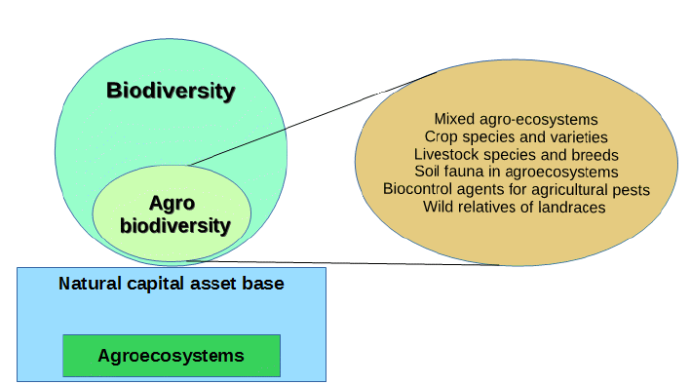
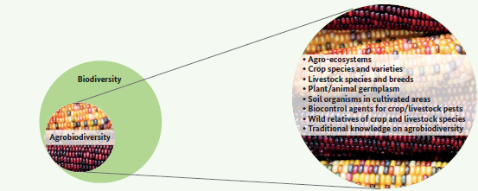
Biodiversity and Agrobiodiversity (2)
Agrobiodiversity is an important part of biodiversity
Agrobiodiversity…
vital sub-set of biodiversity
Source: Filipa Monteiro [12], Source: Warwick Wainwright, 2018 [13], FAO, 2006 [14]
Notes:
Agrobiodiversity is an important part of biodiversity
It is a vital sub-set of biodiversity. Many people's food and livelihood security depend on the sustained management of various biological resources that are important for food and agriculture.
Agrobiodiversity (as you can see in Figure) can be broadly defined as all domesticated biodiversity (namelly crops and livestock) within agricultural systems, plus non-domesticated biodiversity that interplay in various ways with the health and functioning of agricultural systems. The former role is declining primarily in response to farm intensification, which has eroded natural capital in many agroecosystems. Biodiversity and agrobiodiversity are underpinned by sustaining natural capital and agroecosystems. The various elements that comprise agrobiodiveristy are outlined
Agricultural biodiversity, also known as agrobiodiversity thus includes:
Harvested crop varieties, livestock breeds, fish species
non domesticated (wild) resources within field, forest, rangeland including tree products, wild animals hunted for food and in aquatic ecosystems (e.g. wild fish);
Non-harvested species in production ecosystems that support food provision, including soil micro-biota, pollinators and other insects such as bees, butterflies, earthworms, greenflies; and
Non-harvested species in the wider environment that support food production ecosystems (agricultural, pastoral, forest and aquatic ecosystems).

Slide 26
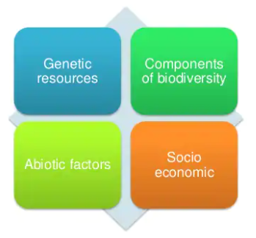
What is agrobiodiversity?
Biodiversity of agroecosystems along with species of crops and farm animals, and the genetic variance within populations, varieties and races
Components :
genetic resources for food and agriculture
biodiversity that supports ecosystem services of agriculture
abiotic factors, e.g., climate
socioeconomic and cultural dimensions (Zimmerer, 2014).
Source: Karl S. Zimmerer et. Al., 2018 [15]; Raihanathus Sahdhiyya A, 2019 [16]
Notes:
The term ‘agrobiodiversity’ was coined in the 1980s. According to UNCED (1992), it has evolved only in recent years in the wake of the general biodiversity discourse. Agrobiodiversity is the sub-set of general biodiversity directly developed and managed by humans. Analogous to the term biodiversity, agrobiodiversity encompasses different levels. It refers to the biodiversity of agroecosystems along with species of crops and farm animals, and the genetic variance within populations, varieties and races. Soil organisms, insects, fungi, and wild species from off-farm natural habitats as well as cultural and local knowledge on biodiversity form the basis of the exploitation of biodiversity.
Four principal components of agrobiodiversity exist:
genetic resources for food and agriculture;
biodiversity that supports ecosystem services of agriculture;
abiotic factors, e.g., climate; and
socioeconomic and cultural dimensions.

Slide 27
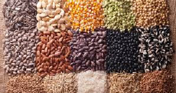
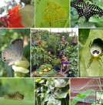
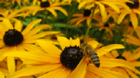
What is agrobiodiversity?
“…The variety and variability of animals, plants and micro-organisms, at the genetic, species and ecosystem levels, which are necessary to sustain key functions of the agroecosystem”
  It includes all components of biological diversity of relevance to food and agriculture, and all agricultural ecosystems
  Essential part of agrobiodiversity is the human activity of agriculture which conserves this biodiversity
  Results of interactions among genetic resources, the environment and the management systems and practices
Source: Filipa Monteiro, 2017 [12]
Notes:
Providing a general definition agrobiodiversity can be defined as “…The variety and variability of animals, plants and micro-organisms, at the genetic, species and ecosystem levels, which are necessary to sustain key functions of the agroecosystem”.
Agricultural biodiversity includes all components of biological diversity of relevance to food and agriculture, and all components of biological diversity that constitute the agricultural ecosystems. It defined as “the variety and variability of animals, plants and micro-organisms, at the genetic, species and ecosystem levels, which are necessary to sustain key functions of the agroecosystem.
It can be considered an essential part of agrobiodiversity as it is the human activity of agriculture which conserves this biodiversity.
Agrobiodiversity is the outcome of the interactions among genetic resources, the environment and the management systems and practices used by farmers and herders. It has developed over millennia, as a result of both natural selection and human interventions.

Slide 28
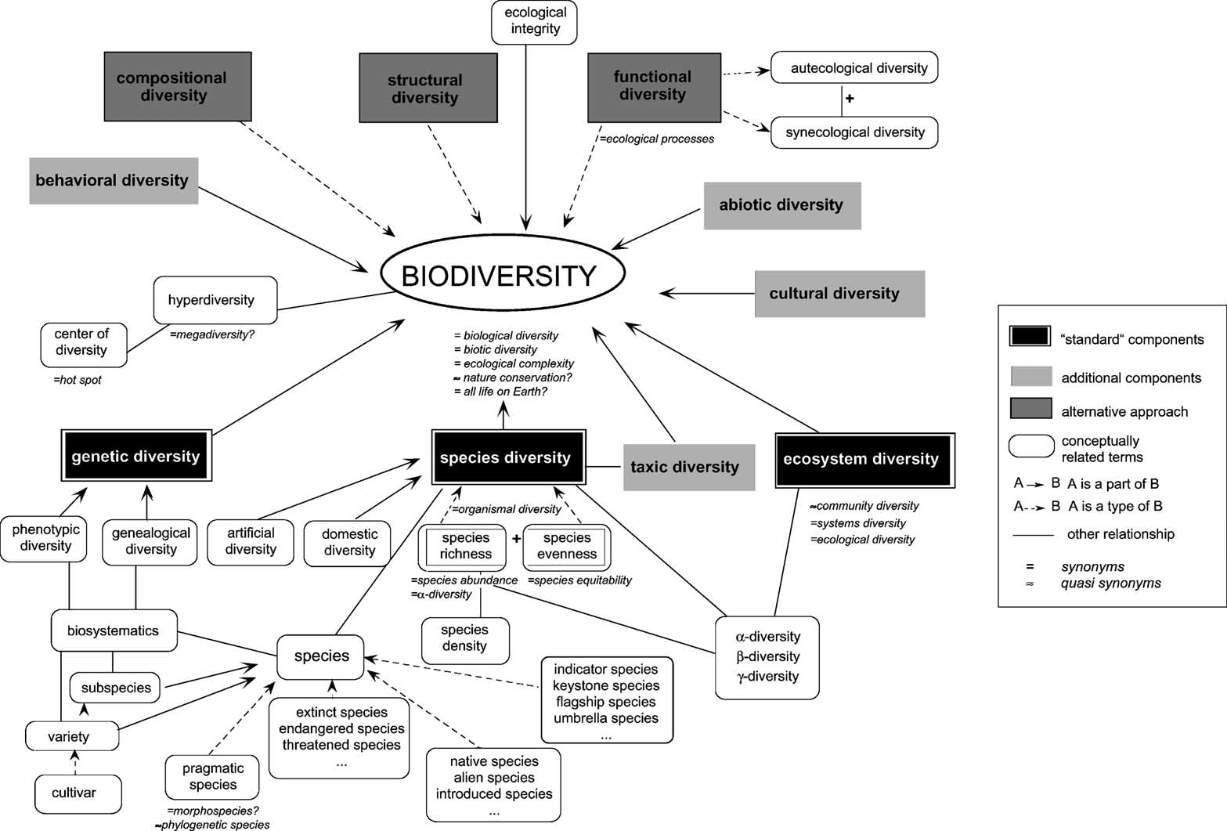
Agrobiodiversity is complex
Agrobiodiversity includes all crops and livestock, their wild relatives, and all interacting and supporting species (e.g.pollinators), in relation with pests, parasites, predators and competitors - comprehensive concept emphasizing crops and livestock - i.e. food production process.
Variety and variability of animals, plants and micro-organisms crucial for food and agriculture, originated from the interaction between the environment, genetic resources and the management systems and those practices used by people (FAO)
Agricultural expansion & intensification and reduction in the types and levels of ecosystem services led to biodiversity loss in agroecosystems
(AGRO)
Source: Peter Duelli and Martin K. Obrist, 2003 [20]
Source: Karl S. Zimmerer et. Al. 2018 [15]; Gcsnc [11]
Notes:
Agrobiodiversity is complex and this relied on the some definition given to agrobiodveristy
Agrobiodiversity includes all crops and livestock, their wild relatives, and all interacting and supporting species such as pollinators and symbiotic agents related to pests, parasites, predators, and competitors. In the current definition, agrobiodiversity refers to a comprehensive concept emphasizing crops and livestock.
The Food and Agriculture Organization (FAO) explains agrobiodiversity as the variety and variability of animals, plants and micro-organisms that are crucial for food and agriculture, and which originate from the interaction between the environment, genetic resources and the management systems and those practices used by people. In particular, it contains two categories:
the wild relatives of domesticated species (for example, wild relatives of crop species or species that are genetically usable breeding materials);
or breeding individuals of plants and domesticated animals (which in the case of crops, is referred as landraces. This FAO definition seems to be comprehensive and acceptable in many scientific communities.
Agricultural expansion and intensification led to biodiversity loss in agroecosystems and reduction in the types and levels of ecosystem services that people benefit from. Farmland biodiversity is a ground for provision of ecosystem services needed to sustain agriculture per se and the environment as a whole.

Slide 29
Agrobiodiversity is complex
Result of natural selection processes (e.g. adapting to changing weather patterns or particular land characteristics) engaged with the human dimension over millennia
It provides resources and processes embedded in farming systems under sustainable development
Allow to meet current food and nutrition needs
Result of the interaction between the environment, genetic resources and management systems and practices used by culturally diverse peoples.
It encompasses the variety and variability of animals, plants and micro-organisms that are necessary for sustaining key functions of the agro-ecosystem
Local knowledge and culture integral parts of agrobiodiversity
Source: FAO, 2006 [14]; Biodiversity International, 2017 [17]
Notes:
Understanding the complexity of the values and processes underlying the management of local genetic resources and related traditions is a fundamental step for both private and public stakeholders to take for agrobiodiversity resource conservation and sustainable valorization
Agricultural biodiversity is the result of natural selection processes (for example adapting to changing weather patterns or particular land characteristics) that have been intertwined with the careful selection and inventive developments of farmers, forest dwellers, hunter-gatherers, herders and shers over millennia (e.g. selecting for taste, ease of processing or harvesting).
Sustainable managing agricultural biodiversity provides resources and processes embedded in farming systems, which allow these systems to meet current food and nutrition needs, while having minimal negative impact on the environment and generating multiple ecosystem services.
Agrobiodiversity is the result of the interaction between the environment, genetic resources and management systems and practices used by culturally diverse peoples, and therefore land and water resources are used for production in different ways.
Thus, agrobiodiversity encompasses the variety and variability of animals, plants and micro-organisms that are necessary for sustaining key functions of the agro-ecosystem, including its structure and processes for, and in support of, food production and food security.
Local knowledge and culture can therefore be considered as integral parts of agrobiodiversity, because it is the human activity of agriculture that shapes and conserves this biodiversity

Slide 30
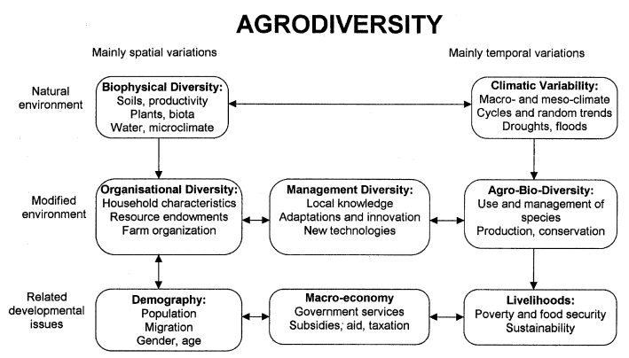
Components of agrobiodiversity
Source: H. Brookfield and M. Stocking, 1999 [21]
Notes:
Following the definitions above, it is essential to any understanding of agrobiodiversity to know
how farmers practices and circumstances affect different aspects of biological diversity ranging from genetic to the whole landscape; and
how biological diversity affects rural elements of society from individual livelihoods to households, communities and the wider economy.
Overlying this two-way interaction are different scales of operation, both spatially and temporally, and different degrees of modification of natural biological diversity.
The figures shows the conceptualization of the elements of agrodiversity according to Brookfield and their relationship with each other. Each element contains components that contribute to the main characteristics that would typify that particular element and the start of the construction of a potential agrodiversity database.

Slide 31
Trends and history of agrobiodiversity
Since the 1900s, some 75-percent of plant genetic diversity has been lost as farmers worldwide have left their multiple local varieties and landraces for genetically uniform, high-yielding varieties.
30-percent of livestock breeds are at risk of extinction; six breeds are lost each month.
Today, 75-percent of the world's food is generated from only 12 plants and five animal species.
Of the 4-percent of the 250-000 to 300-000 known edible plant species, only 150 to 200 are used by humans. Only three-rice, maize and wheat - contribute nearly 60-percent of calories and proteins obtained by humans from plants.
Animals provide some 30-percent of human requirements for food and agriculture and 12-percent of the world's population live almost entirely on products from ruminants.
Source: FAO, 2006 [14]
Notes:
Locally varied food production systems could be under threat, including local knowledge and the culture and skills of women and men farmers. With this decline, agrobiodiversity is disappearing; the scale of the loss is extensive. With the disappearance of harvested species, varieties and breeds, a wide range of unharvested species also disappear.
Figures and trends shows that more than 90 percent of crop varieties have disappeared from farmers' fields; half of the breeds of many domestic animals have been lost. In fisheries, all the world's 17 main fishing grounds are now being fished at or above their sustainable limits, with many fish populations effectively becoming extinct. Loss of forest cover, coastal wetlands, other “wild” uncultivated areas, and the destruction of the aquatic environment exacerbate the genetic erosion of agrobiodiversity.
More in specific:
Since the 1900s, some 75-percent of plant genetic diversity has been lost as farmers worldwide have left their multiple local varieties and landraces for genetically uniform, high-yielding varieties.
30-percent of livestock breeds are at risk of extinction; six breeds are lost each month.
Today, 75-percent of the world's food is generated from only 12 plants and five animal species.
Of the 4-percent of the 250-000 to 300-000 known edible plant species, only 150 to 200 are used by humans. Only three-rice, maize and wheat - contribute nearly 60-percent of calories and proteins obtained by humans from plants.
Animals provide some 30-percent of human requirements for food and agriculture and 12-percent of the world's population live almost entirely on products from ruminants.

Slide 32
Importance of agrobiodiversity
In agricultural systems biodiversity is important for:
for the production of food, fibre, fuel, fodder...(goods)
to conserve the ecological foundations to sustain life (life support function)
to allow adaptation to changing situations (like climate change, natural disaster, etc. …)
and to sustain rural peoples’ livelihoods (sustainable agriculture – food security, income, employment,...)
To support sustainability preserving ecosystem services
Specificity: it has been developed through human intervention over generations and it requires human management to sustain it
Notes:
Why it is important agrobiodiversity? In agricultural systems biodiversity is important for:
for the production of food, fibre, fuel, fodder...(goods)
to conserve the ecological foundations to sustain life (life support function)
to allow adaptation to change situations (like climate change, natural disaster, etc. …)
and to sustain rural peoples’ livelihoods (sustainable agriculture – food security, income, employment,...)
Biodiversity loss in the agricultural landscape affects not just the production of food, fuel, and fiber but also a range of ecological services supporting clean water supplies, habitats species and human health
There is a specific role played by agrobiodiversity: it has been developed through human intervention over generations and it requires human management to sustain it

Slide 33
Importance of agrobiodiversity
Experience and research have shown that agrobiodiversity can:
Increase productivity, food security, and economic returns
Reduce the pressure of agriculture on fragile areas, forests and endangered species
Make farming systems more stable, robust, and sustainable
Contribute to sound pest and disease management
Conserve soil and increase natural soil fertility and health
Contribute to sustainable intensification
Diversify products and income opportunities
Reduce or spread risks to individuals and nations
Help maximize effective use of resources and the environment
Reduce dependency on external inputs
Improve human nutrition and provide sources of medicines and vitamins
Conserve ecosystem structure and stability of species diversity
Source: Filipa Monteiro, 2017 [12]
Source: FAO, 2006 [14]
Notes:
Experience and research have shown that the role of agrobiodiversity can be defined in terms of:
Increase productivity, food security, and economic returns,
Reduce the pressure of agriculture on fragile areas, forests and endangered species,
Make farming systems more stable, robust, and sustainable,
Contribute to sound pest and disease management,
Conserve soil and increase natural soil fertility and health,
Contribute to sustainable intensification
Diversify products and income opportunities
Reduce or spread risks to individuals and nations
Help maximize effective use of resources and the environment,
Reduce dependency on external inputs
Improve human nutrition and provide sources of medicines and vitamins, and,
Conserve ecosystem structure and stability of species diversity

Slide 34
Sustainable Development Goals: Linking the biosphere to sustainable and healthy food
Source: Biodiversity International, 2017 [17]
Notes:
What is nowadays required is a fundamentally different model of agriculture based on diversifying farms and farming landscapes.
There is a general consensus that business as usual is not working, and it is time for a paradigm shift. The 2030 Agenda and its Sustainable Development Goals provide such a framework, which focuses on achieving multiple benefits at the same time – for example:
including nutrition goals in farming systems;
increasing yields without increasing the levels of inorganic and synthetic chemicals in the system;
shaping landscapes which create positive synergies between wild and cultivated lands;
improving environmental integrity while reducing poverty and gender inequality.
The Sustainable Development Goals are indivisible and not hierarchical. However, none of the social and economic goals can be achieved if there is an inadequate natural physical resource base to sustain human life.
In this representation of the Sustainable Development Goals, the economy serves society, and both depend on the integrity of the biosphere. In this vision, all the Sustainable Development Goals are directly or indirectly connected to a sustainable product value chain still preserving agrobiodiverisity.

Slide 35
Components of agrobiodiversity
Habitat diversity
Inter-species diversity
Intra-species diversity
Harvested species
Cultural diversity
Socio economic
Understand the implication in ecosystem
Source: FAO, 2006, [14]; Gcsnc [11]
Notes:
How can we describe the components of agrobiodiversity? These can be differentiated in terms of:
Habitat diversity – land use varies with soil and terrain. Hedges, borders, three in the land scape and farm type
Inter-species diversity – different species of plan, animal and microbial
Intra-species diversity – very important for agrobiodiversity including genetic resources and unique traits like resistance to drought, cold, disease and other aspects like rooting, taste and storage
Harvested species and associated species: species used for food (e.g. rice, maize), pollinators, beneficial or harmful predators, soil organisms.
Socio economic and cultural diversity include: traditional and local knowledge of agrobiodiversity, cultural factors ….in terms of type of farmer and farm, regulations, common property, resources an ownerships, tourism connect agricultural land scale
And understanding the implication of agrobiodiversity in ecosystem systems within specific functions and processes and services provided

Slide 36
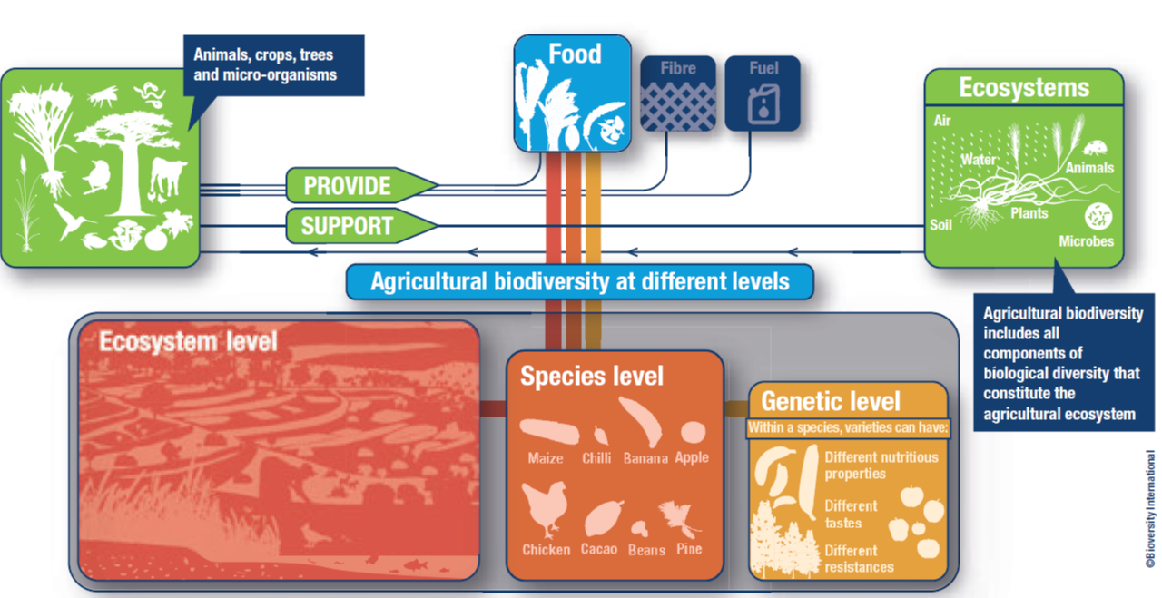
Components of agrobiodiversity
Source: Agrobiodiversity platform [19]
Notes:
As said Agricultural biodiversity is defined as “the variety and variability of animals, plants and micro-organisms that are used directly or indirectly for food and agriculture, including crops, livestock, forestry and fisheries”
As it possible to see there are several key components and dynamics affecting agrobiodiversity.
Agrobiodiversity can be identified at levels:
ecosystem levels (in terms of landscapes, bioregions, landscapes, biomes, habitats and populations),
species or organismal levels (in terms of kingdome, phyla, families, genera, species, subspecies and populations),
genetic diversity (individuals, genes) thus the variation which a species can have
As it is possible to see from the picture the variety of crops, animals has certain values providing specific product on one side and on the other regulating ecosystems and ecosystem services
Agricultural biodiversity is a critical component of a sustainable food system. Without agricultural biodiversity, a food system cannot be sustainable.
What we need is to be able to produce a wide variety of nutritious foods while having minimal impact on the environment in terms of a sustainable food system.
The loss of agricultural biodiversity in our global food production systems is an issue of increasing concern, recognized by the Rio Convention on Biological Diversity and the Sustainable Development Goals of the United Nations.
When we lose agricultural biodiversity, we also lose the options to make our diets healthier and our food systems more resilient and sustainable.

Slide 37
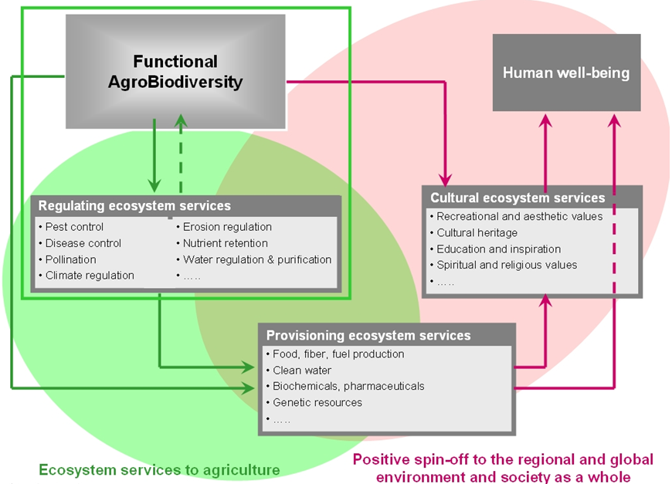
Functional Agrobiodiversity
“… those elements of biodiversity on the scale of agricultural fields or landscapes, which provide ecosystem services that support sustainable agricultural production and can also deliver benefits to the regional and global environment and the public at large”
ECNC-European Centre for Nature Conservation
Source: ELN-FAB, 2012 [22]
Notes:
Here it come the concept of Functional AgroBiodiversity. Functional AgroBiodiversity provides regulating, provisioning and cultural ecosystem services that are essential for human well-being. Positive synergies often exist among regulating, provisioning and cultural services and with biodiversity conservation as can be seen from this conceptual diagram. The green area in the diagram highlights the core focus of the European Learning Network. The red area highlights positive spin-off of Functional AgroBiodiversity to the local (e.g. water quality, recreation) and global environment (e.g. climate change) and society as a whole. The graph is adapted from the Millennium Ecosystem Assessment (2005). Supporting services are not included as they are not directly used by the people.
The concept of functional agrobiodiversity is increasingly being used as a framework in scientific research, policymaking and on-farm implementation.
Functional agrobiodiversity (FAB) refers to ‘those elements of biodiversity on the scale of agricultural fields or landscapes, which provide ecosystem services that support sustainable agricultural production and can also deliver benefits to the regional and global environment and the public at large’.
Important relationships between agriculture and FAB which could be taken into account by agro-environmental measures
As described in the conceptual scheme Functional agrobiodiversity plays an Important role towards regulating and supporting services to agriculture and farming. Six main key ecosystems roles or services can be distinguished: Pollination, disease suppression and pest control, nutrient regulation, water regulation and erosion control as well as soil structuring. Each of these ES depends on healthy soils and diverse soil organism communities.

Slide 38
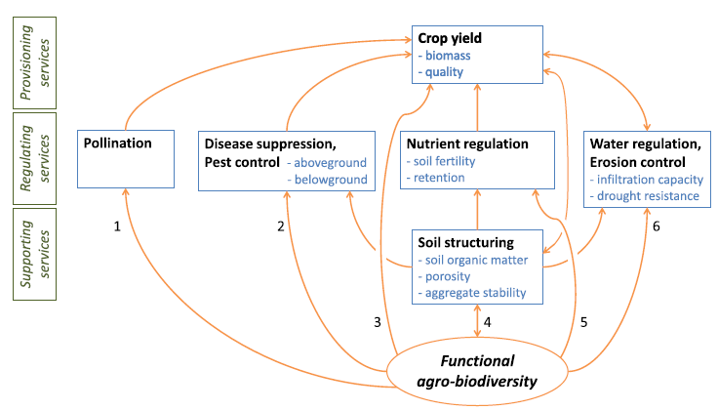
Contributions of functional agrobiodiversity to ecosystem services for agriculture
Source: Elke Plaasa et al., 2019 [23]
Notes:
As also described in the previous conceptual scheme Functional Agricultural biodiversity (FAB) supports agricultural production guarantying:
Direct contributions to the crop yield by pollination, mainly by insects, but also mammals and birds, some pollinating insects have below-ground larval stages. Wild agrobiodiversity also plays an important supplementary role. A significant portion of fruit production is dependent on pollination by insects.
biological pest control by parasitism and predation, often made by insects which may have below-ground larval stages or use soil animals as alternative prey; natural enemies of plague insects can help to keep them below the damage threshold, so that the use of crop protection products is limited or not necessary; disease can be controled by fungi and bacteria, indirectly also by soil animals such as earthworms;
nutrient regulation of soils and crops e.g. by nitrogen-fixing bacteria, efficient uptake of nutrients via mycorrhiza; a provisional service is genetic diversity as a prerequisite for the ability to adapt. It is vitally important to maintain genetic diversity, in order for agricultural crops and livestock to be able to adapt – naturally or with human intervention – to future needs and challenges.
Soil organisms ensure the maintenance and development of good soil structure, with positive effects on water regulation, erosion, leaching, etc. the favourable soil structure is made by fungi, bacteria, earthworms and other soil animals; moreover aeration and creation of soil pores by burrowing soil animals allows easy soil penetration and growth of plant roots. Moreover natural and semi-natural vegetation in the agricultural landscape can help in erosion control, relieve heat stress in cattle, etc. It also provides a habitat for other useful organisms, such as natural enemies of plague species, and it determines the appearance of the landscape.
decomposition and mobilisation and immobilisation of nutrients by microorganisms decomposing organic matter and mineralizing nutrients, processes which are mediated by soil animals (e.g. via bioturbation, litter fragmentation and translocation of plant remains);
regulate soil water-drainage and moisture holding capacity . Double sided arrows indicate mutual dependency of services; these may result in synergies or trade-offs.

Slide 39
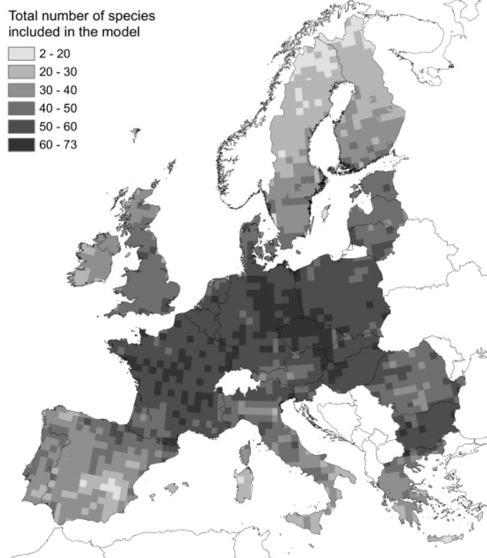
Status of agrobiodiversity
Great variability in EU
Sum of the species occurrence maps for the 132 species included in the analysis per 50 km grid cell
Source: Karl S. Zimmerer, 2018 [15]
Source: Overmars, et al., 2014 [24]
Notes:
The status of agrobiodiversity varies importantly at EU level.
Looking at the study of Overmarset in 2014 it is possible to see how agrobiodiversity, here defined as the total number of species, presents a wide range.
The study of Overmarset in 2014 based on Sum of the species occurrence maps for the 132 species included in the analysis per 50 km grid cell revealed that the state of the overall biodiversity in agriculture is better in the southern and eastern parts compared to the western and northern part of the European Union (EU). They adopted a species-oriented methodology enabling spatially explicit indicator for biodiversity quantification on agricultural lands. The provided map demonstrates great variety in the state of the biodiversity of agricultural areas in the EU.

Slide 40
Loss of agrobiodiversity
Agrobiodiversity has co-evolved with farming systems and breeding systems
Agrobio biodiversity is being lost as:
  Farming production systems shifted to more intensive production
  Traditional agricultural practices and knowledge are displaced and undervalued
  Climate change and land-use changes accelerate land degradation
  Value chains are under pressure to provide standard products year round in any country and any season
Conservation approaches have been developed to system biodiversity loss and seed systems to guarantee sure that biodiversity is not only conserved
Source: Agrobiodiversity platform [19]
Notes:
Because agricultural biodiversity has co-evolved with farming and breeding systems, so it is already deeply integrated within these systems. Therefore, increasing what we know about agricultural biodiversity, its components, and their interactions can help countries leverage their existing resources and knowledge for integrated nutrition and environmental outcomes.
Agricultural biodiversity is, however, under threat. Despite the many benefits it provides, agricultural biodiversity is being lost as:
Farming production systems have shifted to more intensive production practices which rely on fewer varieties, genes or species
Traditional agricultural practices and knowledge are displaced (by intensive, external input-based management practices) and undervalued
Climate change and land-use changes accelerate land degradation
Value chains are under pressure to provide standard products year round in any country and any season.
Conservation approaches have been developed to stem agrobiodiversity loss and strengthen seed systems to ensure that agrobiodiversity preservation, availability and accessibility when and where it is needed.

Slide 41
Loss of agrobiodiversity
The rapid expansion of industrial and Green Revolution agriculture
Globalization of the food system and marketing, with the consequences of:
  changes in farmers' and consumers' perceptions, preferences and living conditions
  marginalization of small-scale, diverse food production systems that conserve farmers' varieties of crops and breeds of domestic animals
  reduced integration of livestock in arable production, which reduces the diversity of uses for which livestock are needed
Reduced use of “nurture” fisheries techniques that conserve and develop aquatic biodiversity
Replacement of local varieties by improved or exotic varieties and species
Source: FAO, 2006 [14]
Notes:
There are many reasons for this decline in agrobiodiversity. The decline has accelerated throughout the 20th century and increased demands from a growing population and greater competition for natural resources. The principal underlying causes include:
The rapid expansion of industrial and Green Revolution agriculture. This includes intensive livestock production, industrial fisheries and aquaculture. Some production systems use genetically modified varieties and breeds. Moreover, relatively few crop varieties are cultivated in monocultures and a limited number of domestic animal breeds, or fish, are reared or few aquatic species cultivated.
Globalization of the food system and marketing. The extension of industrial patenting, and other intellectual property systems, to living organisms has led to the widespread cultivation and rearing of fewer varieties and breeds. This results in a more uniform, less diverse, but more competitive global market. As a consequence there have been:
changes in farmers' and consumers' perceptions, preferences and living conditions;
marginalization of small-scale, diverse food production systems that conserve farmers' varieties of crops and breeds of domestic animals;
reduced integration of livestock in arable production, which reduces the diversity of uses for which livestock are needed; and,
Reduced use of “nurture” fisheries techniques that conserve and develop aquatic biodiversity.
The main cause of loss of variability from crop populations (also called genetic erosion of crops)is the replacement of local varieties by improved or exotic varieties and species. Frequently, genetic erosion occurs as old varieties in farmers' fields are replaced by newer. Genes and gene complexes, found in the many farmers' varieties, are not contained in the modern. Often, the number of varieties is reduced when commercial varieties are introduced into traditional farming systems.

Slide 42


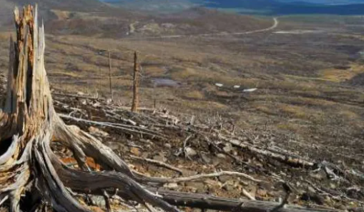
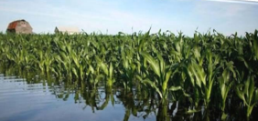
Loss of agrobiodiversity: threats
Climate change
Population growth
Cultural change
Environmental pollution
Deforestation
Natural disaster
Overgrazing
Overharvesting
Desertification
Eutrophication
Source: Raihanathus Sahdhiyya A., 2019 [16]; Barry Hoogezand, 2013 [25]
Notes:
The main global threats to which agrobiodiversity is exposed are:
Climatic Change including global warming, which have an effect on the provision on service for example like food production in terms of food provision security availability, access absorption
Population Growth and Overpopulation, which depends on the way resources are used and distributed amongst the population
Cultural change, in an urban – industrialization era culture Farmers' attitudes and desires are influenced by their society's culture, moreover Cultural changes could have an effect on field appliances and bring introduction of new crops
Other threats are represented by:
Environmental pollution and use of pesticides which indirectly bring to acidification problems
Deforestation decreasing the size of the arable land and thus diversity. Clearing the Earth's forests on a large scale worldwide and resulting in many land damages. One of the causes of deforestation is to clear land for pasture or crops
Natural disaster to which fiels crops or livestock are exposed to
Overgrazing - Overgrazing can be defined as the practice of grazing too many livestock for too long a period on land unable to recover its vegetation, or of grazing ruminants on land not suitable for grazing as a result of certain physical parameters such as its slope. Overgrazing exceeds the carrying capacity of a pasture thus not giving the possibility to provide an ecosystem service with loss of biodiversity
Overharvesting “that refers to the harvesting of a renewable resource like plants, fish stocks, forests, grazing pastures, and game animals. Sustained overharvesting is one of the primary threats to biodiversity bring leading to resource destruction, including extinction at the population level and even extinction of whole species.
Desertification. Desertification is caused by reduction of biodiversity and causes further reduction of biodiversity. Reduction of biodiversity reduces carbon sinks hence increasing climate change. Thus, it is the loss of biodiversity that initiates the vicious circle of desertification-global warming-further loss of biodiversity
Eutrophication is process by which a water body becomes enriched in dissolved nutrients (such as phosphates) that stimulate the growth of aquatic plant life usually resulting in the depletion of dissolved oxygen. The eutrophication in an aquatic ecosystem causes significant changes in biodiversity. Eutrophication leads to changes in the availability of light and certain nutrients to an ecosystem. This causes shifts in the species composition so that only the more tolerant species survive and new competitive species invade and out-compete original inhabitants.
Thus non-living factors that affect agrobiodiversity are thus climatic and chemicals

Slide 43
Threats: land degradation
Landscapes simplification due to changing patterns of land use
Land use might decrease species abundance and this decrease species abundance
Links between people and surrounding environment can be not harmonized
Need of a systemic and systematic conservation plan, assessments of lands impact
Several approaches developed
Source: Karl S. Zimmerer et. Al., 2018 [15]; Dunja Mijatovic, 2016 [26]
Notes:
In this slide we are going to explain a bit more about land degradation.
Landscapes around the world are undergoing simplification due to changing patterns of land use. Changing land-use practices can result in a reduction of agrobiodiversity —crop, livestock and aquatic diversity and the biodiversity associated with ecosystem functions, such as pollination and soil productivity. Land-use changes that take insufficient account of their consequences for agrobiodiversity may lead to the loss of landscapes’ capacity to support sustainable production and rural livelihoods
Although land use activities have positive effects on biodiversity of a region in many cases, land use might also lead to decreasing species abundance. The interrelationship between land use and biodiversity is vital to harmonize the links between people and surrounding environment.
Landscapes around the world are undergoing simplification due to changing patterns of land use. Changing land-use practices can result in a reduction of agrobiodiversity —crop, livestock and aquatic diversity and the biodiversity associated with ecosystem functions, such as pollination and soil productivity. Land-use changes that take insufficient account of their consequences for agrobiodiversity may lead to the loss of landscapes’ capacity to support sustainable production and rural livelihoods
The biodiversity concept along with the overall richness of species, present in a particular area, covers the diversity of genotypes, functional groups, communities, habitats and ecosystems. Consequently, there is a complex relationship between biodiversity and land use. These dual relationships are often bilateral and thus identification and justification of cause and effect relationships are difficult. In some places, land use plans or land management activities may be crucial for sustaining specific patterns of biodiversity such as urban forest and urban agriculture.
To attain a systemic and systematic conservation plan, assessments of lands impact are required.

Slide 44
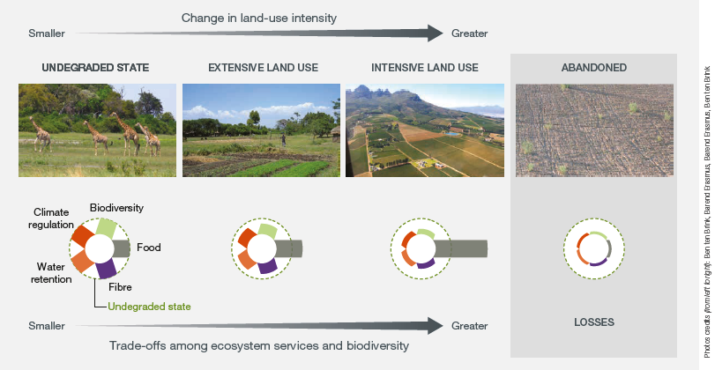
Threats: land degradation
Land degradation
Source: Project LIFE „Biodiversity in Standards and Labels for the Food Sector”, Biodiversity: Status quo [1]; Source: ipbes, 2018 [27]
Notes:
An effect of land degradation is presented in this Picture due to an overand intnsive use of land
This figure shows the trade-offs among ecocsystem services and biodiersity with land use intensification, using food production as an example. In this specific example as food production increases, there is a decreas in other ecosystem services and biodiverstiy (illustrated by reduced bars) as compared to the undegraded state. In extreme cases, land has been degraded to the point of abandonment (right panel), thus providing less of all ecosystems services. This pattern generally applies to all ecosystems and land-use types.

Slide 45
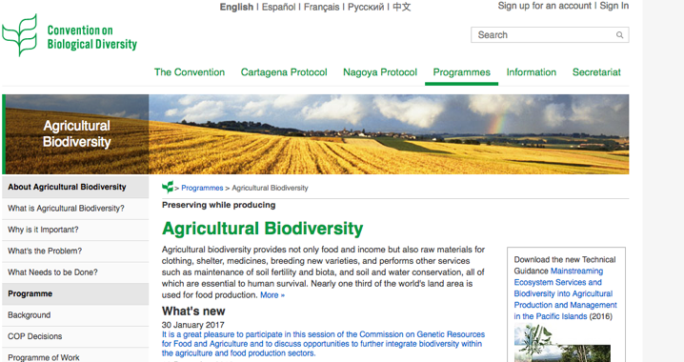
Dimensions of agrobiodiversity
The Convention on Biological Diversity (CBD) represents the conservation of biological diversity, the sustainable use of its components, and sharing of benefits arising from the use of genetic resources
Agrobiodiversity based on four dimensions as genetic resources for food and agriculture for:
PLANT
ANIMAL
MICROBIAL
FUNGI
Source: CBD, https://www.cbd.int/
Source: Filipa Monteiro, 2017 [12]
Notes:
The Convention on Biological Diversity was inspired by the world community's growing commitment to sustainable development. It represents the conservation of biological
diversity, the sustainable use of its components, and sharing of benefits arising from the use of genetic resources.
According to The Convention on Biological Diversity , agrobiodiversity is comprised of four dimensions
PLANT
ANIMAL
MICROBIAL, and
and FUNGI

Slide 46
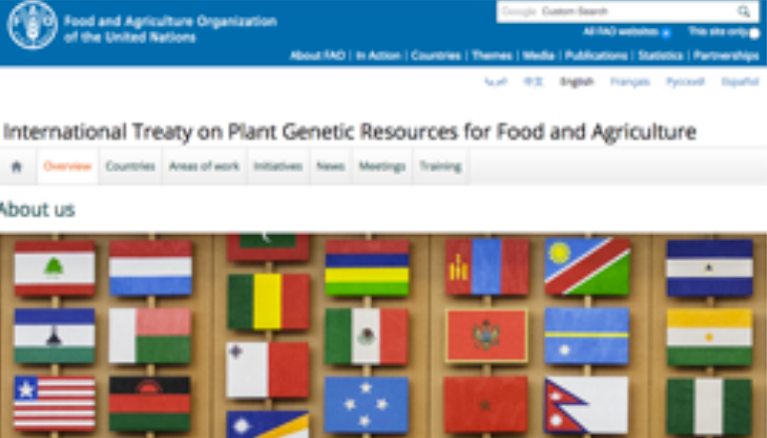
Genetic resources for food and agriculture: PLANT
It includes:
crops
wild plants harvested and managed for food
trees on farms
pasture and rangeland species
The International Treaty on Plant Genetic Resources for Food and Agriculture- 2001 aims to:
1. recognizing the enormous contribution of farmers to the diversity
2. establishing a global system to provide farmers, plant breeders and scientists
3. ensuring that recipients share benefits they derive from the use of these genetic materials with the countries where they have been originated
Source: Filipa Monteiro, 2017 [12]
Notes:
Looking such dimensions with particular attention for the food and agriculture plant genetic resources, includes crops, wild plants harvested and managed for food, trees on farms, pasture and rangeland species.
With referring to The International Treaty on Plant Genetic Resources for Food and Agriculture- 2001 there are specific aims
The Treaty facilitates access to the genetic materials of the 64 crops in the Multilateral System for research, breeding and training for food and agriculture.
The Treaty aims at:
1. recognizing the enormous contribution of farmers to the diversity of crops that feed the world;
2. establishing a global system to provide farmers, plant breeders and scientists with access to plant genetic materials;
3. ensuring that recipients share benefits they derive from the use of these genetic materials with the countries where they have been originated.

Slide 47
Genetic resources for food and agriculture: ANIMAL
It includes:
all animal species,
breeds and strains that are of economic, scientific and cultural interest to humankind (i.e. food and agricultural production)
More than 40 species of animals that have been domesticated (or semi-domesticated) in the last 10 to 12 thousand years by:
Direct contribution (through animal products used for food and fibre)
Indirect contribution (through functions and products such as draft power, manure, transport, store of wealth etc.)
Source: Animal genetic Training course [28]
Source: Filipa Monteiro, 2017 [12]
Notes:
Animal genetic resources (AnGR) is used to include all animal species, breeds and strains that are of economic, scientific and cultural interest to humankind in terms of food and agricultural production for the present or the future..
Another equivalent term increasingly used is farm animal genetic resources.
More than 40 species of animals that have been domesticated (or semi-domesticated) during the past 10 to 12 thousand years which contribute directly (through animal products used for food and fibre) and indirectly (through functions and products such as draft power, manure, transport, store of wealth etc.)
In the picture …

Slide 48
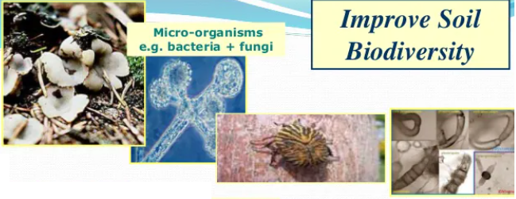
Genetic resources for food and agriculture: MICROBIAL
Microorganisms include:
all living organisms other than plants and animals
mostly microscopic cellular organisms (i.e. bacteria, mycoplasmas, protozoa, fungi and some algae)
Key issues:
Lack of information of microorganism diversity
lack of research programs related to their role in ecosystem functions
difficult to detect early changes in ecosystems without proper techniques (e.g. example is drinking water testing for microbial contamination
Source: Filipa Monteiro, 2017 [12]
Notes:
Microorganisms include all living organisms other than plants and animals and are mostly microscopic cellular organisms that include bacteria, mycoplasmas, protozoa, fungi and some algae.
As we said soil microrganisms ensure the maintenance and development of good soil structure, with positive effects on water regulation, erosion, leaching, etc. In addition, a healthy soil ecosystem ensures the release of nutrients and better disease resistance, which are essential to good crop development. Moreover they have a function of nutrient regulation of soils and crops e.g. by nitrogen-fixing bacteria, efficient uptake of nutrients.
There are some key issue regarding such genetic resource like:
Lack of information of microorganism diversity, combined to
Lack of research programs related to their role in ecosystem functions.
Moreover it is difficult to detect early changes in ecosystems without proper techniques. One example is drinking water testing for microbial contamination.

Slide 49
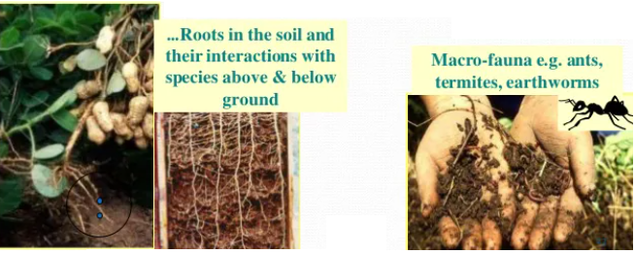
Genetic resources for food and agriculture: MICROBIAL and FUNGI
Fungi:
vital roles in ecosystem functions
influence on humans and human-related activities
Crucial activities:
decomposition
nutrient cycling
nutrient transport
Key role for sustainable development
Source: Filipa Monteiro, 2017 [12]
Notes:
Fungi are among the most important organisms in the world, not only because of their vital roles in ecosystem functions but also because of their influence on humans and human-related activities.
Fungi are essential to such crucial activities as decomposition, nutrient cycling, and nutrient transport and are indispensable for achieving sustainable development.

Slide 50
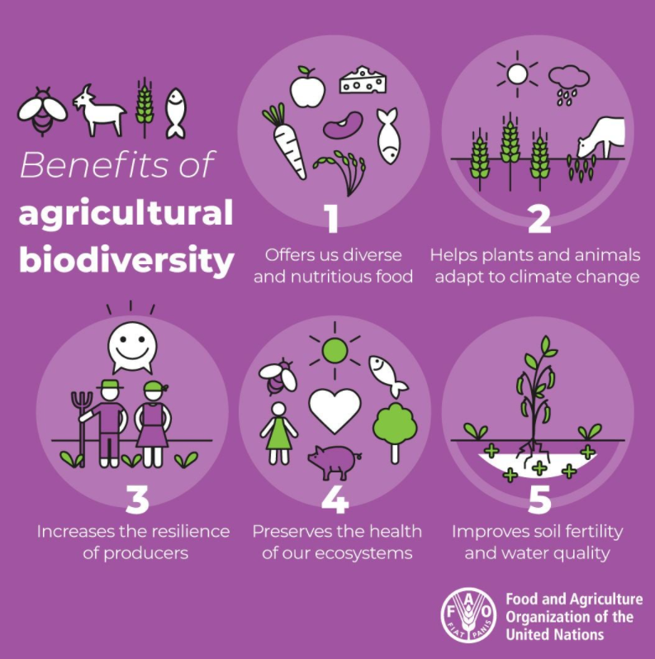
Benefits in agrobiodiversity
Offer a diverse nutritious food
Support plants and animal adapting to climate changes
Increase resilience of producers
Preserve human health and ecosystems
Improve soil fertility and water quality
Source: Agrobiodiversity platform [19]
Notes:
FAO proposes 5 main the benefits provided by agrobiodiversity:
Offering a diverse nutritious food necessary to provide source of food and nutrition to human, livestock and cultivated plants,
Support plants and animal adapting to climate changes
Increase resilience of producers
Preserve human health and ecosystems
Improve soil fertility and water quality
Moreover should be also considered as benefits:
The medical and health value
The genetic resource provided for plant and animal
The overall taxonomy knowledge
And of course the overall socio-economic to support livelihood
We will now have an emphasis on ecosystems services in the next slides

Slide 51
Benefits in agrobiodiversity by agricultural practices based on biodiversity
Reduction of soil erosion (i.e. hedgerows, cover crops, agroforestry or intercropping)
Pest and diseases controlled by selecting plants
Greater diversity in landscapes (i.e. patches of trees, wild vegetation, oral strips)
Crop diversity, enhancing wild biodiversity conservation
Soil quality (i.e. crops rotation)
Yield (i.e. patches of trees, wild vegetation, oral strips )
Diversification (increased resilience)
Source: Biodiversity International, 2017 [17]
Notes:
We already saw how the scheme of Functional Agricultural biodiversity (FAB) described the benefits towards agrobiodiveristy preservation. Here we can will say something more about agricultural practices based on biodiversity
Using agricultural practices based on biodiversity – genetic, varieties, species, soil and landscapes – can increase yields, and reduce waste and dependencies on external inputs.
• Soil erosion can be reduced by using agricultural biodiversity practices, such as hedgerows, cover crops, agroforestry or intercropping. In Indonesia, intercropping coffee trees with vegetables in hilly areas led to a 64% reduction in soil erosion, and no decrease in coffee yield.
• Pest and diseases can be controlled by selecting plants that increase the number of pest predators, or by using pest or disease resistant varieties.
• Greater diversity in landscapes – with patches of trees, wild vegetation, oral strips – leads to more diverse pollinators. Organic elds worldwide have been found to host about 70% more bees and 50% more kinds of bees than conventional elds.
• Crop diversity, increased vegetation diversity and certain agroecological practices enhance wild biodiversity conservation.
• Soil quality. Cropping systems with high agricultural biodiversity from crop rotations, displayed increased soil carbon by 28%–112% and nitrogen by 18%–58% compared with those with low agricultural biodiversity.
• Yield. with patches of trees, wild vegetation, oral strips corn and soybean systems by adding crop rotations while reducing tillage increased yield by 7% and 22% respectively.
• Diversity among and within species increases resilience to environmental fluctuations because they respond differently to change or create beneficial synergies.

Slide 52
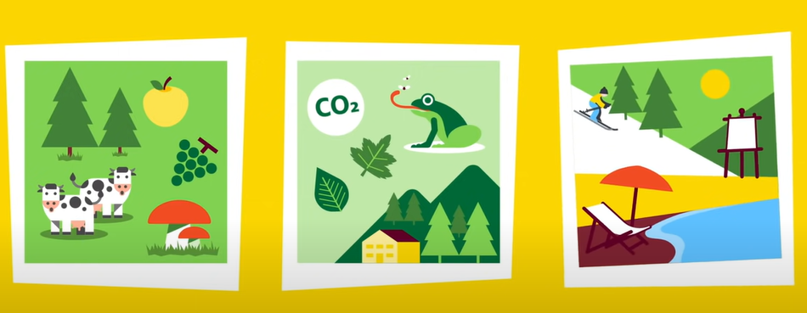
Agricultural biodiversity and Ecosystem services
Ecosystem services are defined as:
“the benefits people obtain from ecosystems. These include services such as food, water, timber and fibre (provisioning); services that affect climate, floods, disease, wastes and water quality (regulating); services that provide recreational, aesthetic and spiritual benefits (cultural). The human species, while buffered against environmental changes by culture and technology, is fundamentally dependent on the flow of ecosystem services.”
Source: https://www.youtube.com/watch?v=r7UCAsBT5Yg [30]
Source: Biodiversity International, 2017 [17]
Notes:
Let’s now to have a closer look about the link among agricultural biodiversity and ecosystem services.
Ecosystem services as defined as “those benefits people obtain from ecosystems. These include services such as food, water, timber and fibre (provisioning); services that affect climate, floods, disease, wastes and water quality (regulating); services that provide recreational, aesthetic and spiritual benefits (cultural). The human species, while buffered against environmental changes by culture and technology, is fundamentally dependent on the flow of ecosystem services.”

Slide 53
Agricultural biodiversity and Ecosystem services: a capital-based framework
Range of services that are of fundamental importance to human well-being, health, livelihoods, and survival [29].
Benefits that people obtain from ecosystems or as the direct and indirect contributions of ecosystems to human well-being [29]
Ecosystem services (ES) as contributions of ecosystem structure and function (in combination with other inputs) to human well-being
Contribution of the natural capital to human wellbeing, which forms only by interaction with human, social and built capital
Source: Anda Ruskule et al., 2016 [29]
Notes:
Ecosystems have potential to supply a range of services that are of fundamental importance to human well-being, health, livelihoods, and survival
Different ways of defining ecosystem service have been developed so far – they can be described as the benefits that people obtain from ecosystems or as the direct and indirect contributions of ecosystems to human well-being
More recent publications define the ecosystem services (ES) as contributions of ecosystem structure and function (in combination with other inputs) to human well-being

Slide 54
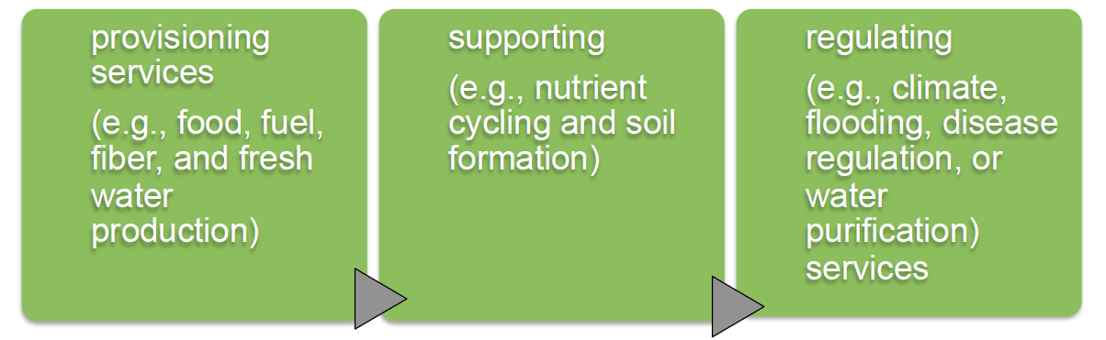
Agricultural biodiversity and Ecosystem services: a supporting role (1)
It includes diverse range of organisms that contribute to:
nutrient cycling
pest and disease regulation
pollination, pollution and sediment regulation
maintenance of the hydrological cycle
erosion control
carbon sequestration
climate regulation
Economic assessment of services
(including agrobiodiversity)
Cultural and non-material services
Notes:
As it can be seen also in the figure the components of agrobiodiversity that support ecosystem services upon which agriculture is based include a diverse range of organisms that contribute to nutrient cycling, pest and disease regulation, pollination, pollution and sediment regulation, maintenance of the hydrological cycle, erosion control, carbon sequestration and climate regulation.
The economic assessment of services provided by agrobiodiversity at the landscape level is affected by the combination of different types of agricultural and non-agricultural ecosystems.
In specific there are 4 main categories describing the ecosystem services: provision services, regulating services, supporting services, and cultural services

Slide 55
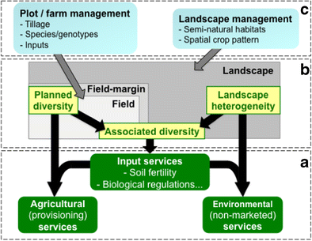
Agricultural biodiversity and Ecosystem services: a supporting role (2)
Four categories
provisioning services (i.e. products obtained from ecosystems)
regulating services (climate, floods, drought,..) and resilience
Supporting services (i.e. feedback services)
cultural services and non-material benefits
Michel Duru et al., 2015 [31]
Notes:
Mostly based on the Millennium Ecosystem Assessment (MEA) ecosystem services there are 4 types of categories that can be defined as:
provisioning services (i.e., products obtained from ecosystems such as food, forage, feed, fiber, and fuel), A good that humans can use directly. Examples of provisions include lumber, food crops, medicinal plants, natural rubber, and furs.
regulating services (e.g., climate regulation), Natural ecosystems help to regulate environmental conditions. Natural ecosystems, such as tropical rainforests and oceans, remove carbon from the atmosphere. Ecosystems also are important in regulating nutrient and hydrologic cycles.
Resilience depends greatly on species diversity. For example, several different species may perform similar functions in an ecosystem, but differ in their susceptibility to disturbance. If a pollutant kills one plant species that contains nitrogen-fixing bacteria, but not all plant species that contain nitrogen-fixing bacteria, the ecosystem can still continue to fix nitrogen
Supporting services. i.e. feedback services, that are necessary for proper delivery of the other three types of services, such as nutrient cycling. Focusing on relations between ecosystem services and agriculture. Natural ecosystems provide numerous support services such as pollination of food crops. Ecosystems also provide natural pest control services because they provide habitat for predators that prey on agricultural pests.
cultural services (i.e., non-material benefits such as aesthetic and recreational enjoyment), The awe-inspiring beauty of nature has instrumental value because it provides an aesthetic benefit for which people are willing to pay. Similarly, scientific funding agencies may award grants to scientists for research that explores biodiversity with no promise of any economic gain.
With referring to the picture there is a categorization of the services into “input services” (to farming systems) and “output services” (from farming systems).
Input services “supporting services” (e.g., soil fertility, microclimate regulation) and “regulating services” (e.g., pollination, natural pest control). They enable farming systems to depend less on marketed inputs, e.g., mineral fertilizers, pesticides, and irrigation water.
“Output services” include what we call hereafter “agricultural services” that are marketed with their quantitative and qualitative properties (e.g., cash crops, milk, meat), and “environmental services” that are nonmarketed, e.g., cultural value.

Slide 56
Holistic concepts of Agrobiodiversity and assessment methods
Notes:
In the last part of this presentation we are going to see some holistic view on the concepts of agrobiodiversity and an introduction to specific assessment methods

Slide 57
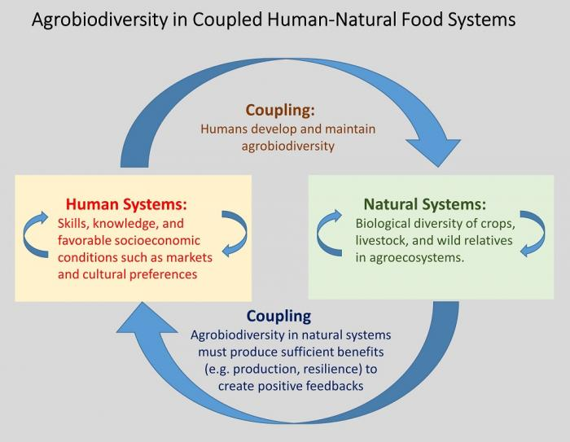
Human-environment interactions of biodiversity of agriculture and food systems
Biodiversity of agriculture and food begun 4,000–7,000 years ago
Industrial changes around 1800 have subsequently transformed the biodiversity of agriculture and food systems
The human-environment interactions a key planetary-scale changes involving the environmental and social dimensions of sustainability
Agrobiodiversity is a complex, human-interdependent resource system
The human-environment are expanding in planetary transformations
Source: Filipa Monteiro, 2017 [12]; https://www.e-education.psu.edu/geog3/node/1060
Notes:
Agriculture and food systems are prominent drivers of changes in global Earth and socioeconomic systems in the “Anthropocene,” a time of intense human interactions with the planet.
Biodiversity of agriculture and food systems has undergirded the long-term development and spread of agriculture beginning 4,000–7,000 years ago
Changes of the modern, industrial period beginning around 1800 (Foley et al., 2013) have subsequently transformed the biodiversity of agriculture and food systems
The human-environment interactions of this biodiversity—referred to as agrobiodiversity—are increasingly recognized as central in planetary-scale changes involving the environmental and social dimensions of sustainability
agrobiodiversity as a complex, human-interdependent resource system
The human-environment interactions of the biodiversity of agriculture and food systems have been integral and are subject to expanding planetary transformations.
This dynamics are summarized in the figures. Farmers' selection and management practices, and their use of genetic resources, have played an important role in agrobiodiversity conservation. Local knowledge, and related gender differences, can be seen as key factors in shaping and influencing plant and animal diversity. Farmers' selection and management practices, and their use of genetic resources, have played an important role in agrobiodiversity conservation.
The key points to note about this definition are:
First, and most importantly, the biological diversity of agri-food systems includes vital coupling to the human system, most directly the people who are growers and their skills, knowledge, and other factors. Agrobiodiversity exists squarely at the intersection of human and natural systems.
Second, it encompasses both our cultivated species of plants and animals, which are crops and livestock chosen and evolved for production, as well as their still living wild relatives and the biodiversity of the ecosystems associated with this production (both the agroecosystem itself and the surrounding uncultivated ecosystem).
Agrobiodiversity production in the natural system must be sufficient to offer positive feedbacks into the human system in order to offer the incentive for continued production.
The points just described in the definition of agrobiodiversity are illustrated in figure 9.6, which depicts agrobiodiversity as a Coupled Human-Natural System (CNHS)

Slide 58
Mainstreaming agricultural biodiversity
Mainstreaming biodiversity definition “ …. integration of the conservation and sustainable use of biodiversity in cross-sectoral plans such as poverty reduction, sustainable development, climate change adaptation/mitigation, trade and international cooperation, as well as in sector-specific plans such as agriculture, fisheries, forestry, mining, energy, tourism, transport and others” (Convention on Biological Diversity)
In practice: specific components of biodiversity (e.g. genetic, varietal, species, landscape) are integrated into other sectors for the generation of mutual benefits.
Source: Biodiversity International, 2017 [17]
Notes:
Under the Convention on Biological Diversity, mainstreaming biodiversity is defined as: “the integration of the conservation and sustainable use of biodiversity in cross-sectoral plans such as poverty reduction, sustainable development, climate change adaptation/mitigation, trade and international cooperation, as well as in sector-specific plans such as agriculture, fisheries, forestry, mining, energy, tourism, transport and others.”
In practice, mainstreaming means that specific components of biodiversity (e.g. genetic, varietal, species, landscape) are integrated into other sectors for the generation of mutual benefits.
Examples are: linking tourism to biodiversity for conservation and economic returns; or using diversity in agriculture to increase productivity and resilience while at the same time conserving biodiversity.

Slide 59
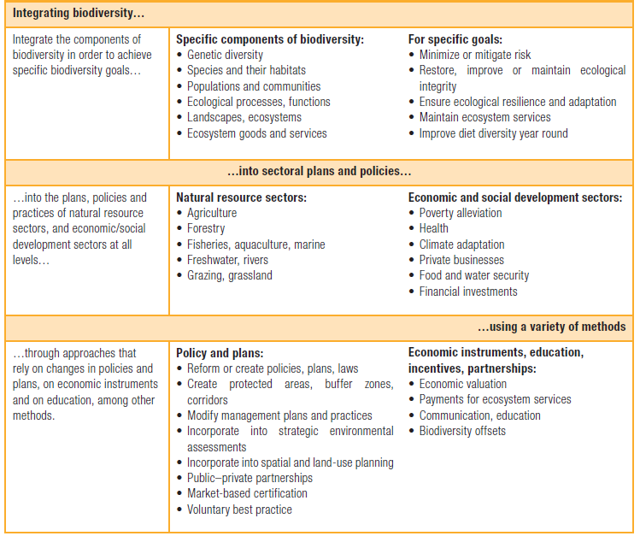
Mainstreaming agricultural biodiversity
Enabling policymakers to make progress to the SDG
Make a difference through the food and agricultural policies
Source: Biodiversity International, 2017 [17]
Notes:
According to the table this integration may be into the plans, policies and practices of natural resource sectors, such as agriculture or forestry, or other economic and social sectors, such as poverty alleviation or climate adaptation. Methods can comprise changes in policies, plans or laws, public–private partnerships or communication campaigns
Mainstreaming agricultural biodiversity in food systems contributes to their sustainability and enables policymakers to make progress toward their commitments to the Sustainable Development Goals
and the Aichi Biodiversity Targets. Governments make a difference through the food and agricultural policies they adopt. Corporations make a difference through the business models they select. Given the right policy environment, together with appropriate management actions and information, from the same starting point, different results are possible. Policies and actions matter.

Slide 60
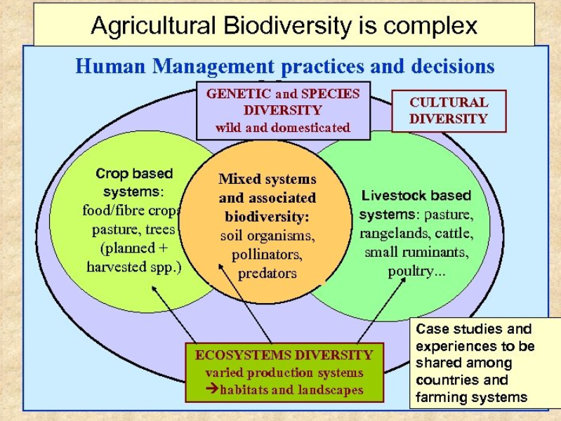
Mainstreaming agricultural biodiversity: challenges
Complexity
Specialization for increasing productivity, cost-efficiency and reaching economies of scale, and diversification for risk mitigation and stability
New ways of cross-sectoral working
common measures of success for policy-makers
Source: Biodiversity International, 2017 [17]
Notes:
While the potential benefits are multiple, mainstreaming agricultural biodiversity in food systems is easier said than done.
First, using agricultural biodiversity is not a ’one size fits all’ solution. On the contrary, it is complex. It is about the diversity of varieties, species and systems, and how to manage such a range of options for multiple objectives – income generation, nutrition, sustainable natural resources and risk mitigation. Mainstreaming agricultural biodiversity therefore requires a systems approach, which recognizes the connectivity among elements, multiple viewpoints and the multifunctionality of food systems.
Second, there is a clear tension between specialization for increasing productivity, cost-efficiency and reaching economies of scale, and diversification for risk mitigation and stability. Specialization, with intensified production geared towards local, national or international markets, can foster transitions out of poverty and boost local economic development.
Third, mainstreaming diversity across the food system requires new ways of cross-sectoral working. While an increasing number of government and private sector departments are embracing multidisciplinary approaches, the successful coordination and implementation of such efforts remains a challenge. Sector accountability and reward lines may not favour them working together and there may be competition among sectors for influence and resources. Additionally, the way different sectors approach problems may be incompatible.
A fourth challenge for policymakers is current common measures of success. Success is usually measured within sector (e.g. nutrition outcomes, production outcomes or environment outcomes) without considering negative effects (or indeed positive synergies) on other sectors. In reality, policymakers have to engage in trade-offs and balancing acts among sector goals.
Source: www.bioversityinternational.org, Mainstreaming in sustainable food systems agrobiodiversity [1]

Slide 61

Visualization of the Expanded Definition of Agrobiodiversity
Expanded Definition needs that advancing agrobiodiversity science and scholarship as well as policy and management requires meeting the challenges and opportunities posed by these knowledge configurations
Source: Karl S. Zimmerer et. al., 2019 [33]
Notes:
In figure 1 is summarized the the Expanded Definition of Agrobiodiversity by multiple types and scales of agrobiodiversity as a complex, human-interdependent resource system as well agrobiodiversity—including associated sociocultural practices
Agrobiodiversity exerts influence on, and is affected by, the factors of environmental and biotic resources (e.g., soil, water, pollinators) together with sociocultural and linguistic practices, development and technologies, and multi-scale institutions and social relations. But agrobiodiversity—including associated sociocultural practices
The knowledge concept and definition of biodiversity can be Expanded Definition of Agrobiodiversity comprised of four themes: (1) ecology and evolution; (2) governance; (3) food, nutrition, and health; and (4) global environmental and socioeconomic changes

Slide 62
Agrobiodiversity Knowledge concepts: Themes and Values
Agrobiodiversity Knowledge concept comprised of four themes:
ecology and evolution
Governance
food, nutrition, and health
global environmental and socioeconomic changes
Source: Karl S. Zimmerer et. al., 2019 [33]
Notes:
Agrobiodiversity Knowledge concept comprised of four themes: (1) ecology and evolution; (2) governance; (3) food, nutrition, and health; and (4) global environmental and socioeconomic changes.
The framework highlights the distinct themes and networks (Fig. 2) whose overlap enables cross-theme integration
Governance of agrobiodiversity refers to policy and legal research as well as wide-ranging biocultural approaches.
Biocultural approaches, defined the biological and cultural dimensions of human-environment systems. Thy can focus on the long-term co-evolution of agrobiodiversity and incorporated new scientific advances
Market- and livelihood-based approaches include the support of economic value chain approaches involving indigenous and smallholder producers, retailing and wholesale outlets for agrobiodiversity across urban and rural spaces
Please look on the further reading of Karl S. Zimmerer et. al., 2019 The biodiversity of food and agriculture (Agrobiodiversity) in the anthropocene: Research advances and conceptual framework, Anthropocene

Slide 63
Synopsis
This lecture gives an insight into:
  agrobiodiversity main concepts, components and importance
  agrobiodiversity and ecosystem services,
  global priorities on agrobiodiversity management and assessment and potential preservation strategies
  Human-environment interactions within agrobiodiversity
  Conceptual visualization of Agrobiodiveristy and assessment methods
The lecture includes also examples from agribiodiversity status-quo according to FAO, Convention on Biological Diversity and Millennium Ecosystem Assessment (MEA)
Notes:
Summary of contents and learners achievments

Slide 64
References
Project Biodiversity in Standards and Labels for the Food Sector, LIFE15GIE/DE/000737 LIFE. “Biodiversity in Standards and Labels for the Food Sector - Biodiversity: Status quo”, Project Biodiversity in Standards and Labels for the Food Sector, LIFE15GIE/DE/000737 LIFE - https://www.business-biodiversity.eu/en/biodiversity/what-is-biodiversity
https://slideplayer.com/slide/13495817/
What are ecosystem services? https://www.youtube.com/watch?v=r7UCAsBT5Yg
Camilo, M. et al. How many species are there on earth and in the ocean?, PLoS Biology, 9 (8), 2011.
Sabatini, F. et al. Where are Europe´s last primary forests?, Diversity and Distribution. 24, 1426-1439 (2018).
Newbold, T. et al. Global effects of land use on local terrestrial biodivesity, Nature. 520, 45-69 (2015).
Homepage ICUN Red List, 2019
© pictures: pixabay; Bayerische Landesanstalt für Landwirtschaft; Mike Sutton-Croft
https://slideplayer.com/slide/13495817/
Copyright 2003, by the authors of the material, with license for use granted to the Center for Biodiversity and Conservation of the American Museum of Natural History. All rights reserved
https://www.gcsnc.com . Global Declines in the Genetic Diversity of Wild Species, Conservation of biodiversity, apes_3e_trm_18_lecture_slide_18.pptx

Slide 65
References
Filipa Monteiro, Agrobiodiversity from definition to application, Training course: use of agrobiodiversity information in GBFI and other databases, June 2017 https://gbif.isa.ulisboa.pt/sites/default/files/05_Agrotraining_Into%20AGB%20info%20for%20crop%20breeding.pdf]
Warwick Wainwright, Economic instruments for supplying agrobiodiversity conservation, PhD thesis, 2018
FAO, Building on gender, agrobiodiversity and local knowledge. A training manual, 2006, https://www.fao.org/3/y5956e/Y5956E03.htm#ch1.1
Karl S. Zimmerer et. al., New services and roles of biodiversity in modern agroecosystems: A review, Ecological Indicators 93 (2018) 1126–1135
Raihanathus Sahdhiyya A, 2019, Threats to agrobiodiversity (Agricultural Biodiversity) - https://pt.slideshare.net/RaihanathusSahdhiyya/threats-to-agrobiodiversity-agricultural-biodiversity
Biodiversity International, 2017. Mainstreaming Agrobiodiversity in Sustainable Food Systems: Scientific Foundations for an Agrobiodiversity Index. Bioversity International, Rome, Italy. www.bioversityinternational.org
Dicoagroecologie, https://dicoagroecologie.fr/en/encyclopedia/agrobiodiversity/
Agrobiodiversityplatform, https://www.facebook.com/agrobiodiversityplatform/photos/4399331816801538
Peter Duelli and Martin K. Obrist, Biodiversity indicators: the choice of values and measures, Agriculture, Ecosystems and Environment 98 (2003) 87–98

Slide 66
References
Brookfield and M. Stocking. Agrodiversity: Definition, Description and Design Global Environmental Change 9 (1999) 77-80
ELN-FAB (2012) Functional agrobiodiversity: Nature serving Europe’s farmers. – Tilburg, the Netherlands: ECNC-European Centre for Nature Conservation [https://ec.europa.eu/environment/nature/natura2000/platform/documents/functional_agrobiodiversity_eln-fab_publication_en.pdf]
Elke Plaasa et al., 2019, Towards valuation of biodiversity in agricultural soils: A case for earthworms, Ecological Economics 159 (2019) 291–300
Overmars, K.P., Schulp, C.J.E., AlkemadeR, Verburg PH, Temmec, A.J.A.M., Omtzigt, N.,cSchaminéed, J.H.J., 2014. Developing a methodology for a species-based and spatially explicit indicator for biodiversity on agricultural land in the EU. Ecol. Indic. 37, 186–198
Barry Hoogezand, The effect of natural disasters on agricultural protection: a panel data analysis, 2013, https://edepot.wur.nl/257180
Dunja Mijatovic, Landscapes for Agrobiodiversity, 2016, CONSERVATION DEBATES OFTEN IGNORE AGROBIODIVERSITY
ipbes – The assessment report on Land degradation and restoration – full report. (2018)
Animal genetic Training course, http://agtr.ilri.cgiar.org/index.php?option=com_content&view=article&id=240&Itemid=298
Anda Ruskule et al. (2016) THE GUIDEBOOK ON “THE INTRODUCTION TO THE ECOSYSTEM SERVICE FRAMEWORK AND ITS APPLICATION IN INTEGRATED PLANNING” [X], Online ISBN number: 978-9934-556-39-5

Slide 67
References
What are ecosystem services?, https://www.youtube.com/watch?v=r7UCAsBT5Yg
Michel Duru et al., How to implement biodiversity-based agriculture to enhance ecosystem services: a review, Agron. Sustain. Dev. (2015) 35:1259–1281
European Commission, 2009. Natures role in climate change. Nature and Biodiversity, August, 2009. http://ec.europa.eu/environment/nature/info/pubs/docs/climate_change/en.pdf.
Karl S. Zimmerer et. al., The biodiversity of food and agriculture (Agrobiodiversity) in the anthropocene: Research advances and conceptual framework, Anthropocene 25 (2019) 100192
Altieri, M.A. Biodiversity and pest management. Agro-ecosystems, Harworth Press, New York, 1994
Ricotta, C., Corona, P., Marchetti, M., Chirici, G., Innamorati, S., 2003. LaDy: software for assessing local landscape diversity profiles of raster land cover maps using geographic windows. Environ. Modell. Software 18, 373–378.
Di Battista, T., Fortuna, F., Maturo, F., 2017. BioFTF: an R package for biodiversity assessment, with the functional data analysis approach. Ecol. Indicators. 73, 726–732.
Cardoso, P., Rigal, F., Carvalho, J.C., 2015. BAT – biodiversity assessment tools, an R package for the measurement and estimation of alpha and beta taxon, phylogenetic and functional diversity. Methods Ecol. Evol. 6, 232–236.
Barbara Burlingame et al., Leveraging agricultural biodiversity for sustainable diets, highlighting Pacific Small Island Developing States, Advances in Food Security and Sustainability, 2019.
ECA, Biodiversity in farming, 2019, Audit preview Information on an upcoming audit, https://www.eca.europa.eu/lists/ecadocuments/ap19_09/ap_biodiversity_en.pdf

Slide 68
Further readings
Karl S. Zimmerer et. al., New services and roles of biodiversity in modern agroecosystems: A review, Ecological Indicators 93 (2018) 1126–1135
Biodiversity International, 2017. Mainstreaming Agrobiodiversity in Sustainable Food Systems: Scientific Foundations for an Agrobiodiversity Index. Bioversity International, Rome, Italy. www.bioversityinternational.org
Biodivesity International, MAINSTREAMING IN SUSTAINABLE FOOD SYSTEMS AGROBIODIVERSITY, 2017
Karl S. Zimmerer et. al., The biodiversity of food and agriculture (Agrobiodiversity) in the anthropocene: Research advances and conceptual framework, Anthropocene 25 (2019) 100192All_you_need_to_know_about_Mainstreaming_agrobiodiversity
Filipa Monteiro, Agrobiodiversity from definition to application, Training course: use of agrobiodiversity information in GBFI and other databases, June 2017 Wainwright2019
Warwick Wainwright, Economic instruments for supplying agrobiodiversity conservation, PhD thesis, 2018
Elke Plaasa et al., 2019, Towards valuation of biodiversity in agricultural soils: A case for earthworms, Ecological Economics 159 (2019) 291–300
Devra Jarvis et al. Managing Agroecosystem Services, 2013
ELN-FAB (2012) Functional agrobiodiversity: Nature serving Europe’s farmers. – Tilburg, the Netherlands: ECNC-European Centre for Nature Conservation
Brookfield and M. Stocking. Agrodiversity: Definition, Description and Design Global Environmental Change 9 (1999) 77-80
World Health Organization and Secretariat of the Convention on Biological Diversity, Connecting global priorities: biodiversity and human health: a state of knowledge review, 2015.

Slide 69

Short-bio
Dr. sc. ing., Francesco Romagnoli, Professor
Scopus Author ID: 36998780600
ORCiD: 0000-0003-1814-7310
H-index = 14
Professor at RTU IESE with a specialization in Eco-design and Life Cycle Assessment
Main research areas: LCA and System Dynamics modelling within techno-feasibility and sustainability evaluations, evaluation of Bio- and circular-economy solutions, overall Life Cycle Sustainability Assessment including environmental LCA (E-LCA), Life Cycle Costs (LCC) and Social LCA (S-LCA), urban system’s resilience evaluation, biogas from seaweeds and microalgae
Leading of the University courses of: LCA and Eocodesign, Risk and Reslience, Applied Geophysics methods.
Head of the Biosystem Laboratory at RTU Institute of Energy Systems and Environment

Slide 70
Thank you

