Slide 1
Connecting Global Priorities:
Human Health, Economic development and Agrobiodiversity
Notes:
Within the next part of the lecture we will we are going to look at topic Connecting Global Priorities: Human Health, Economic development and Agriculture

Slide 2
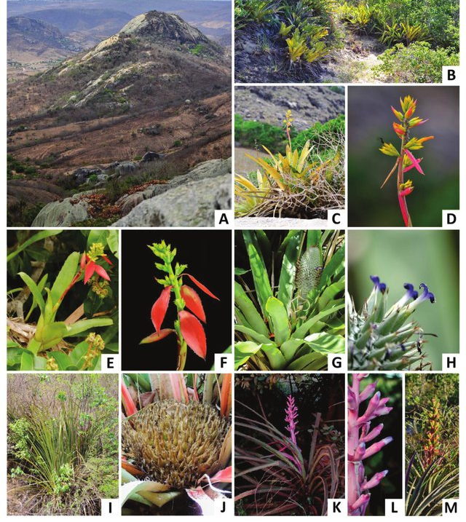
Biodiversity and ecosystems
Simple exmaple of biodiversity
Healthy ecosystem performs its various functions well
Equilibrium is maintained and dependent upon biodiversity
Diversity of species influences availability of resources, such as water, biomass, recycle biologically essential nutrients
Biodiversity increases the stability of ecosystem functions through time
Source: Connecting global priorities: biodiversity and human health: a state of knowledge review [1]
Source: Toomaz C.E and Versieux M.L., 2019 [2]
Notes:
Ecosystems includes physical and chemical biotic (e.g. plants, animals, humans) and abiotic (e.g. light, oxygen, temperature, soil texture and chemistry, nutrients) interactions.
A healthy ecosystem – one that performs its various functions well and where equilibrium is maintained – it is dependent upon biodiversity. This is often referred to as ecosystem integrity, ecosystem stability or ecosystem health.
Fluxes of energy, biogeochemical cycles such as nutrient cycling and oxygen production, and community dynamics such as predator–prey interactions are regulated by the earth’s biota. The interactions of biotic and abiotic components determine ecosystem processes and influence changes over space and time.
The biodiversity underpins the ecosystem services that, in turn, supports human health. Some species functional characteristics can be critical to ecosystem services; their loss can result in permanent changes.
Studies have concluded that diverse communities tend to be more productive both because they contain key species that have a large influence on productivity, and because differences in among organisms increase the total capture of resources (light, water). Thus, biodiversity loss reduces the efficiency by which ecological communities capture biologically essential resources, produce biomass, and decompose and recycle biologically essential nutrients.
The impact of biodiversity on any single ecosystem process is non-linear and saturating, such that change accelerates as biodiversity loss increases. And on the contrary, biodiversity increases the stability of ecosystem functions through time.

Slide 3
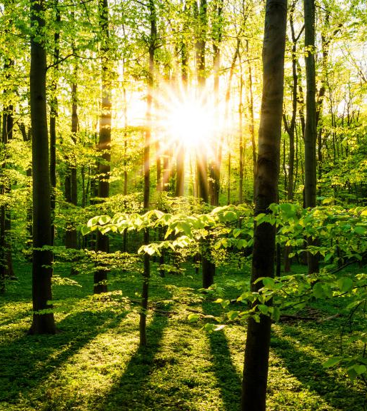
Ecosystem services
Ecosystem services are benefits that people obtain from ecosystems to human well-being
Ecosystem services are of fundamental importance to human well-being, health, livelihoods, and survival
Changes in ecosystem services can have indirect effects on livelihoods, income, local migration and may even cause political conflict.
Source: Connecting global priorities: biodiversity and human health: a state of knowledge review, 2015 [1]
Source: Jonh Smith, «Adobe stock», royalty-free pictures [3]
Notes:
Different ways of defining what exatly are ecosystem service have been developed so far – but in general, they can be described as the benefits that people obtain from ecosystems (MEA, 2005) or as the direct and indirect contributions of ecosystems to human well-being (TEEB, 2010). More recent publications define the ecosystem services (ES) as contributions of ecosystem structure and function (in combination with other inputs) to human well-being (Burkhard et al., 2012; Burkhard B. &
Maes J. Eds., 2017).
Ecosystems have potential to supply a range of services that are of fundamental importance to human well-being, health, livelihoods, and survival (Costanza et al., 1997; Millennium Ecosystem Assessment (MEA), 2005; TEEB Synthesis, 2010).
The human species, while buffered against environmental changes by culture and technology, is fundamentally dependent on the flow of ecosystem services, and the changes in ecosystem services have an indirect effects on livelihoods, income, local migration and may even cause political conflict.

Slide 4
Benefits of ecosystem services
Source: European Environmental Agency, 2021 [4]
Notes:
These and other important benefits, called “ecosystem goods and services”, are essential to our society, our economic development, and human health and well-being.
The benefits of ecosystem servieces can be summrized into three categories – Provisional services, regulating services and cultural services.
The main material benefits of form ecosystems are resources such as crops, livestock, fresh water and many others, which are used by humans for energy, food, cothes and medicine. The ecosystem provides also seld- regulating services such as flood regulation, water purification, climate regulation and pollination.
Ecosystem services is not only the source of our food, but also provides less tangible benefits, such as spiritual enrichment, and areas for recreation and leisure, recognized as «Cultural services».
There are five primary ways how changes in ecosystem services can affect humans : i) Change in the delivery of supporting and regulating services from natural habitat is important for agricultural production; ii) The loss of habitat for wild species, which contribute to diets in many parts of the world; iii) Increased interaction with disease host, vectors and reservoirs ; iv) Loss of medicinal plants; v) Cultural ecosystem services and mental well-being associated with interactions with nature and landscapes.

Slide 5
Impacts on ecosystem services
The cause – effect cycle
Causes for loss in agrobiodiversity :
Habitat loss
Deforestation
Unsustainable farming
Population boom
Global warming
Pressure on ecosystem
Change in ecosystem services supply
Trade-offs between different services
Change in benefits to society
Policy action
Notes:
The capacity of the ecosystem to supply services for human well-being directly depends on the ecosystem condition (its structure and processes). While increasing the pressure on ecosystem or by changing the land use type (and thus fundamentally impacting or destroying the previous ecosystem), people influence the ecosystem service supply or trade-offs between different services also linked with agrobiodiversity and agriculture. The casues for loss of agrobiodiversity can be deforestation, habitat loss, unsustainable farming, population boom, global warming, which are cause changes in benefits to society and requires policy action that can have an impact on ecosystem.
Biodiversity loss due to the changes in ecosystem service supply is a serious problem and can have direct, and sometimes significant, human health impacts, particularly if ecosystem services are no longer adequate to meet social needs. Indirectly, changes in ecosystem services affect livelihoods, income, local migration and may even cause political conflict.
An example of ecosystem impact cycle contributing is when by draining a wetland people can gain arable land and thus valuable food products, but at the same time lose such services as flood protection, natural habitats and species diversity as well as possibilities for nature tourism. In counting together all the benefits (in monetary or other terms), the value of wetland most probably would be much higher that the value of arable land.

Slide 6
Pest control as an ecosystem service
Crops pest are threat to crop production
Insect pests damage crops on the field (pre-harvest) and during crop storage (post- harvest) – one third of crop production is lost to pests, diseases and weeds
BUT
For natural ecosystems plant-feeding insects (i.e. pest species) usually do little damage because:
natural habitats tend to be rich with insect predators and parasitoids which regulate the biodynamics (i.e. attack plant feeders, keep their numbers in control and protect plants from serious damage)
Source: Filipa Monteiro [5]
Notes:
Agrobiodiversity has a key role in supporting ecosystem services
One example is given by pest control.
Crop pests constitute a serious threat to crop production.
Insect pests can cause severe crop losses both on the field (pre-harvest) and during crop storage (post- harvest). It is estimated that approximately a third of crop production is lost to pests, diseases and weeds.
In natural ecosystems, on the other hand, plant-feeding insects (known as pest species in agricultural crops) usually do little damage.
This is to a large extent due to the fact that natural habitats tend to be teeming with insect predators and parasitoids that attack plant feeders, keep their numbers in check and thereby protect plants from serious damage.

Slide 7
Landscape management as support to natural pest control
Insect predators can be preserved and enhanced with simple cultural techniques, like provisioning natural enemies with resources that are lacking within the agricultural crop, such as nectar, pollen, alternative prey, or shelter.
Adding floral resources is a simple and effective tool to support predators and parasitoids and to regulate the ecosystem services
Source: Filipa Monteiro [5]
Notes:
Insect predators that naturally occur in agricultural systems can be preserved and enhanced with simple cultural techniques.
Such practices may involve provisioning natural enemies with resources that are lacking within the agricultural crop, such as nectar, pollen, alternative prey, or shelter (overwintering sites).
Adding floral resources can be a simple and effective tool to support predators and parasitoids and to harness the biocontrol services they provide.
An example:
the majority of Diadegma semiclausum (a parasitic wasp) failed to attack any Diamondback moth (Plutella xylostella) larvae in the cages without nectar plants, whereas individuals provided with a nectar plant parasitized more than 300 larvae each. Thus, adding food sources to agro-ecosystems could be a simple and effective way to enhance the effectiveness of biological control programmes.

Slide 8
Pollinators
Critical role in agriculture and food security and for the broader functioning of ecosystems
Enabling the natural fertilization and reproduction of flowering plants.
75% of the world’s leading food crops, from cacao to pumpkins, are partially reliant on animal pollinators
1/3 of all crop production depends on animal pollinators.
The overall value of pollination services globally was estimated at $173 billion per year in 2009
Bees the most important pollinator
Diversity and abundance of wild insect pollinators has declined
Source: Filipa Monteiro [5]
Notes:
Pollinators play a critical role in agriculture and food security and for the broader functioning of ecosystems. Pollination enables the natural fertilization and reproduction of flowering plants.
Seventy-five percent of the world’s leading food crops, from cacao to pumpkins, are partially reliant on animal pollinators for fruit and seed production.
One-third of all crop production depends on animal pollinators. The overall value of pollination services globally was estimated at $173 billion per year in 2009, and the acreage of crops requiring pollination is increasing.
Bees are thought to be the most important pollinators in most environments, including agriculture
Honey bees are the main pollinators managed today for farming; yet native bees and other wild pollinators are now known to be as important in agriculture.
The diversity and abundance of wild insect pollinators have declined in many agricultural landscapes.
Whether such declines reduce crop yields, or are mitigated by managed pollinators such as honey bees, is unclear

Slide 9
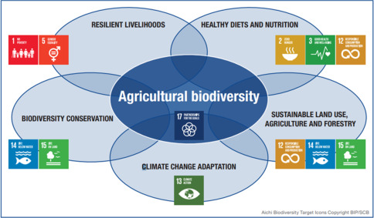
Sustainable Development Goals: Linking the biosphere to sustainable and healthy food
Source Advances in Food Security and Sustainability, 2019 [6]
Notes:
The knowledge about impact of biodiversity loss, ecosystem services and public health has increased considerably in the past decades, but the full range of impacts of biodiversity loss on ecosystem functioning and the following consequences is not fully understood yet.
As presented in the picture agricultural biodiversity contributes to multiple sustainability dimensions and UN SDGs. Measuring agrobiodiversity enables researchers, policy makers, and farmers to work toward a more sustainable health and food system. Numerous validated methodologies and indicators have been developed for assessing agricultural biodiversity; however, quantifying biodiversity remains problematic as no single indicator is universally applicable.

Slide 10
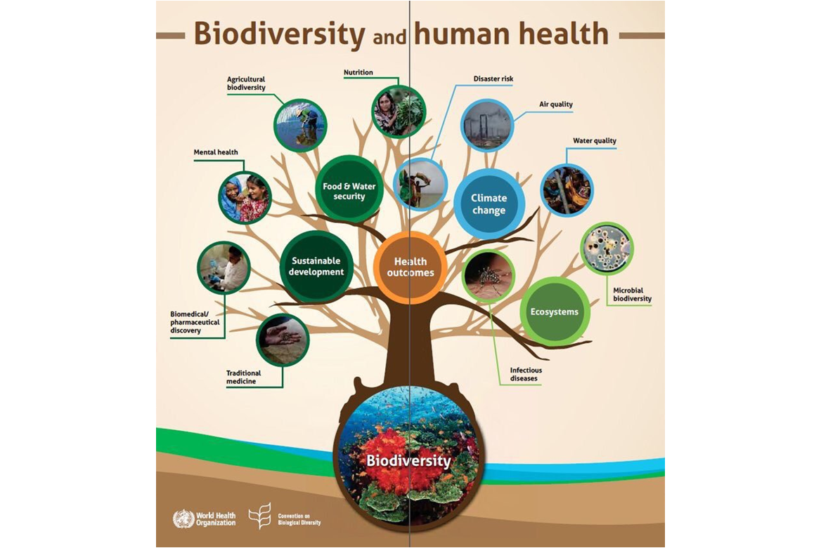
Biodiversity and human health
Biodiversity and human health are linked in many ways:
  Psychological
  Physiological
  Regulation of the transmission and prevalence of some infectious diseases
  Provision of food and good nutrition, clean air and water
  The provision of traditional and modern medicines
Source: Connecting global priorities: biodiversity and human health: a state of knowledge review, 2015. [1]
Notes:
Biodiversity and human health are linked in many ways:
A broad range of pathways through which biodiversity may provide health and well-being benefit to people: psychological (e.g. green spaces and iconic wildlife), physiological (directly through the human microbiome, and indirectly through exercise in green spaces), regulation of the transmission and prevalence of some infectious diseases , provision of food and good nutrition, clean air and water, the provision of traditional and modern medicines.
The interactions between biodiversity and health are manifested at multiple scales from individuals, through communities and landscapes to a planetary scale.
At the scale of the individual person, the human microbiota – the commensal microbial communities present in our gut, in our respiratory, oropharyngeal and urogenital tracts and on our skin – contribute to our nutrition, help regulate our immune system, and prevent infection.
At the community level (such as farms), many aspects of biodiversity – among crops and livestock, associated pollinators and pest control organisms and in soils – support agricultural production.

Slide 11
Ecosystem services, Biodiversity and Food
Ecosystems services, biodiversity and food systems interact in terms of environmental condition, nutrient supply, emisions and other impacts
Biodiversity is a key source of food diversity and provides a natural richness of nutrients and bioactive non-nutrients for healthy human. In addition, biodiversity also underpins critical supporting ecosystem services, such as pollination and soil fertility, essential to food production, both in terms of quantity and quality.
Thre is a strong need for nature-positive food production and supply systems which “produce more with less” aiming at:
  1) Protecting nature
  2) Sustainable managing of existing food production and supply systems
  3) Restoring and rehabilitating natural environments
Nature based solutions can help the Sustainable managing of food production
Source: The State of Food Security and Nutrition in the World 2021[7]
Notes:
Ecosystem services provide food primarily at the production level and the necessary environmental conditions and nutrients in the agriculture, fisheries and forestry sectors for food to be produced. Food and agricultural production systems, on the other hand, impact on the environment in multiple ways, including through their impact on biodiversity, soil and water quality, animal and plant health, greenhouse gas emissions, toxicity, as well as food loss and waste.
Biodiversity is a key source of food diversity and provides a natural richness of nutrients. In addition, biodiversity also underpins critical supporting ecosystem services, such as pollination and soil fertility, essential to food production, both in terms of quantity and quality.
There is a strong need for nature-positive food production and supply systems which “produce more with less” to ensure sufficient nutritious food supplies for a growing world population over the coming decades. Nature-positive production involves actions aimed at the three interrelated goals of protecting nature, sustainably managing existing food production and supply systems, and restoring and rehabilitating natural environments:
It is possible to maintain production levels, while halting the impacts on natural ecosystems and protecting marginal agricultural areas that are rich in biodiversity, such as peatlands and mangroves. A recent global estimate suggests that up to 40 percent of global agricultural land could be restored without reducing production, if inputs used and crop distribution were optimized.
Sustainably managing existing food production and supply systems renews ecosystems’ ability to provide healthy soil and clean water, and also supports biodiversity. This is accomplished by favouring the circular use of resources and supporting multiple ecosystem services by nature based solutions that aim at diminishing the need for chemical fertilizers while promoting soil health and carbon absorption.
Nature based solutions can contribute to restoring the land considered degraded, by either rewilding it or by restoring its agricultural productivity, while also contributing to preserving the quality of all land resources.

Slide 12
Biodiversity and food security
B i o d i v e r s i t y
Food utilization
Food accesability
Food availability
Food stability
Equal distribution of food among society within economic, physical and social constrains
Relates to the ways in which food products are combined and processed to provide healthy diets
Production and distribution of adequate quantities of a sufficiently wide variety of good quality foods to meet nutritional needs
Continuous availability, access and use of food over time
Source: The State of Food Security and Nutrition in the World 2021[7]
Notes:
Food security is recognized as having four dimensions: availability, access, utilization and stability. Biodiversity contributes to each one of them.
FOOD AVAILABILITY depends on the production and distribution of adequate quantities of a sufficiently wide variety of good quality foods to meet people’s nutritional needs. Food production and supply depends on a multitude of different components of biodiversity, both wild and domesticated. Genetic improvement over recent decades has helped food production levels to keep pace with a growing world population. However, the focus of intensive selection on a few species and breeds or varieties has also contributed to the loss of genetic diversity, placing the capacity of food systems to respond to future challenges at risk.
FOOD UTILIZATION relates to the ways in which food products are combined and processed to provide healthy diets. The nutrient composition of foods varies not only across plant and animal species but also across varieties and breeds within species. In addition, safe and nutritious diets depend not only on food products themselves but also on other services provided by biodiversity. For example, many people rely on their local ecosystems to purify their water supplies and as sources of fuelwood.
ACCESS TO FOOD depends on making sure that food is distributed and available locally and is affordable to all people. Physical, social and economic constraints to food acquisition may need to be overcome so that everyone is able to obtain the food they need when they need it.
FOOD STABILITY is the continuous availability, access and good use of food over a period of time. Biodiversity contributes in many ways to the stability of food supplies. Different kinds of plants and animals are able to provide food at different times of the year and in different environmental conditions. Some are particularly well adapted to coping with threats such as hot or dry weather or pest or disease outbreaks. Whole ecosystems contribute to the stability of the food supply by, for example, reducing the risk of flood or storm damage or by providing habitats for a diverse range of wild pollinators and other wild species and thus reduce the risk of fluctuations in the provision of pollination and other ecosystem services.
Agriculture and biodiversity have considered as separate concerns, however biodiversity underpins much of modern agriculture and in reality the development of contemporary food production systems has resulted in extensive land conversion and biodiversity loss. Despite progress, world food system if highly dysfunctional and inequitable, where there unable to feed a significant part of humanity adequately, and still continues to contribute to environmental and health problems, high species extinction rates, loss of genetic diversity, and land and ecosystem degradation.
Therefore, innovative and acceptable ways of integrating biodiversity conservation and food production need to be identified.

Slide 13
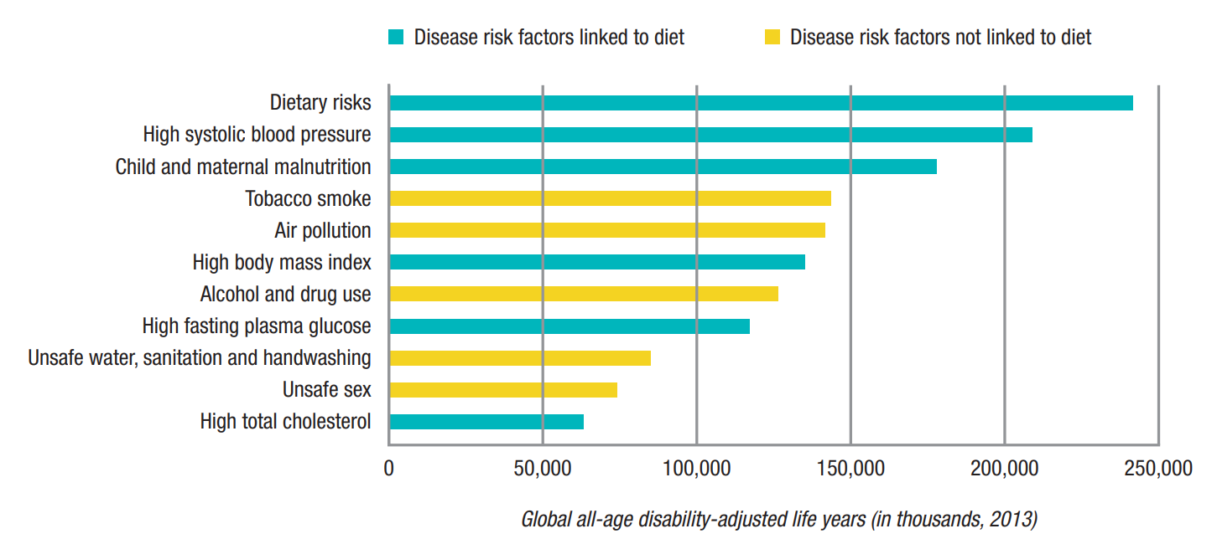
Food biodiversity and nutrition
World faces a major problem due to the lack of biodiversity with high nutritional significance, resulting in malnutrition and hidden hunger
Food biodiversity – the diversity of plants, animals and other organisms used for food, both cultivated and from the wild – is a critical element in response to global malnutrition, and it supports sustainable food systems
There is an emerging “double burden” of malnutrition and “hidden hunger” in developing countries
The estimated cost of undernutrition to potential economic development is between US$ 20 and 30 billion annually
Source: Biodiversity International, 2017, [8]; How The World’s Food Security Depends on Biodiversity, 2020 [9]
Notes:
A diverse diet should contain many different foods consumed in sufficient amounts. A varied diet is the only way to ensure adequate intakes of these nutrients and related compounds. A healthy human diet is composed of many hundreds of beneficial bioactive components, a small subset of which have been characterized and identified as nutrients. Biodiversity for human nutrition includes the diversity of plants, animals and other organisms used in food systems and provided by ecosystems.
Food biodiversity reaches consumers through two principal pathways: (1) consumption via own production or gathering from the wild and (2) purchase of wild or cultivated species.
World faces a major problem for replacement of foods derived from biodiversity with high nutritional significance by globally marketed foods that are higher in energy but less dense in nutrients and other functional factors. The result is an emerging “double burden” of malnutrition and “hidden hunger” in developing countries. Up to half a million vitamin A-deficient children go blind every year, half of them dying within a year of losing their sight; and iron deficiency is damaging the mental development of 40–60% of children in developing countries. The estimated cost of undernutrition to potential economic development is between US$ 20 and 30 billion annually. The graph on bottom of the page shows global disability-adjusted life years (DALYs) attribuited to level 2 risk factors in 2013 for both men and women combined. The diatery risks here is indicated as highest ones. Also clihd and maternal malnutrion is the third highest risk.

Slide 14
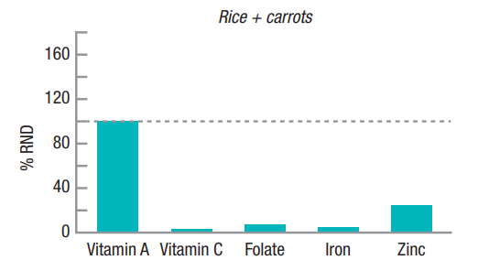
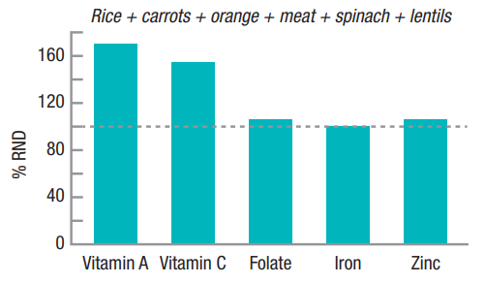
Agrobiodiversity and healthy diets
Agricultural biodiversity is an important strategy in dealing with ongoing climate change and food nutrition problems
The link to the role of ecosystems and their role for providing essential elements and nutrients is yet to be integrated in planning, assessment and policies.
The nutrient content between different species, or different varieties or breeds of the same species, can vary a thousandfold. This information can be used to maximize the nutritional adequacy of diets.
Source: Biodiversity International, 2017, [8]; How The World’s Food Security Depends on Biodiversity, 2020 [9]
Notes:
Despite the increased recognition of the potential of biodiversity for nutrition, national global food supplies have become more homogeneous in composition, being largely dependent on a few global crops. The world still faces tremendous challenges in securing adequate food that is healthy, safe and of high nutritional quality for all, and doing so in an equitable and environmentally sustainable manner. Climate change, ecosystems and biodiversity under stress, increasing urbanization, social conflict and extreme poverty are making healthy food supply a big challange.
Agricultural biodiversity, including utilization, and maintenance of plant genetic resources for crop improvement and diversification, is an important strategy in dealing with ongoing climate change and food nutitiosness giving opportunities to improve crop yield and resilience by improving the neglected and underutilized species and conserving crop diversity as well as crop wild relatives. Crop wild relatives represent one of our most precious resources in trying to deal with climate change, while at the same time improving the nutritional quality of crops and food (Hunter and Heywood 2011). For example, the perennial seabuckthorn has considerable tolerance to abiotic stresses like frost and cold, assumed to be associated with the high levels of ascorbic acid and myo-inositol. As well as containing genetic traits for enhanced nutritional quality, they also have novel pest resistance and tolerance to heat, drought and salinity, among other traits. However, crop wild relatives cannot be taken for granted and they are currently under threat from changing climate most likely to be negatively impacted by climate change. For these reasons, better knowledge of how wild food species are likely to be impacted by climate change will be critical for both biodiversity conservation and developing sustainable use and livelihood strategies.
While diet diversity has long been recognized as important for adequate nutrient intake and human health, the concept of nutritional diversity has yet to be integrated into planning, assessments, and policies and programmes of agricultural and food systems. By using diversity metrics in agriculture–nutrition strategies, synergies as well as trade-offs with other outcomes, e.g. environmental benefits, can be evaluated and taken into account. The Recommended nutrient density presented in figures in this slide shows that example to demonstrate how consumption of a diverse range of nutritionally distinct foods can fulfil nutrient needs. Dietary guidelines around the world recommend a varied diet rich in fruits, vegetables, whole grains, nuts, seeds and other sources for optimal health. A diverse diet increases the likelihood of consuming adequate amounts of the full range of nutrients essential to human health.
Innovative and acceptable ways of integrating biodiversity conservation and food production need to be identified. Improved availability, accessibility, affordability and acceptability of food biodiversity are key factors for achieving better diets.

Slide 15
Social dimension of health and biodiversity
Inequality in society among different social groups makes some groups more vulnerable to poor health
Social groups more reliant on biodiversity and ecosystem services, such as timber, water and food, are usually more vulnerable to biodiversity loss
Lowest levels of health inequality are found for populations exposed to the greenest environments
Developing countries are more reliant on biodiversity than developed countries and have greater negative health impacts of biodiversity change
Access to, use and management of biodiversity have different health impacts depending on gender roles
Source: Connecting global priorities: biodiversity and human health: a state of knowledge review, 2015 [1]
Notes:
The social dimensions of biodiversity are present in relation to how the impacts of biodiversity change are mediated among groups of differing socioeconomic status.
Social and economic determinants also influence the dynamics between biodiversity changes and human health. The inequities of how society is organized mean that the freedom to lead a flourishing life and to enjoy good health is unequally distributed within societies. This inequity is seen in the conditions of early childhood and schooling, the nature of employment and working conditions, the physical form of the built environment, and the quality of the natural environment in which people reside. Depending on the nature of these environments, different groups will have different experiences of material conditions, psychosocial support and behavioural options, which make them more or less vulnerable to poor health. Unequal distribution of health-damaging experiences is not in any sense a “natural” phenomenon but is the result of a combination of poor social policies and programmes, unfair economic arrangements and power relationships.
Population groups more reliant on biodiversity and ecosystem services, especially on provisioning services such as timber, water and food, are usually more vulnerable to biodiversity loss and those less covered by social protection mechanisms (e.g. health insurance). Vulnerable groups include indigenous populations, specific groups dependent on biodiversity and ecosystem services and, for example, farmers. However, at the same time the populations exposed to the greenest environments have been found to also have the lowest levels of health inequality related to income deprivation, suggesting that healthy physical environments can be important for reducing socioeconomic health inequalities.
Developing countries are more reliant on biodiversity and ecosystem services than developed countries, and their health systems are usually less prepared to protect the health of their populations, which leads to greater negative health impacts of biodiversity change.
Different gender roles in relation to biodiversity management, conservation and use can also have an impact on human health. Access to, use and management of biodiversity have different health impacts on women and men and boys and girls, which are determined by gender norms, roles and relations.

Slide 16
Integrating biodiversity and human health: approaches and frameworks
To integrate biodiversity and health in research and policy, multidisciplinary approaches are adopted
Most recognized approaches for integrating human health and the health of other species or ecosystems:
  The EcoHealth
  One Health
  “one medicine”
Wider potential applications and benefits, including the following:
  understanding of the health services provided by biodiversity
  knowledge for agricultural efforts
  assessment of environmental health exposures
Healthy People
Healthy Environment
Healthy Animals
Source: Connecting global priorities: biodiversity and human health: a state of knowledge review, 2015 [1]
Notes:
In large part, the biodiversity and health sectors have worked separately to achieve their respective goals. To better integrate biodiversity and health in research and policy, the adoption of multidisciplinary approaches that incorporate contributions from both the social and natural sciences is needed. Most recognized approaches for integrating human health and the health of other species or ecosystems:
The EcoHealth
One Health
“one medicine”
At their core they share the common goal of a more comprehensive understanding of the ecosystem-based dynamics of health than can be yielded through a single-species perspective alone.
Given the integral links between biodiversity and human health, these approaches consider the connections between humans, animals and the environment, and can thus promote a more complete understanding of mutual dependencies, risks and solutions. These perspectives allow us to move beyond single-silo viewpoints to a broader and more upstream consideration of the drivers, detection, control and prevention of disease.
In addition, these approaches have wider potential applications and benefits, including informing our understanding of the health services provided by biodiversity, as well as how anthropogenic changes or biodiversity may impact disease risks. Ecosystems may provide health-benefiting functions. These functions and their underlying mechanisms may be missed when focusing on a single species;
Also, these approaches provide important knowledge for agricultural efforts. For example, several disease risks for human and domestic animals also pose risks for biodiversity.
Finaly, these approaches help the assessment of environmental health exposures and outcomes.

Slide 17
Further readings
Connecting global priorities: biodiversity and human health: a state of knowledge review, World Health Organization and Secretariat of the Convention on Biological Diversity, 2015.
Andreas Kontoleon, Unai Pascual, Melinda Smale, Agrobiodiversity Conservation and Economic Development, Published February 18, 2011 by Routledge
Transforming food systems for food security, improved nutrition and affordable healthy diets for all, FAO, IFAD, UNICEF, WFP and WHO, 2021
Advances in Food Security and Sustainability, Volume 4, FAO, 2019

Slide 18
References
[1] Connecting global priorities: biodiversity and human health: a state of knowledge review, World Health Organization and Secretariat of the Convention on Biological Diversity, 2015.
[2] Toomaz C.E and Versieux M.L., «Bromeliaceae from Rio Grande do Norte State, Northeastern Brazil», Phytotaxa 422(2):113-143, October 2019
[3] Jonh Smith, «Adobe stock», royalty-free pictures
[4] European Environmental Agency, 2021, available at: https://www.eea.europa.eu/signals/signals-2021/infographics/what-are-ecosystem-services/image/image_view_fullscreen
[5] Filipa Monteiro, Agrobiodiversity from definition to application, Training course
[6] FAO, Advances in Food Security and Sustainability, Volume 4, Chapter 5, 2019
[7] FAO, IFAD, UNICEF, WFP and WHO. 2021. The State of Food Security and Nutrition in the World 2021. Transforming food systems for food security, improved nutrition and affordable healthy diets for all. Rome, FAO.
[8] Biodiversity International, 2017. Mainstreaming Agrobiodiversity in Sustainable Food Systems: Scientific Foundations for an Agrobiodiversity Index. Biodiversity International, Rome, Italy
[9] How The World’s Food Security Depends on Biodiversity, Food and Agriculture Organization of the United Nations, 2020

Slide 19

Short-bio
Dr. sc. ing., Maksims Feofilovs, Asist. Professor
Scopus Author ID: 57194546521
ORCiD: 0000-0002-0797-150X
H-index = 4
Asist. Professor at RTU IESE
Main research areas: modelling of complex system processes with system dynamics approach and life cycle analysis.
Leading of the University courses of: LCA and Ecodesign, Risk and Resilience
Head of the Information and Study Centre on Sustainable Development at RTU Institute of Energy Systems and Environment

