Slide 1
Examples of agrobiodiversity assessment and preservation strategies
Notes:
Welcome to last part of this video lecture about Agrobiodiversity and ecosystem services main concepts. I am professor Francesco Romagnoli and together with my collegue dr. Maksims Feofilovs I am now going to focus on some Examples of agrobiodiversity assessment and preservation strategies..

Slide 2
Specific contents
Agrobiodiversity Index
Species diversity Shannon-Wiener Index
Metrics to measure food biodiversity for healthy, diverse diets
(Agro)Biodiversity in Life Cycle Asessment
Nature based solutons
Using biodiversity to provide multiple services in sustainable farming systems
Notes:
Five main parts will be dedicated to this section:
Species diversity Shannon-Wiener Index
Metrics to measure food biodiversity for healthy, diverse diets
(Agro)Biodiversity in Life Cycle Asessment
Using biodiversity to provide multiple services in sustainable farming systems

Slide 3
(Agro)Biodiversity measurement methods
Index based approaches:
Richness
Evenness
Taxonomic
Margalef’s index
Simpson’s Diversity index
Shannon-Wiener
Agrobiodiversity index
Assessment tool:
BioFTF (Di Battista et al., 2017)
  statistical biodiversity assessment biodiversity profile based on different richness
BAT – Biodiversity Assessment Tool taxonomic (Cardoso et al., 2015)
  Measurement and estimation of biodiversity based on R (coefficient of correlation)
LaDy - Landscape Diversity Software Shannon-Wiener (Ricotta et al., 2003)
  computing local landscape diversity profile
Life cycle analysis based assessment:
Potentially Disappearing Fraction of Species (PDFs)
Product (agro)Biodiversity Footprint (PBF)
Ricotta, C., Corona, P., Marchetti, M., Chirici, G., Innamorati, S., 2003 [1]
Di Battista, T., Fortuna, F., Maturo, F., 2017 [2]
Karl S. Zimmerer et. al., 2018 [3]
Cardoso, P., Rigal, F., Carvalho, J.C., 2015 [4]
Notes:
To define precise pathways and action policies towards better practicies for agricultural practices without having negative impacts on ecosysem and biodiversity and to help evaluate and compare alternative devlepoment scenarios different measurment methods are used.
Biodiversity can be measured by many indices such as species richness, evenness, taxonomic indices, Margalef’s index, Simpson’s index, Shannon-Wiener index and finalli Agrobiodiversity index from FAO.
The Agrobiodiversity Index is a consistent, long-term monitoring tool to measure and manage biodiversity across four dimensions: diets, production, seed systems, and conservation, we will see more about this index in the next video lecture.
Many recent studies have proposed new methods and software for dealing with Agro)biodiversity assessment. For example, Di Battista et al. (2017) proposed the R package BioFTF, which is a tool for statistical biodiversity assessment in the functional data analysis framework. This tool is a scalar measure that reflects the information provided by the biodiversity profile and allows for ordering communities with different richness.
BAT is based on correlation assessment based on the measurement and the estimation of alpha and beta biodiversity in their multiple facets (taxon, phylogenetic and functional). This tool performs many analyses, based on either species identities or trees, depicting species relationships.

Slide 4
Richness and evenness, taxonomix indecies
Richness = The number of groups of related individuals. Richness is expressed as the number of species
Evenness = Proportions of species present on a site. The more equal species are in proportion to each other the greater the evenness of the site. A site with low evenness indicates that a few species dominate
Taxonomic indices: consider the taxonomic relation between different organisms in a community. There three types of indices can be used on different spatial scales:
  Alpha diversity refers to diversity within a particular area, community or ecosystem (usually species level);
  Beta diversity is species diversity between ecosystems. For example, the diversity of mangroves versus the diversity of seagrass beds;
  Gamma diversity is a measure of the overall diversity for different ecosystems within a region
Source: Sohier, Charlotte, 2020 [5]
Notes:
Richness = The number of groups of related individuals. Richness is expressed as the number of species
Evenness = Proportions of species present on a site. The more equal species are in proportion to each other the greater the evenness of the site. A site with low evenness indicates that a few species dominate
Taxonomic indices: These indices take into account the taxonomic relation between different organisms in a community. Taxonomic diversity, for example, reflects the average taxonomic distance between any two organisms, chosen at random from a sample. The distance can be seen as the length of the path connecting these two organisms along the branches of a phylogenetic tree. These three types of indices can be used on different spatial scales :
Alpha diversity refers to diversity within a particular area, community or ecosystem, and is usually measured by counting the number of taxa within the ecosystem (usually species level);
Beta diversity is species diversity between ecosystems; this involves comparing the number of taxa that are unique to each of the ecosystems. For example, the diversity of mangroves versus the diversity of seagrass beds;
Gamma diversity is a measure of the overall diversity for different ecosystems within a region. For example, the diversity within the coastal region of Gazi Bay in Kenia.

Slide 5
Agrobiodiversity Index
Notes:
Let’s now start with an overview about agrobiodiversity index.

Slide 6
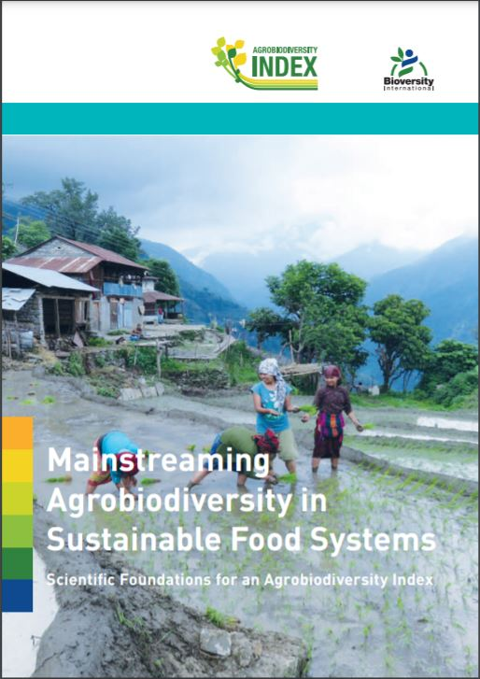
Background of the Agrobiodiversity Index
Risk of rapid global declines of (agro)biodiversity – e.g. bee as world’s primary crop pollinators (FAO)
Of 6000 plants and animals used food in only 9 account for 66% of total crop production
Focus on single components of agrobiodiversity (such as neglected species, crop diversity or fish richness)
Agrobiodiversity influenced by different management actions and policy decision
Agrobiodiversity Index (ABDI)
Source: Sarah K. Jones et al., 2021, [1]; Biodiversity International, 2017[2]
Notes:
The 2019 FAO State of the World’s Biodiversity for Food and Agriculture reports that food diversity has been declining worldwide. For example likelihood of a bee, one of world’s primary crop pollinators, being found in any given place in Europe and North America
Although the use of traditional crop varieties persists, of more than 6,000 different plant species cultivated for food, just 9 contribute around 66% of total crop production namely sugarcane, maize, rice, wheat, potatoes, soybeans, oil-palm fruit, sugar beet and cassava). The Food and Agriculture Organization’s (FAO’s) State of the World’s Biodiversity for Food and Agriculture 2019 report represents a major milestone in highlighting agrobiodiversity’s importance and decline, as well as the need for better agrobiodiversity monitoring to make the transition towards more sustainable and resilient food systems.
Most global analyses of the state of agrobiodiversity to date focus on single components of agrobiodiversity (such as neglected species, crop diversity or fish richness) and do not integrate information on agrobiodiversity across the food system.
Yet agrobiodiversity exists on our plates, in production systems and in conservation, in each place contributing to different food system sustainability outcomes and influenced by different management actions and policy decisions.
These were the reasons to evaluate an multicriteria and holistic assessment method named as Agrobiodiveristy index.

Slide 7
Obejectives of the ABDI
Measures to:
Apply over the interconnected dimensions of diets, production and genetic resources
Use in different locations by different actors to provide biodiversity trends
Provide key data for allocation of financial resources
Measure progress towards relevant targets in the SDGs
Target groups:
Companies
Governments
Investors
Farmers
Source: Sarah K. Jones et al., 2021, [1]; Biodiversity International, 2017[2]
Notes:
The Agrobiodiversity Index (ABDI) is an approach mainly focused on the food systems to collating agrobiodiversity data aimed at enabling policymakers, non-governmental organizations, civil society leaders and businesses to understand relationships between dimensions of agrobiodiversity across the food system, compare agrobiodiversity use and conservation across countries, and identify priority interventions to enhance agrobiodiversity for more sustainable food systems.
The Agrobiodiversity Index is comprised of a simple set of measures to:
Apply across three interconnected dimensions of diets, production and genetic resources
Use in different locations by different actors to provide insights into agricultural biodiversity trends
Provide key data for allocation of financial resources
Measure progress towards relevant targets in the Sustainable Development Goals and relevant UN Conventions.
The Agrobiodiversity Index is critical for decision-makers to measure and manage actions towards developing sustainable food systems:
• Companies implementing sustainable business practices that increase long-term shareholder value both by reducing risks in the supply chain and enhancing attractiveness to consumers
• Governments pursuing sustainable development by investing in progressive food, agriculture and conservation actions and monitoring country progress towards global goals
• Investors in green bonds contributing capital to sustainable environmental and climate focused development projects
• Farmers, consumer groups and local organizations wanting evidence to inform their decisions about sustainable practices and purchases.

Slide 8
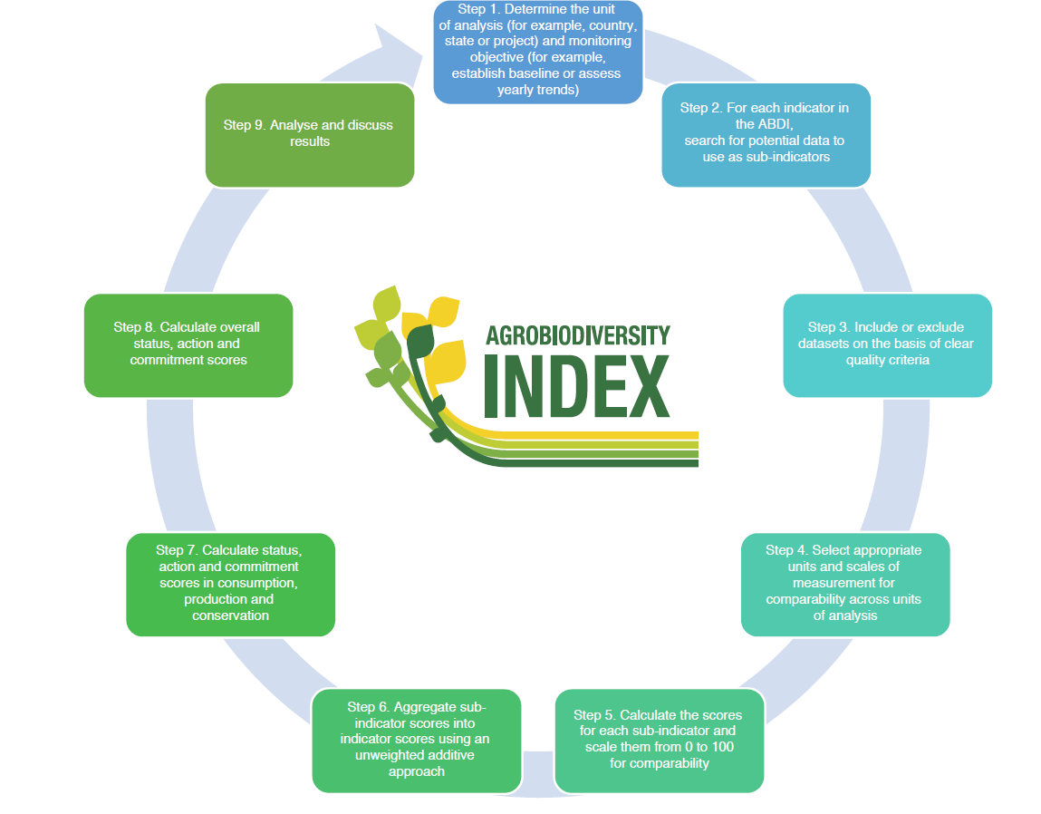
ABDI approach
Source: Sarah K. Jones et al., 2021, [1]; Biodiversity International, 2017[2]
Notes:
Applying the ABDI involves selecting the unit and scope of analysis (step 1), identifying appropriate datasets for the 22 indicators (steps 2 and 3), calculating and scaling the sub-indicator scores (steps 4 and 5), and aggregating these scores into composite measures (steps 6–8) to explore the use and conservation of agrobiodiversity across the food system (step 9). The ABDI logo was designed by Biodiversity International.

Slide 9
ABDI indicators
Category | Pillar | Indicators
Status | Consumption | Varietal diversity
 |  | Species diversity
 |  | Functional diversity
 |  | Underutilized species
 | Production | Varietal diversity
 |  | Functional diversity
 |  | Underutilized species
 |  | Pollinators and natural enemies
 |  | Soil biodiversity
 |  | Landscape complexity
 | Conservation | Varietal diversity
 |  | Species diversity
 |  | Functional diversity
 |  | Underutilized species
Action | Consumption | Management practices supporting agrobiodiversity
 | Production | Diversity-based practices
 | Conservation | Management practices supporting agrobiodiversity
 | Consumption | Management practices supporting agrobiodiversity
Commitment | Production | Commitments supporting agrobiodiversity
 | Conservation | Commitments supporting agrobiodiversity
 | Consumption | Commitments supporting agrobiodiversity
Scores scale: 0 to 100
Where:
0 – i.e. least desirable score
100 – i.e. most desirable score
Source: Sarah K. Jones et al., 2021, [1]; Biodiversity International, 2017[2]
Notes:
ABDI uses 22 indicators designed to measure agrobiodiversity within each pillar of the food system (consumption, production and conservation) across three measurement categories (status, action and commitment).
Each 22 indicators, has one or more associated sub-indicators to assess the status of, and actions or commitments to enhance, agrobiodiversity’s contribution to sustainability outcomes across three pillars of the food system: consumption and markets, contributing to healthy diets (pillar 1); production systems, contributing to agricultural sustainability (pillar 2); and genetic resource conservation, contributing to safeguarding future use options (pillar 3).
Each pillar has specific indicators addressed to the types of diversity promoted within a certain context for example varietal, species, functional or by a certain ecosystem service provided like pollinators or soil biodiversity. Indicators are aggregated to provide composite status, action and commitment scores in consumption, production and conservation.
All scores generated from the ABDI are on a scale of 0 to 100, with 0 representing the lowest (least desirable) and 100 the highest (most desirable) score. High scores can be interpreted as showing where agrobiodiversity status, actions or commitments are high relative to a global threshold, which represents the ideal case for ensuring agrobiodiversity use and conservation to enhance food system sustainability. Conversely, a low score shows where agrobiodiversity is relatively poorly used and conserved, hindering sustainability.
Species diversity use Species diversity Shannon’s diversity index for its definition. Such indicators will be more deeply presented in the next part of the presentation.
Further information on how the datasets were selected, analysed, scaled and aggregated is provided in paper of Sarah K. Jones reported as further reading material where the study for 80 countries is proposed.

Slide 10
ABDI: study on 80 countries
Moderate mean agrobiodiversity status score (56.0 out of 100)
Moderate mean agrobiodiversity action score (47.8 out of 100)
Low mean agrobiodiversity commitment score (21.4 out of 100)
Mean agrobiodiversity status scores in consumption and conservation are 14–82% higher in developed countries than in developing countries
scores in production are low across least developed, developing and developed countries.
Absence of globally consistent data for several important components of agrobiodiversity
Source: Sarah K. Jones et al., 2021, [1]
Notes:
Agrobiodiversity Index calculations for 80 countries reveal a moderate mean agrobiodiversity status score (56.0 out of 100), a moderate mean agrobiodiversity action score (47.8 out of 100) and a low mean agrobiodiversity commitment score (21.4 out of 100), indicating that much stronger commitments and concrete actions are needed to enhance agrobiodiversity across the food system. Mean agrobiodiversity status scores in consumption and conservation are 14–82% higher in developed countries than in developing countries, while scores in production are consistently low across least developed, developing and developed countries. The study of Jones found an absence of globally consistent data for several important components of agrobiodiversity, including varietal, functional and underutilized species diversity.

Slide 11
Shannon-Wiener Index
Notes:
For the next part of the lecture, I would like to introduce to you the Shannon-Wiener Index

Slide 12
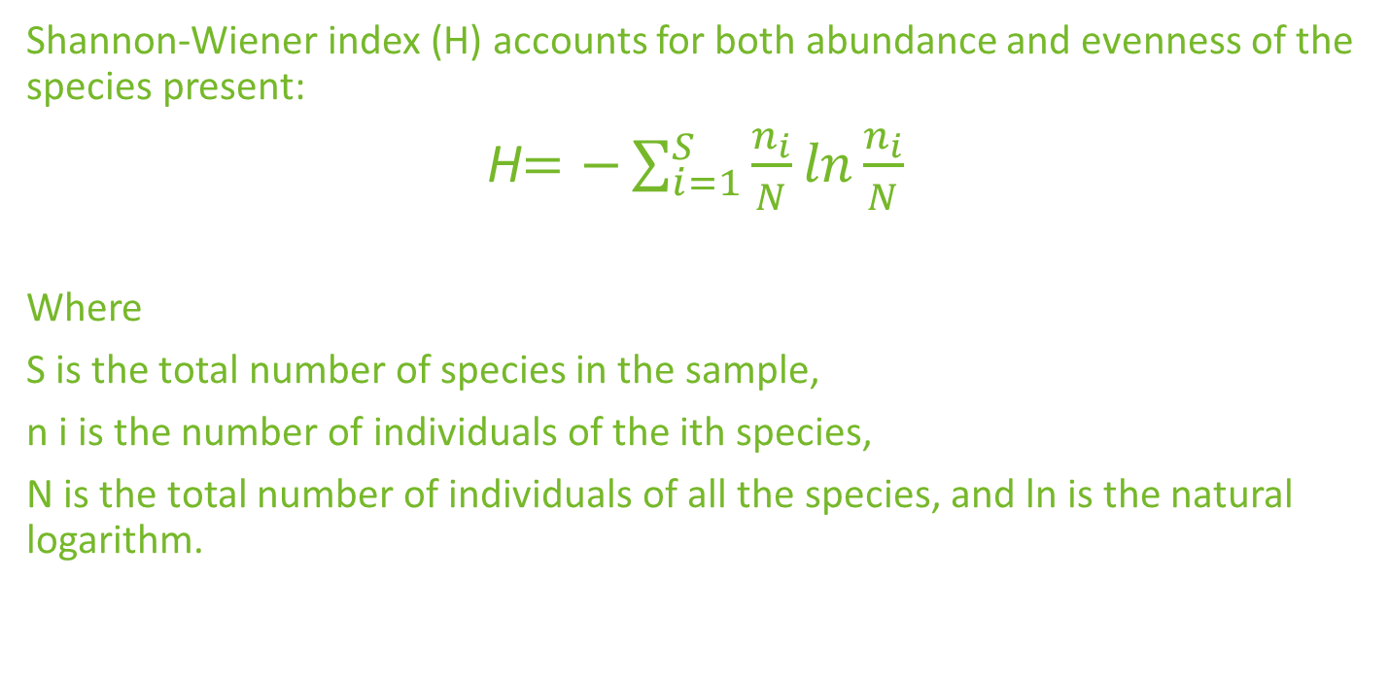
Shannon-Wiener index
Shannon-Wiener index (H) accounts for both abundance and evenness of the species present:
H$=−\sum_{i=1}^{S}{\frac{n_{i}}{N}\ln{\frac{n_{i}}{N}}}$
Where
S is the total number of species in the sample,
n i is the number of individuals of the ith species,
N is the total number of individuals of all the species, and ln is the natural logarithm.
Source: Yu Peng, Min Fan, Jingyi Song, Tiantian Cui & Rui Li, 2018 [7]
Notes:
The most widely used diversity index in the ecological literature is the Shannon-Wiener diversity index. The Shannon diversity index (H) is another index that is commonly used to characterize species diversity in a community. Like Simpson's index, Shannon's index accounts for both abundance and evenness of the species present. The proportion of species i relative to the total number of species (p_{i}) is calculated, and then multiplied by the natural logarithm of this proportion (lnp_{i}). The resulting product is summed across species, and multiplied by -1:
It assumes that individuals are randomly sampled from a very large community, and that all species are represented in the sample.

Slide 13
Metrics to measure food biodiversity for healthy, diverse diets
Notes:
Further we are going to look ar metrics to measure food biodiversity for healthy, diverse diets

Slide 14
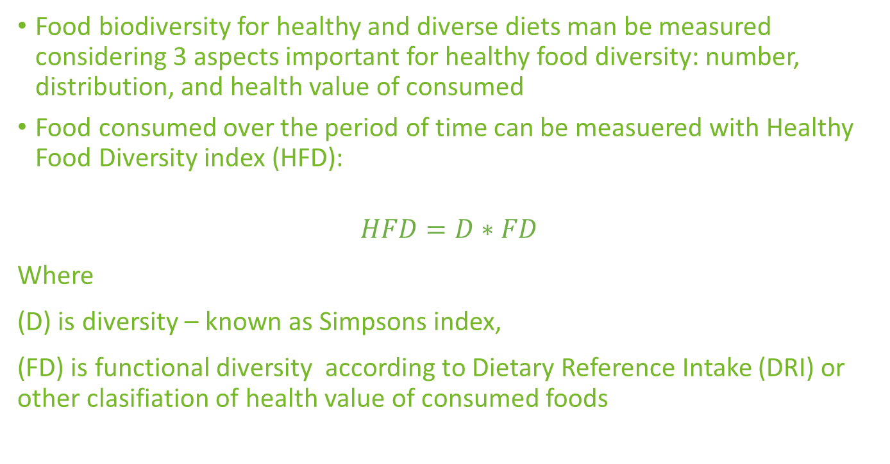
Metrics to measure food biodiversity for healthy, diverse diets ​
Food biodiversity for healthy and diverse diets man be measured considering 3 aspects important for healthy food diversity: number, distribution, and health value of consumed
Food consumed over the period of time can be measuered with Healthy Food Diversity index (HFD):
$$HFD=D∗FD$$
Where
(D) is diversity – known as Simpsons index,
(FD) is functional diversity according to Dietary Reference Intake (DRI) or other clasifiation of health value of consumed foods
Source: Jessica Fanzo, Bruce Cogill and Federico Mattei, 2012 [8]; Larissa S. Drescher, Silke Thiele, Gert B. M. Mensink, 2007 [9]
Notes:
The contribution of food biodiversity to healthy and diverse diets can be measured at different levels. The highest level is food group diversity (e.g. cereals, dark green leafy vegetables and fruit), the next level is diversity within a food group (e.g. mango, banana and apple) and the lowest level considers diversity within a species.
Diet diversity is usually measured by counting food groups eaten in a certain time period. But this measure cannot provide a full picture of food biodiversity. The implication of this is that most research uses dietary intake metrics based on diet diversity, which is not a perfect assessment of the full potential of food biodiversity, but does in an aggregate form represent consumption of diverse species.
What is clear, however, is that often the composite indices mask more than they reveal. For a measurement system for sustainable diets to be successful, it will require a two-step process of developing a suite or dashboard of indicators that form the basis for a composite score or index.
Top 3 aspects important for healthy food diversity: number, distribution, and health value of consumed can be conjsidered in healthy food measurment.
For example, to measure food biodiversity by consumed food over period in terms of Food Diversity index, where Simpson’s index of diversity (D) is applied to represent the number of different species consumed and how evenly the amounts consumed of these different species are distributed based on quantity consumed; and the functional diversity (FD). The FD reflects the diversity in nutrient composition of species consumed by each individual by health value of consumed food, for example Dietery Reference Intake, or other clasifiation of health value of consumed foods.

Slide 15
(Agro)Biodiversity in Life Cycle Asessment
Notes:
The next slides are dedicated to (Agro)Biodiversity in Life Cycle Assessment

Slide 16
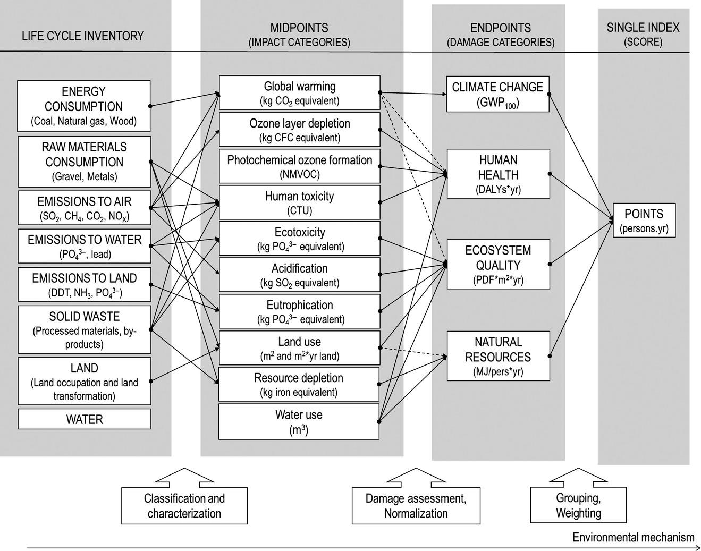
Biodiversity in Life Cycle Assessment
Life Cycle Assessment (LCA) is a method to evaluate product or service impacts from environmental perspective
All inputs and outputs within a product or service system considered (i.e. cradle-to-grave approach)
Biodiversity in LCA integrated at global scale as species richness in certain land use types
Biodiversity assesses as relative environmental impact of anthropogenic production systems
Souza,Ricardo F.M. Teixeira,Ole P. Ostermann, 2014 [10]
Source: Karl S. Zimmerer et. al., 2018 [3]
Notes:
LCA is a systematically method to evaluate product or service from environmental aspects (calculating cradle-to-grave environmental impacts). It considers all inputs and outputs involved in the generation of a product or service with respect to the surrounding environmental conditions. The biodiversity concept could be integrated into LCA at global scale, with regard to species richness of a natural reference situation compared to different land use types
LCA does not assess the changing state of biodiversity or ecosystems, but rather the relative environmental impact of anthropogenic production systems. It links units produced to their marginal/average impacts on the environment.

Slide 17
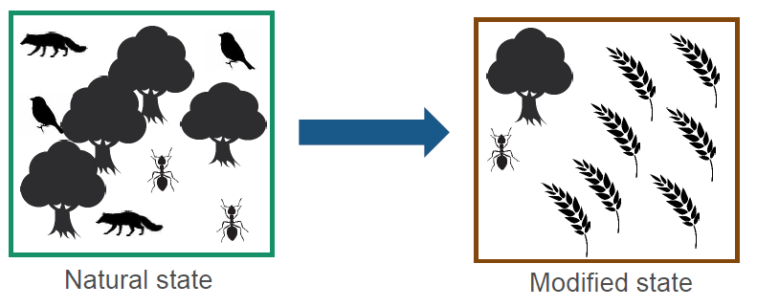
Potentially Disappearing Fraction of Species
Potentially Disappearing Fraction (PDF) assessment based on the lost due an environmental pressure (land use, ecotoxicity, climate change, eutrophication)
10 PFD/m²/yr, can be interpreted as:
10 m² has lost all its species during a year
100 m² has lost 10% of its species during a year
10 m² has lost 10% of its species during 10 years
Potential number of species in natural state: 4
Potential number of species in the modified state: 2
Potential disappeared fraction of species: 2/4 = 0.5
Source: EU B@B Platform Webinar series [11]
Notes:
The endpoint unit used to assess the impacts on biodiversity in operational LCIA methods is PDF(potentially disappearing fraction of species)
PDF accounts for a fraction of species richness that may be potentially lost due to an environmental pressure (land use, ecotoxicity, climate change, eutrophication). The underlying environmental mechanism depends on the pressure being assessed.
What does PFD/m²/yr mean?
10 PFD/m²/yr, can be interpreted as:
10 m² has lost all its species during a year
100 m² has lost 10% of its species during a year
10 m² has lost 10% of its species during 10 years

Slide 18
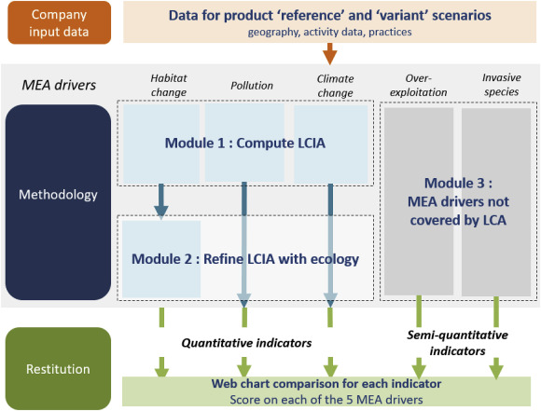
Product Biodiversity Footprint
LCA does not cover Millenium Ecosystem Assessment, 2005, (MEA) indicators fully:
  only land occupation and transformation, pollution, and climate change are covered,
  species overexploitation and invasive species are not.
The Product Biodiversity Footprint (PBF) approach aims at bridging the gap between LCA and ecology trough methodology composed of three modules.
Source: Anne Asselin et.al. 2020 [10]
Notes:
Product impacts on ecosystem quality have long been addressed by Life Cycle Assessment (LCA) mostly assessed within the “biodiversity loss” damage category indicator. However, LCA methods do not cover the 5 drivers of biodiversity loss as identified by (Millenium Ecosystem Assessment, 2005) (MEA): only land occupation and transformation, pollution, and climate change are covered, while species overexploitation and invasive species are not.
The Product Biodiversity Footprint (PBF) approach aims at bridging the gap between LCA and ecology, addressing all five categories of MEA. The methodology combines LCA and ecology current knowledge and organizes them towards practical indicators and representations for business decision. Indicators for spieces overexploitation and invasive spiecies are calculated additionally in a semi-quantitative way and evaluated with results of LCA trough a MCA of 5 indicators together.

Slide 19
Nature Based Solutions
Notes:
Now there will be a small intro into Nature Based Solutions

Slide 20
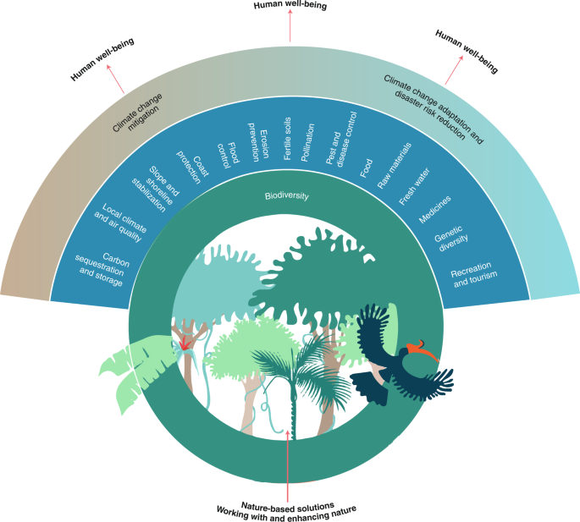
Nature based solutions
Nature-based solutions (NBS) address a variety of environmental, social and economic challenges
NBS actions are aiming at use of exiting natural procceses and solutions, and also at mimicking non-human organisms and communities
Four principal goals are identified by Europena Comissions that can be addresed with NBS:
  Enhancing sustainable urbanisation
  Restoring degraded ecosystems
  Developing climate change adaptation and mitigation
  Improving risk management and resilience
Source: N. Seddon, et.al., 2019 [16]
Source: European Commission, 2015 [15]
Notes:
Nature-based solutions help societies to address a variety of environmental, social and economic challenges in sustainable and are based on actions inspired by or copied from nature. Actions involve use of existing natural solutions and mimicking how non-human organisms and communities cope with environmental challanges. Nature-based solutions use the features of nature, such as to store carbon and regulate water flow, in order to achieve desired outcomes towards reduction of disaster risk, improved human well-being and environment. Nature-based solutions are energy and resource-efficient, resilient to change. Often they are must be adapted to local conditions.
Four principal goals have been identified by Eurpean commision that can be addressed by nature-based solutions:
- Enhancing sustainable urbanisation through nature-based solutions can stimulate economic growth as well as improving the environment, making cities more attractive, and enhancing human well-being.
− Restoring degraded ecosystems using nature-based solutions can improve the resilience of ecosystems, enabling them to deliver vital ecosystem services and also to meet other societal challenges.
− Developing climate change adaptation and mitigation using nature-based solutions can provide more resilient responses and enhance the storage of carbon.
− Improving risk management and resilience using nature-based solutions can lead to greater benefits than conventional methods and offer synergies in reducing multiple risks.
Overall, NBS are an essential component to greening the economy and achieving sustainable development.

Slide 21
NBS for agriculture
Water purification and waste treatment
  Plant trees/hedges/perennial grass strips to increase nutrient uptake.
  Plant biomass crops in locations where they can enhance nutrient uptake.
Erosion regulation
  Avoid harvesting in wet conditions
  Reduce stocking rates of livestock
Water Flow regulation
  Increase soil organic matter by incorporating green manure, slurry or incorporating crop residues to increase water infiltration
  Plant trees / hedges /perennial grass strips to intercept surface run-off.
Climate regulation
  Use soil conservation measures (such as cover crops, wind breaks, deep-rooted plants and minimum or conservation tillage) to enhance storage of soil carbon
  Avoid conversion of permanent grassland to arable.
  Change sowing date
Air quality regulation
  Plant shelter belts to absorb gaseous pollutants, intercept aerosols from pesticides and trap particulates
  Use soil conservation measures (such as cover crops, wind breaks and minimum or conservation tillage) to reduce wind erosion and hence airborne particulates
Source: European Commission, 2015 [15]
Source: F. Miralles-Wilhelm and T. Iseman, 2021 [17]
Notes:
Nature-based Solutions (NbS) are cost-effective interventions that can enhance resilience in agriculture and food production, while mitigating climate change and enhancing the environment.
Agricultural producers have a critical role in implementing NbS in their operations and can help to shape wider landscape scale approaches to Nature-based Solutions.
Nature-based Solutions can help farmers adapt and ensure food production is more resilient to future weather extremes like droughts, heavy storms, or coastal flooding by enhancing soil health and water retention, reducing soil erosion and buffering shorelines, as well as enhancing food and nutrition security through diversified production systems and sources of income. They can reduce use of chemical additives, which reduces production costs and creates safer foods
Nature-based Solutions can reduce carbon emissions from the food sector and store carbon, most significantly by avoiding deforestation and conversion of natural habitat, by conserving, restoring and sustainably managing aquatic ecosystems (e.g. watersheds, wetlands, coastal mangroves, seagrass meadows and coral reefs) to enhance their role in carbon sequestration, and also by changing crop residue, cover crop and tilling practices in ways that enhance the carbon retained in plants and soils
Nature-based Solutions can enhance ecosystems and species by increasing habitat diversity, restoring aquatic ecosystems and wetlands and improving the quality and reliability of water.
Some of the exampls of NBS for Agriculture are given in this slide. For more of examples please see the mentioned reference.

Slide 22
Using biodiversity to provide multiple services in sustainable farming systems
Notes:
Let’s now start the section about using agrobiodiversity to provide multiple services in sustainable farming systems.

Slide 23
Key aspects
Managing farming systems sustainably much more than yields of commodity crops in highly simplified and specialized landscapes
Agricultural biodiversity provides variety and variability within and among species, fields, farms and landscapes.
Agricultural biodiversity is used by rural communities worldwide in many time-tested practices enhancing resilience
Increase the flow of services and benefits agricultural biodiversity provides to communities
Source: Biodiversity International, 2017[2]
Notes:
Looking on key aspects about using biodiversity as a driver for sustainable farming some key aspects should be considered:
Managing farming systems sustainably means that agriculture needs to be about much more than yields of commodity crops in highly simplified and specialized landscapes.
Agricultural biodiversity provides variety and variability within and among species, fields, farms and landscapes. This diversity helps drive critical ecological processes (e.g. soil structure maintenance) and allows a landscape to provide multiple, simultaneous benefits to people (e.g. nutritious foods, income, natural pest control, pollination, water quality).
Agricultural biodiversity is used by rural communities worldwide in many time-tested practices that can confer increased resilience to farms, communities and landscapes.
Using it more effectively and sustainably can help maintain and increase the flow of services and benefits agricultural biodiversity provides to communities

Slide 24
Background
Agriculture dominates global land use
Before the 1950s, farmers often increased agricultural production by increasing the area they cultivated
From 1961 to 2007 total global agricultural production tripled altering earth system biophysical processes to the extent that today genetic diversity loss (biosphere integrity)
Shrinking diversity of agricultural crops grown and consumed:
  three crops (rice, wheat and maize) supply more than 50% of the world’s plant derived calories,
  12 crops and 5 animal species provide 75% of the world’s food
Source: Biodiversity International, 2017[2]
Notes:
Agriculture dominates global land use. Over 38% of the world’s land is used for agriculture, with 11% under arable production; signicantly more land can be converted from native vegetation and brought into production in the forthcoming periods
Before the 1950s, farmers often increased agricultural production by increasing the area they cultivated. The approaches associated with agricultural intensification, such as increased use of inorganic fertilizers and synthetic pesticides, increased mechanization, irrigation and increased use of monocultures, have been very effective in terms of raising gross yields. In the period
from 1961 to 2007 total global agricultural production tripled.
These widely adopted intensification practices have contributed to altering earth system biophysical processes to the extent that today genetic diversity loss (biosphere integrity) is the most surpassed of the nine ‘planetary boundaries’, which should not be transgressed if humanity wishes to remain within a “safe operating space”.
One of the key areas of biodiversity loss is the shrinking diversity of agricultural crops grown and consumed. In this context three crops (rice, wheat and maize) supply more than 50% of the world’s plant derived calories, and only 12 crops and live animal species provide 75% of the world’s food.
For this reason is needed the definitions of common agroecological practices based on agricultural biodiversity

Slide 25
Common agroecological practices based on agrobiodiversity
Agroforestry: trees integrated with crops
Cover crops: crops sown for agroecological purposes like containing soil erosion, controlling pests or enriching the soil with nutrients.
Crop rotations: growth of crops in succession in the same field (e.g. cereal followed by legume) to reduce risks of pests and diseases
Intercropping: mixture of crop species in the same field at the same time,
Live fences: Fences of herbs, shrubs or trees (e.g. hedgerows)
Non-cropped vegetation: fallow fields or patches of natural vegetation
Riparian buffers: vegetation planted or retained on river banks
Source: Biodiversity International, 2017[2]
Notes:
These can be defined as
Agroforestry: A production system in which trees are integrated with crops, thus providing many synergistic relationships, such as shade or nutrients.
Cover crops: Crops which are sown for agroecological purposes, such as containing soil erosion, controlling pests or enriching the soil with nutrients. Green manure is one specific instance of a cover crop. Nutrient-rich plants (usually legumes) are planted and then ploughed into the earth to improve soil quality.
Crop rotations: Different crops grown in succession in the same field (e.g. cereal followed by legume), often to reduce risks of pests and diseases or to add nitrogen to the soil.
Intercropping: A mixture of crop species in the same field at the same time, often with synergistic effects, such as pest suppression.
Live fences: Fences of herbs, shrubs or trees (e.g. hedgerows), either retained from existing native vegetation or deliberately planted.
Non-cropped vegetation: This can be fields left fallow or patches of natural vegetation, such as forest patches, which are left on farm.
Riparian buffers: vegetation planted or retained on river banks to protect river systems from adjacent agriculture.

Slide 26
Healthy farming landscapes
Source: Biodiversity International, 2017[2]
Notes:
Despite the difficulty, scientific evidence and long-term experiments are revealing the complex dynamics of diversified systems and the multiple benefits both from biodiversity to agriculture and from agriculture to biodiversity in terms of contribution to healthy farming landscapes.
Genetic diversity at crop level allows farmers to grow different varieties to suit different environmental conditions (e.g. poor soils) and
resist different weather conditions (e.g. frost, unpredictable rainfall). Planting different varieties of the same crop can decrease pest and
disease damage and facilitate staggered flowering times to attract diverse pollinators.
At farm and field level, selecting different species with different growth forms, leaf size and shape, plant heights, rooting depth and
nutrient uptake strategies, provides farms with more ways to respond to disturbances and shocks. Integrating livestock and crops
reduces the need for synthetic inputs while facilitating more efficient nutrient cycling and availability.
At landscape level, complex landscapes have multiple benefits, e.g. forest remnants can reduce pests borne by the wind, and reduce
soil erosion; patches of non-cropped vegetation also support beneficial plant and insect diversity, like pest enemies and pollinators.
Farmers manage trade-offs among benefits at many scales and across all levels, e.g. more biodiversity can lead to lower greenhouse
gases and better pest control, but may reduce gross yields in the short term.

Slide 27
Improving soil through managing functional biodiversity
6 ha Organic farm north of Montpellier France
Multi-functionality:
Farming
Waste reduction
Soil nutrient cycling and fertilization
carbon capture
Pollination
pest control
Source: Biodiversity International, 2017[2]
Notes:
In the picture is reported the example of a 6ha organic farm north of Montpellier France. Biodiversity provides many functions on his farm, including
reducing food waste, soil nutrient cycling and fertilization, carbon capture, pollination and pest control. More than 200 families benefit from the farm’s produce and share the risk of crop failure.
The farmer has several functions in mind: to build organic matter to increase nutrient and water-holding capacity (high root biomass), to sequester nitrogen to make it available for the principal cropping season (nitrogen fixation); reduce weed cover and soil erosion (complementary plant heights for total soil cover); and poultry forage (palatability).
The farmer obtains these functions through the careful selection of species with specific and complementary functional traits.

Slide 28
References
[1] Sarah K. Jones et al., Agrobiodiversity Index scores show agrobiodiversity is underutilized in national food systems, Nature Food, 2021, https://doi.org/10.1038/s43016-021-00344-3 ​
[2] Biodiversity International, 2017. Mainstreaming Agrobiodiversity in Sustainable Food Systems: Scientific Foundations for an Agrobiodiversity Index. Biodiversity International, Rome, Italy. www.bioversityinternational.org
[3] Ricotta, C., Corona, P., Marchetti, M., Chirici, G., Innamorati, S., 2003. LaDy: software for assessing local landscape diversity profiles of raster land cover maps using geographic windows. Environ. Modell. Software 18, 373–378.
[4] Di Battista, T., Fortuna, F., Maturo, F., 2017. BioFTF: an R package for biodiversity assessment, with the functional data analysis approach. Ecol. Indicators. 73, 726–732.
[5] Karl S. Zimmerer et. al., New services and roles of biodiversity in modern agroecosystems: A review, Ecological Indicators 93 (2018) 1126–1135
[6] Cardoso, P., Rigal, F., Carvalho, J.C., 2015. BAT – biodiversity assessment tools, an R package for the measurement and estimation of alpha and beta taxon, phylogenetic and functional diversity. Methods Ecol. Evol. 6, 232–236
[7] Sohier, Charlotte (2020): Measurements of biodiversity. Available from http://www.coastalwiki.org/wiki/Measurements_of_biodiversity [accessed on 30-11-2021]
[8] Ricardo Iglesias-Rios, Rosana Mazzoni, «Measuring diversity: looking for processes that generate diversity», Natureza & Conservação, Volume 12, 2014
[9] Yu Peng, Min Fan, Jingyi Song, Tiantian Cui & Rui Li, «Assessment of plant species diversity based on hyperspectral indices at a fine scale», Scientific Reports volume 8, Article number: 4776 (2018)
[10] Jessica Fanzo, Bruce Cogill and Federico Mattei, Metrics of Sustainable Diets and Food Systems, 2012
[11] Larissa S. Drescher, Silke Thiele, Gert B. M. Mensink, A New Index to Measure Healthy Food Diversity Better Reflects a Healthy Diet Than Traditional Measures, The Journal of Nutrition, Volume 137, Issue 3, March 2007, Pages 647–651

Slide 29
References
[12] Souza, Ricardo F.M. Teixeira,Ole P. Ostermann, Assessing biodiversity loss due to land use with Life Cycle Assessment: are we there yet? 2014 Global change biology
[13] EU B@B Platform Webinar series “Measuring biodiversity for business and finance”, Webinar 2: Case studies on product level biodiversity measurement approaches for business; Serenella Sala, The initiative to improve biodiversity coverage in the Product Environmental Footprint (PEF)
[14] Anne Asselin et.al. Product Biodiversity Footprint – A novel approach to compare the impact of products on biodiversity combining Life Cycle Assessment and Ecology, Journal of Cleaner Production, Volume 248, 2020
[15] European Commission, Final Report of the Horizon 2020 Expert Group on ‘Nature-Based Solutions and Re-Naturing Cities’ 2015
[16] Source: Nathalie Seddon, Beth Turner, Pam Berry, Alexandre Chausson & Cécile A. J. Girardin, «Grounding nature-based climate solutions in sound biodiversity science», Nature Climate Change, 9, 84-87, 2019
[17] F. Miralles-Wilhelm and T. Iseman, Nature –based solutions in agriculture: THE CASE AND PATHWAY FOR ADOPTION, FAO, 2021

Slide 30
Further readings
Sarah K. Jones et al., Agrobiodiversity Index scores show agrobiodiversity is underutilized in national food systems, Nature Food, 2021, https://doi.org/10.1038/s43016-021-00344-3

Slide 31

Short-bio
Dr. sc. ing., Maksims Feofilovs, Asist. Professor
Scopus Author ID: 57194546521
ORCiD: 0000-0002-0797-150X
H-index = 4
Asist. Professor at RTU IESE
Main research areas: modelling of complex system processes with system dynamics approach and life cycle analysis.
Leading of the University courses of: LCA and Ecodesign, Risk and Resilience
Head of the Information and Study Centre on Sustainable Development at RTU Institute of Energy Systems and Environment
Notes:
Thank you for participating in this lecture

Slide 32

Thank you!
Dr. sc. ing., Francesco Romagnoli, Professor
Scopus Author ID: 36998780600
ORCiD: 0000-0003-1814-7310
H-index = 14
Professor at RTU IESE with a specialization in Eco-design and Life Cycle Assessment
Main research areas: LCA and System Dynamics modelling within techno-feasibility and sustainability evaluations, evaluation of Bio- and circular-economy solutions, overall Life Cycle Sustainability Assessment including environmental LCA (E-LCA), Life Cycle Costs (LCC) and Social LCA (S-LCA), urban system’s resilience evaluation, biogas from seaweeds and microalgae
Leading of the University courses of: LCA and Eocodesign, Risk and Reslience, Applied Geophysics methods.
Head of the Biosystem Laboratory at RTU Institute of Energy Systems and Environment
Notes:
Thank you for your attention. See you for the next lecture.

Slide 33
Thank you

